Slide 1
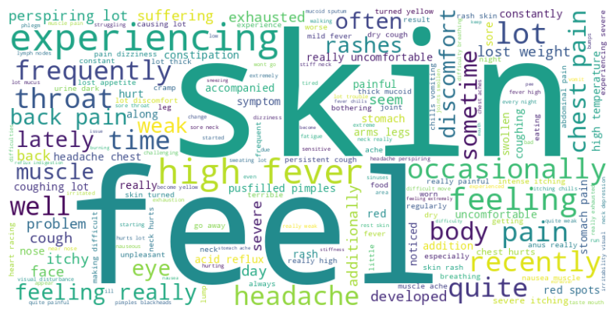
DiagnoseMe! Predictive Symptom2Disease Analysis
Carla Ardiaca: 1633638

Slide 2
Cleaning data
ORIGINAL TEXT
I’ve a sore throat and a lot of sneezing. There are times when the skin around my eyes and my lips swell. I find that once I start, I just cannot stop.
From uppercase to lowercase
i’ve a sore throat and a lot of sneezing. there are time when the skin around my eye and my lip swell. i find that onc i start, i just cannot stop.
1
Remove contractions
i have a sore throat and a lot of sneezing. there are time when the skin around my eye and my lip swell. i find that onc i start, i just can not stop.
2
Remove punctuation marks
i have a sore throat and a lot of sneezing there are time when the skin around my eye and my lip swell i find that onc i start i just can not stop
3
Remove StopWords
sore throat lot sneezing times skin around eyes lips swell find start stop
4

Slide 3
Data preparation for model training
sore throat lot sneezing times skin around eyes lips swell find start stop
Apply dictionary of tokens
[71, 14, 2, 169, 0, 1, 88, 67, 0, 0, 0, 0, 0]
Padding
[71, 14, 2, 169, 0, 1, 88, 67, 0, 0, 0, 0, 0, 0, 0, 0, 0, 0, 0, 0, 0, 0, 0, 0, 0, 0, 0]
Label encoding target variable
One hot encoding
{'Acne': 0, 'Arthritis': 1, 'Bronchial Asthma': 2, 'Cervical spondylosis': 3, 'Chicken pox': 4, .... 'peptic ulcer disease': 22, 'urinary tract infection': 23}
[1., 1., 0., 0., 0., 0., 0., 0., 0., 0., 0., 0., 0., 1., 0., 0., 0., 0., 0., 0., 0., 0., 0., 0., 0., 0., 0., 0., 0., 0., 0., 0., 0., 0., 0., 0., 0., 0., 0., 0., 0., 0., 0., 0., 0., 0., 0., 0., 0., 0., 0., 0., 0., 0., 0., 0., 0., 0., 0., 0., 0., 0., 0., 0., 0., 0., 1., 0., 0., 0., 1., 0., 0., 0., 0., 0., 0., 0., 0., 0., 0., 0., 0., 0., 0., 0., 0., 1., 0., 0., 0., 0., 0., 0., 0., 0., 0., 0., 0., 0., 0., 0., 0., 0., 0., 0., 0., 0., 0., 0., 0., 0., 0., 0., 0., 0., 0., 0., 0., 0., 0., 0., 0., 0., 0., 0., 0., 0., 0., 0., 0., 0., 0., 0., 0., 0., 0., 0., 0., 0., 0., 0., 0., 0., 0., 0., 0., 0., 0., 0., 0., 0., 0., 0., 0., 0., 0., 0., 0., 0., 0., 0., 0., 0., 0., 0., 0., 0., 1., 0., 0., 0., 0., 0., 0., 0., 0., 0., 0., 0., 0., 0., 0., 0., 0., 0., 0., 0., 0., 0., 0., 0., 0., 0., 0., 0., 0., 0., 0., 0.]

Slide 4
Model selection
87%
85%
83%
81%
85%
Random Forest
Logistic Regression
Gradient boosting
Gaussian Naïve Bayes
Bernoulli Naïve Bayes

Slide 5
Model selection
Random Forest
Dictionary size
Remove from diccionary
Max depth 60
Max features log2
n_estimators 200
200 words
[also, get, causing]
TOP 1 SCORE → 95%
TOP 3 SCORE → 99%

Slide 6
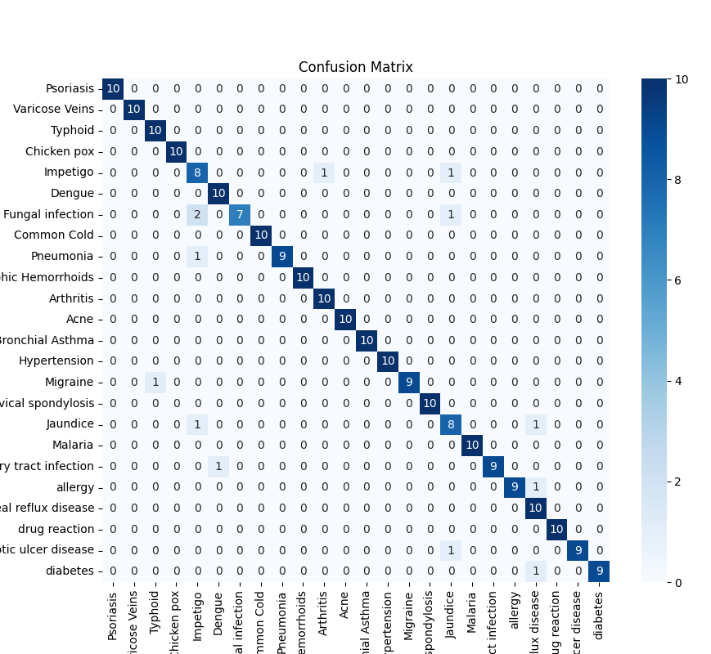
TOP 1 SCORE
Confusion
matrix

Slide 7
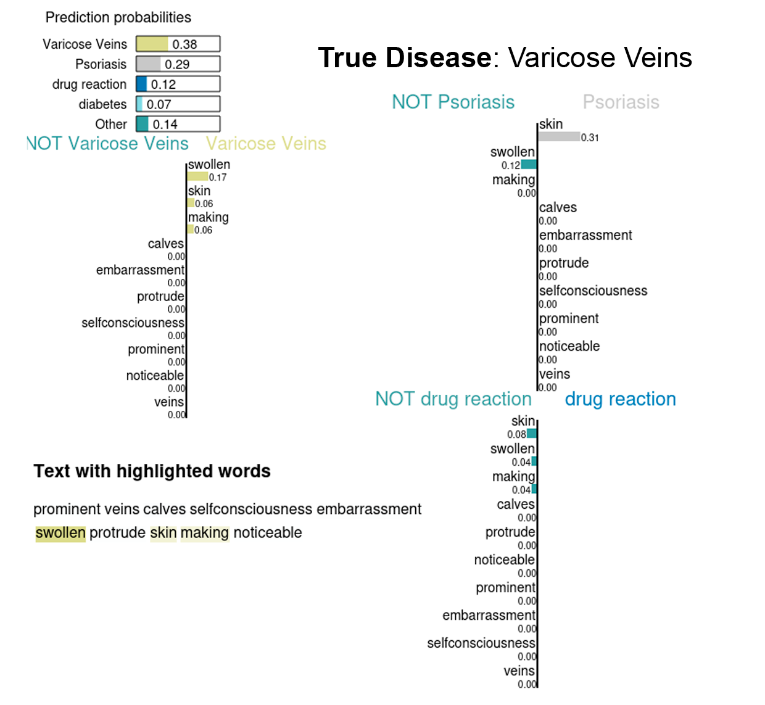
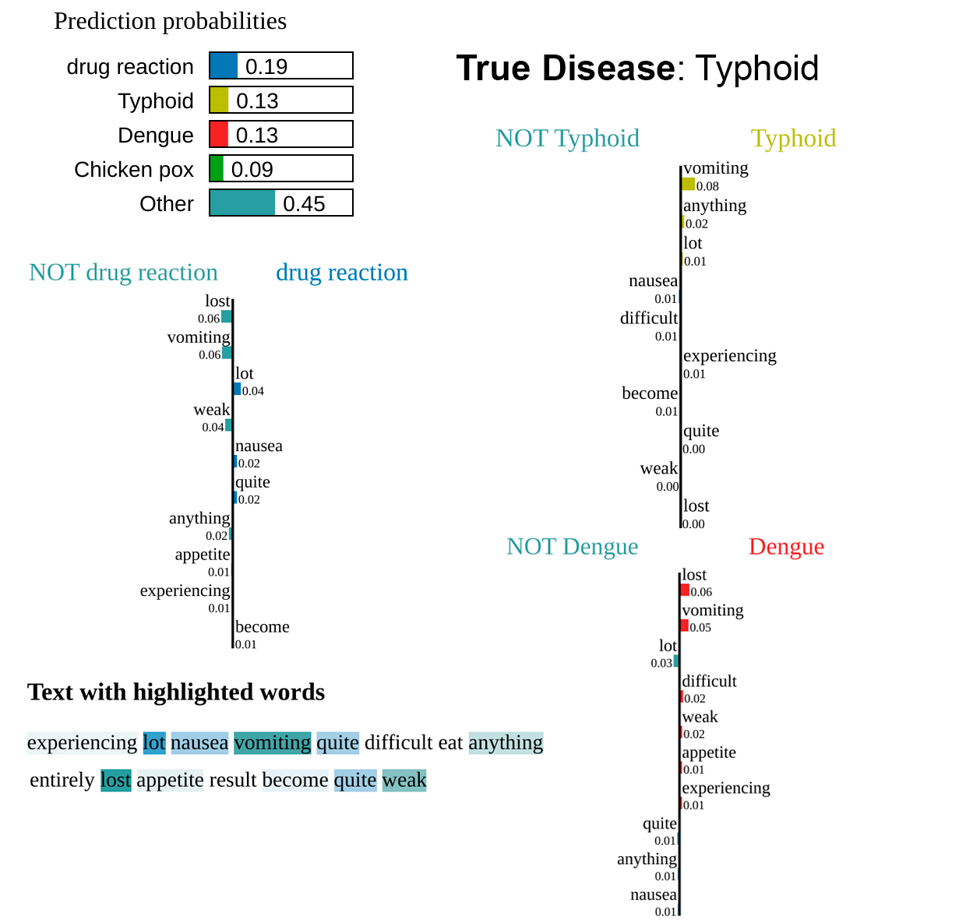
TOP 1 SCORE
LIME Explainability ✓
LIME Explainability X

Slide 8
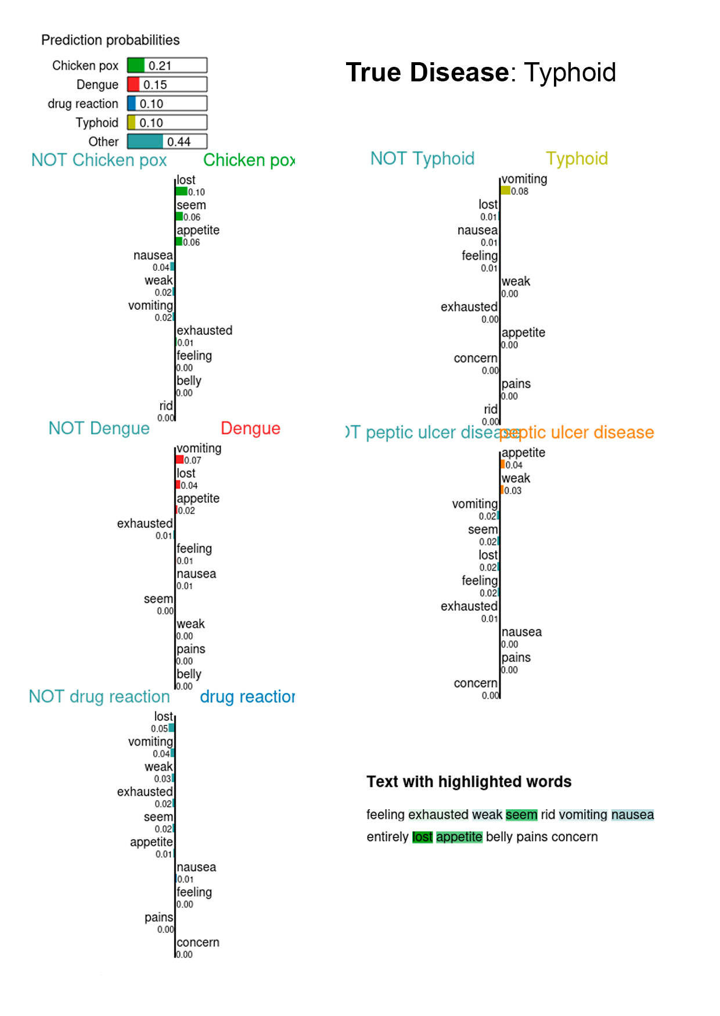
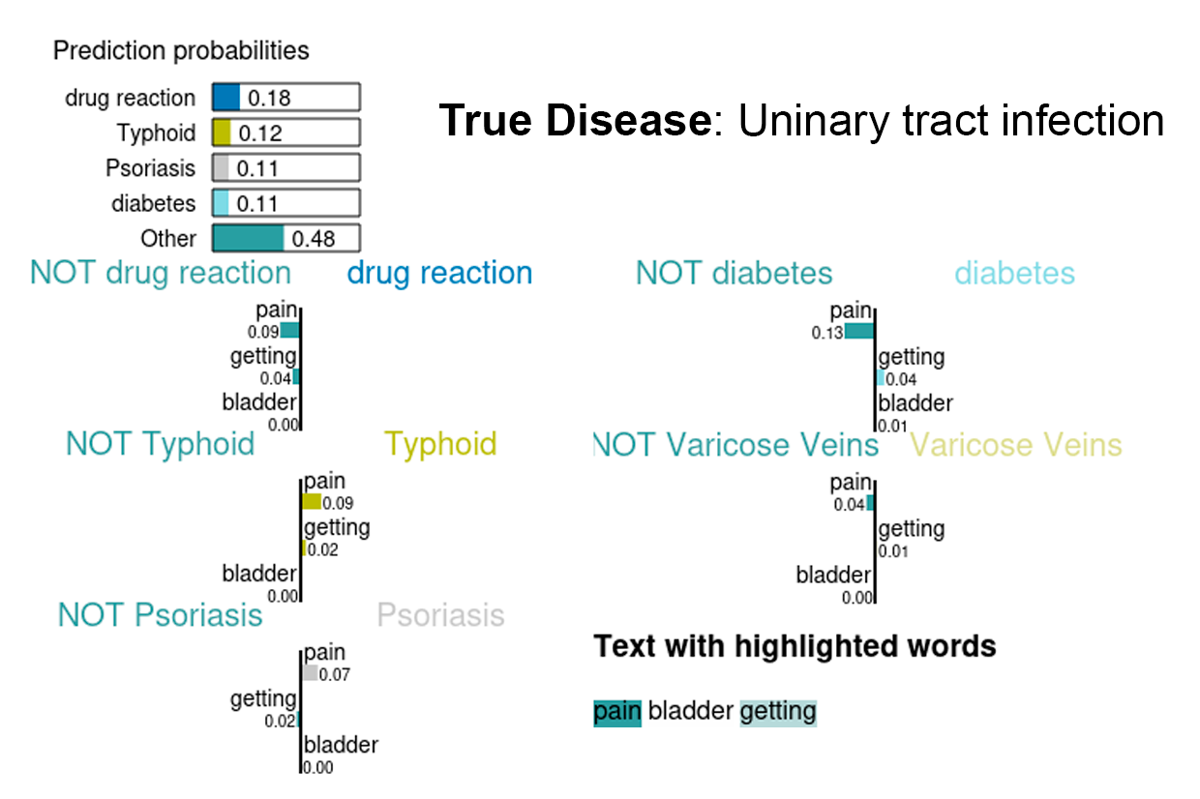
TOP 3 SCORE
The 2 misclassified prediction in TOP 3

Slide 9
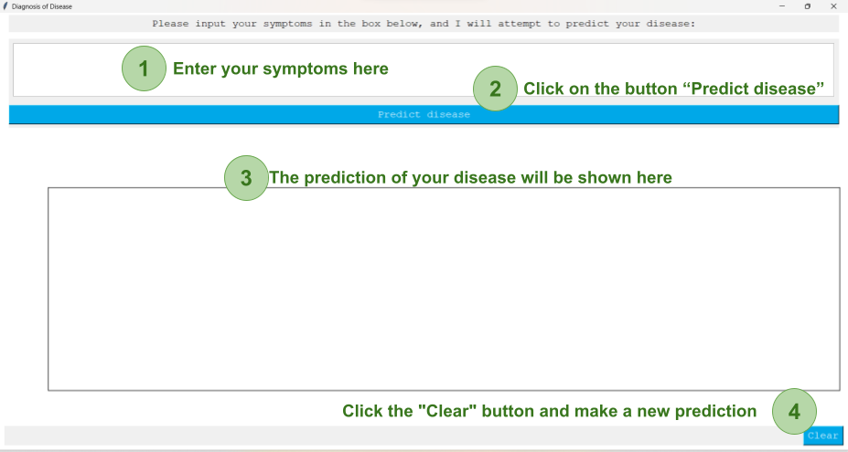
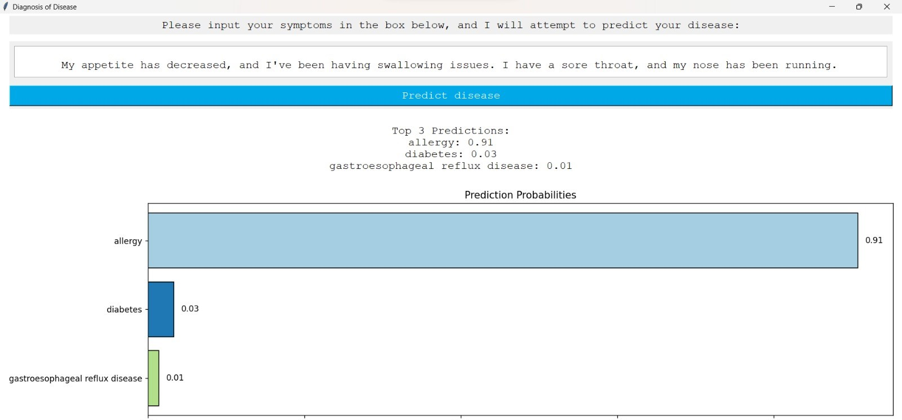
Graphical Interface

Slide 10
Possible Improvements
01
02
03
04
04
EMBEDDINGS
NEW MODELS
MORE DISEASES
MORE TRAINNING DATA

