Slide 1
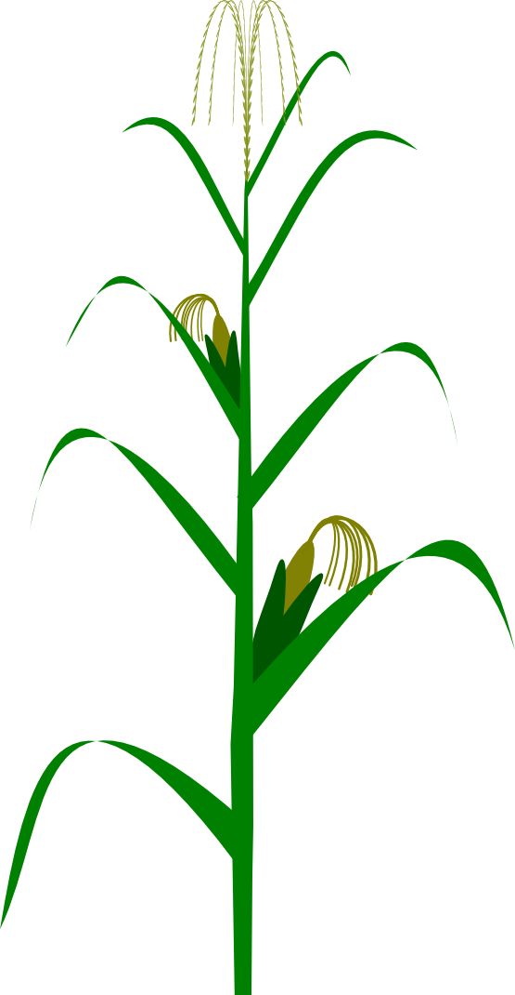
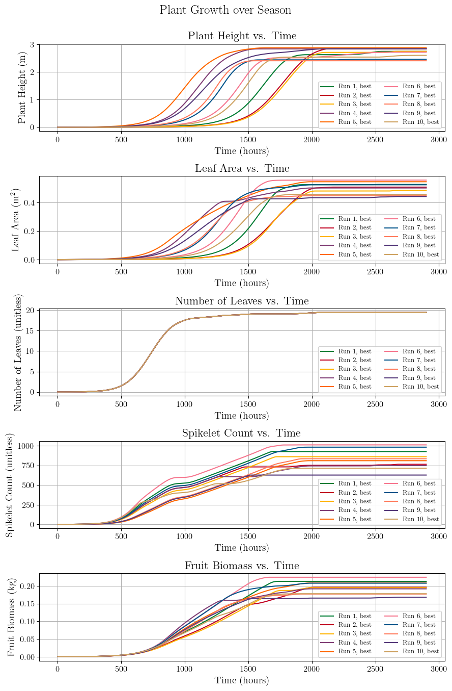
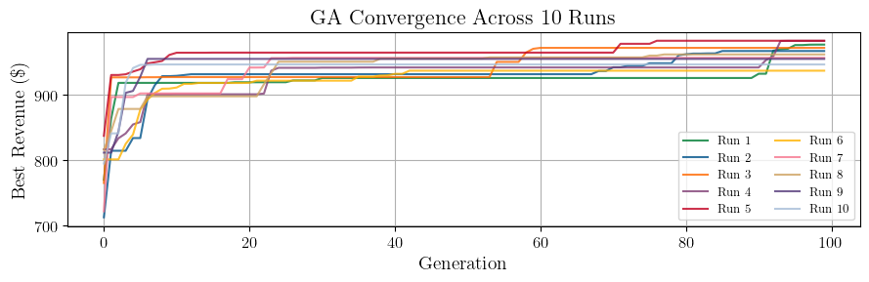

Optimizing Irrigation & Fertilizer Strategy via Crop Model + Genetic Algorithm
Crop as Control System | Irrigation & Fertilizer as Inputs
Growth modeled with coupled ODEs
Corn as case study
Find Optimal Irrigation & Fertilizer Inputs with Genetic Algorithm Optimization
Thousands of simulations of crop growth over a season per GA run
Perform 10 GA runs
Results
16% higher revenue
$999 vs. $859 per acre
17% less irrigation water used
15 vs. 18 inches
32% less fertilizer used
307 vs. 450 lbs per acre
Input disturbances
Precipitation, d_{S}
Temperature, d_{T}
Solar radiation, d_{R}
Initialize
Evaluate
Rank
Control inputs
Irr. freq., u₁
Irr. amt., u₂
Fert. freq., u₃
Fert. amt., u₄
↑$$
Best
Worst
…
↓$$
State variables
Plant height, x_{h}
Leaf area, x_{A}
No. leaves, x_{N}
Flower size, x_{c}
Fruit biomass, x_{P}
Repeat for 100 gens
Select
Mate
Revenue
$$$
Parents
Children
Feedback
Delayed nutrient absorption
via FIR convolution
Cumulative stress tracking
via EMA filtering
Carla J. Becker, Tarek I. Zohdi (2026)

Slide 2
Input disturbances
Precipitation, d_{S}
Temperature, d_{T}
Solar radiation, d_{R}
GA control inputs
Irr. freq., u₁
Irr. amt., u₂
Fert. freq., u₃
Fert. amt., u₄
MPC control inputs
Irr. amt., u_{w}
Fert. amt., u_{f}
State variables
Plant height, x_{h}
Leaf area, x_{A}
No. leaves, x_{N}
Flower size, x_{c}
Fruit biomass, x_{P}
Revenue
$$$
Feedback

Slide 3
1. Initialize
A fully random population
(initial irr/fert strategy)
2. Evaluate
↑$$
Each individual according to a cost function
↓$$
3. Rank
…
Individuals by revenue
Best
Worst
4. Mate
Parents
Until G generations, or convergence
Top performers in hopes of achieving stronger strategies
Children
5. Select
And remove unfit individuals, add new random individuals
6. Update
Search bounds if revenue increase stagnates
Check every 10 generations

