Slide 1


WEEK 2
SPRINT 3
PL6
QUA

Slide 2


about us.

Slide 3
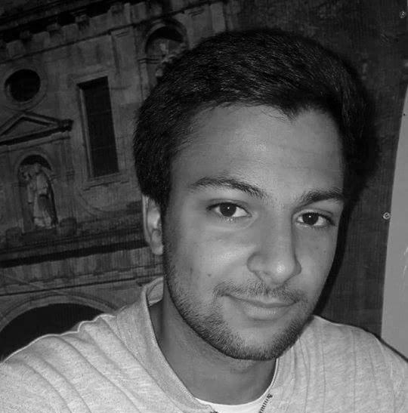
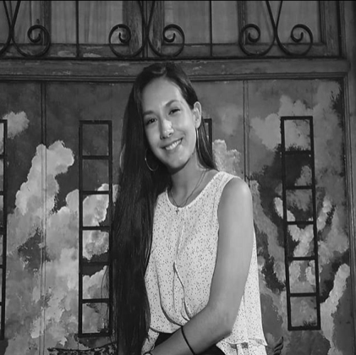

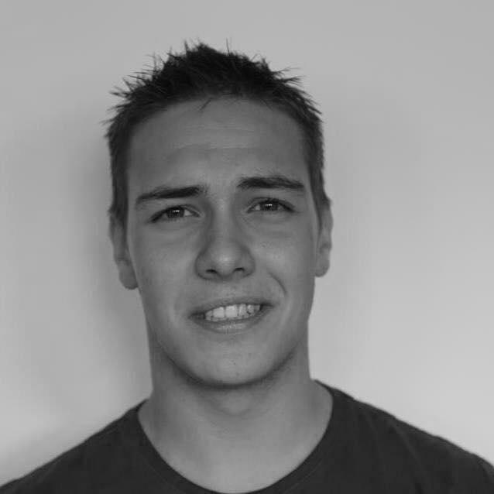
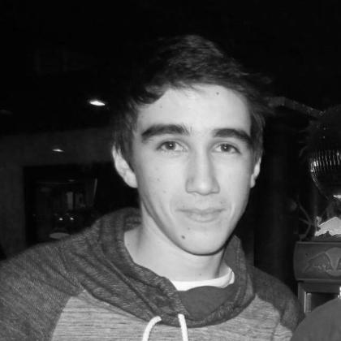
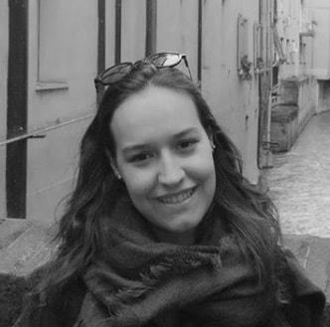
QUA
Hugo Marques
Viviana Abreu
Maria Alves
Luís Gonçalves
Rui Reis
Ana Almeida

Slide 4
Sprint #3 goals.
• Update the QUA section of the quality manual according to experience and the feedback.
• Manage your team quality processes and monitor their metrics as usual.

Slide 5
tasks.
 | TASK #1 | TASK #2 | TASK #3 | TASK #5 | TASK #6
TASK | Task delegation and group leadership | Elaboration of the meeting minutes | Status data gathering from the other units | Organization of the tasks and presentation | Update of the QUA section of the QM
OWNER | Hugo Marques | Viviana Abreu | Viviana Abreu Ana Almeida | Ana Almeida | Ana Almeida Hugo Marques Viviana Abreu
GOAL EFFORT | 45 MINUTES | 30 Minutes | 1 HOUR | 1 HOUR | 5 HOURS
EFFECTIVE EFFORT | 45 MINUTES | 35 Minutes | 1 HOUR | 1 HOUR | 7 HOURS
STATUS | COMPLETED | COMPLETED | IN PROGRESS | COMPLETED | IN PROGRESS

Slide 6
planned tasks.
 | TASK #1 | TASK #2 | TASK #3 | TASK #4 | TASK #5 | TASK #6
TASK | Task delegation and group leadership | Elaboration of the meeting minutes | Status data gathering from the other units | Weekly presentation | Update of the QUA section of the QM | Organization of the tasks and presentation
OWNER | Hugo Marques | Viviana Abreu | Viviana Abreu Ana Almeida | Hugo Marques | Full Group | Ana Almeida
GOAL EFFORT | 1 HOURS | 1 HOURS | 2 HOURS | 30 MINUTES | 4 HOURS (each) | 2 HOURS
STATUS | IN PROGRESS | IN PROGRESS | IN PROGRESS | IN PROGRESS | IN PROGRESS | IN PROGRESS

Slide 7
Metrics.
Number of hours spent: 10
Information documents gathered and analysed: 2

Slide 8
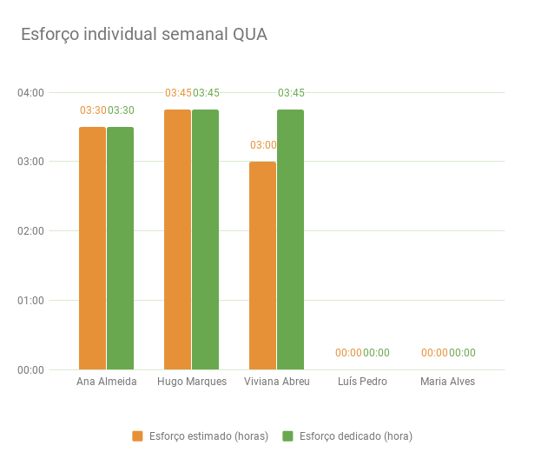

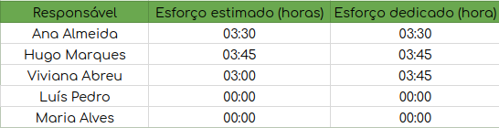
Esforço semanal.

