Slide 1


WEEK 1
SPRINT 4
PL6
QUA

Slide 2


about us.

Slide 3
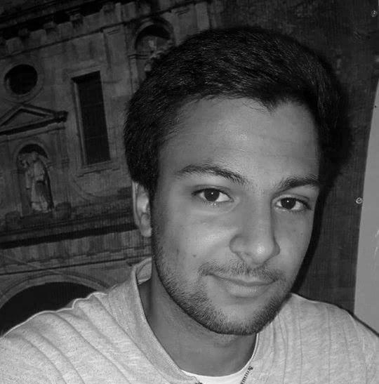
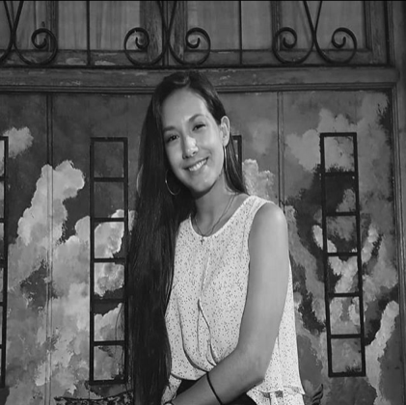
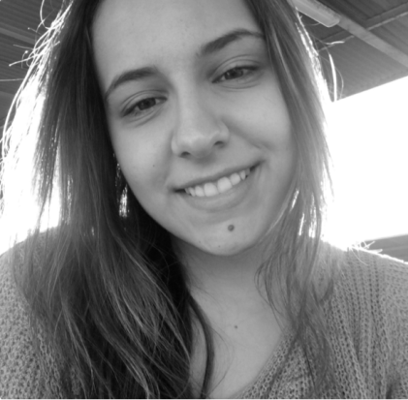
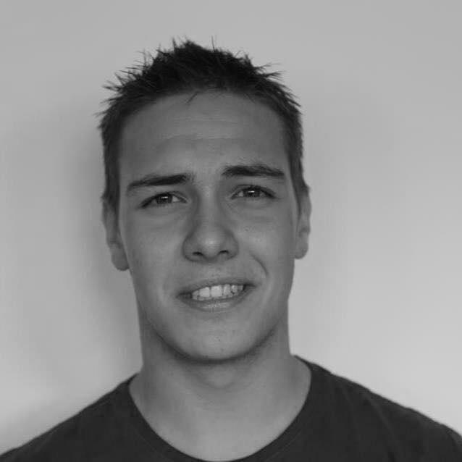
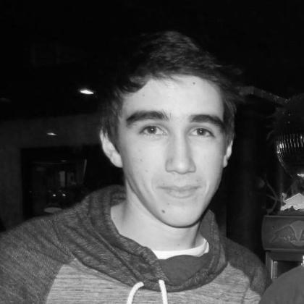
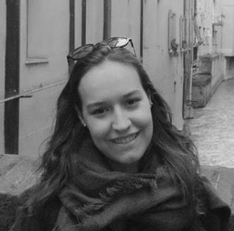
QUA
Hugo Marques
Viviana Abreu
Maria Alves
Luís Gonçalves
Rui Reis
Ana Almeida

Slide 4
Sprint #4 goals.
• Update the QUA section of the quality manual according to experience and the feedback.
• Ensure that all team members are working according the Quality Manual procedures and provide evidence of that.

Slide 5
Last week tasks.
 | TASK #1 | TASK #2 | TASK #3 | TASK #4 | TASK #5 | TASK #6 | TASK #7
TASK | Task delegation and group leadership | Elaboration of the meeting minutes | Status data gathering from the other units | Update of the Quality Manual | Manage the teams quality processes and monitor their metrics | Update of meeting and documents life cycle processes | Organization of the tasks and presentation
OWNER | Hugo Marques | Viviana Abreu | Luís Gonçalves Rui Reis | Full Group | Ana Almeida | Maria Alves | Ana Almeida
GOAL EFFORT | 45 MINUTES | 30 MINUTES | 1 HOUR | 2 HOURS (each) | 2 HOURS | 25 MINUTES | 1 HOURS
EFFECTIVE EFFORT | 45 MINUTES | 30 MINUTES | 1 HOUR | 9 HOURS | 1 HOUR | 30 MINUTES | 45 MINUTES
STATUS | COMPLETED | COMPLETED | COMPLETED | COMPLETED | COMPLETED | COMPLETED | COMPLETED

Slide 6
planned tasks.
 | TASK #1 | TASK #2 | TASK #3 | TASK #4 | TASK #5 | TASK #6 | TASK #7
TASK | Task delegation and group leadership | Elaboration of the meeting minutes | Status data gathering from the other units | Manage team processes and metrics | Update the processes of the QUA section of the QM | Organization of the tasks and presentation | REQ/IMP – Ensure and provide evidence that the MQ is being properly used
OWNER | Hugo Marques | Viviana Abreu | Viviana Abreu Luís Gonçalves Rui Reis | Hugo Marques | Luís Gonçalves | Ana Almeida | Rui Reis Hugo Marques
GOAL EFFORT | 1 HOURS | 1 HOURS | 2 HOURS | 2 MINUTES | 1 HOUR | 2 HOURS | 2 HOURS
STATUS | IN PROGRESS | IN PROGRESS | IN PROGRESS | IN PROGRESS | IN PROGRESS | IN PROGRESS | IN PROGRESS

Slide 7
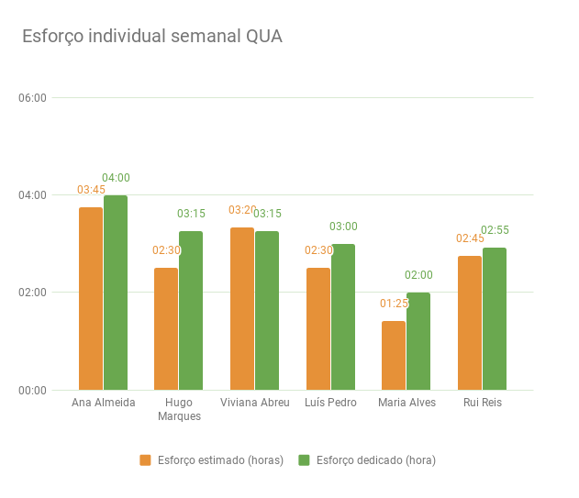

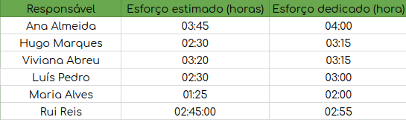
Metrics.
Number of hours spent: 18:45h
Information documents created, gathered and analysed: 8

Slide 8
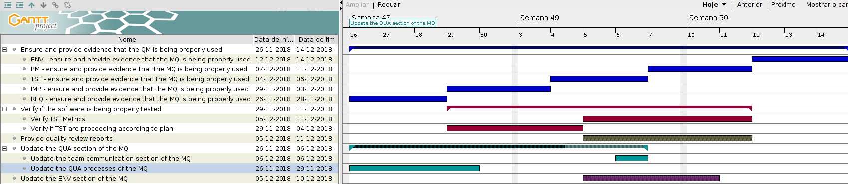
Esforço semanal.

