Slide 1


WEEK 1
SPRINT 4
PL6
QUA

Slide 2


about us.

Slide 3
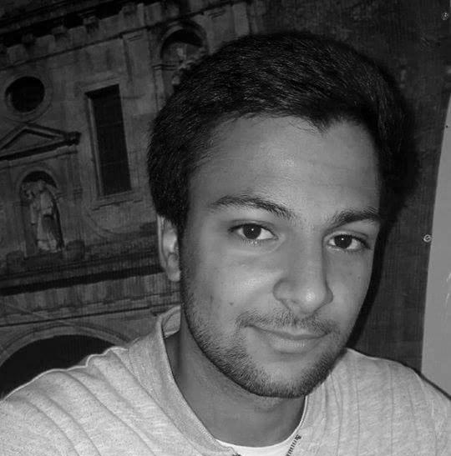
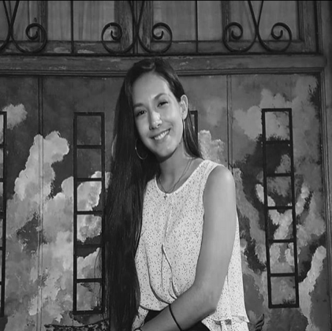
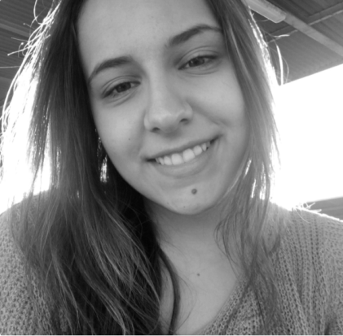
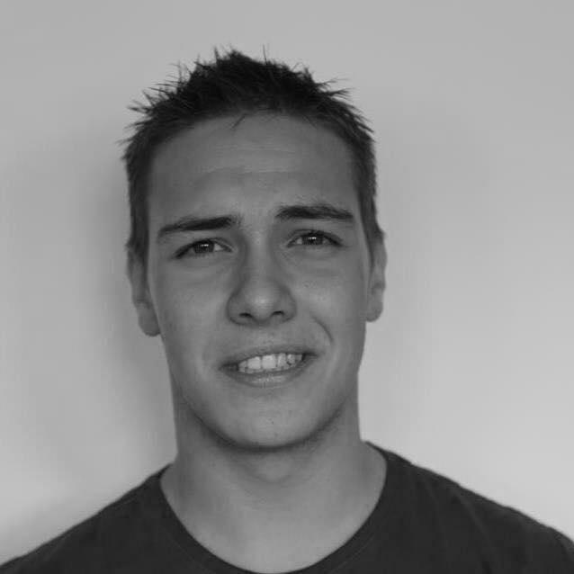
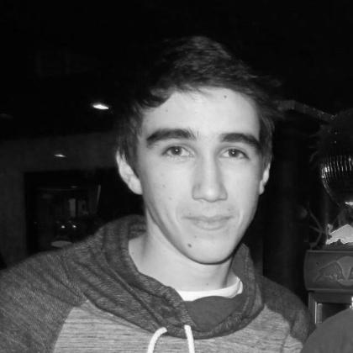
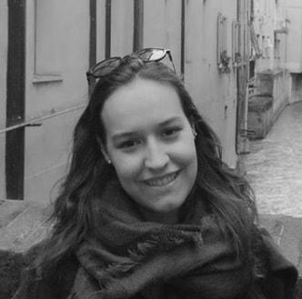
QUA
Hugo Marques
Viviana Abreu
Maria Alves
Luís Gonçalves
Rui Reis
Ana Almeida

Slide 4
Sprint #4 goals.
• Update the QUA section of the quality manual according to experience and the feedback.
• Ensure that all team members are working according the Quality Manual procedures and provide evidence of that.

Slide 5
Last weeks tasks.
 | TASK #1 | TASK #2 | TASK #3 | TASK #4 | TASK #5 | TASK #6 | TASK #7
TASK | Task delegation and group leadership | Elaboration of the meeting minutes | Status data gathering from the other units | Update of the Quality Manual | Manage the teams quality processes and monitor their metrics | REQ - ensure and provide evidence that the MQ is being properly used | Organization of the tasks and presentation
OWNER | Hugo Marques | Viviana Abreu | Luís Gonçalves Rui Reis | Full Group | Ana Almeida | Full Group | Ana Almeida
GOAL EFFORT | 45 MINUTES | 30 MINUTES | 1 HOUR | 1:30 HOUR | 20 MINUTES | 1 HOUR | 30 MINUTES
EFFECTIVE EFFORT | 45 MINUTES | 30 MINUTES | 1 HOUR | 1 HOUR | 30 MINUTES | 1 HOUR | 45 MINUTES
STATUS | COMPLETED | COMPLETED | IN PROGRESS | IN PROGRESS | COMPLETED | IN PROGRESS | COMPLETED

Slide 6
planned tasks.
 | TASK #1 | TASK #2 | TASK #3 | TASK #4 | TASK #5 | TASK #6 | TASK #7
TASK | Task delegation and group leadership | Elaboration of the meeting minutes | Status data gathering from the other units | Manage team processes and metrics | Verify if TST processes are going according to plan | Organization of the tasks and presentation | IMP - ensure and provide evidence that the MQ is being properly used
OWNER | Hugo Marques | Viviana Abreu | Luís Gonçalves Rui Reis | Ana Almeida | Viviana Abreu | Ana Almeida | Luís Gonçalves Rui Reis
GOAL EFFORT | 1 HOUR | 30 MINUTES | 1 HOUR | 30 MINUTES | 2 HOUR | 1 HOUR | 2 HOURS
STATUS | IN PROGRESS | IN PROGRESS | IN PROGRESS | IN PROGRESS | IN PROGRESS | IN PROGRESS | IN PROGRESS

Slide 7
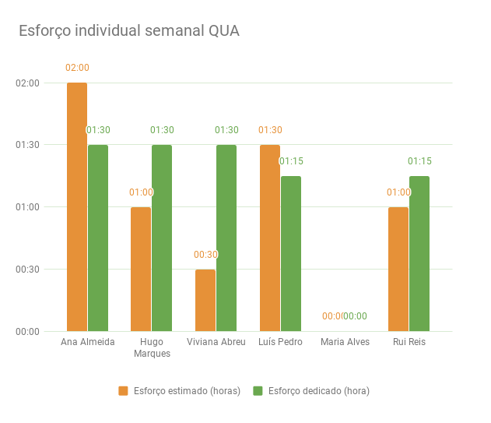
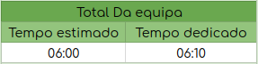
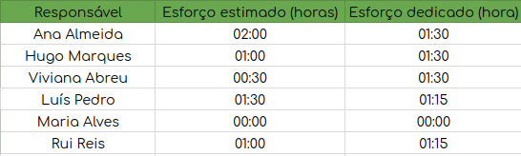
Metrics.
Number of hours spent: 06:10
Information documents created, gathered and analysed: 2

Slide 8
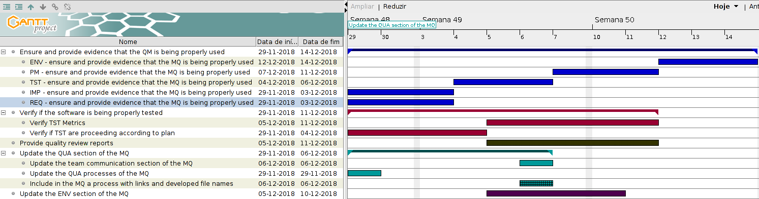
Esforço semanal.

