Slide 1
employee promotion pre-screening
Metis DS Bootcamp Winter 2021 Carla Moestafa

Slide 2
PROJECT DEFINITION
predicting employee to be promoted
potential use
  Pre-screening employees to be promoted to save the selection time
criteria for model selection:
  We don’t want to many people that should be promoted, to be left out: maximize TP, minimize FN
  To minimize bias if possible

Slide 3
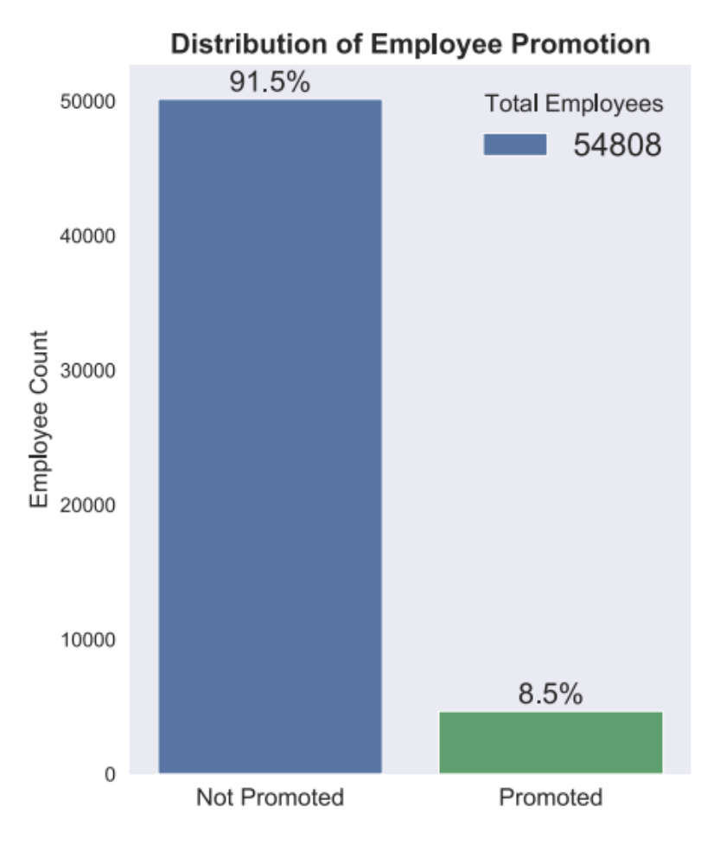
EDA
source: https://www.kaggle.com/arashnic/hr-ana
20 features including dummy categorical features
Features types:
  continuous numerical
  ordinal numerical
  categorical

Slide 4
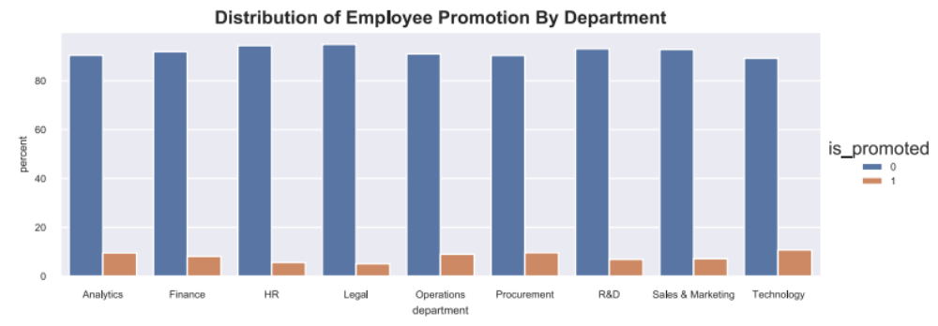
EDA

Slide 5
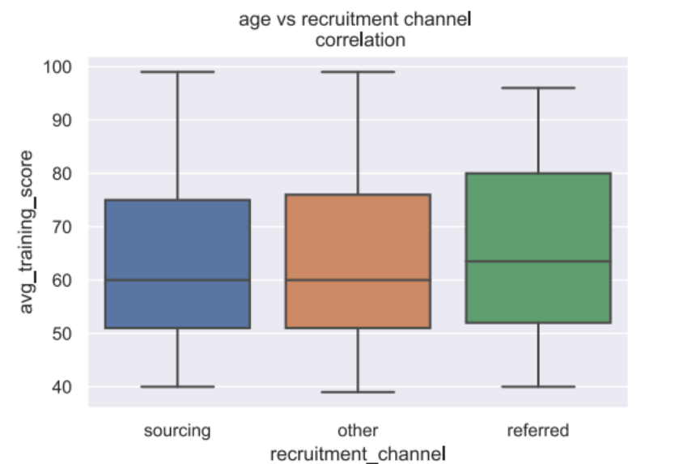
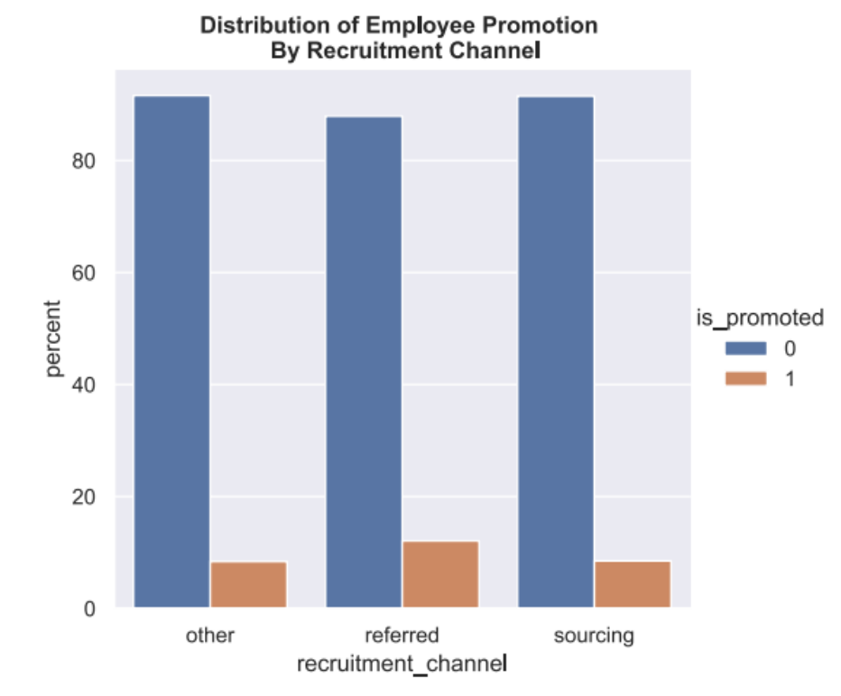
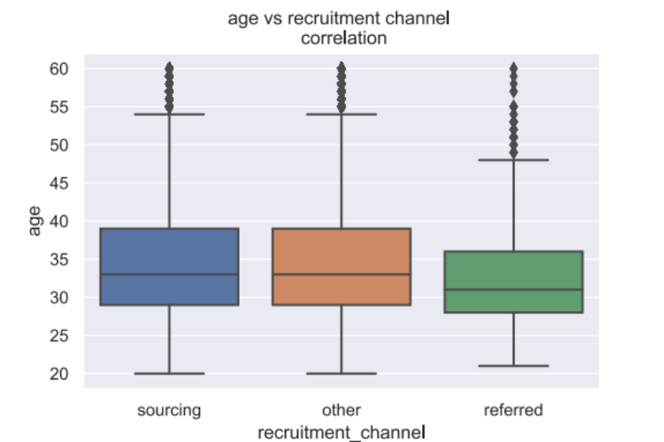
EDA

Slide 6
EDA
outliers:
  The average promotion rate in smaller regions (smaller staff counts) is much lower than average
  Average promotion rate for referred employee is significantly higher than average
  Lower promotion rate in some dept. (HR, legal)

Slide 7
METRICS
confusion matrix
recall, precision, auc & f1 scores
  Minimize FN, maximize tp
probability
  setting a threshold to incl. all FN and incl. more employees in the pre-screening
  listing the selected employees

Slide 8
METHOD
EDA
Split the data into train dataset and test dataset holdout for testing selected model.
StandardScale the train dataset
Random Oversampling train dataset
Kfold Cross Validatation
GridSearchCV
Classifier: LogisticRegression

Slide 9
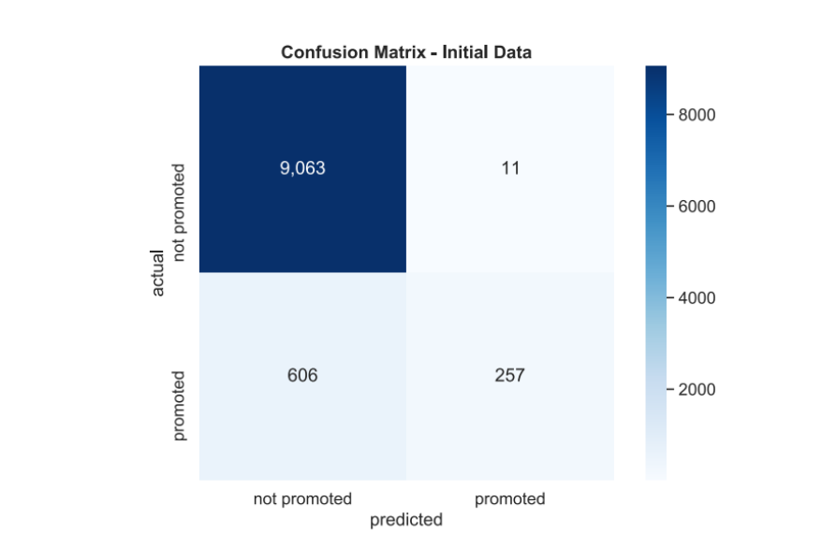
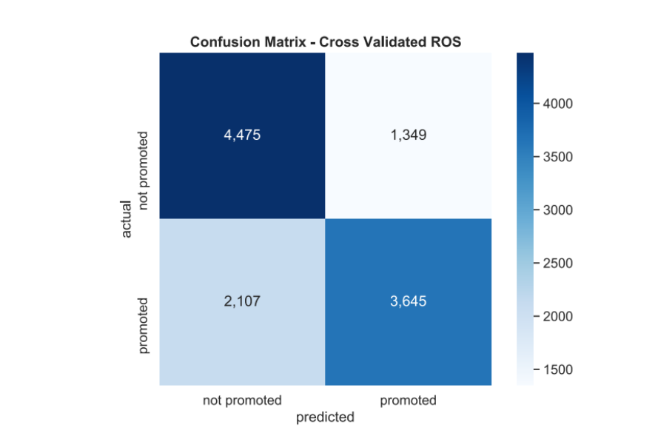
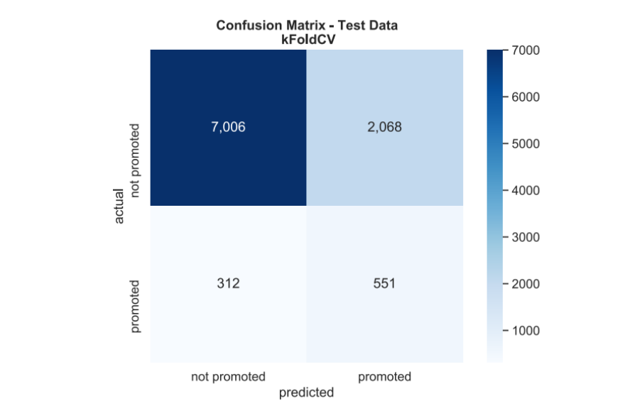
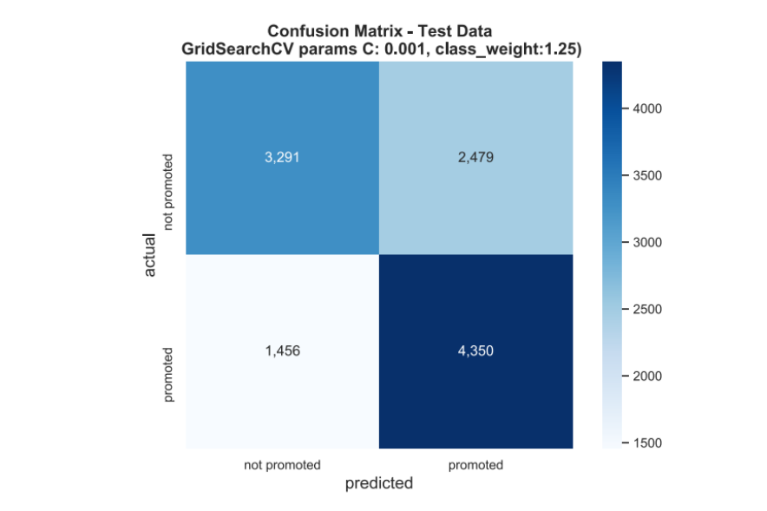
confusion matrices
Metis DS Bootcamp Winter 2021
Project-3 <number>

Slide 10
Results
Standard/Scaling, Upsampling and KFoldCV improved in identifying the target class during the training.
For my case, feature engineering/KFoldCV seemed to overfit
GridSearhCV provided best results.
The parameter here is the best that I tested.
‘best parameters’: {'C': 0.001, 'class_weight': {1: 1.25}, 'penalty': 'l2'}
param_grid = [{'penalty':['l1', 'l2'], 'class_weight':[{1:1.25}, "balanced"], 'C':[0.001,0.01, 0.1, 1, 10, 100, 1000]}]

