Slide 1
Maurice Leblanc Lupin Books
Project – 4
Carla Moestafa

Slide 2

Data Source:
DATA
Maurice Leblanc, Arsène Lupin, Books
10 books:
The extraordinary adventures of Arsène Lupin, Gentleman-Burglar
Arsène Lupin vs Herlock Sholmes
The hollow needle
The blonde lady
The crystal stopper
The confessions of Arsène Lupin
The double life of Arsène Lupin
The secret of Sarek
The secret tomb
The return of Arsène Lupin
128 bundled chapters

Slide 3
PRE-PROCESSING
Raw text files
split the books into chapters
Pre-processing
remove accents
bundle into one documents
word tokenize
remove punctuations
convert to lower case
save into csv file

Slide 4
TOPIC MODELING
Apply stopwords
expanding the built-in stop-words
Topic Modeling
Tfidf + NMF
pos-tag the text
6 topics, 20 top-words

Slide 5
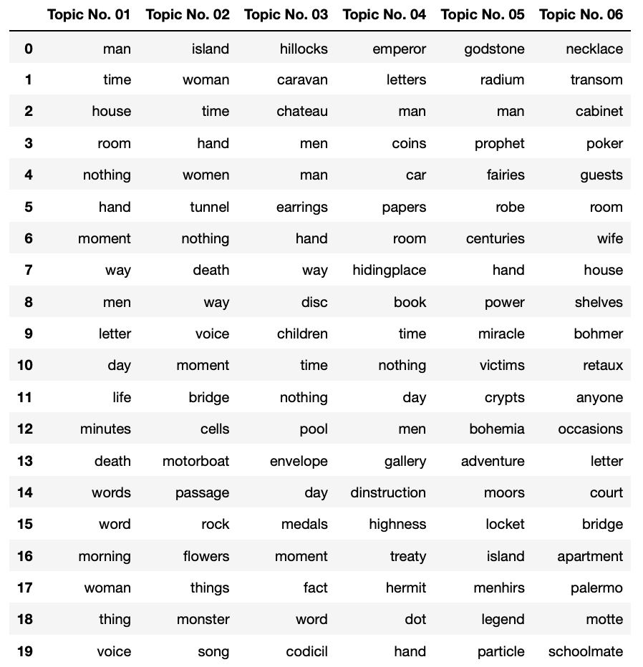
TOPIC MODELING
some interpretations:
Topic 1 :
death in daily life setting
Topic 2 :
unusual? death in a holiday setting (island , monster, island, motorboat...)
Topic 3 :
road trip/holiday (caravan, orchard, hillocks, pool) & valuable (earrings, medals)
Topic 4 :
nobility, valuable documents, secrecy
Topic 5 : special substance/material (godstone, radium, menhirs, particle),l egend/history (prophet, menhir, crypts, centuries)
Topic 6 : jewelry, (gambling/game) party? (poker, bridge, guests)

Slide 8
Example of Topics in Book 1
BOOK 1: Gentleman Burglar
Dominant Topic = Topic 3
Chapter | Topic#
C_01 | 3
C_02 | 3
C_03 | 1
C_04 | 1
C_05 | 3
C_06 | 5
C_07 | 3
C_08 | 3
C_09 | 5

Slide 9
SENTIMENT ANALYSIS

Slide 10
Negative Sentiments in the Books

Slide 11
Book 16 The Return of Arsène Lupin Dominant Topic : Topic#4
Chapter | Topic#
C_01 | 6
C_02 | 4
C_03 | 6
C_04 | 6
C_05 | 4
C_06 | 1
C_07 | 1
C_08 | 3
C_09 | 6
C_10 | 1
C_11 | 3
C_12 | 4
C_13 | 4
C_14 | 1
C_15 | 4
C_16 | 1
C_17 | 1
C_18 | 1
C_19 | 4

Slide 12
some thoughts…
I should have started the workflow by preparing a corpus with higher definition, breaking down the chapters into sub-chapter or lines…
Improve stop-words

Slide 13
FUTURE IMPROVEMENTS
Try other topic modeling
Do more in depth sentiment analysis
Character analysis and interactions

