Slide 1

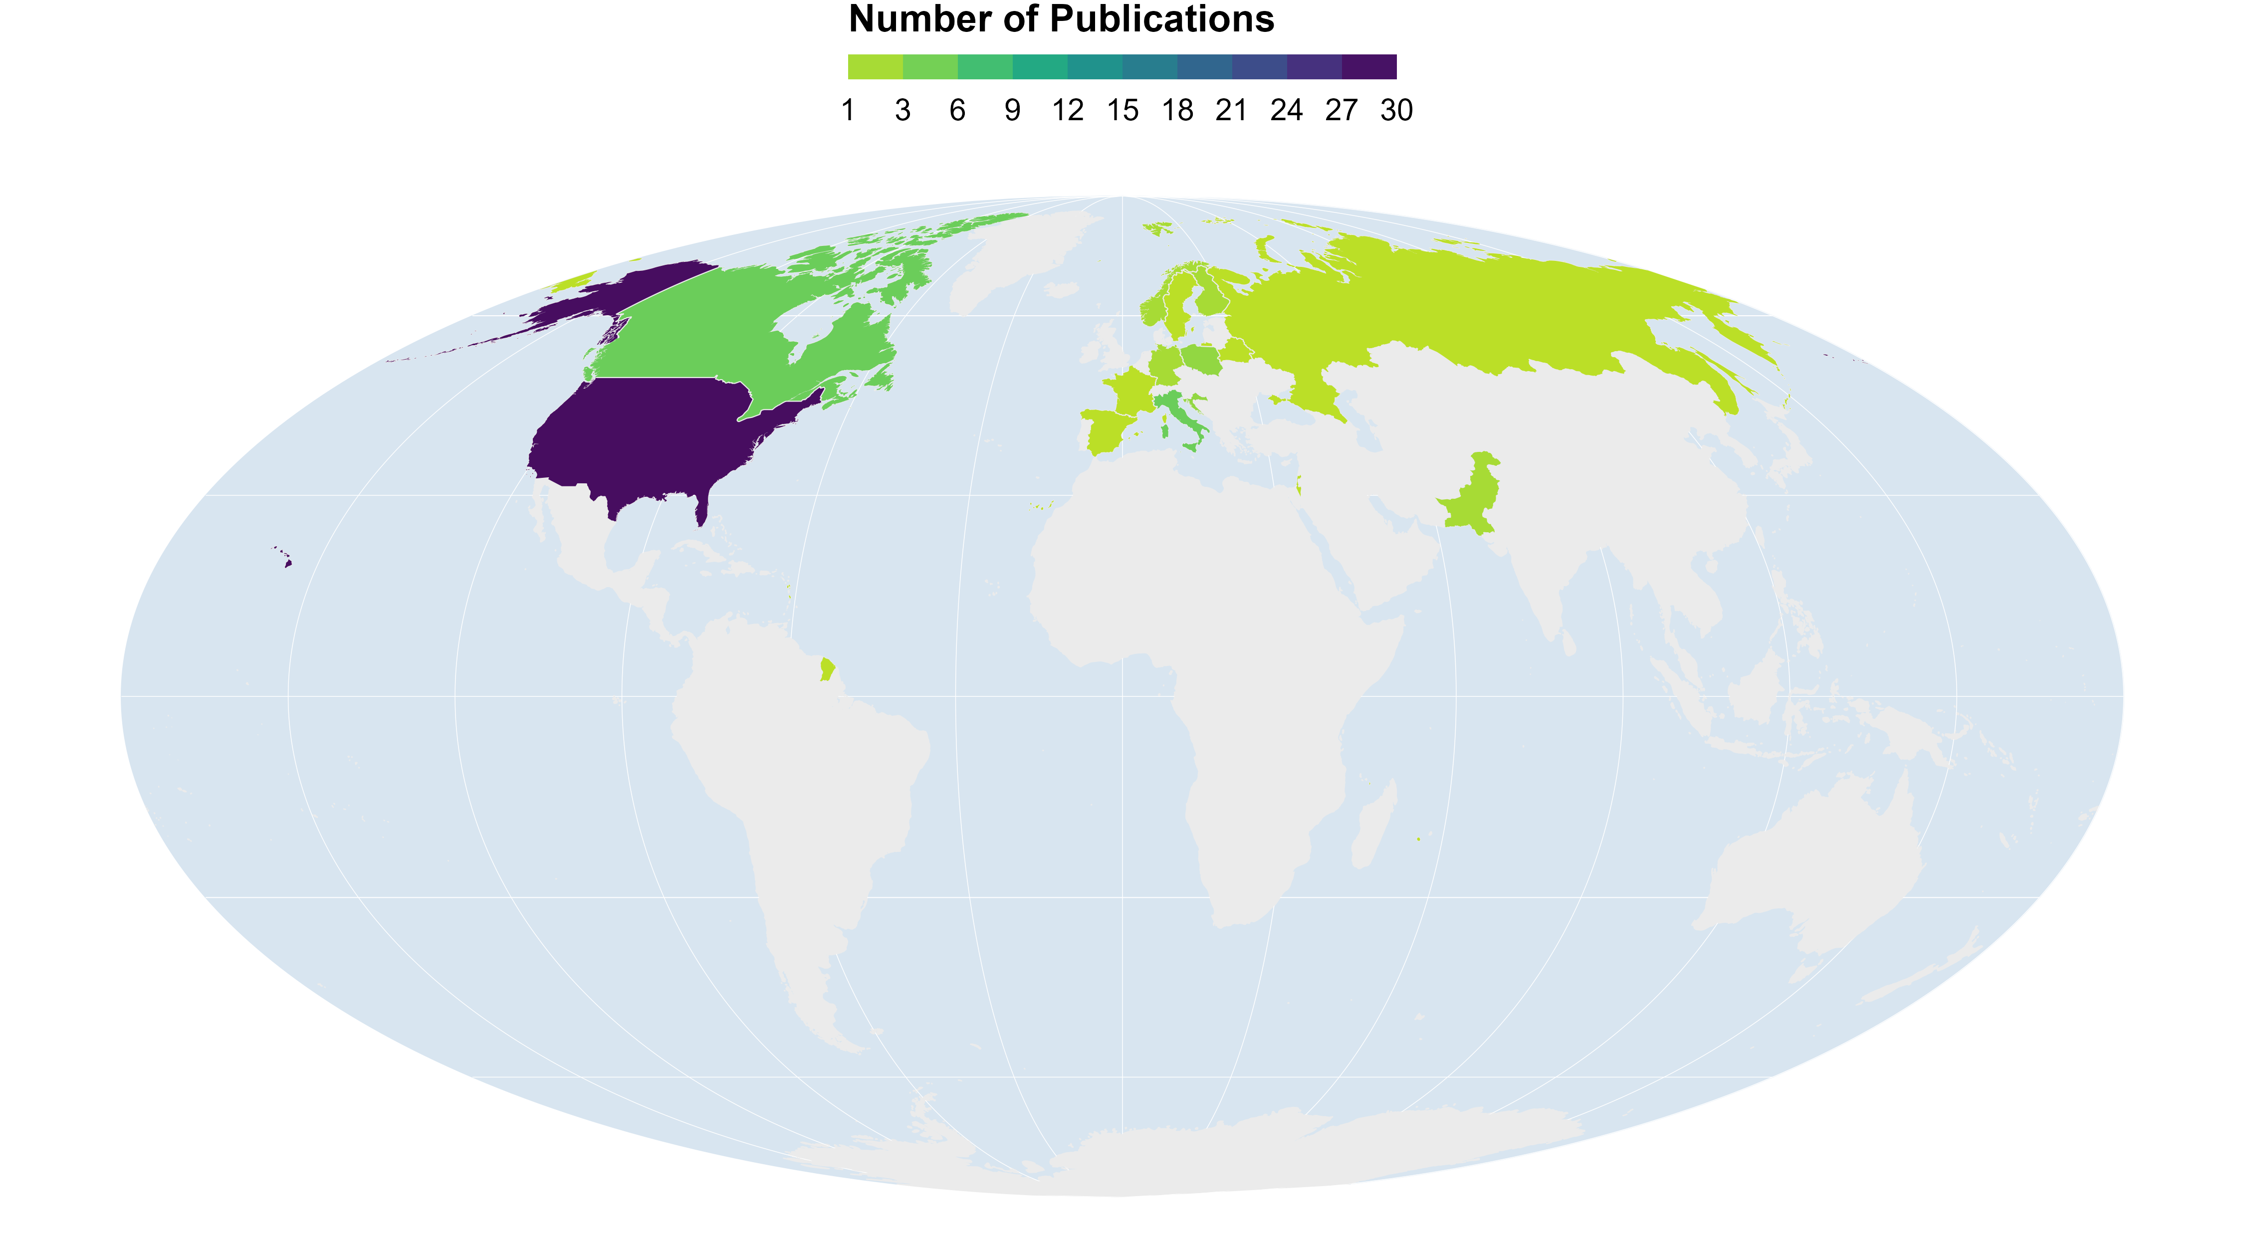
Results – Distribution of Publications
N Total:59
Notes:
Regions of study: 24 USA/CAN; 1 RUS; 14 EUR, 1 ISR Total: 40
Europe: 1 ESP, 2 GER, 4 SCA (1 FIN only), 5 ITA/FR (2 ITA/FRA), 1 BAL/DIN, 1 POL/BEL
North America: 3 USA/CAN, 4 CAN, 17 USA
Year (publication): Min:1971 Max:2022
Duration of study: Min:1 yr Max: 22

Slide 2
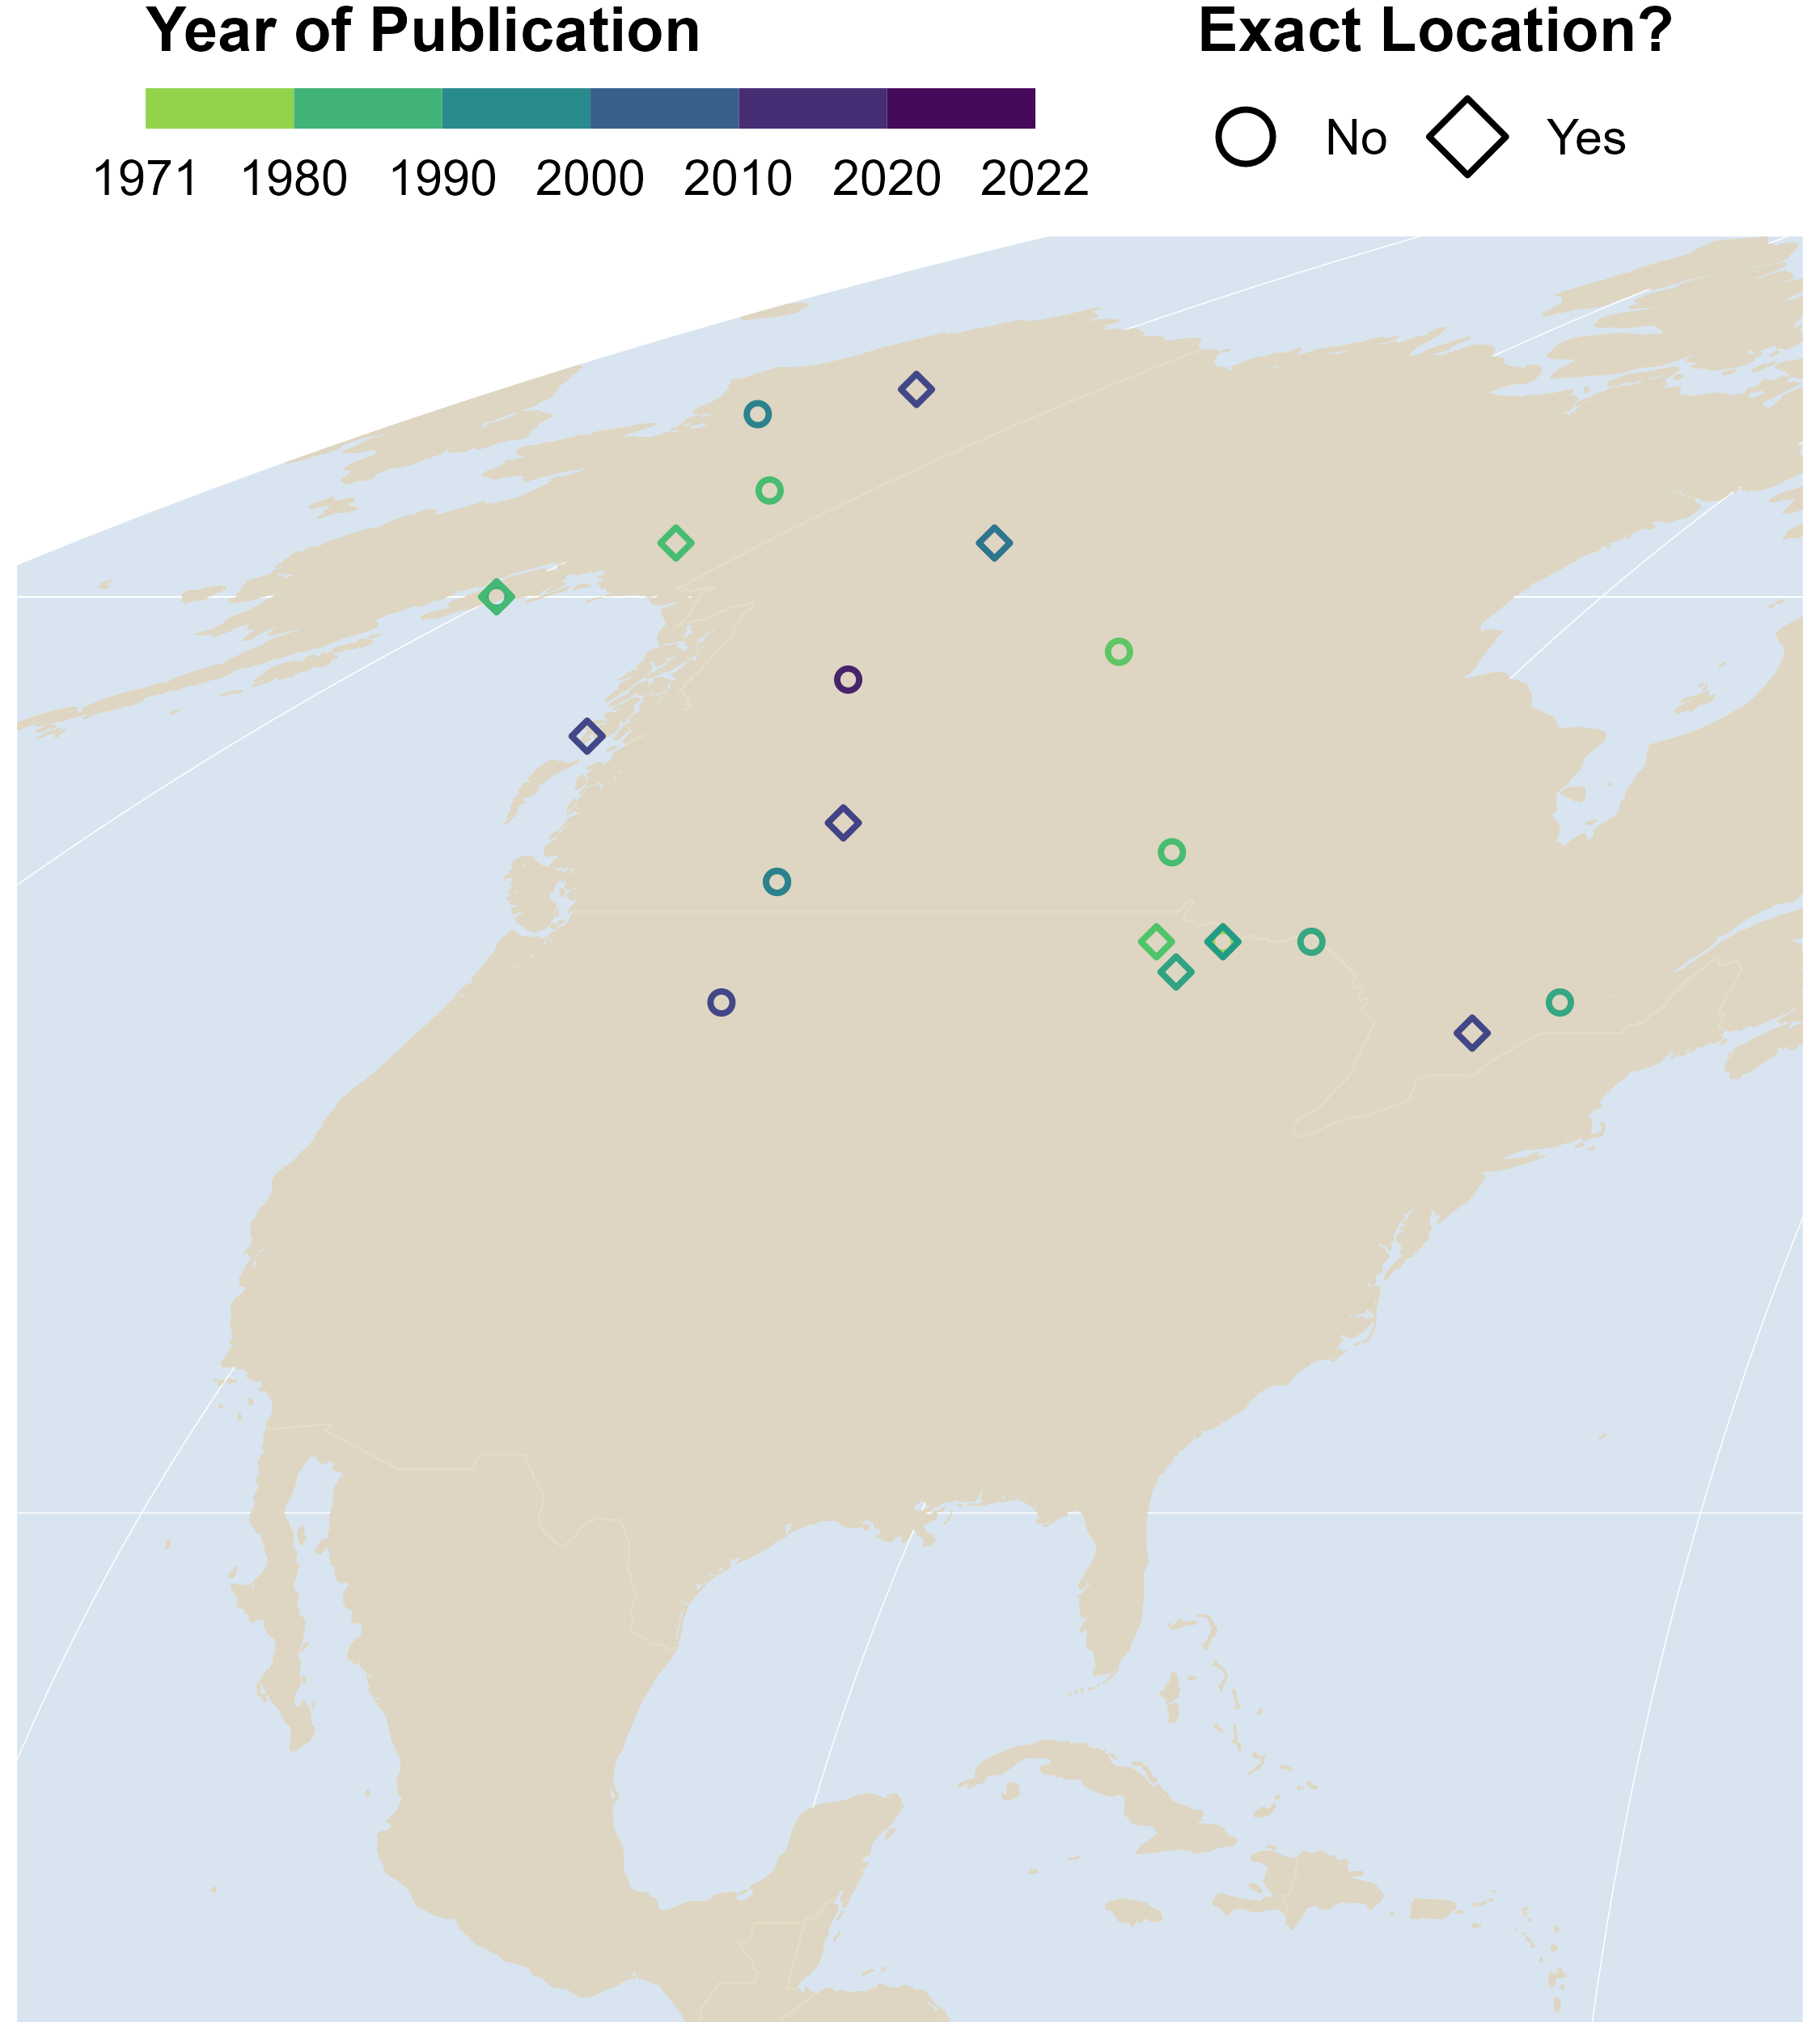
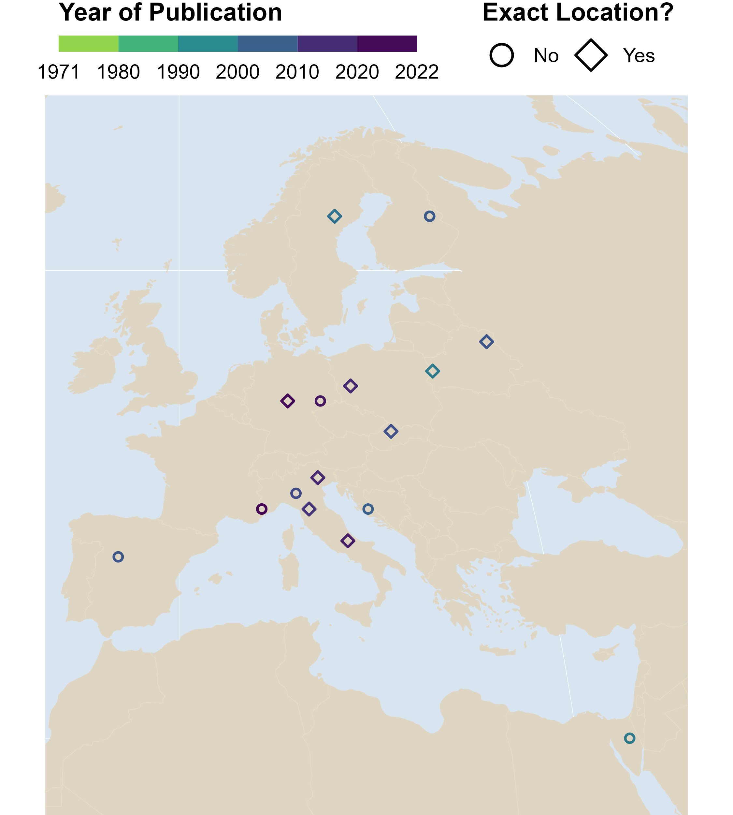
Results – Year of Publication
Notes:
Regions of study: 24 USA/CAN; 1 RUS; 14 EUR, 1 ISR Total: 40
Europe: 1 ESP, 2 GER, 4 SCA (1 FIN only), 5 ITA/FR (2 ITA/FRA), 1 BAL/DIN, 1 POL/BEL
North America: 3 USA/CAN, 4 CAN, 17 USA
Year (publication): Min:1971 Max:2022
Duration of study: Min:1 yr Max: 22

Slide 3
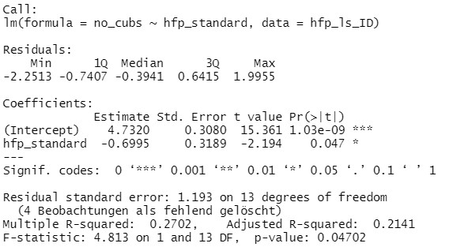
Preliminary Results: First Linear Models
Survival ~ Protected areas
Litter size ~ Human footprint
Notes:
11 studies mentioned mean pack sizes.
8 in North America (7.01,) 3 in Europe (5.97).

Slide 4
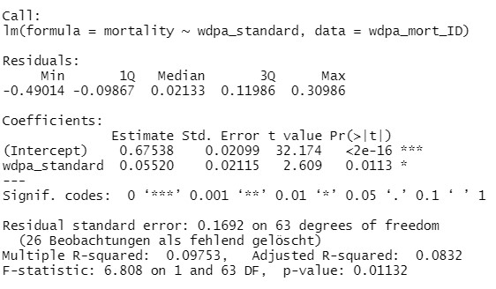
Preliminary Results: First Linear Models
Mortality ~ Protected areas
Litter size ~ Human footprint
Notes:
11 studies mentioned mean pack sizes.
8 in North America (7.01,) 3 in Europe (5.97).

Slide 5
First Models: Litter size ~ Human footprint
Notes:
11 studies mentioned mean pack sizes.
8 in North America (7.01,) 3 in Europe (5.97).

Slide 6
First Models: Survival rate ~ Protected areas
Notes:
11 studies mentioned mean pack sizes.
8 in North America (7.01,) 3 in Europe (5.97).

Slide 7
Next steps
Run linear mixed models
Further specify hypotheses
Create plots of outcome from linear models
Finish writing thesis
Notes:
11 studies mentioned mean pack sizes.
8 in North America (7.01,) 3 in Europe (5.97).

