Slide 1


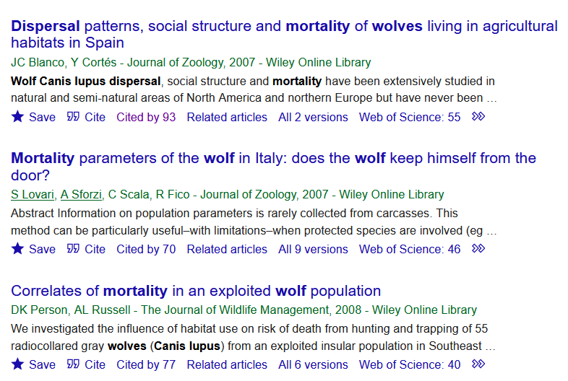
Methods – Search strings
Search strings:
"wolves" OR "canis lupus" OR "wolf" AND "dispersal" OR "demography" OR "demographics" OR "mortality" OR "survival"
“Canis lupus” AND “Europe” AND “dispersal”
First 5 pages before & after 2000
Notes:
The original uploader was PNG crusade bot at English Wikipedia., Public domain, via Wikimedia Commons. Available at: https://upload.wikimedia.org/wikipedia/commons/2/28/Google_Scholar_logo.png Last accessed 09.06.2022

Slide 2
Methods – Search strings
Search strings:
"wolves" OR "canis lupus" OR "wolf" AND "dispersal" OR "demography" OR "demographics" OR "mortality" OR "survival"
“Canis lupus” AND “Europe” AND “dispersal”
First 5 pages before & after 2000
Notes:
The original uploader was PNG crusade bot at English Wikipedia., Public domain, via Wikimedia Commons. Available at: https://upload.wikimedia.org/wikipedia/commons/2/28/Google_Scholar_logo.png Last accessed 09.06.2022

Slide 3
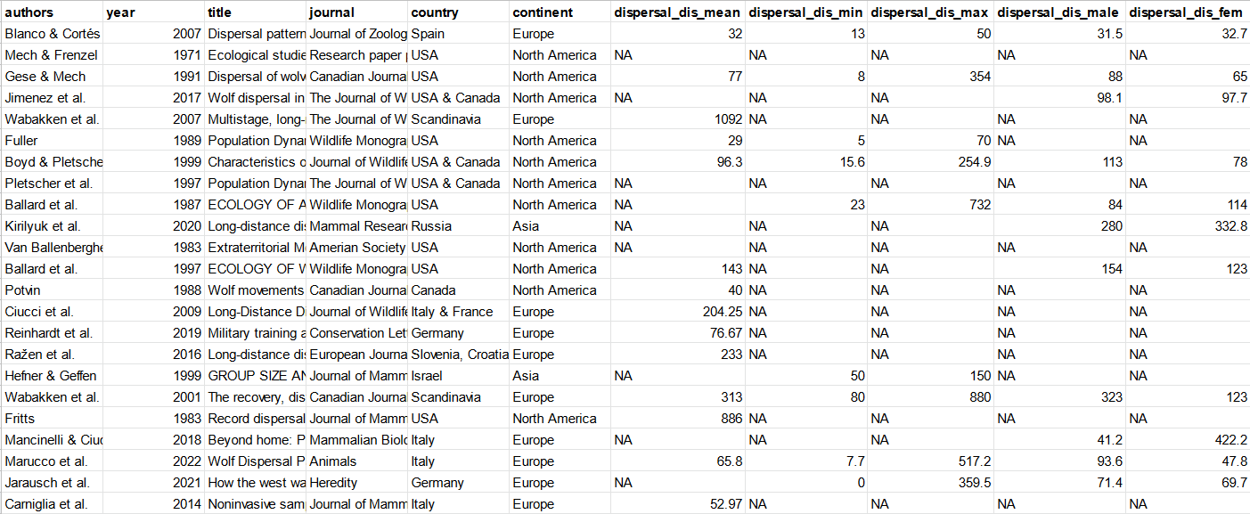
Methods – Data extraction & cleaning
Notes:
Means
What decisions did I make?
Created separate tabs

Slide 4
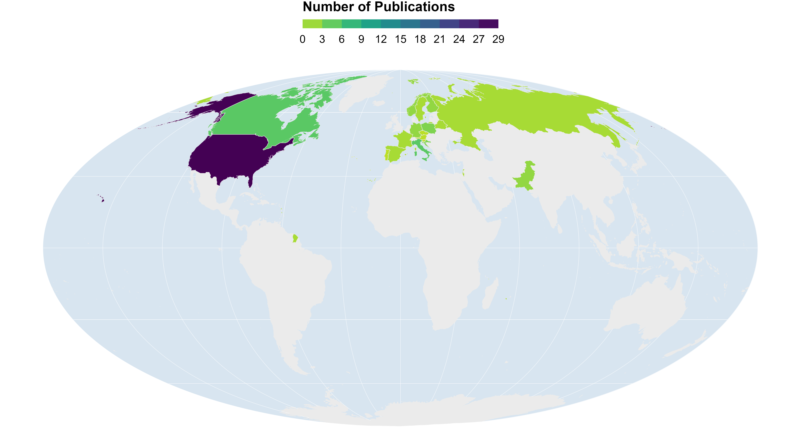
Results – Distribution of Publications
Notes:
Regions of study: 24 USA/CAN; 1 RUS; 14 EUR, 1 ISR Total: 40
Europe: 1 ESP, 2 GER, 4 SCA (1 FIN only), 5 ITA/FR (2 ITA/FRA), 1 BAL/DIN, 1 POL/BEL
North America: 3 USA/CAN, 4 CAN, 17 USA
Year (publication): Min:1971 Max:2022
Duration of study: Min:1 yr Max: 22

Slide 5
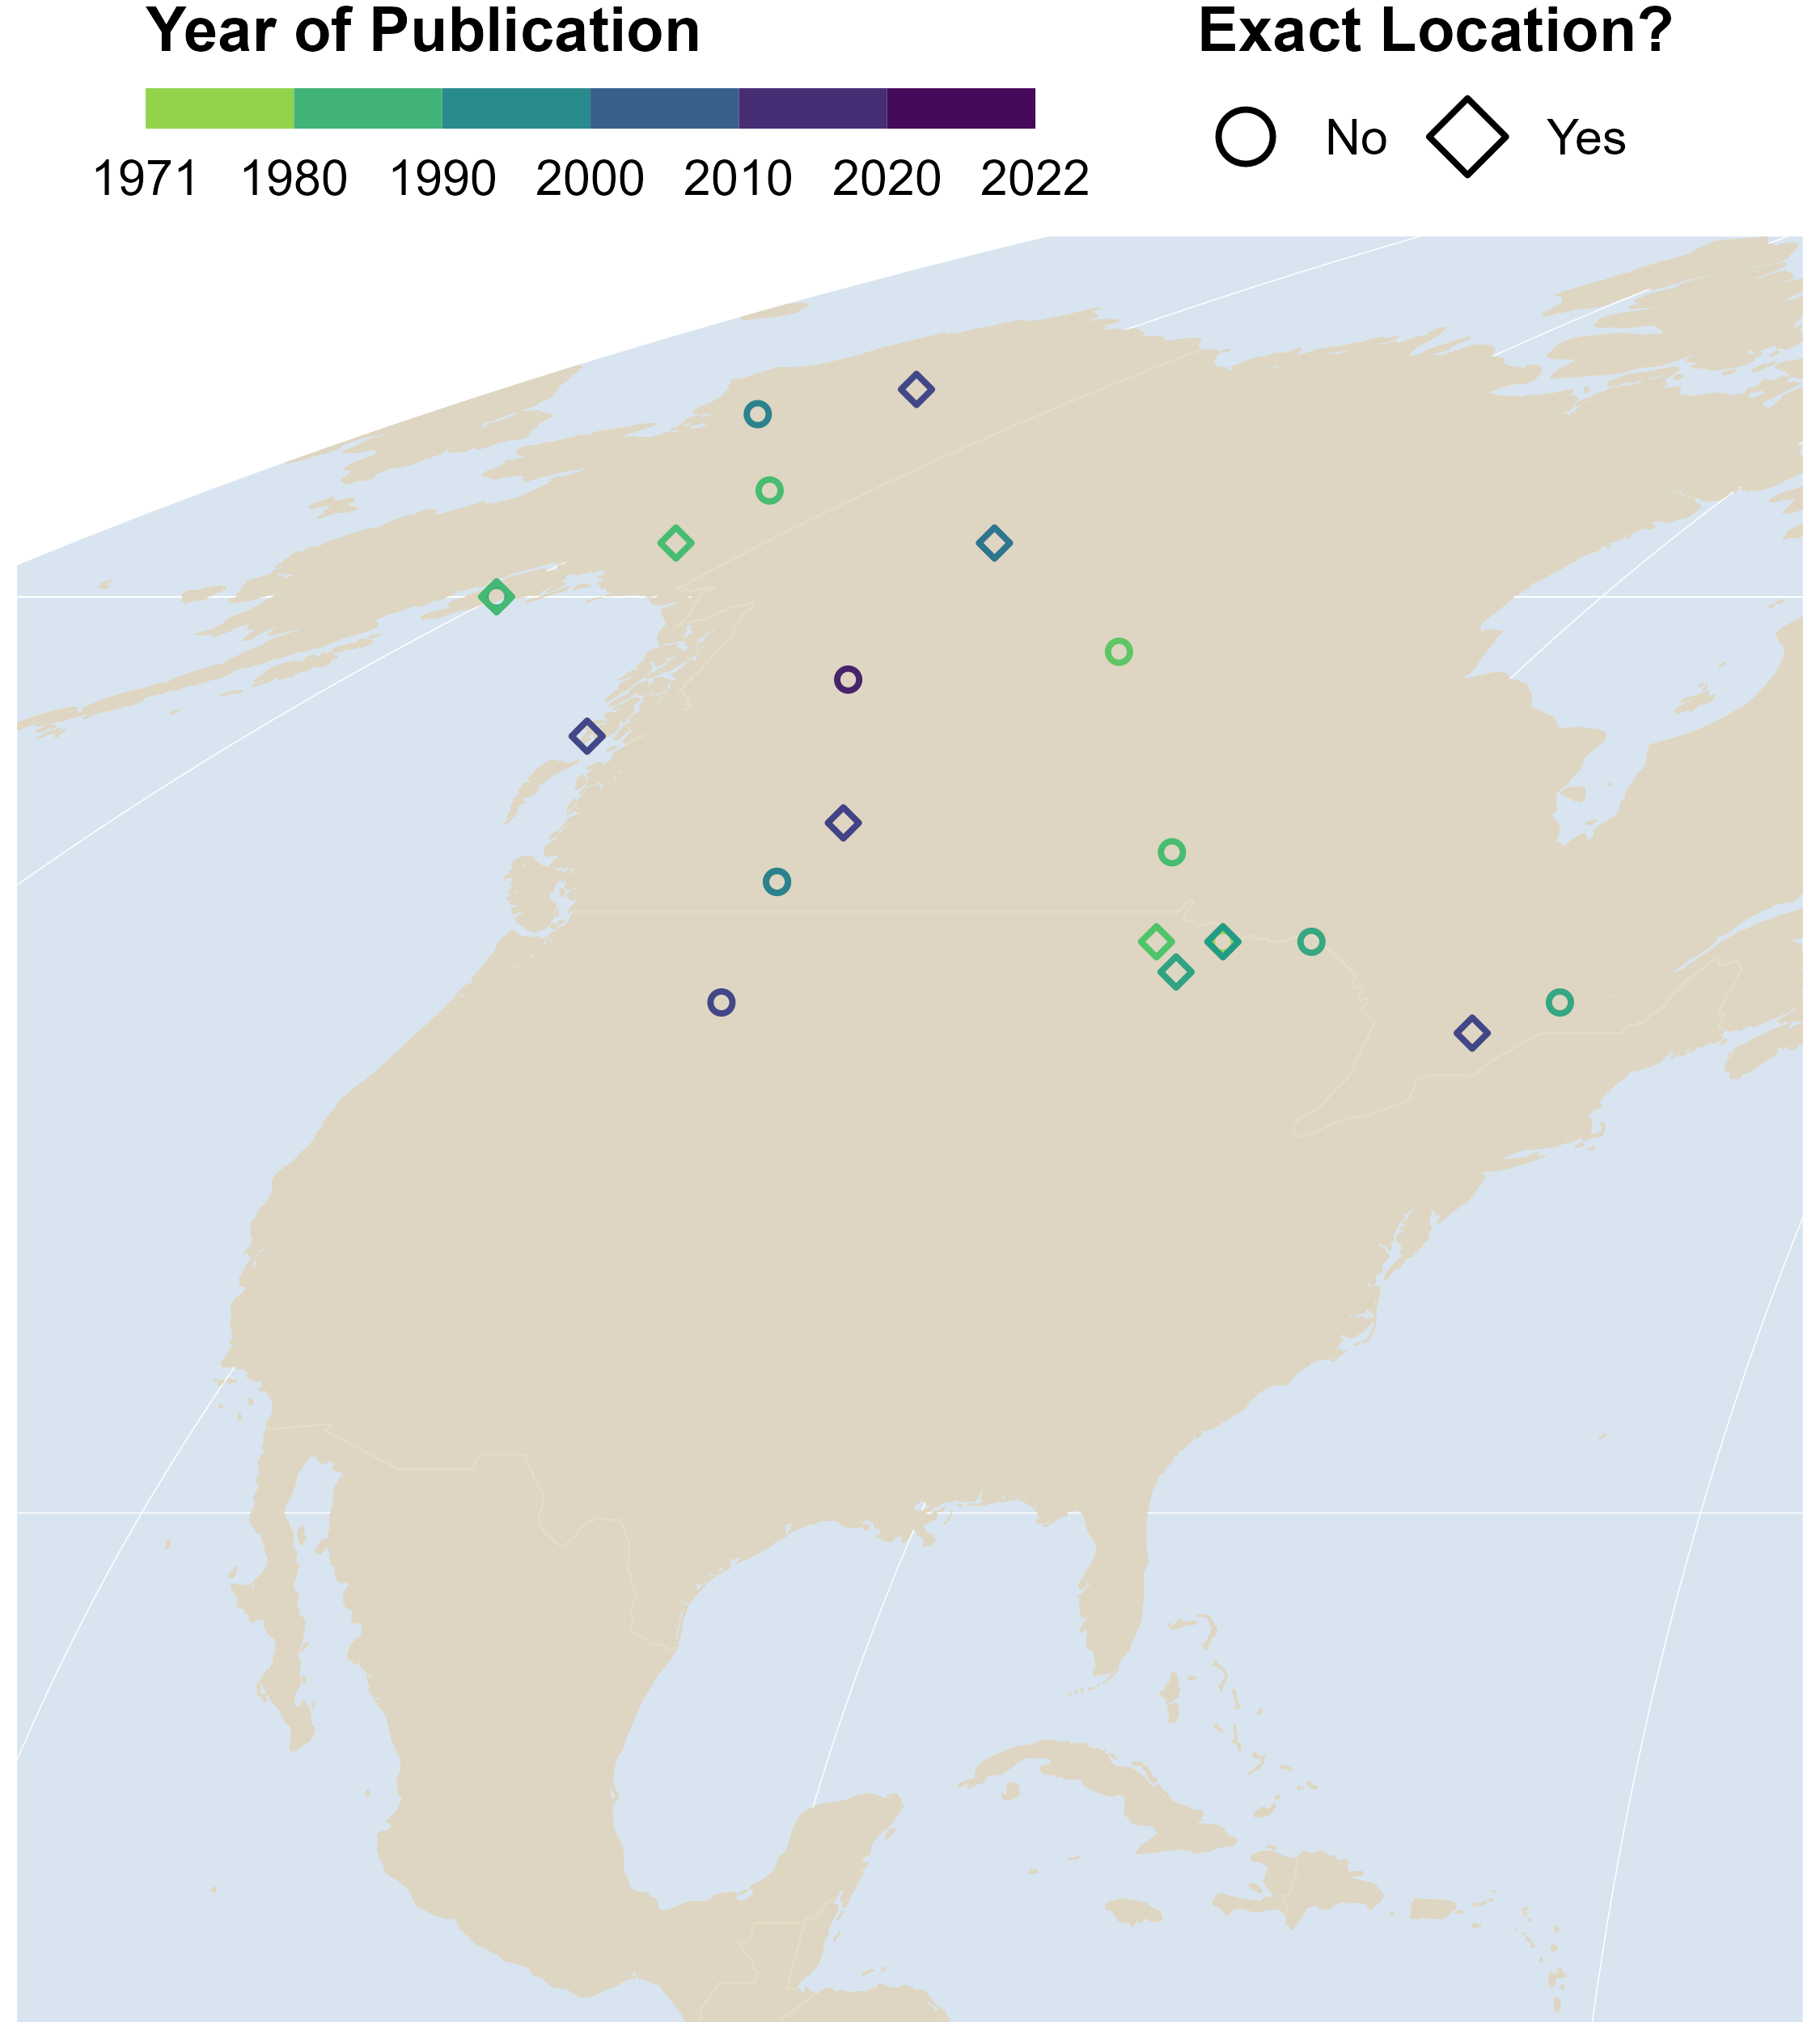
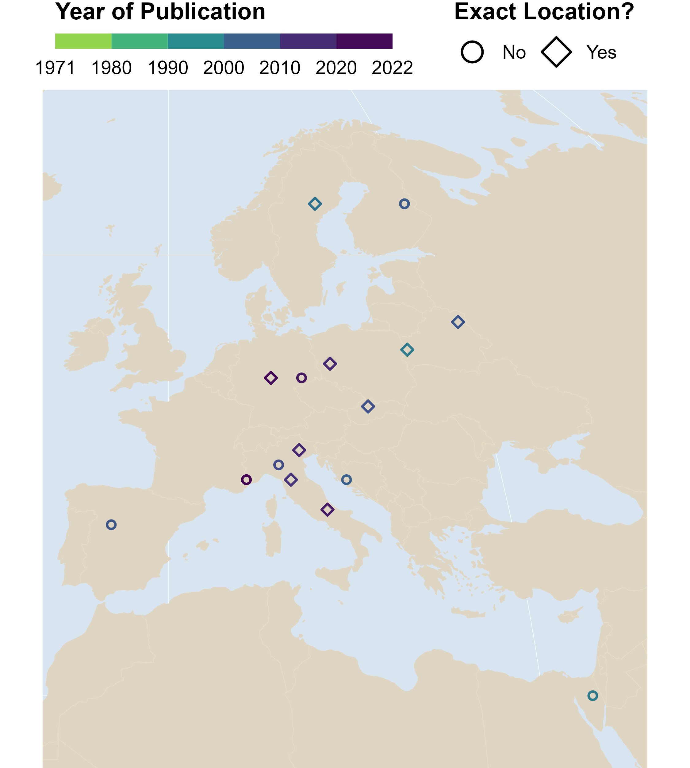
Results – Year of Publication
Notes:
Regions of study: 24 USA/CAN; 1 RUS; 14 EUR, 1 ISR Total: 40
Europe: 1 ESP, 2 GER, 4 SCA (1 FIN only), 5 ITA/FR (2 ITA/FRA), 1 BAL/DIN, 1 POL/BEL
North America: 3 USA/CAN, 4 CAN, 17 USA
Year (publication): Min:1971 Max:2022
Duration of study: Min:1 yr Max: 22

Slide 6
Results – Pack size
Notes:
11 studies mentioned mean pack sizes.
8 in North America (7.01,) 3 in Europe (5.97).

Slide 7
Results – Litter size
Notes:
11 studies mentioned mean pack sizes.
8 in North America (7.01,) 3 in Europe (5.97).

Slide 8
Results – Mortality rate
Notes:
11 studies mentioned mean pack sizes.
8 in North America (7.01,) 3 in Europe (5.97).

Slide 9
Results – Population growth rate
Notes:
11 studies mentioned mean pack sizes.
8 in North America (7.01,) 3 in Europe (5.97).

