Slide 1


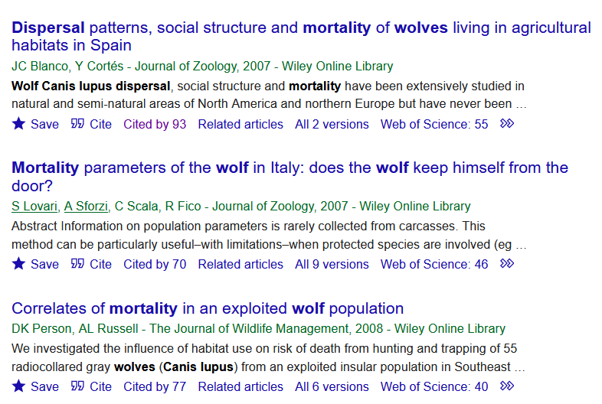
Methods: A Selection of Search Strings
Search strings:
"wolves" OR "canis lupus" OR "wolf" AND "dispersal" OR "demography" OR "demographics" OR "mortality" OR "survival"
"wolves" OR "canis lupus" OR "wolf" AND “pack size” OR “litter size” OR "demography" OR "demographics" OR "mortality" OR "survival" AND “specific country”
First 5 pages before & after 2000
Notes:
The original uploader was PNG crusade bot at English Wikipedia., Public domain, via Wikimedia Commons. Available at: https://upload.wikimedia.org/wikipedia/commons/2/28/Google_Scholar_logo.png Last accessed 09.06.2022

Slide 2
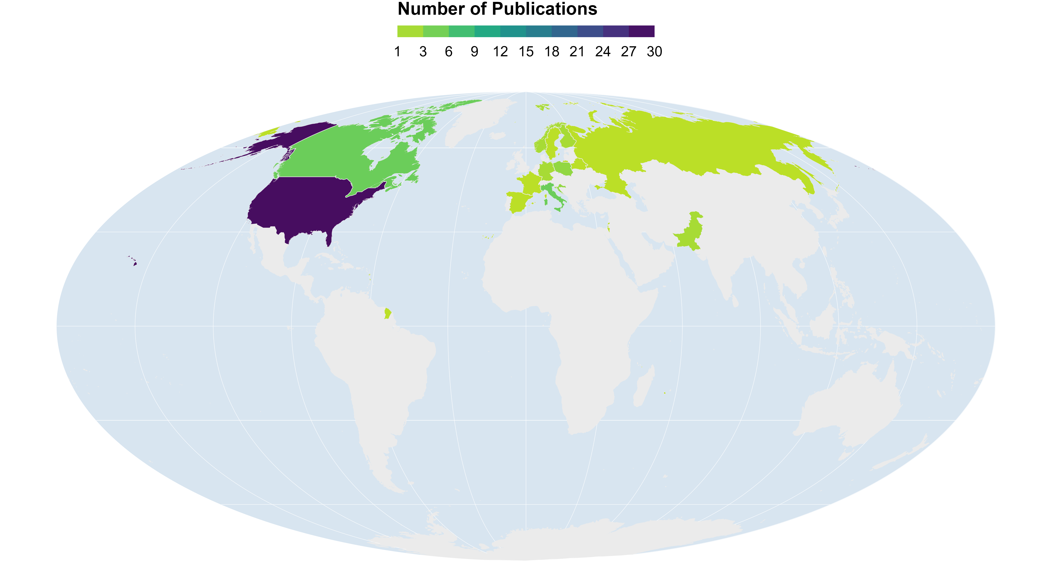
Results: Distribution of Publications
N Total:59
Notes:
Regions of study: 24 USA/CAN; 1 RUS; 14 EUR, 1 ISR Total: 40
Europe: 1 ESP, 2 GER, 4 SCA (1 FIN only), 5 ITA/FR (2 ITA/FRA), 1 BAL/DIN, 1 POL/BEL
North America: 3 USA/CAN, 4 CAN, 17 USA
Year (publication): Min:1971 Max:2022
Duration of study: Min:1 yr Max: 22

Slide 3
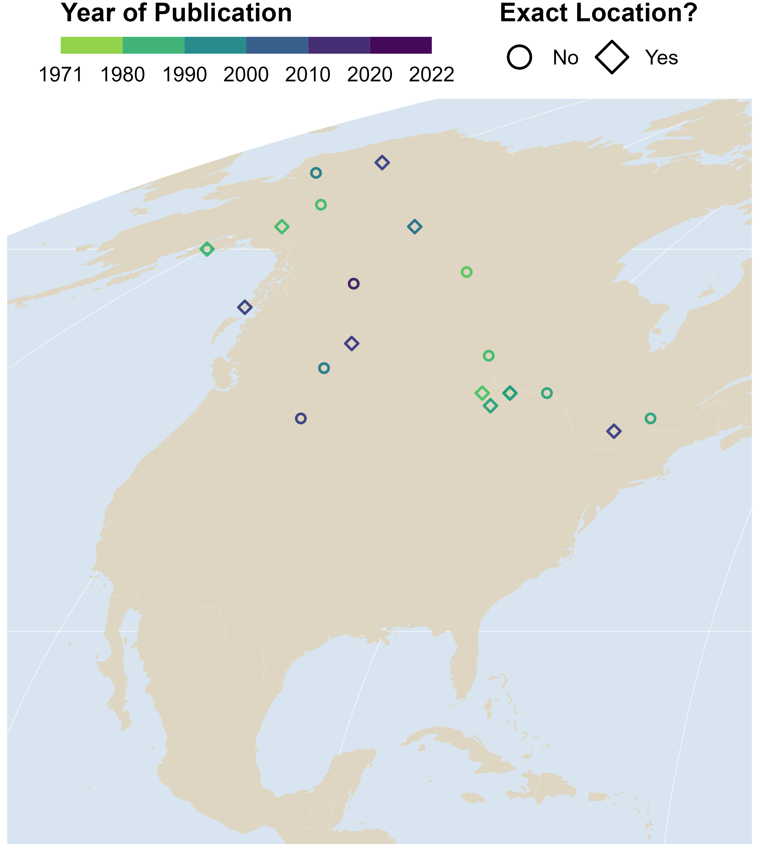
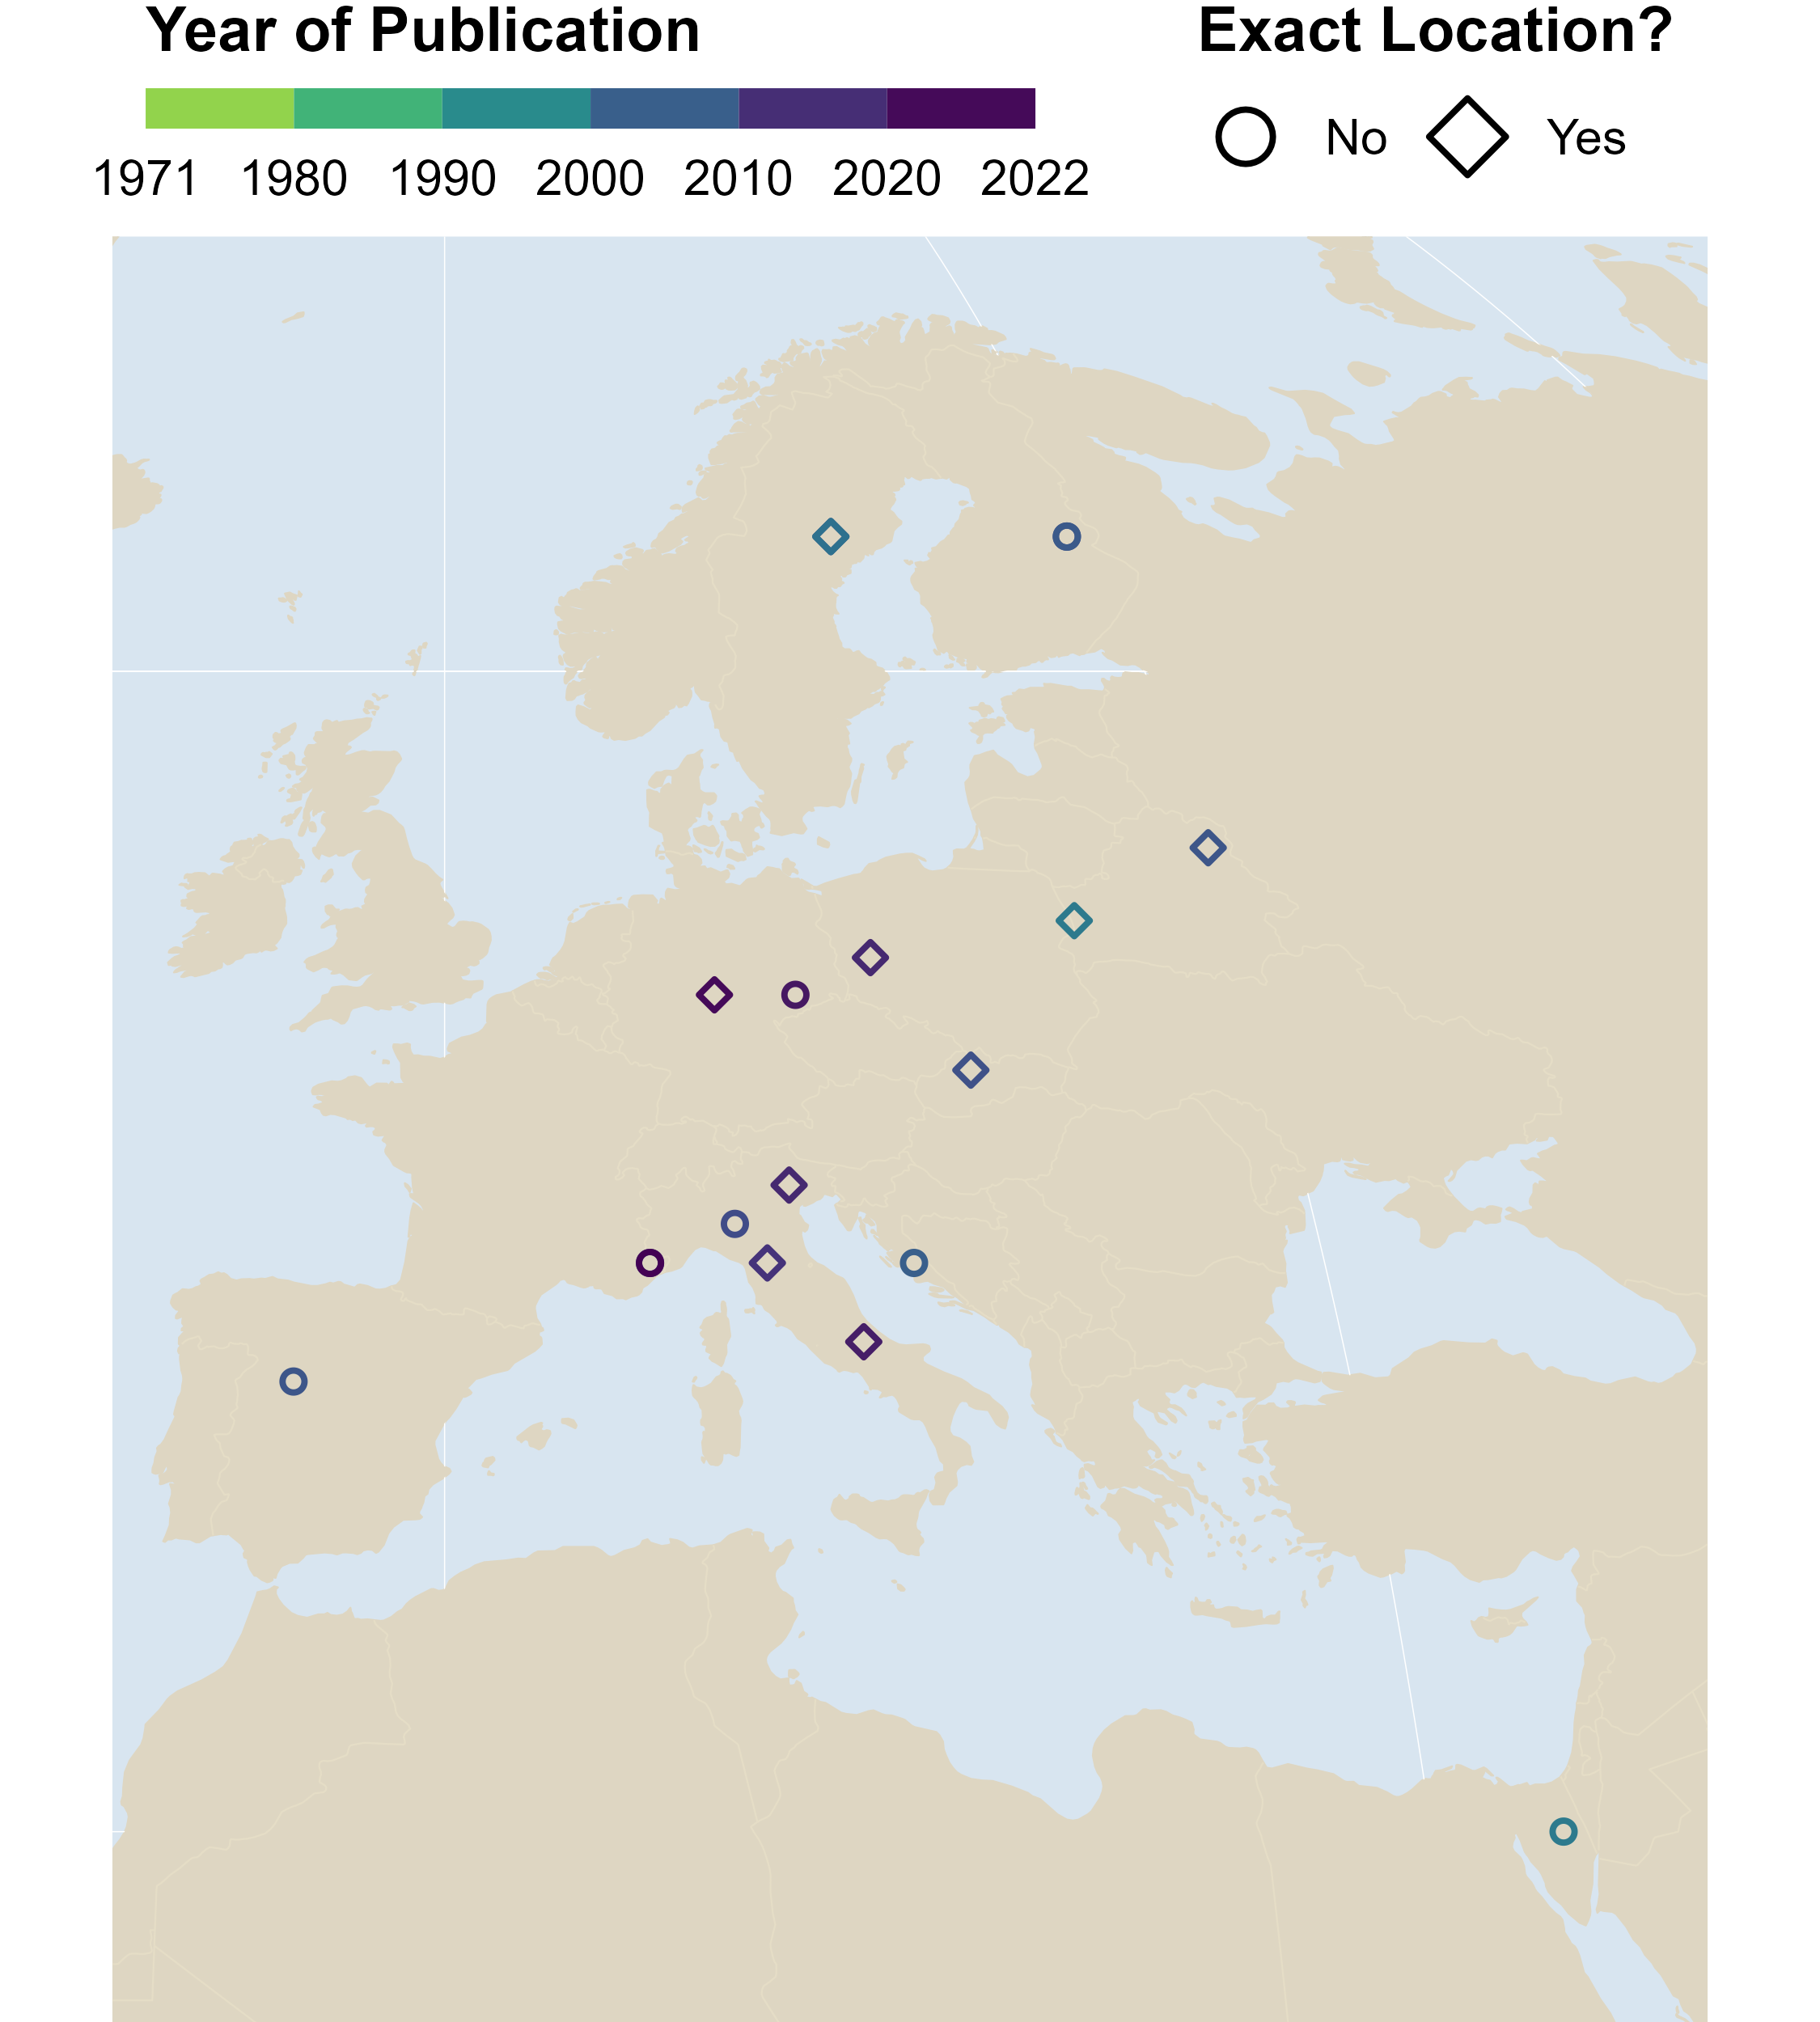
Results: Year of Publication
: 10
: 10
: 12
: 8
Notes:
Regions of study: 24 USA/CAN; 1 RUS; 14 EUR, 1 ISR Total: 40
Europe: 1 ESP, 2 GER, 4 SCA (1 FIN only), 5 ITA/FR (2 ITA/FRA), 1 BAL/DIN, 1 POL/BEL
North America: 3 USA/CAN, 4 CAN, 17 USA
Year (publication): Min:1971 Max:2022
Duration of study: Min:1 yr Max: 22

Slide 4
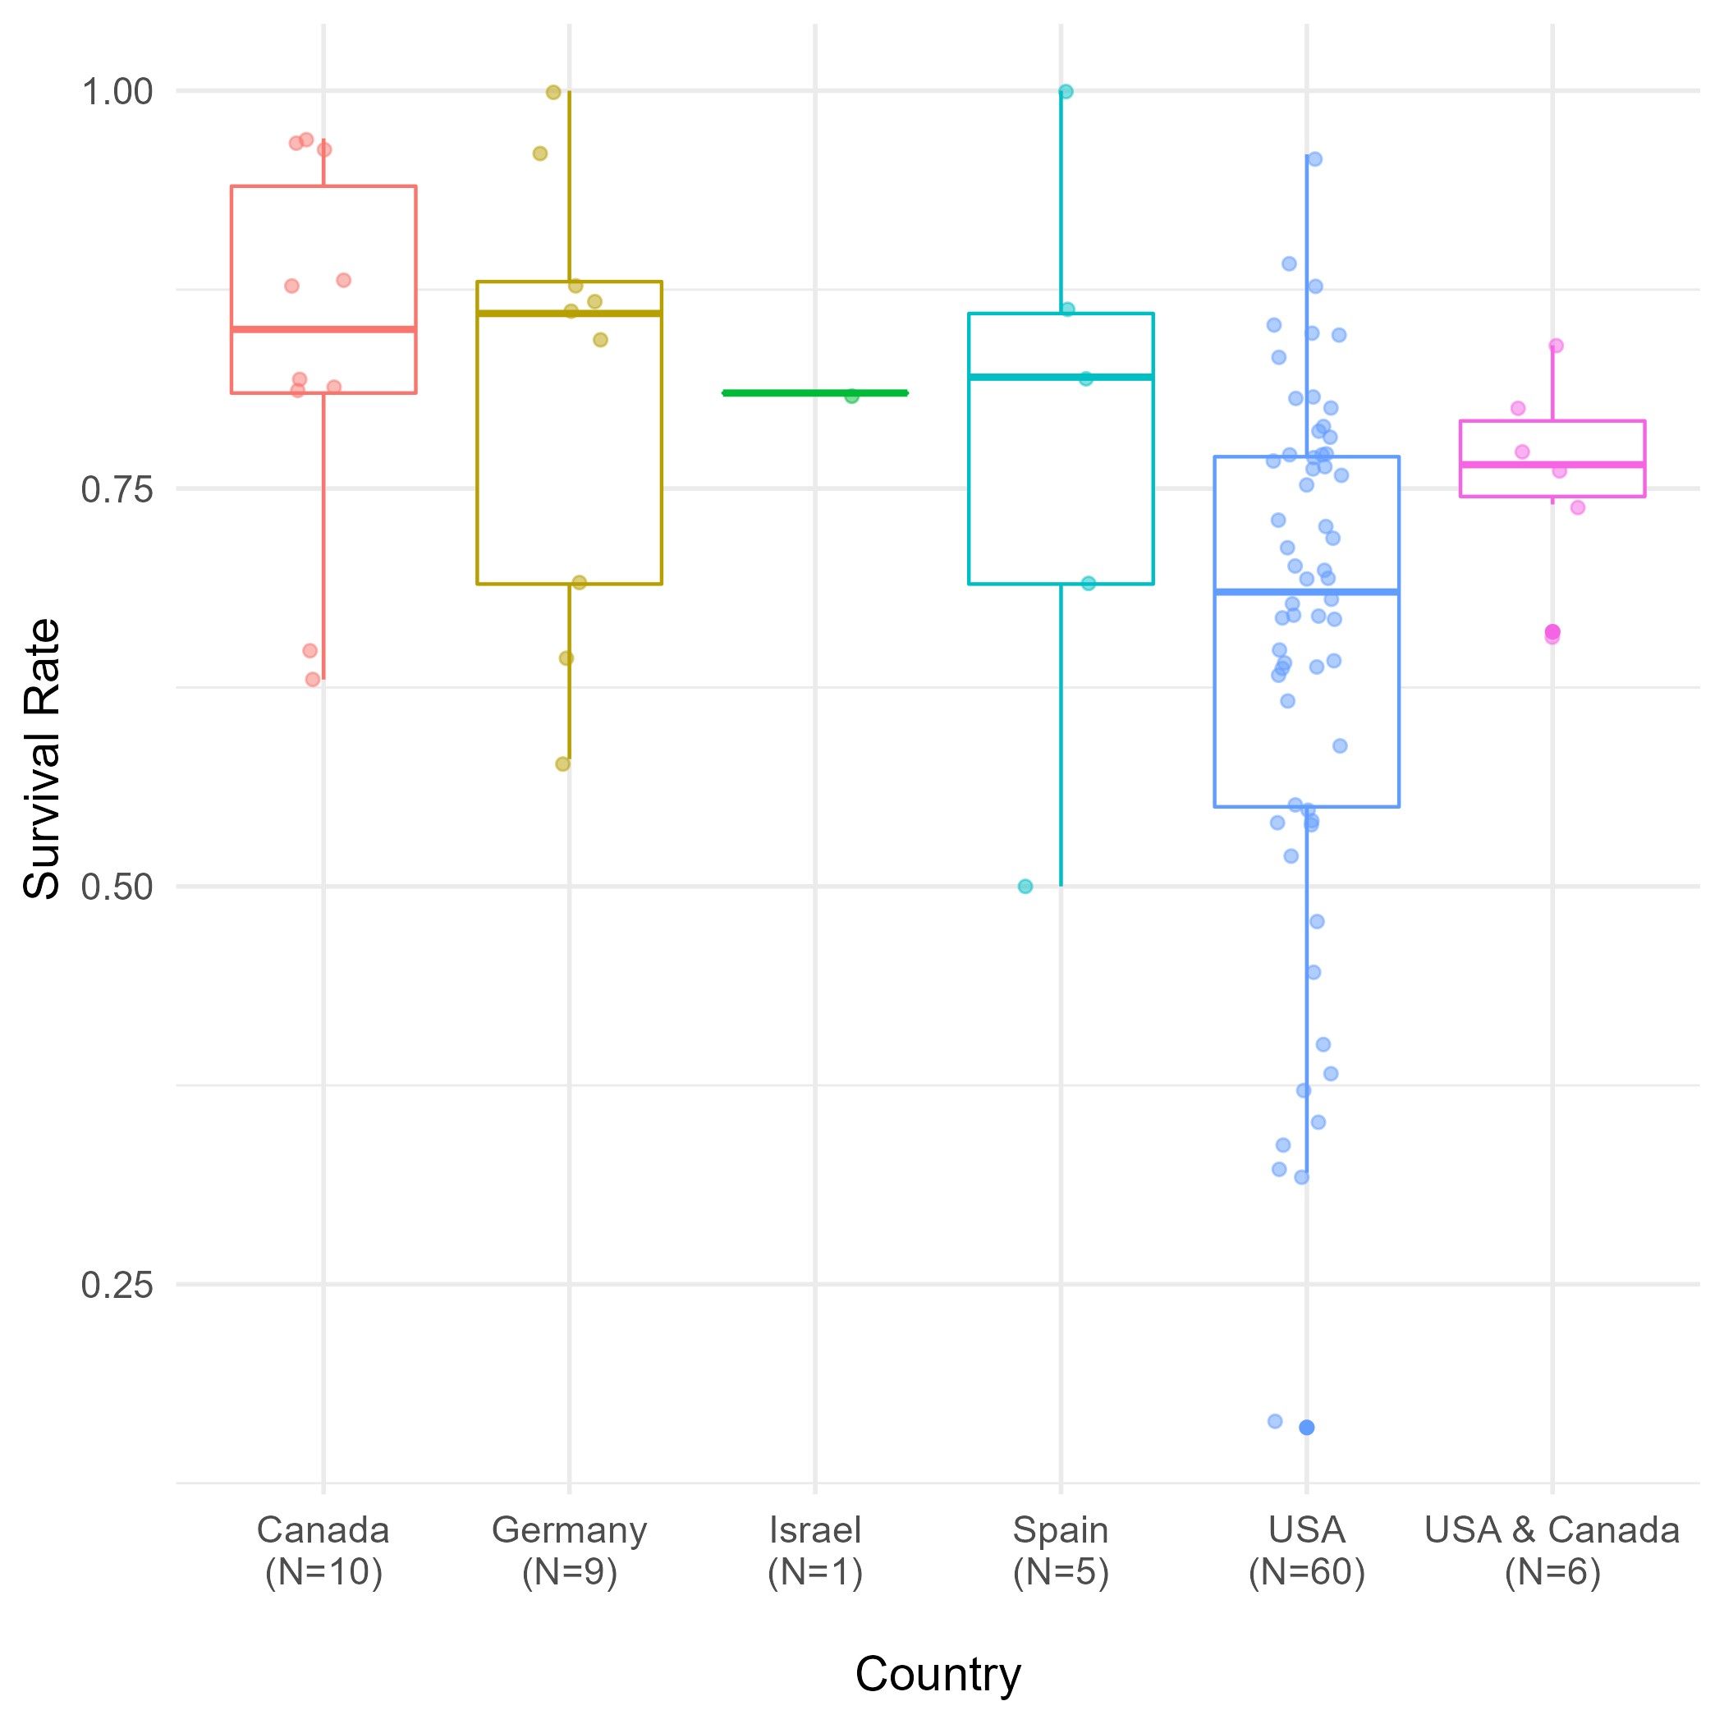
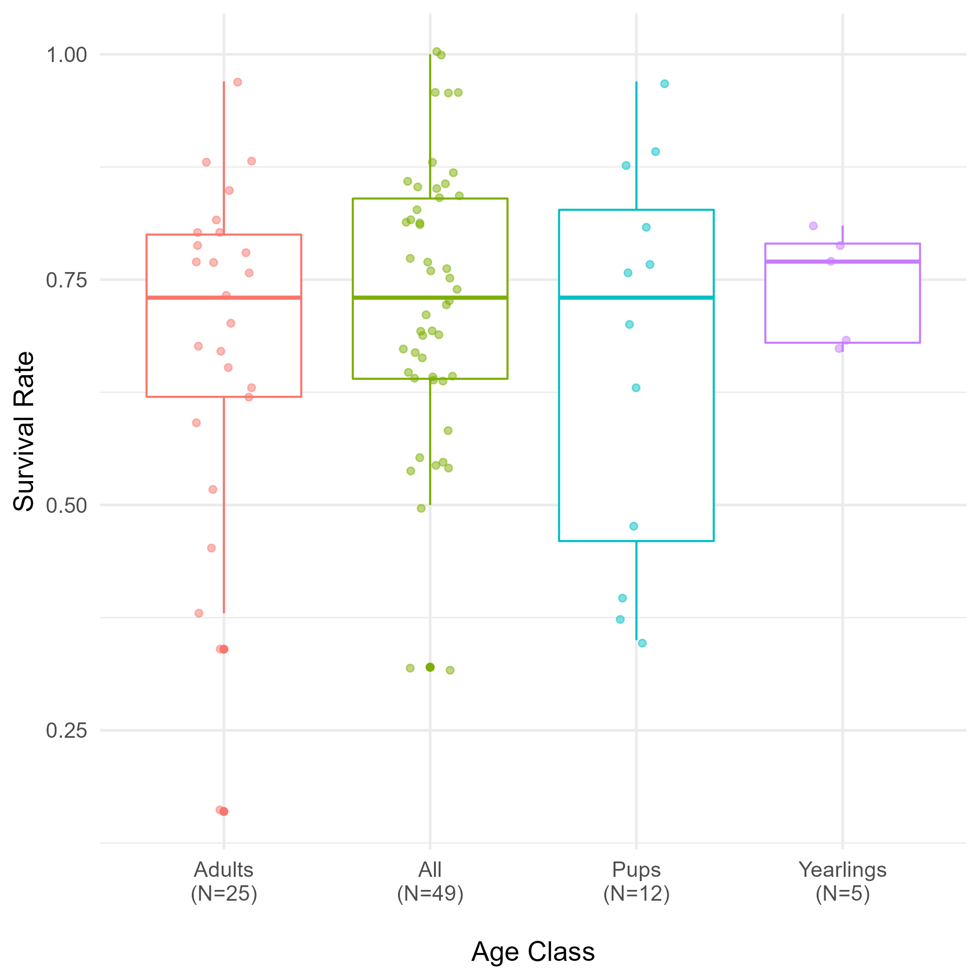
Results: Survival Rate per Country & Age Class
N Total:91
Notes:
11 studies mentioned mean pack sizes.
8 in North America (7.01,) 3 in Europe (5.97).

Slide 5
Results: Pack Size
Country | Average Pack Size | SD | N Studies
USA | 7.02 | 2.85 | 6
USA & Canada | 6.9 | NA | 1
Scandinavia (Sweden & Norway) | 6.15 | 0.21 | 2
Canada | 7.07 | NA | 1
Italy | 5.6 | NA | 1
Poland | 3.6 | NA | 1
Pakistan | 4.5 | 3.54 | 2
Poland, Slovakia & Czech Republic | 4.45 | NA | 1
Notes:
11 studies mentioned mean pack sizes.
8 in North America (7.01,) 3 in Europe (5.97).

Slide 6
Results: Litter Size
Country | Average Litter Size | SD | N Studies
USA | 4.50 | 1.34 | 8
Canada | 5.38 | 0.52 | 4
USA & Canada | 5.3 | NA | 1
Poland & Belarus | 6.25 | NA | 1
Italy | 2.4 | NA | 1
Poland | 5.1 | NA | 1
Belarus | 6.1 | NA | 1
Pakistan | 3.2 | NA | 1
Poland & Slovakia & Czech Republic | 1.9 | NA | 1
Notes:
11 studies mentioned mean pack sizes.
8 in North America (7.01,) 3 in Europe (5.97).

Slide 7
A Selection of Hypotheses
H1: Wolf populations in protected areas will have higher survival rates than populations outside of PAs
H2: Forest loss will have a negative impact on litter and pack size
H3: Development threat, (especially agricultural expansion) will have a negative impact on survival rate, litter and pack sizes of wolf populations
Notes:
11 studies mentioned mean pack sizes.
8 in North America (7.01,) 3 in Europe (5.97).

Slide 8
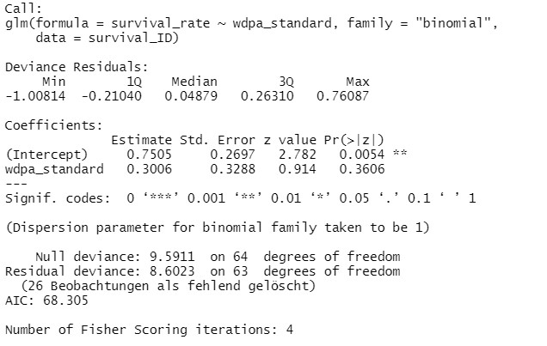
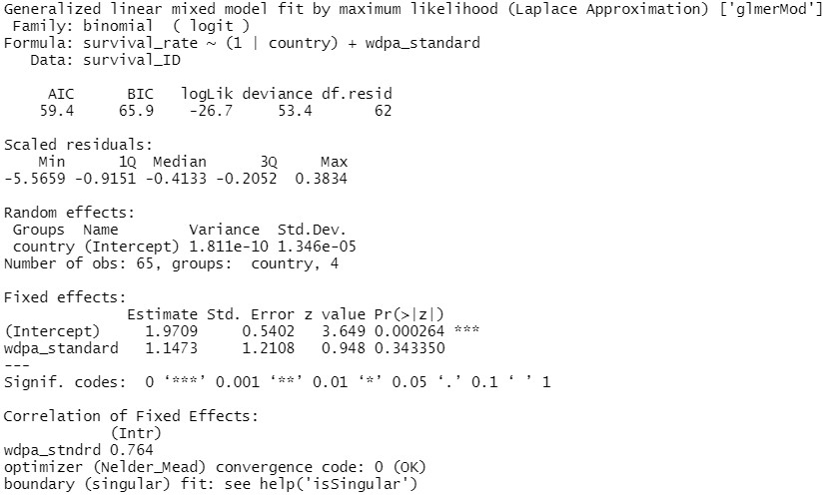
Preliminary Results: First Linear Models
Survival ~ Protected areas
Survival ~ (1|country)+ Protected areas
Notes:
11 studies mentioned mean pack sizes.
8 in North America (7.01,) 3 in Europe (5.97).

Slide 9
Next steps
Run more linear mixed models
Maybe rather sort by population than country
Further specify hypotheses
Create plots of outcome from linear models
Finish writing thesis
Notes:
11 studies mentioned mean pack sizes.
8 in North America (7.01,) 3 in Europe (5.97).

