Slide 1
Optimal route: An algorithm that simplifies the distribution of merchandise
Juan Diego Gutierrez
Carla Daniela Rendón
Medellín, 1/11/2018

Slide 2
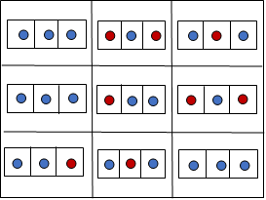
Data Structures
Figure 1
For the design of the data structure, first we apply a matrix of arrays; to divide the map into different quadrants. Clients and recharging stations that belong to a quadrant will be stored in an array
To each vehicle we assign a quadrant to travel, where the vehicle will visit all customers in that quadrant including charging stations, we apply a greedy algorithm in each quadrant to travel the nodes
Figure 1: A matrix of arrays, where the blue nodes are clients and the red nodes are load stations

Slide 3
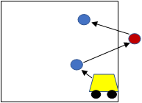
Algorithm and Complexity
OPERATION | COMPLEXITY
Read the file | O(N), N being the number of lines
Divide into Quadrants | O(N), N being the number of vehicles
Create Quadrants | O(N x M), N being the rows and M the columns
Create Node | O(1)
Add Node | O(N), N being the index in the array where the node is stored
Travel | O(N x M x P), N being the rows, M the columns and P the number of nodes in the array
Calculate Distance | O(1)
Calculate Time | O(1)
Finish Travel | O(N), N being the number of clients in the quadrant
Add Routes | O(N), N being the index of the array where the node is stored
Print Routes | O(N), N being the number of quadrants
Print Time | O(1)
Figure 2
Figure 2: The possible cases that can occur when a car travels its quadrant
Table 1: Time complexity of the algorithm.

Slide 4
Algorithm design criteria
We decided to apply this data structure because we consider that it is optimal to solve the problem. In the given problem we have a map with many nodes, applying directly a greedy algorithm, it would not be the most efficient solution, but, by dividing the map into quadrants, we create smaller maps where we reduce the number of nodes, optimizing the execution of greedy algorithm, applying it to quadrants with few nodes.
Also in our data structure we implement an algorithm that optimizes the division of the map into quadrants, calculating the two closest factors that multiplied give us the number of quadrants.

Slide 5
Table of the Time Execution
Number of Vehicles | Execution Time
6 | 1068 ms
20 | 2001 ms
42 | 2069 ms
100 | 2015 ms
200 | 2070 ms
300 | 2082 ms

Slide 6
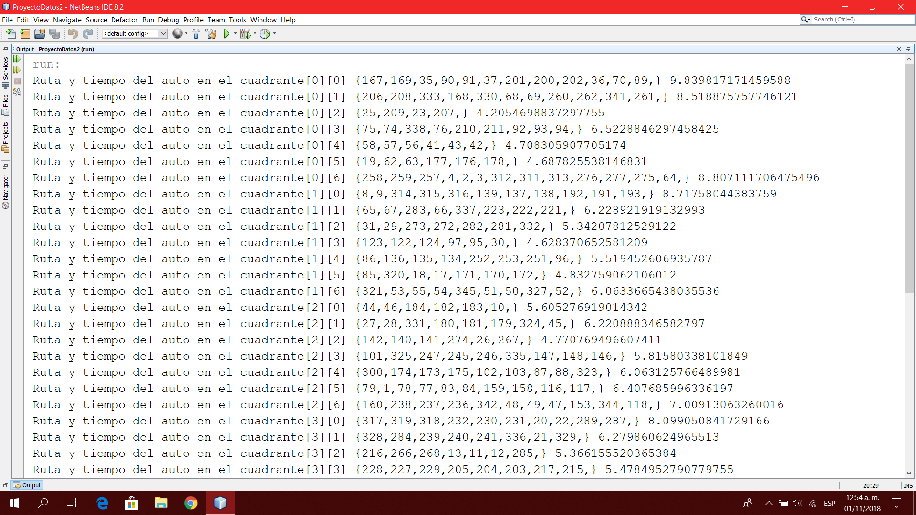
Software prototype

