Slide 1
Beyond Official Statistics
Predicting sovereign debt crises with macro data, satellite nightlights, and news text
COUNTRIES
MAIN AP
BEST AUC
129
0.519
0.904
Low- and middle-income economies
Macro + Satellite validation
All Features robustness model
Team: Jinen Wang, Levi Liu, Wuhao Xia, Chenyi Jiang
Columbia SIPA - DSPC7100 Applying Machine Learning - Spring 2026

Slide 2
Problem and Data
Official crisis-warning systems depend on statistics that arrive late, are revised, and can be strategically reported by distressed governments.
World Bank WDI
VIIRS Nightlights
GDELT News Text
GDP growth
Inflation, reserves, debt
Official baseline
Observed activity proxy
Growth and volatility
GDP-light divergence
Media tone
Conflict and protest events
Debt and IMF mentions
Unit: country-year panel, 2000-2023. Target: crisis onset within the next three years.

Slide 3
Approach
Strict lag-only features: no current-year macro, satellite, or text values enter the model.
Nested XGBoost specifications quantify the incremental value of satellite and text signals.
LASSO provides a sparse, interpretable baseline.
SHAP, fairness audit, and misreporting index support interpretation.
Validation design
Train: years through 2018
Out-of-time validation: 2019-2020
Rolling-origin checks across five historical windows
2021-2023 is right-censored under a three-year target
FEATURE BLOCKS
MODELS
92
4
candidate lag-only features
nested XGBoost specs

Slide 4
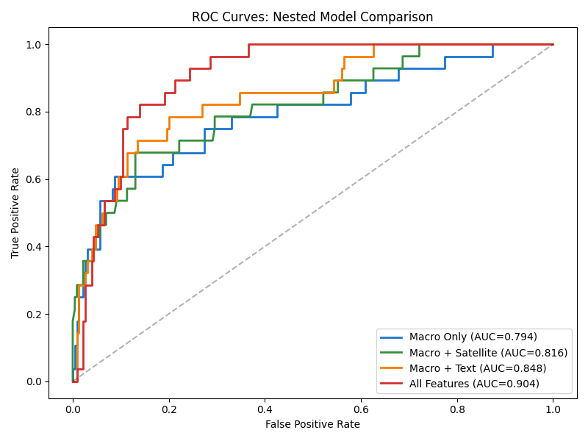
Results
MACRO ONLY AP
MACRO + SATELLITE AP
ALL FEATURES AUC
ROLLING MEAN AP
0.461
0.519
0.904
0.366
official baseline
preferred main model
robustness model
Macro + Satellite
Main interpretation
Satellite signals deliver the most stable improvement in rare-crisis precision.
Text features add signal, but performance is less stable across windows.
All Features ranks well by AUC, but average precision is weaker than Macro + Satellite.

Slide 5
Next Steps
What we have now
Most valuable next steps
A reproducible multimodal early-warning pipeline.
A country-level misreporting index requested in TA feedback.
Fairness diagnostics and region-specific threshold checks.
A transparent account of sensor, text, and label limitations.
Extend crisis labels through 2026 for a clean 2021-2023 test.
Harmonize DMSP and VIIRS to recover a longer satellite history.
Validate misreporting flags with IMF Article IV and case evidence.
Use the model as decision support, not automated surveillance.
Bottom line: alternative data helps, especially satellite nightlights, but the responsible claim is predictive early warning with transparent limitations.

