Slide 1
Price elasticity of supply

Slide 2
What factors determine the extent to which the quantity supplied for different goods and services changes in response to movements in selling price.
Firms will adjust their supply of a good or service in response to changes in the selling price.
Following a rise in the price, which of the following businesses will find it easiest to raise their output levels?
car manufacturers
bespoke shoe producers
coffee producers.

Slide 3
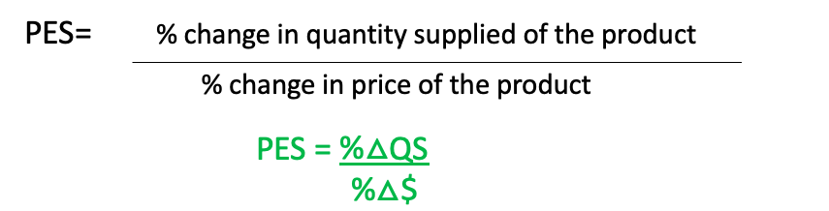
Key term: Price elasticity of supply
A measure of the responsiveness of quantity supplied to changes in price. When the price of a good or service changes we would also expect a change in the quantity supplied BUT not a change in supply – i.e a movement along the supply curve not a shift in the supply curve.
The degree to which the quantity supplied changes depends on the price elasticity of supply for the product, measured by the formulae:
% change in quantity supplied for the good or service / % change in the price of the product.

Slide 4
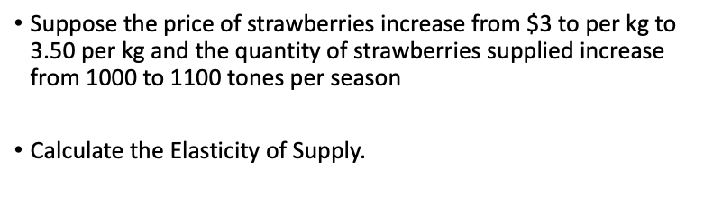
$3 → $3.50
1000t → 1100 t
3.5-3/3 = % change in price
1100 - 1000/1000 =% change in QS
PES = 1/10 (QS) divided by ⅙ (P)
PES = 0.6 (inelastic)

Slide 5
Range of price elasticity of supply (PES) values
Goods and services with a PES value > 1 and < infinity are PES elastic (i.e a top heavy fraction). Following a change in the price of a good or service then the % change in quantity supplied for the product is greater than the initial % change in price.
Goods and services with a PES value < 1 and > 0 are PES inelastic (i.e a bottom heavy fraction). Following a change in the price of product the % change in quantity supplied for the good or service is less than the initial % change in price.
Goods and services with a PES value = 1 have unitary elasticity. Following a change in price the resulting % change in quantity supplied will be equal to the % change in price.

Slide 6
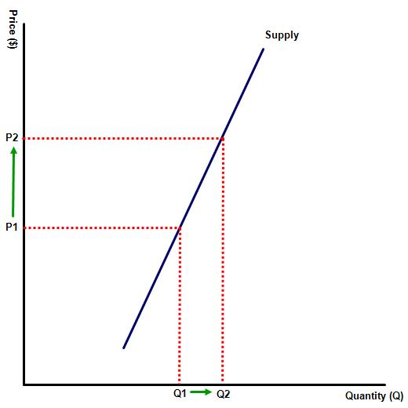
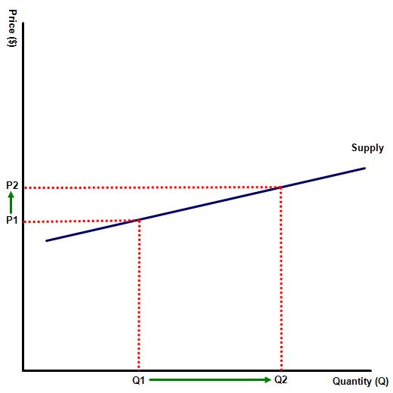
The following diagrams illustrate the supply curve for two products, one represents a firm producing children's toys and the other an olive farmer. Which is which?

Slide 7
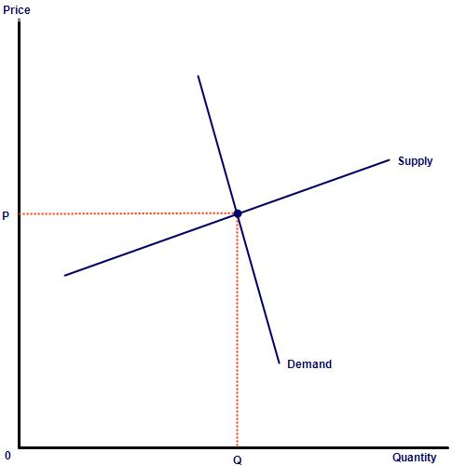
Activity : A comparison of two businesses
Diagram 1 illustrates the market for children's toys, or indeed many manufactured products.
(a) Illustrate on the diagram a rise in demand for children's toys. Draw the new equilibrium.
(b) Following the rise in demand for their product, how is the factory owner likely to change her production levels in response to both higher demand and higher prices?
(c) How easy will this be for the factory owner, presuming that skilled labour and sufficient raw materials are available to increase production levels?

Slide 8
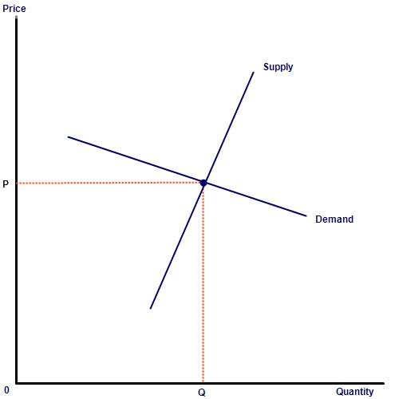
A comparison with the olive farmer
Diagram illustrates the market for olives, or indeed many agricultural or primary products.
(a) Illustrate on the diagram a rise in demand for olives. Draw the new equilibrium.
(b) Following the rise in demand for his olives, how is the olive farmer likely to change his production levels in response to both higher demand and higher prices?
c) How easy will this be for the farmer?

Slide 9
Other determinants of PES
Describe the impact of the following on the level of PES for any good or service.
(a) The degree to which costs rise in response to changes in output
(b) The level of unused capacity in the production unit
(c) The degree of mobility of the necessary factors of production
(d) The ability of the business to store stock or other raw materials

Slide 10
Activity investigation
Investigate how long it takes to produce the following items:
a Toyota car
coffee (from planting the original tree to drinking your first cup)
drilling for oil
bespoke suit.
Explain the likely impact of your findings on the price elasticity of supply?

Slide 11


Slide 12
Questions: (HL)
1. Using the formulae % change in supply / % change in price, calculate the PES elasticity of the following goods and services and state whether each is PES elastic, inelastic or PES unitary:
a. Price goes from 50 TL to 90 TL forcing supply to increase from 60 units to 100
b. Supply rises from 10 – 20 following a rise in price from 10 TL to 50 TL
c. Price falls from 100 – 50 and supply is unchanged
d. Supply rises from 10 – 30 when price rises from 100 TL to 110 TL

Slide 13
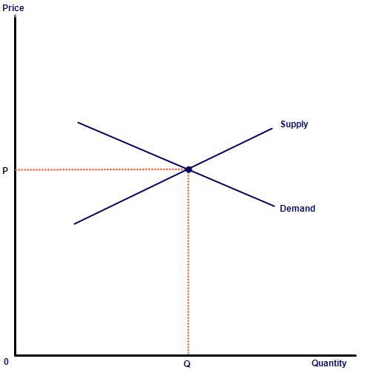
Assign each of the following products to one of the following PES and PED curves - ski equipment, bespoke shoes, diamonds, tickets for a football stadium, cheap T-shirts and bread:

Slide 14
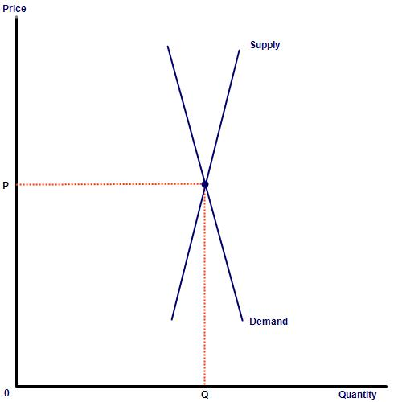

Slide 15
