Slide 1
Chapter 13

Slide 2
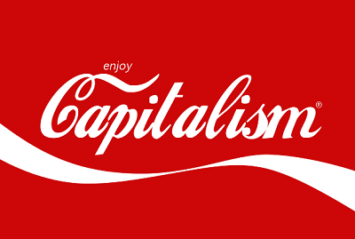
Quiz on google classroom
Free market economies
What goods and services are produced?
In a free market economy, consumer sovereignty decides what goods and services are produced. Consumer sovereignty refers to the ultimate power of the consumer in the economy to determine resource allocation.
If consumers demand a particular good resources will be allocated to produce the product as entrepreneurs see the opportunity to make a profit from selling it to consumers.
This process takes place through the price mechanism, which is the communication system that exists between consumers and producers in a free market economy

Slide 3
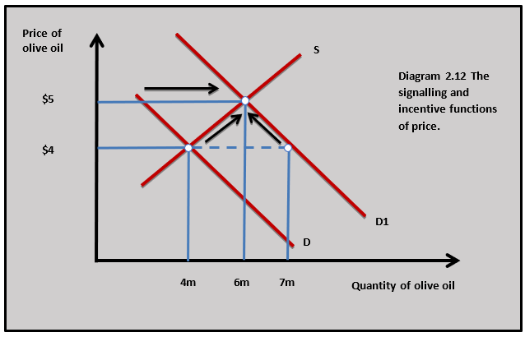
Functions of the price mechanism

Slide 4
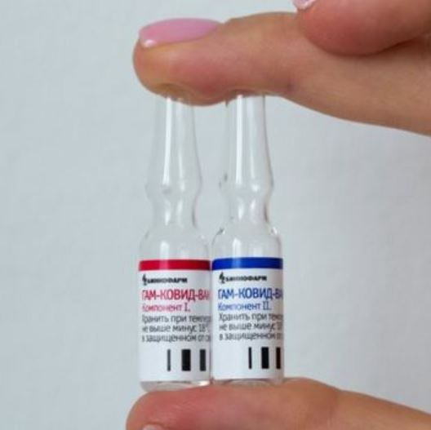
Producing enough Covid19 vaccine to meet demand is going to be a challenge all over the world. It requires an unprecedented level of coordination between scientists, pharmaceutical companies and governments. Left to itself the market could find a solution. High demand and limited supply would drive up the price of a vaccine to level where everyone who is willing and able to pay for the vaccine will get it.
The vaccine could be rationed by the price mechanism. But this raises some important issues.
The vaccine may well go to wealthy people in rich countries which may leave little available to poorer people in different countries and in ELDCs.

Slide 5
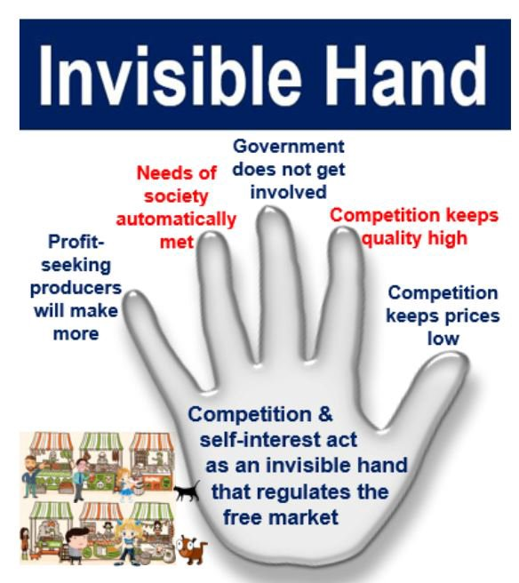
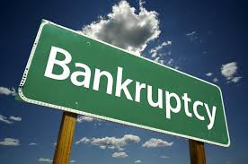
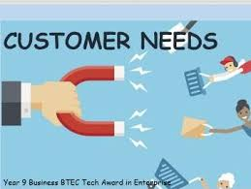



Slide 6
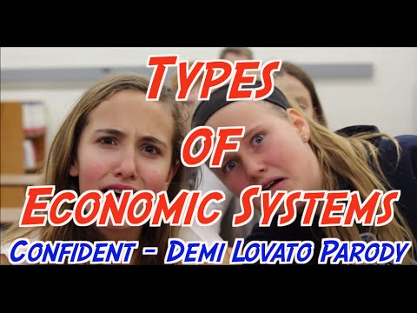

Slide 7
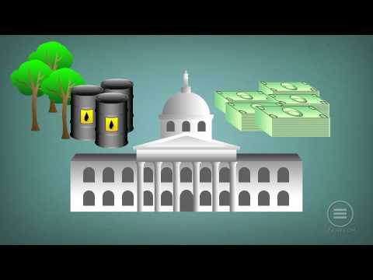

Slide 8




Explain why nations abandoned the traditional economics model
Place the following nations on the arrow diagram below:
Canada, France, Venezuela, Hong Kong, N. Korea, USA, India, Cuba, Sweden
Free market system Mixed economic system Planned economic system
Why do we have no pure market economics ?
N. Korea

Slide 9
Free market system
Advantages of the economic system
Disadvantages of the economic system
Group 1
Rachel, Ahza,John,Farrall, Darren
Group 2
Angela, Kevin, Mikha, Jewel, Nadine
Group 3
Carl, Syarah,Alexandra,Priscillia
Group 4
Jessica, Yolanda, Felicia,Jesslyn,Ryan
Group 5
Khaiser, Jovian, Audrea, Dustin,Dexion

Slide 10

Mixed Market

Slide 11
The video describes four smart phone applications which allows suppliers and consumers to meet - Feastly, Uber and Airbnb
In small groups prepare a short presentation on one of these services and decide whether the service provides a cost or benefit to the society where they operate. Responses must consider a range of customers including:
customers
suppliers
the government
traditional suppliers of the services such as taxi drivers and take away food outlets.

