Slide 1
Price elasticity of demand
SEC 3

Slide 2
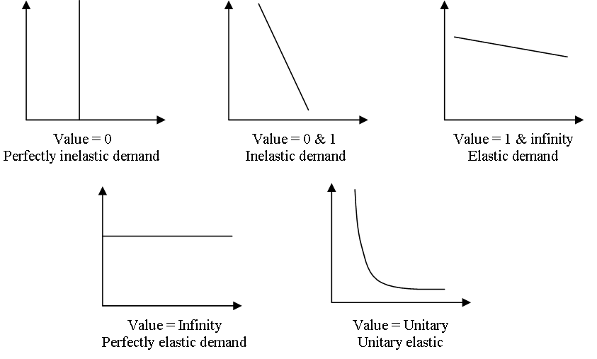
Graph 1
Graph 2
Graph 3

Slide 3
a. Following a rise in price of 10%, I would reduce my consumption of the product by more than 10%.
b. Following a rise in price of 10%, I would reduce my consumption of the product by less than 10%.
c. Following a rise in price of 10%, I would reduce my consumption of the product by about 10%.

Slide 4
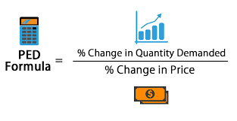
Examples of PED elasticity
1. A good sees a 10% rise in quantity demanded in response to a 5% fall in price. This would be expressed by the equation 10 / 5 = 2 (elastic PED)
2. Quantity demanded for a service rises by just 2% in response to a fall in the price of the service of 20%. This would be expressed by the equation 2 / 20 = 0.1 (PED inelastic)
3. When the price for a good rises from £ 5 to £ 6, quantity demanded for that product falls by 20%. This would be expressed as 20 / 20 = 1 (unitary elasticity).

Slide 5
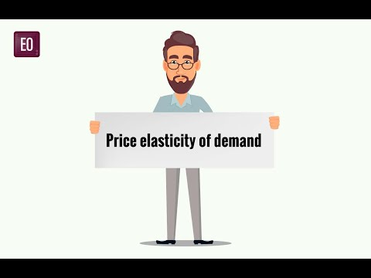

Slide 7
1. Calculate the PED for each product, and then comment on your result.
(a) The price of a camera is valued at $150, and the quantity demanded at this price is 4 million units. During the end of year sales the shop reduces the price to $130 and as a result the quantity demanded rises to 6m.
(b) The same shop sells batteries for their cameras for just $1, and the quantity demanded is 10 million. Following a price rise to $1.10 the quantity demanded falls to 9,500,000 units.
(c) The same shop also sells flash lights for $5, and the quantity demanded at this price is 2 million units. Following a reduction in the selling price $4.50, quantity demanded rises to 2.2m

Slide 8
% change new -old /old
6 less 4/4 = 50%
130 less 150/150 = 13%
50%/13% =PED of 3.84

Slide 9
Orhan Bufe is a snack and sandwich shop, operating in the popular Blue Mosque area of the city, where there are many similar businesses operating. Its fastest selling products are hamburgers, cheese toasties and shish kebabs. These products currently sell for the following prices: hamburgers 10 TL, cheese toasties 8TL and the shish kebab, the Bufe’s signature dish sells for 12 TL. In 2018 the firm sold 10,000 hamburgers, 15,000 cheese toasties and 40,000 shish kebabs.
In an attempt to try and improve revenue the owner Orhan Uluturk decided to increase all prices by 10%. Market research gained from other similar shops in the area suggests that the price elasticity of demand for each product is:
Hamburger: (-) 1.5; Cheese toast : (-) 2.0; shish kebab: (-) 0.6
You have been asked to evaluate the planned price increases.
(a) Comment on the planned price changes.
(b) Would a 10% price reduction have been better for some or all of the products?
(c) What benefit (if any) would advertising bring to the firm?

Slide 10
Goods and services with a PED value > 1 (ignoring the negative signs) are ____________ (i.e a top heavy fraction) as the % change in quantity demanded is _________ than the initial % change in price.
Goods and services with a PED value < 1 are ___________ (i.e a bottom heavy fraction) as the % change in quantity demanded is ________ than the % change in price.
Goods and services with a PED value = 1 have __________ elasticity as the % change in quantity demanded is _________ to the % change in price.

Slide 11
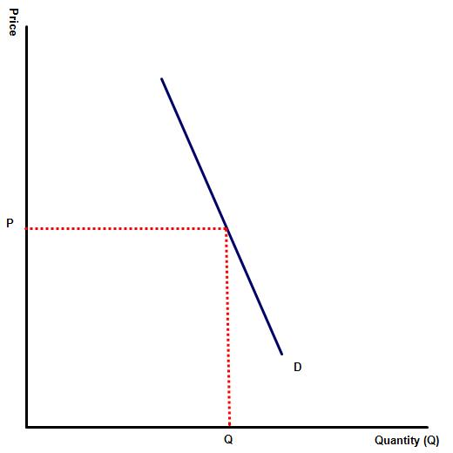
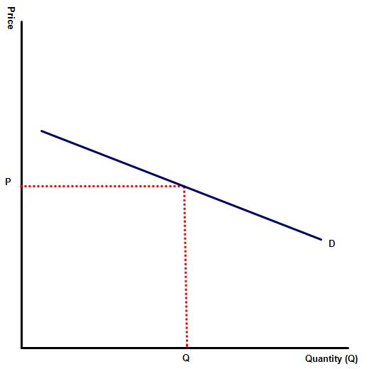
representing the demand for two products, bread and plasma televisions, which is which?

Slide 12
Explain how the following determine the level of PED for a good or service?
(a) Whether a good / service is a necessity or a luxury item?
(b) The number of substitutes that a product has?
(c) The number of compliments that a product has?
(d) The strength of the brand loyalty towards a product
(e) Explain why mobile phone providers and gym membership have a low PED inelasticity, despite there being a range of competing brands in the market.
(f) Why do high priced items such as designer clothing tend to more PED elastic than low priced items such as a printed T-Shirt.
(g) Explain the likely relationship between time and PED?
(h) Explain why goods purchased on a frequent basis e.g. phone minutes are more likely to have a lower PED than purchases made less frequently?
(i) Complete the sentence: If a good is broadly defined, i.e. the demand for petrol or meat. This will generally be PED __________. But specific brands of petrol or beef are likely to be more PED ______________ following a price change.

