Slide 1
Chapter 6
The role of Markets in allocating resources

Slide 2
Resource allocation
Because productive resources are scarce relative to human wants we must decide:
What to produce? | How to produce? | Who to produce for?
Should we use resources to produce as many consumer goods as possible or allocate some resources, for example, to build new roads or to provide better health care? | What tools and machinery will be needed? How many workers will be required and what skills will they need? Is it cheaper to employ more labour or more machinery? Types of resources? Renewable ? | Should people in the greatest need get the goods and services they require? Or should they be produced for people who can pay the most for them? What price should they pay?

Slide 3
Economic systems
Who in an economy decides what goods and services to produce, how to produce them and who to produce them for, and how are these decisions are made?
Looking What to produce
Market economy | Mixed economy | Planned economy
Who? Private sector firms and consumers How? The price mechanism | Who? Private sector firms and consumers, and a government How? The price mechanism and government planning | Who? Government How? Government planning

Slide 4
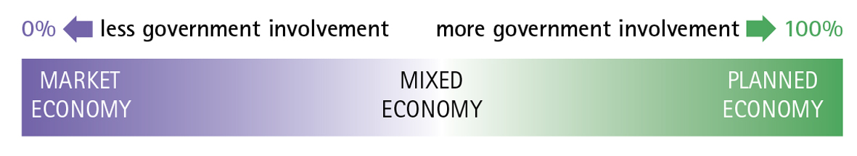
Economic systems
Bahamas
Singapore
Argentina
Mauritius
Nepal
Paraguay
Denmark
France
Italy
Sweden
UK
Many developed economies
China
Cuba
North Korea

Slide 5

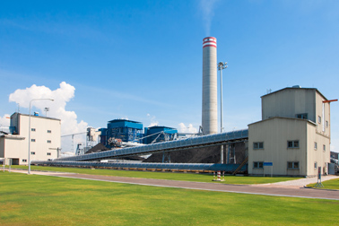
The market economic system
Consumers
Private sector producers
Goods and services
Money
Consumption
Exchange
Production
In a free market economic system all decisions are taken by private sector organizations and individuals. There is little or no role for government or a public sector and therefore little or no taxation or public spending.

Slide 6
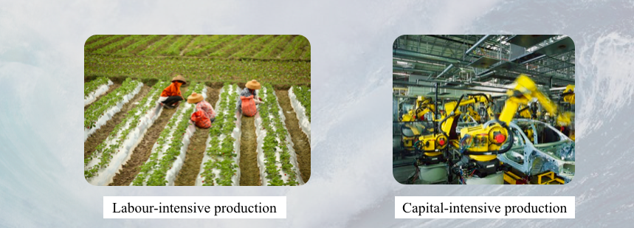

Slide 7
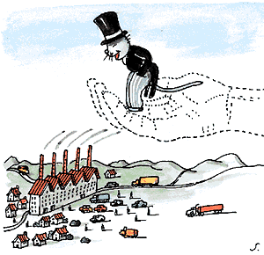
The role of the price mechanism
Resources are allocated and re-allocated in response to changes in price
If there is an increase in the price of a good due to an increase in demand for the good there is a signal to the producers
The price signal tells producers that consumers wish to buy this good
We assume that producers are rational and wish to maximise their profits
There is an incentive for them to produce more
Producers reallocate more resources to those goods where the demand is highest (they will make more profit)
There is not central planning agency
Adam Smith said it was like there was an invisible hand moving the factors of production around to produce the goods and services wanted by the buyers in the economy
Price mechanism = the forces of supply and demand

Slide 8



The Price Mechanism
Prices as the Allocating mechanism in the market economy
Wow, we keep selling out of brown bags, let's raise the price!
Yeah, and we better lower the price of black bags!
If only they'd make more brown leather handbags!
Price of brown bags rises, other colors must get cheaper to sell
More brown bags are made available to buyers
Looks like the money's in brown these days, PRODUCE MORE!
Orders for brown bags rise while they fall for black bags
More brown bags are made and provided to the market

Slide 9
The price mechanism
A market is any set of arrangements that brings together all the producers and consumers of a good or service so that they can engage in exchange.
Market price and quantity traded
Consumers consume goods and services to maximize their utility (satisfaction)
Private firms produce goods and services to maximize their profits
As consumer demand for a product rises
MARKET PRICE RISES
Production becomes more profitable, so producers increase output
As consumer demand for a product falls
MARKET PRICE FALLS
Production becomes less profitable, so producers reduce output

Slide 10
The function of Price
The price mechanism is based on the law of supply and demand
1. Signalling function
Prices send signals to both consumers and producers
Prices perform a signalling function – they adjust to demonstrate where resources are required, and where they are not.
Prices rise and fall to reflect scarcities and surpluses
2. Rationing function
Prices serve to ration scarce resources when demand in a market outstrips supply.
When there is a shortage, the price is bid up – leaving only those with the willingness and ability to pay to purchase the product.
3. Transmission of preferences/incentive function
Through their choices consumers send information to producers about the changing nature of needs and wants
Higher prices act as an incentive to raise output because the supplier stands to make a better profit.
When demand is weaker in a recession then supply contracts as producers cut back on output.

Slide 11
Functions of price
Coffee market with demand & supply and market in equilibrium
Assume there is an higher demand of coffee.
Supply can not meet demand immediately they will raises their price of coffee signalling shortage in the market.
Given that the price increase of coffee some consumers can not afford the coffee thus rationing giving decrease in demand.
Increase in price of coffee and forecasts of future profits act as incentive to other suppliers to increase supply of coffee leading more supply of coffee and more no shortage.
This could to other factors of productions eg labour ⬆ to hire more workers to supply coffee the ⬆ wages signalling the shortage.
With ⬆ wages some firms cannot hire employees rationing/reallocating
The ⬆ in wages will act as incentive of workers to move into the area
Notes:
The equilibrium price of a good is:
a price at which quantity supplied equals quantity demanded.
a price at which excess demand equals zero.
At the equilibrium price there is no net tendency for price to change.

