Slide 1

top 5 zip codes Investment Analysis
Carrie Liu | 04/01/2022

Slide 2

OVERVIEW
Objective: To select the top 5 zip codes in NY and predict their respective return of investment
Our Approach:
Data: Zillow Research
To select the top 5 zip codes with a certain criteria
To establish time series modeling with ARIMA to forecast the monthly return (i.e. home values)
Review Period: 01/31/2000 – 02/28/2022

Slide 3
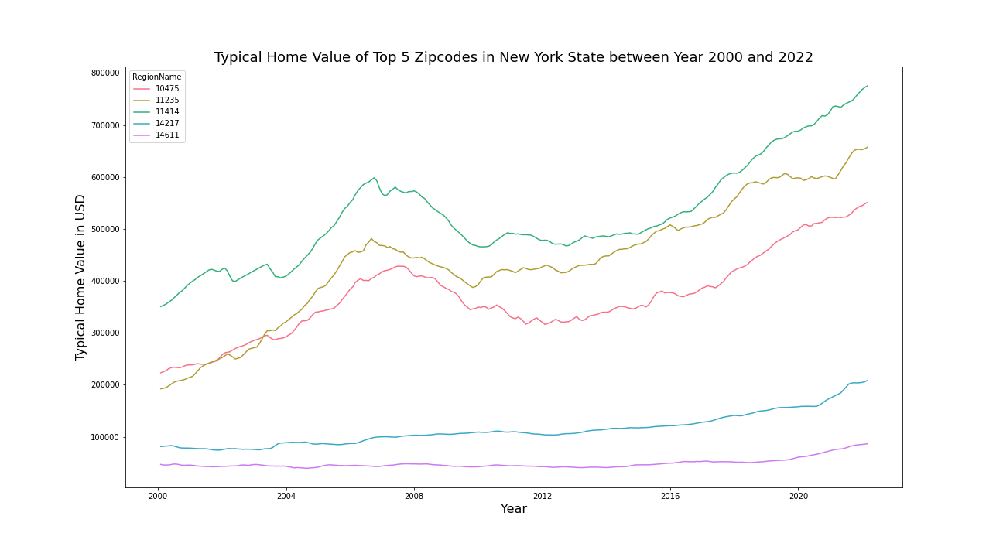
5 ZIPCODES
State: NY
Typical Home Value: ZHVI
Urbanization: Top 25% of SizeRank
Total Growth Rate: 2009 - 2020
Diversification: Different County

Slide 4
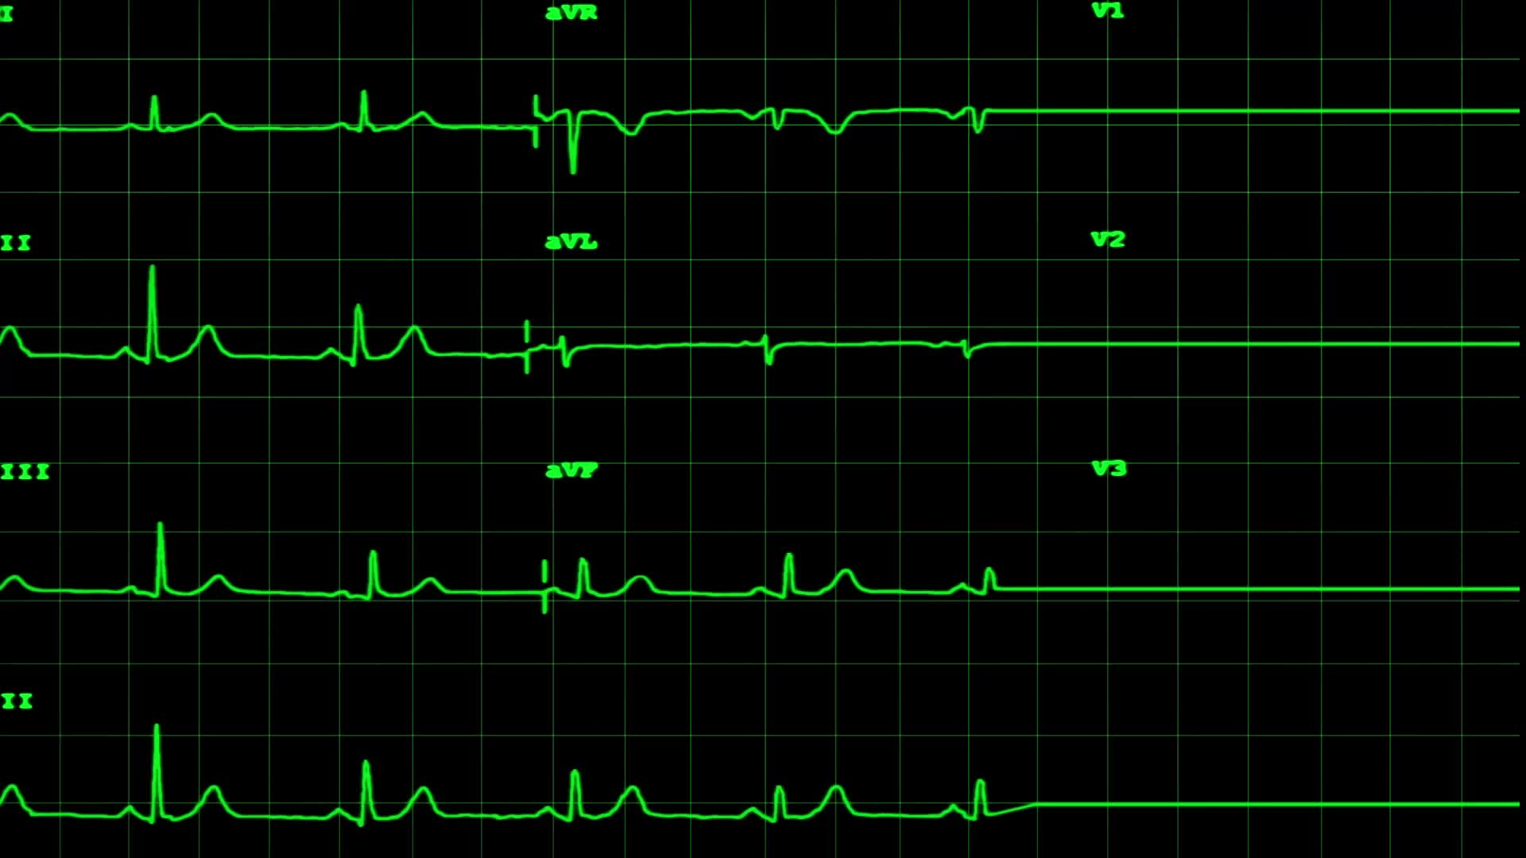
TIME SERIES MODELING WITH ARIMA
Stationarity Check
rolling mean shows a trend
rolling standard deviation
Dickey-Fuller test
Autoregressive integrated moving average – ARIMA
ACF-PACF (Autocorrelation – Partial Autocorrelation Function)
Parameters selection: AIC (Akaike Information Criterion) as Regularization Measure
Validation with the MSE (Mean Square Error):
One-step Ahead Forecasting
Dynamic Forecasting

Slide 5
FORECASTING
ZIP CODE | CITY | 1-YEAR ROI | 3-YEAR ROI | 5-YEAR ROI | 10-YEAR ROI
11235 | Brookly | 5.60% | 18.09% | 32.05% | 74.63%
14217 | Kenmore | 6.62% | 16.50% | 27.26% | 58.72%
10475 | Bronx | 4.49% | 13.51% | 23.31% | 51.67%
11414 | Queens | 3.87% | 11.68% | 20.06% | 43.85%
14611 | Rochester | 4.03% | 10.29% | 16.92% | 35.30%
Note: The 5 zip codes are ordered by 3-year ROI (descending).

Slide 6
NEXT STEPS
We need to consider other external factors to improve the models and ultimately the quality of the forecasts.
The factors to be further taken into consideration are:
Historic Event: financial crisis / pandemic
Macro Economics: interest rate (mortgage rate, our client will apply leverage to their investment)
House Market Safety Score: given the hate crime is severe in the New York City, the safety will be a key concern when people buy the houses.

Slide 7

Thank You!

