Slide 1
Roadmap to Accelerate AI Strategy for Higher Education CIOs
Gartner for IT Leaders Toolkit
Notes:
Ver 2024-1204
Presenter's Name
Presenter's Name

Slide 2
AI strategy is about setting the vision and goals of what an organization wants to achieve with AI, in alignment with the institutional strategy.

Slide 3
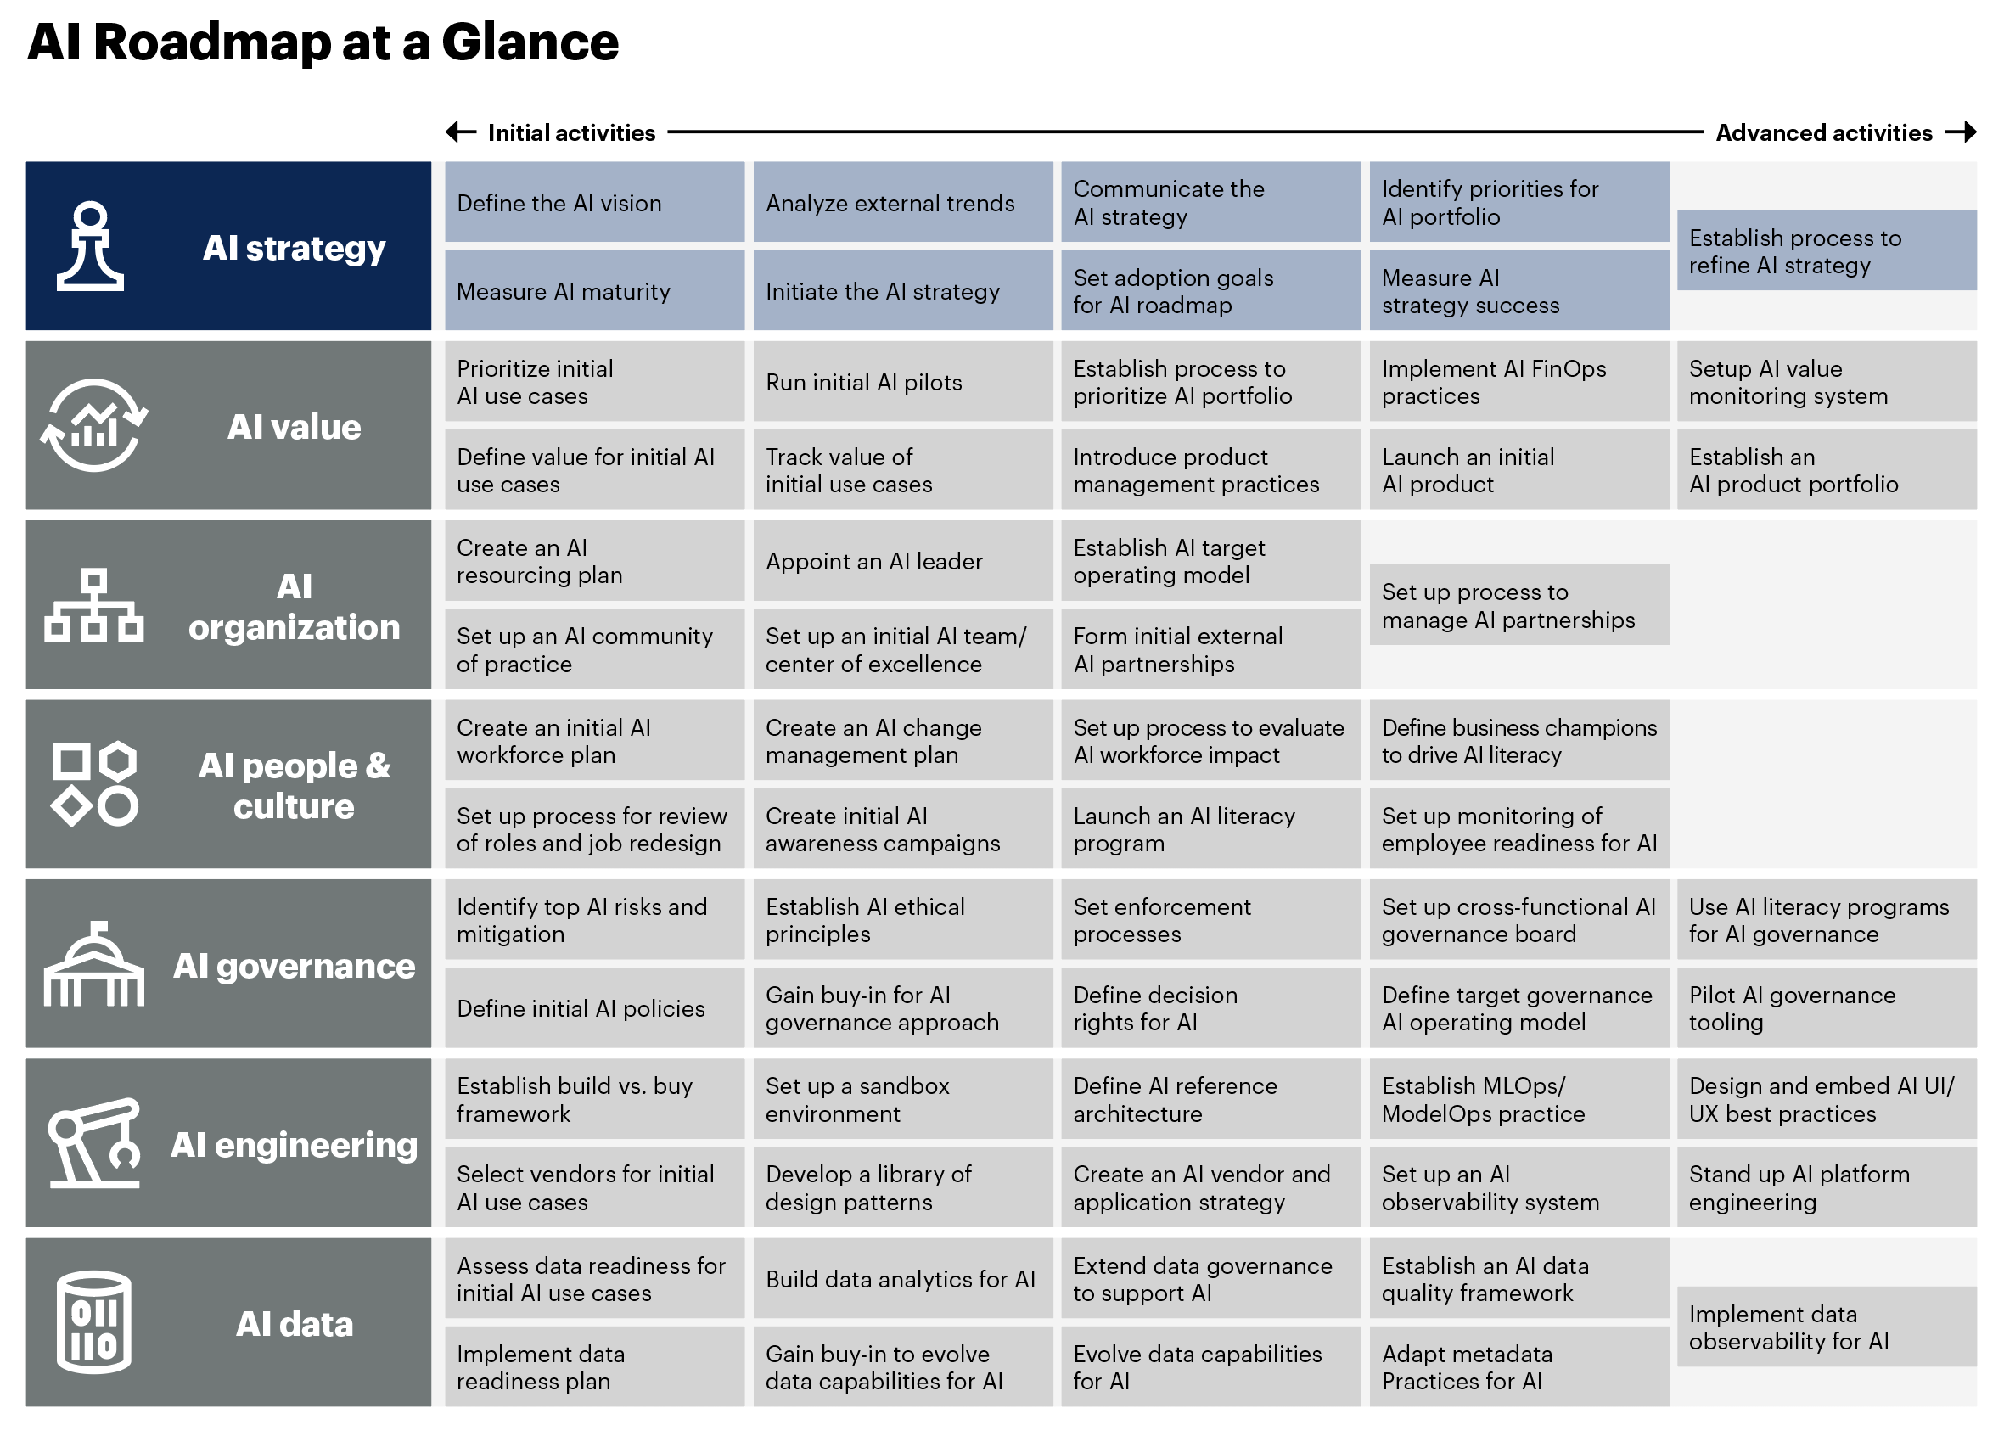
Accelerating Strategy Development
Gartner’s Toolkit: Build Your Organization’s AI Roadmap provides key guidance for CIOs.
The AI strategy is the first step in developing a comprehensive AI roadmap​.
Many of the initiatives and priorities identified during strategy development will feed into other roadmap activities. ​

Slide 4


AI Strategy Roadmap
AI strategy
Define the
AI vision
Note
The focus of this toolkit is to help you:
Define the AI vision
Initiate the AI strategy
With industry-specific examples and insights to accelerate your organization’s progress in preparing an AI strategy.
Measure AI maturity
Analyze external trends
Initiate the AI strategy
Communicate the
AI strategy
Set adoption goals for AI roadmap
Identify priorities for AI portfolio
Measure AI strategy success
Establish process to refine AI strategy
See Toolkit: Build Your Organization’s AI Roadmap for detailed descriptions of the key tasks in the activity.

Slide 5
Define the AI Vision
The AI vision is informed by:
1
2
3
Technology trends that are shaping investments
Business outcomes
and priorities critical to achieve through
technology investments
Your AI pace and ambition that define how fast and how far you want to go with AI
5 © 2025 Gartner, Inc. and/or its affiliates. All rights reserved.

Slide 6



Examples of AI Vision: Higher Education
Implications for AI Vision
“Students will gain skills, guided by personalized AI experiences, ensuring they graduate not just job-ready, but future-ready.” — Seneca Polytechnic
AI is a consistent theme within global higher education institutional strategies.
Higher education visions typically focus on how an AI strategy may impact research, teaching, learning and administrative efficiency.
Many early activities have failed to scale up from proofs of concept without a robust and sustained linkage to institutional goals.
Ensure your AI strategy aspires to create measurable outcomes that advance organizational mission, goals and values.
“As organizations worldwide grapple with new regulatory obligations and ethical concerns, our mission is to provide innovative AI research and practical solutions.” — The Wharton School, The University of Pennsylvania
“To be a centre of excellence in AI research, AI education, and AI practice.” —National University of Singapore
Sources: Reimagining Higher Education: Seneca Polytechnic Set to Transform Postsecondary Learning With Integration of Microsoft Azure AI, Seneca Polytechnic; Advancing the Responsible and Trustworthy Use of AI in Business and Society, Wharton Accountable AI Lab; Corporate Overview, National University of Singapore (NUS) Artificial Intelligence Laboratory (NUSAiL)

Slide 7
2025 Technology Trends Shaping AI Vision: Higher Education
Trends
Implications for AI Vision
Financial resilience: Enrollment and government policy challenges
The higher education sector continues to reinvent in the face of cost constraints, policy changes, challenging student demographics, and emergence of new technologies.​
AI offers potential solutions, but appropriate institutional investment, technology maturity and AI literacy are required to succeed.
Identify and prioritize key use cases and leverage appropriate AI tools to support enterprise needs, including established AI and emerging GenAI technologies.​
Ensure institutional ambition and governance can help move AI from experimentation to scale.
IT operating models: Modernizing for efficiency and enhanced experience
Industry partnerships: Collaborating to increase research capacity and talent
Modernization capabilities: Reducing dependency on legacy infrastructure
Student experience: Personalizing teaching, learning and support services
AI roadmap: Evaluating and evolving institutional AI readiness
Source: Top Business Trends in Higher Education for 2025 and Top Technology Trends in Higher Education for 2025​

Slide 8
Business Outcomes and Priorities: Higher Education
Most critical outcomes from digital technology investments
Multiple responses allowed
Implications for AI Vision
Key target outcomes of AI in education include: ​
High-quality student experience ​
Productivity of staff and faculty
Impact and utilization of technologies and estate assets
Regulatory compliance and risk management
Enhanced efficiencies and new business development opportunities​ for research and teaching
Use AI to drive innovation by pursuing use cases, technologies and business models that are critical to institutional success.
n = 126 higher education CIOs and technology executives answering
Q. Thinking about your enterprise’s investments in digital technologies, which types of outcomes are most critical to your enterprise?
Source: 2025 Gartner CIO and Technology Executive Survey

Slide 9
Prioritizing Your Organization’s AI Pace
High User AI Adoption
AI Anarchy
AI Accelerated
Implications for AI Vision
AI initiatives present but with uncontrolled risks and spend
Aiming or evolving toward being AI first
Institutional AI pace of change will depend on two primary factors:​
Institutional ambition (and centralized investment)​
Institutional adoption by users​
Most higher education institutions are still in the early phases — AI cautious or even in some state of AI anarchy.​
Vendor development is frequently outpacing adoption, creating a tension between AI expectation and AI realities.
Low Institutional AI Ambition
High Institutional AI Ambition
AI Cautious
AI Steady
Minimal to no AI initiatives underway
Limited number of targeted AI initiatives
Low User AI Adoption
For more information on AI pace, see Pacing Yourself in the AI Races: 2024 IT Symposium/Xpo Keynote Insights
Notes:
Hold

Slide 10
Benchmarking Pace of AI Investments in Higher Education
Implementation stages of industry-specific generative AI use cases
Single response per row
Implications for AI Vision
97% of higher education CIOs have deployed or are planning to deploy GenAI in the next three years.ª
GenAI for personal productivity is the highest priority, with 96% of higher education CIOs having deployed or are planning to deploy in the next three years.
AI for assessment grading and feedback, AI virtual assistants (for student administrative support and personalized tutors), and AI-enabled research are also attracting significant higher education sector interest.
n varies; higher education industry senior IT and business leaders; excluding “don’t know/unsure”
Q. Thinking about generative AI use cases at your enterprise, please indicate the stage of implementation.
Source: 2024 Gartner Business Outcomes of Technology Survey
ª 2025 Gartner CIO and Technology Executive Survey, n = 123

Slide 11
Compare Your Organization With Peers and Leaders
Examples of AI in Higher Education
University of Sydney
Enabled AI acceleration by enabling educators to build AI “agents” to answer questions, provide feedback, give advice, explain concepts, do role plays and guide learning activities. Educators can tailor agents to courses and integrate them into learning management systems, ensuring support is accurate, relevant and aligned to course objectives.
York University
Launched a secure, scalable AI solution with a no-code, user-friendly interface that makes it accessible to all users. Enabled effortless integration of diverse knowledge sources into AI solutions to enhance system intelligence and ensure accurate, hallucination-free responses.
University of South Florida
Enabled Copilot for all users, created an M365 Copilot preview program and used MS Security Copilot to enhance IT security insights. Developed custom AI chatbots and AI-generated IT ticketing systems, while researchers are using high-performance computing resources, Microsoft Azure AI Hub and OpenAI Studio to develop AI applications and use fine-tuned LLMs for research.
Source: AI in Higher Education: Case Examples
Questions When Benchmarking
Who could you best compare your organization with at present (both inside and outside higher education)?
Who do you see as AI leaders who you most want to emulate in three to five years?
What is their approach to AI?
How would you classify their AI pace?
What can you learn from their position?
Are their AI ambitions and investments delivering appropriate return, user engagement and market impact?
What lessons can you learn from their approach?

Slide 12
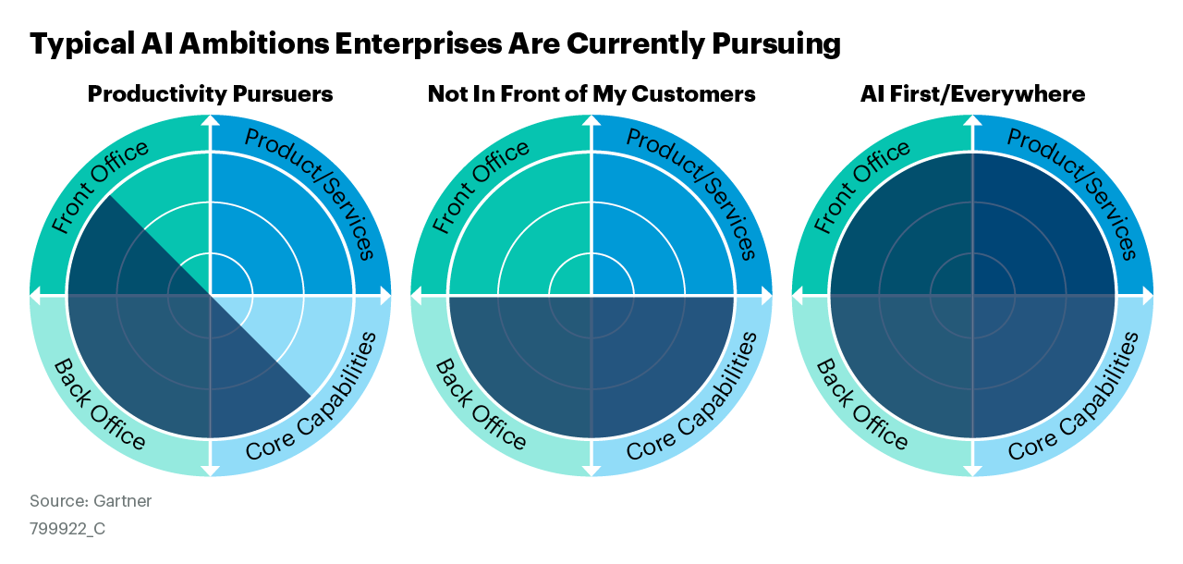
Decide Your Organization’s AI Ambition
Implications for AI Vision
For generative AI, most higher education institutions first prioritized internal-facing use cases, with a “not in front of my students” ambition. ​
Where appropriate governance isn't in place, student, staff and faculty use can lead to AI anarchy and a chaotic "AI everywhere" pattern. ​
Concerns around risk, bias, cost and return can drive institutions to focus on back-office use cases before exploring those that are business-critical and customer-facing.​
Regulatory/compliance needs, data quality, and risk of reputational damage remain key considerations for reviewing and resetting the AI ambition. ​
Focal areas where AI activities are initiated
Source: Toolkit: Workshop to Define Your Enterprise’s AI Ambition
Notes:
Keep figure as-is

Slide 13
Examples of AI Vision Statements for Higher Education
AI Anarchy
AI Cautious
AI Steady
AI Accelerated
“To uphold academic integrity and foster genuine learning, we aim to implement AI responsibly, ensuring its use enhances rather than replaces human thinking, while strictly regulating its application across all educational activities.”
“To implement AI solutions selectively, proceed with AI adoption at a measured pace, focusing on building foundational capabilities and understanding long-term impacts, while maintaining a strong focus on data privacy and security.”​
“To proactively adopt AI solutions that support education, research and administrative effectiveness, improving institutional efficiency and student satisfaction.”​
“To lead the higher education sector in AI-driven personalized education, research impact and operational efficiency, enhancing student outcomes and operational efficiency through appropriate AI technologies.”​

Slide 14
Initiate the AI Strategy
The AI strategy articulates:
1
2
3
AI priorities …
That are the most critical to your business goals
Portfolio of AI use cases …
Required to achieve AI priorities
Communications plan …
Provide consistent and interactive communications
14 © 2025 Gartner, Inc. and/or its affiliates. All rights reserved.

Slide 15
Link Business Goals to AI Priorities: Higher Education
Critical outcome | Supporting objective | Means to achievement | Example AI use case
Excel in customer experience. | Increase student engagement, persistence and outcomes. | Students leverage AI to understand concepts, prompt reflection and access additional resources for learning. | Personalized AI tutor
Increase human capital effectiveness or operating margins. | Increase staff and faculty throughput, speed, capacity and agility. | Students, faculty and staff leverage AI to enhance personal productivity, accelerate teaching content production, support program redesign and provide administrative support. | Personal productivity tools Teaching content creation Research assistant for literature reviews and grant proposal development
Generate revenue. | Evolve the institution to scale up student recruitment, enrollment, success and alumni donations. | Leverage AI within student support and advancement to nudge students and alumni toward actions that increase their enrollment and performance and institutional profitability. | Student engagement Fundraising

Slide 16
Build Your Portfolio of AI Use Cases
AI is an enabler of specific use cases for industries. This use-case comparison plots these use cases against business value and feasibility axes, inviting strategic conversations and driving investment decisions.
Review the use cases plotted on the graphic, comparing them with the maturity and requirements of your own organization.
Calculated risks offer medium to high business value but low to medium feasibility. They represent riskier options.
Likely wins offer both medium to high feasibility and business value, making them wins in most circumstances.​
Marginal gains offer variable feasibility but are defined by their low value, making them more-selective options.​

Slide 17
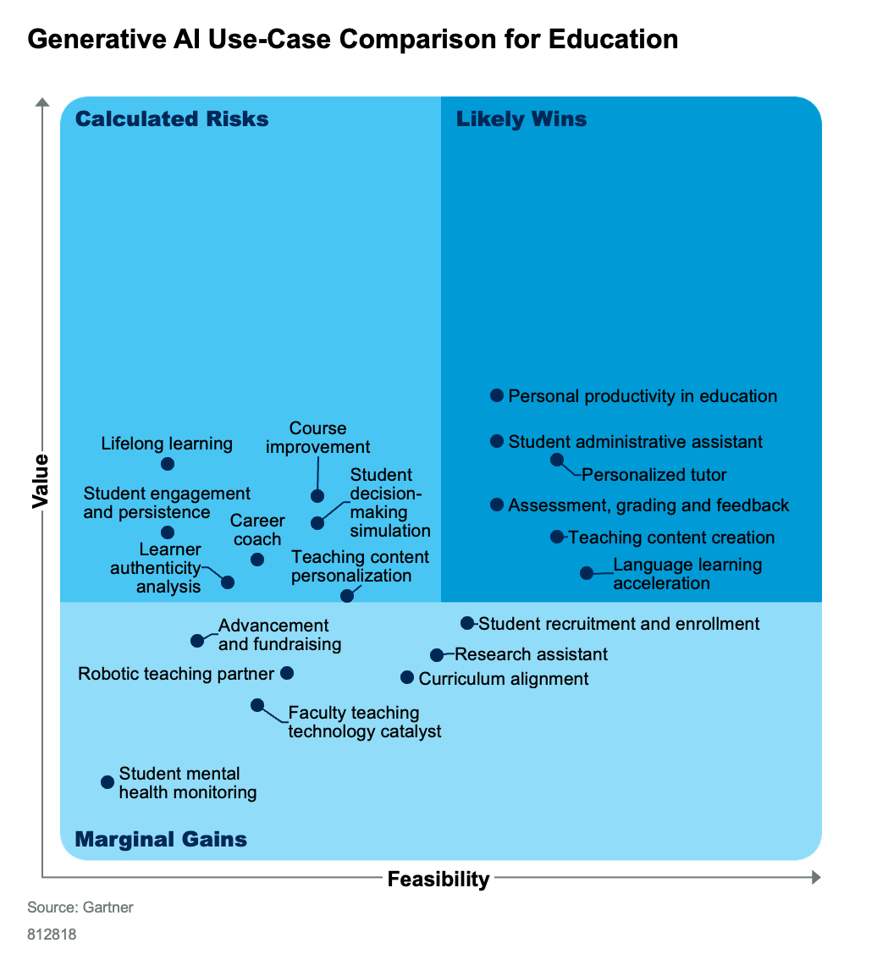
Use-Case Comparisons: Higher Education
Implications for AI Vision
Gartner publishes a use-case comparison for education that articulates value and feasibility of GenAI use cases.
This can be used to inform use-case selection, to identify feasibility, and to communicate likely impacts.
A toolkit is also available to customize your own use cases, value and feasibility scoring.
Education institutions must evaluate each use case being considered to thoroughly understand ROI, how it will be achieved and feasibility of achieving it in a timely and ethical manner.
Source: Generative AI Use-Case Comparison for Education

Slide 18
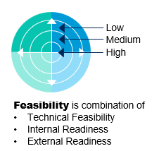
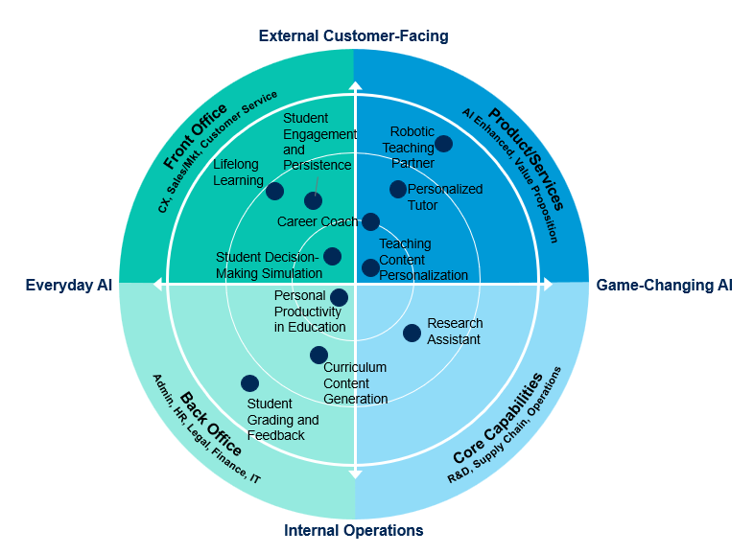
Map AI Ambition to Use Cases: Higher Education
Implications for AI Vision
This opportunity radar is populated with sample GenAI use cases ranking them on feasibility, whether they are game-changing or everyday AI, and if they support customer-facing or internal operations.
Most higher education institutions prioritize internal operational GenAI use cases, but some institutions are seeking evaluating game-changing GenAI use cases such as research assistants and institutionwide AI platforms.
The opportunity radar can be used to map and support stakeholder communication and collaboration around AI use cases to align with your organization's AI ambition.
Source: AI Opportunity Radar: Define Your Retail ‘AI Ambition’ to Focus on the Right Use Cases
Notes:
One for now

Slide 19
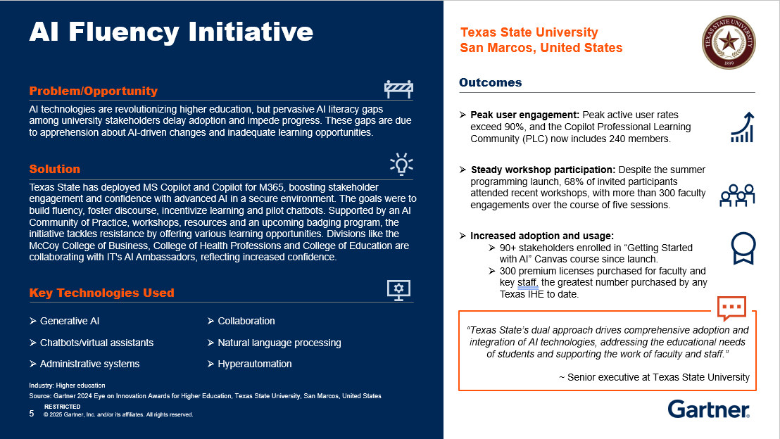
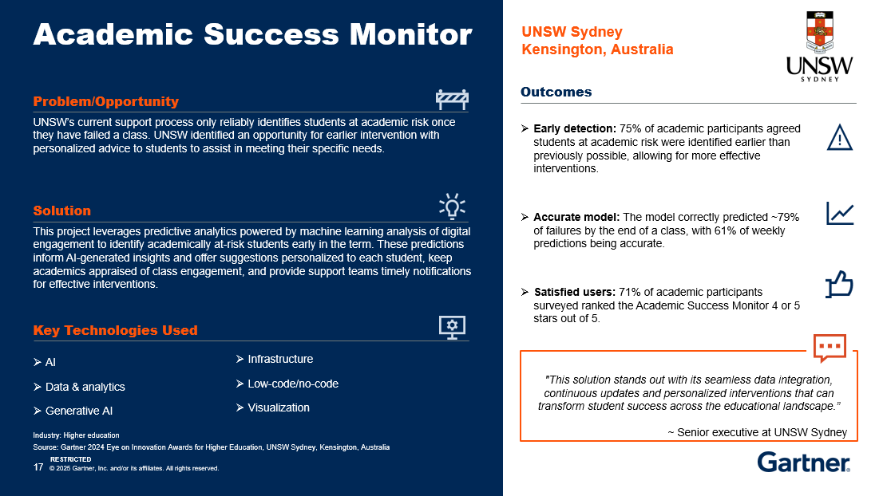
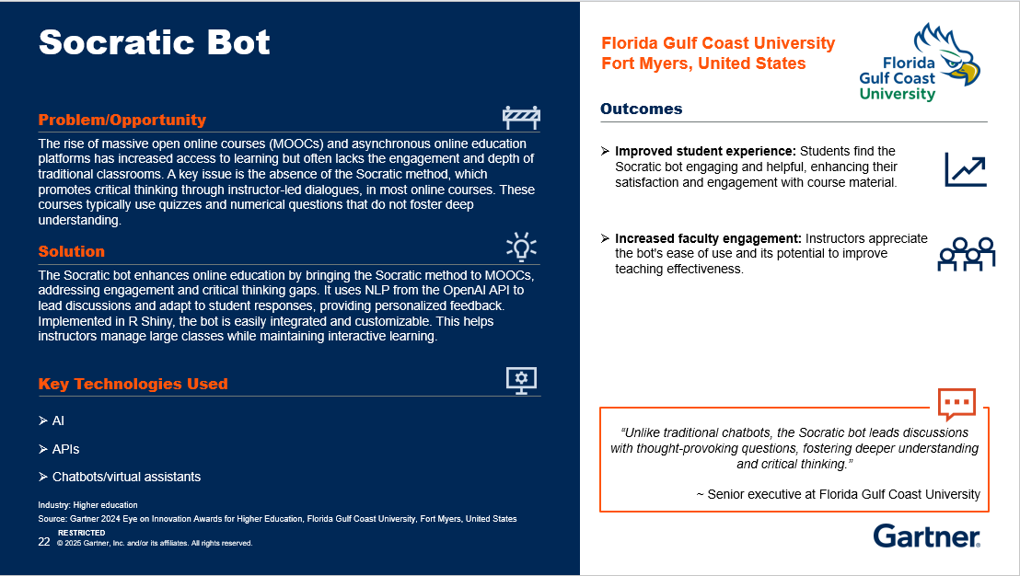
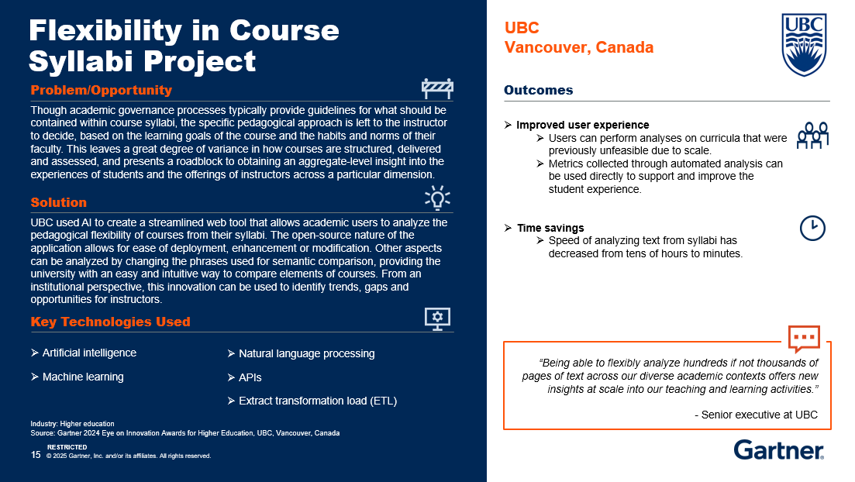
Industry Success Stories: Higher Education
Implications for AI Vision
Use industry case studies to validate opportunities and understand critical success factors, risks, deployment approaches and likely returns. Examples include:
Texas State University targeted AI literacy to accelerate AI adoption, collaboration and maturity.
UNSW leveraged AI to identify students at academic risk and to support personalized early intervention.
Florida Gulf Coast University designed an AI bot to address student engagement and critical thinking gaps.
UBC used AI to enable academic users to analyze and address pedagogical flexibility of courses.
Source: AI in Higher Education: Case Examples
Notes:
Screenshots (illustrative slides) Blank — image icon

Slide 20
Craft Communications Plan for Key Stakeholders: Higher Education
 | Such as … | Benefits | Challenge
Customer | Existing students Alumni | Lifelong learning Personalization Employability AI literacy | Appropriate AI use Critical thinking skills Value of current learning delivery models
Leaders | Cabinet Academic and institutional boards | Improved organizational efficiency and research quality Brand perception | Risk of investment in unproven technologies Unrealistic expectations Inattention to outcomes
Partner | Researchers Teaching faculty | Accelerated research Reduced administration Enhanced student engagement, experience and success | Ambiguity of shared IP Uncontrolled exploration, risk and spend Incentives
Employee | Administrative staff in recruitment, enrollment, student support, advancement | Reduced administrative burden Focus on meaningful and innovative work Skills augmentation | Job insecurity Lack of trust Skills redundancy
Society | Public Regulators Key opinion leaders Media | Regulatory efficiency Targeted AI funding Improved public services​ Economic growth through innovation | Trust Uninformed alarmism Regulatory challenges​ Social inequality​
Implications for AI Vision
Higher education CIOs must:
Continuously communicate current position, ambition, adoption and usage of AI to key stakeholders.
Provide clarity on benefits achieved as well as measures to mitigate AI challenges against stakeholder goals.
Implement robust risk management frameworks, AI ready data practices and AI governance measures to establish firm AI foundations.
Build and manage strategic partnerships with vendors and industry partners to tackle innovation and integration challenges.
Notes:
Same elements, headers

Slide 21
Sample AI Strategy: Higher Education
AI vision
Institutional goal alignment
To adopt AI in a manner and at a rate that supports the values and appropriate evolution of our institution. We will govern AI safely, responsibly and collaboratively with goals of augmenting, not replacing humans, and with a goal of delivering our mission of world-class teaching, learning, research, innovation and operational practices.
To deliver world-class education, research and efficiency, AI will be used to:
Enhance student engagement to increase passing rates, retention and on-time completion.
Increase individual productivity and capacity to innovate.
Decrease time to develop and deploy new programs and delivery modalities.
Increase revenue through enrollment and fundraising.
Increase volume, funding and impact of our research.
AI use cases
Key stakeholders
Next steps
Personal productivity in education
AI virtual tutor
Student support
Research assistant
Faculty, students and staff
Institutional leaders and governing body
Sector regulators
Partners for solution build and deployment
Evaluate AI readiness by taking the AI maturity assessment.
Prioritize AI use cases by their institutional feasibility and value​.
Create an AI roadmap based on position and ambition.
Notes:
Putting it all together.

Slide 22
Additional Input
Gartner AI Maturity Model: This tool can be used to estimate current readiness across several fundamental maturity pillars: AI strategy, AI use-case and product portfolio, AI governance, AI engineering, AI data, AI ecosystems and operating models, and people and culture.
Toolkit: Build Your Organization’s AI Roadmap: CIOs should use this tool as a “menu” of activities to be considered as a starting point when building their own AI roadmaps.
The Pillars of a Successful Artificial Intelligence Strategy: The AI strategy does not stand alone. To be effective, it must be fully and frequently aligned with the business strategy, as well as other enabling technology strategies, most notably those for IT and D&A.

