Slide 1

Undrupalizing
The Business Logic
by Carles Climent Granell

Slide 2


Undrupalizing the business logic
Special Sponsor
http://www.asteeroids.com/

Slide 3

Undrupalizing the business logic
About me
https://github.com/carlescliment
@Carles_Climent
* Backend Developer
* Test Driven
* Framework Agnostic

Slide 4
Undrupalizing the business logic
What's the business logic?
"Part of the program that encodes the real-world business rules." - Wikipedia
Business Layer
Implements the Domain Model in a technology-neutral way.
Application Layer
Bridges the gap betweeen the business layer and the technology.

Slide 5
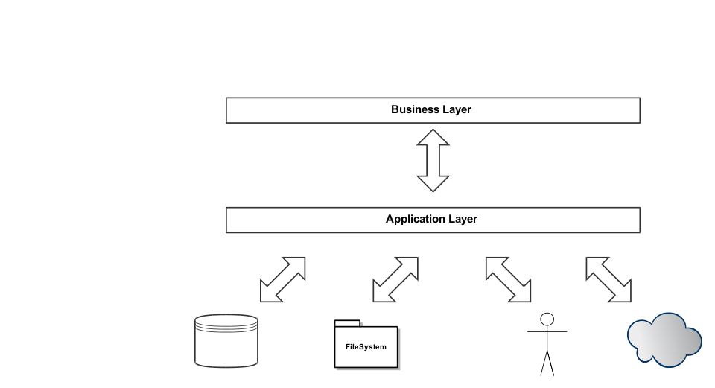
Undrupalizing the business logic

Slide 6
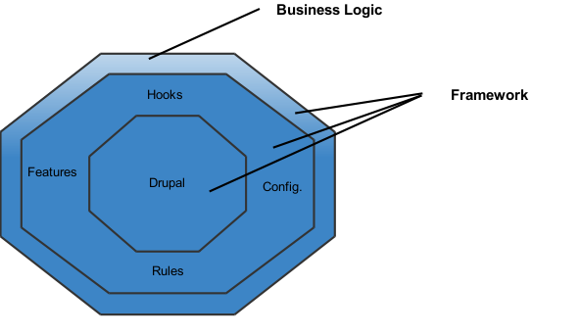
Undrupalizing the business logic
How do we do in Drupal?
- Drupal stays in the center. It is the core of our application.
- Drupal behaviours are extended by hooks, modules, features, rules and configurations.
- The business logic makes intensive use of the framework.

Slide 7
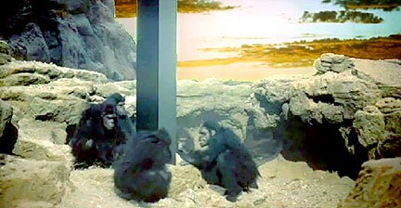
Undrupalizing the business logic
What's wrong with it?
It is constrained to the framework limitations
… so it's design is also constrained.
It is platform-dependant
It is platform-dependant
… so it is not portable.
It is hardly testable
… so it is hardly mantainable.

Slide 8
Undrupalizing the business logic
This is God-Dries.
This is the world-Drupal
This is the Universe-business logic, orbiting around the world-Drupal.
wikipedia

Slide 9
Undrupalizing the business logic
Ports-And-Adapters / Hexagonal Architecture

Slide 10
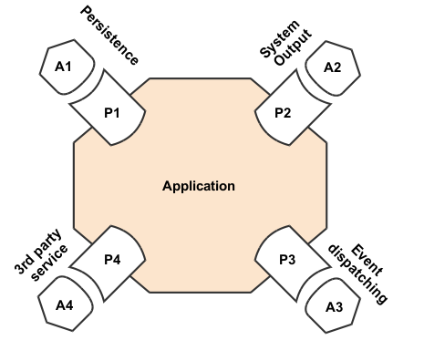
Undrupalizing the business logic
PX – Ports
AX - Adapters
Ports are abstractions provided by the application.
Adapters are implementantions to plug in external platforms (libs, components, frameworks).

Slide 11
Undrupalizing the business logic
Talk is cheap.
Show me the code.

Slide 12
Undrupalizing the business logic
https://github.com/carlescliment/undrupalizing-business-logic

Slide 13
Undrupalizing the business logic
Quinieleitor:
- Admins can create betting slips.
- Betters bet for the current betting slip.
- Admins resolve slip matches.
- Users are given points depending on the number of hits.
- Betters can see a Hall of Fame.
https://github.com/carlescliment/undrupalizing-business-logic/tree/0-origins

Slide 14
Undrupalizing the business logic
Step 1:
- Move procedural code into object oriented code.
- Colocate state and behaviour.
- Start with the change that has the minor impact.
https://github.com/carlescliment/undrupalizing-business-logic/tree/1-objects

Slide 15
Undrupalizing the business logic
Step 2:
- Move objects to a separate lib.
- Modify index.php to autoload with Composer.
https://github.com/carlescliment/undrupalizing-business-logic/tree/2-composer

Slide 16
Undrupalizing the business logic
Step 3:
- Move Drupal Unit Tests to PHPUnit.
Other test frameworks are equally valid. Simpletest is not.
https://github.com/carlescliment/undrupalizing-business-logic/tree/3-phpunit

Slide 17
Undrupalizing the business logic
Step 4:
- Introduce a Dependency Injection Container.
- Modify index.php to require it in a global variable.
Optional, depends on the project. Often useful.
https://github.com/carlescliment/undrupalizing-business-logic/tree/4-pimple

Slide 18
Undrupalizing the business logic
Step 5:
- Bring repositories.
- You need some magic here.
https://github.com/carlescliment/undrupalizing-business-logic/tree/5-repositories

Slide 19
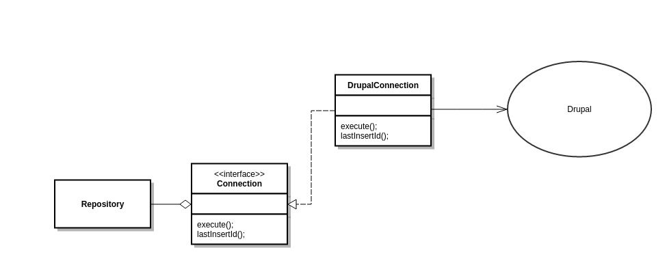
Undrupalizing the business logic
That's a port
That's an adapter
https://github.com/carlescliment/undrupalizing-business-logic/tree/5-repositories

Slide 20
Undrupalizing the business logic
Step 6:
- Make your code easier to use with facade
https://github.com/carlescliment/undrupalizing-business-logic/tree/6-facade

Slide 21
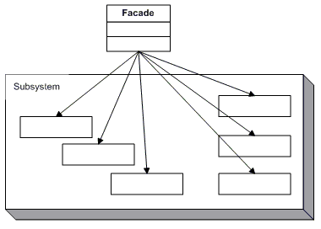
Undrupalizing the business logic
https://github.com/carlescliment/undrupalizing-business-logic/tree/6-facade

Slide 22
Undrupalizing the business logic
Step 7:
- Decouple your logic from the Drupal hooks.
- Bring your favourite Event Dispatcher.
- Write a port and adapter for it
https://github.com/carlescliment/undrupalizing-business-logic/tree/7-event-dispatcher

Slide 23
Undrupalizing the business logic
Step 8:
- You don't need Drupal to handle your access to database.
- Bring your favourite DBAL.
- We already have a port for it. Write an adapter.
https://github.com/carlescliment/undrupalizing-business-logic/tree/9-pdo

Slide 24
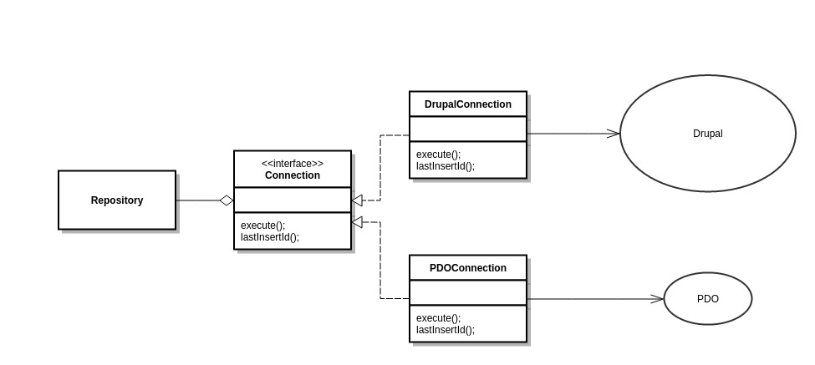
Undrupalizing the business logic
https://github.com/carlescliment/undrupalizing-business-logic/tree/8-pdo

Slide 25
Undrupalizing the business logic
Step 9:
- Drupal functional tests are incredibly slow.
- You don't need the framework to test your business logic anymore.
- C'mon, move your functional tests to PHPUnit.
https://github.com/carlescliment/undrupalizing-business-logic/tree/9-phpunit

Slide 26
Undrupalizing the business logic
- Use your Dependency Injection Container to switch between DBALs.
- Create a database schema you can import.
- Truncate the data to keep consistency.
Your tests will be blazingly fast!
https://github.com/carlescliment/undrupalizing-business-logic/tree/9-phpunit

Slide 27
Undrupalizing the business logic
You liked it?
What would you do with the old SimpleTests?

Slide 28
Undrupalizing the business logic
That's all, folks. Thank you very much.

