Slide 1
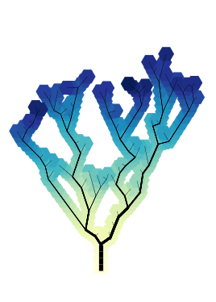
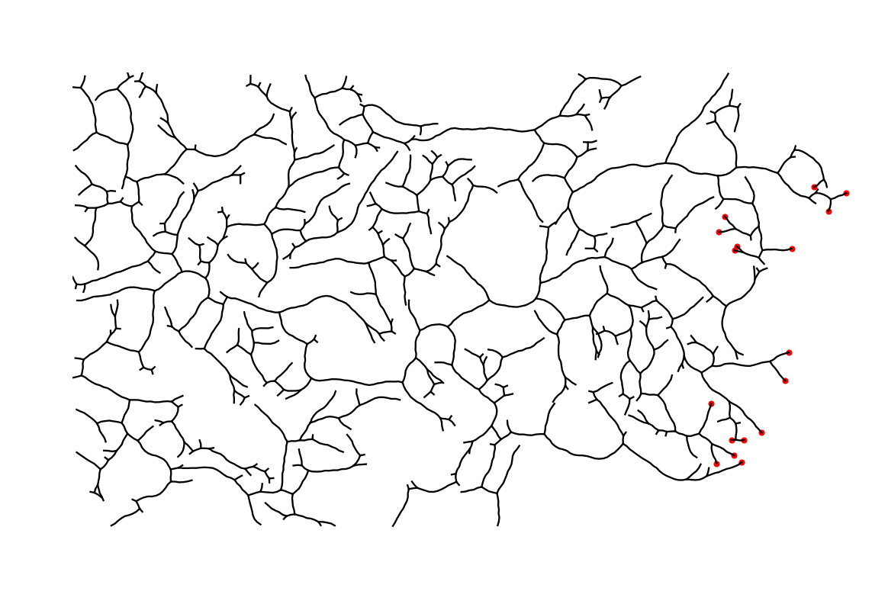
Optimality and Stochasticity in Biological Distribution Networks
Carles Falcó i Gandia

Slide 2
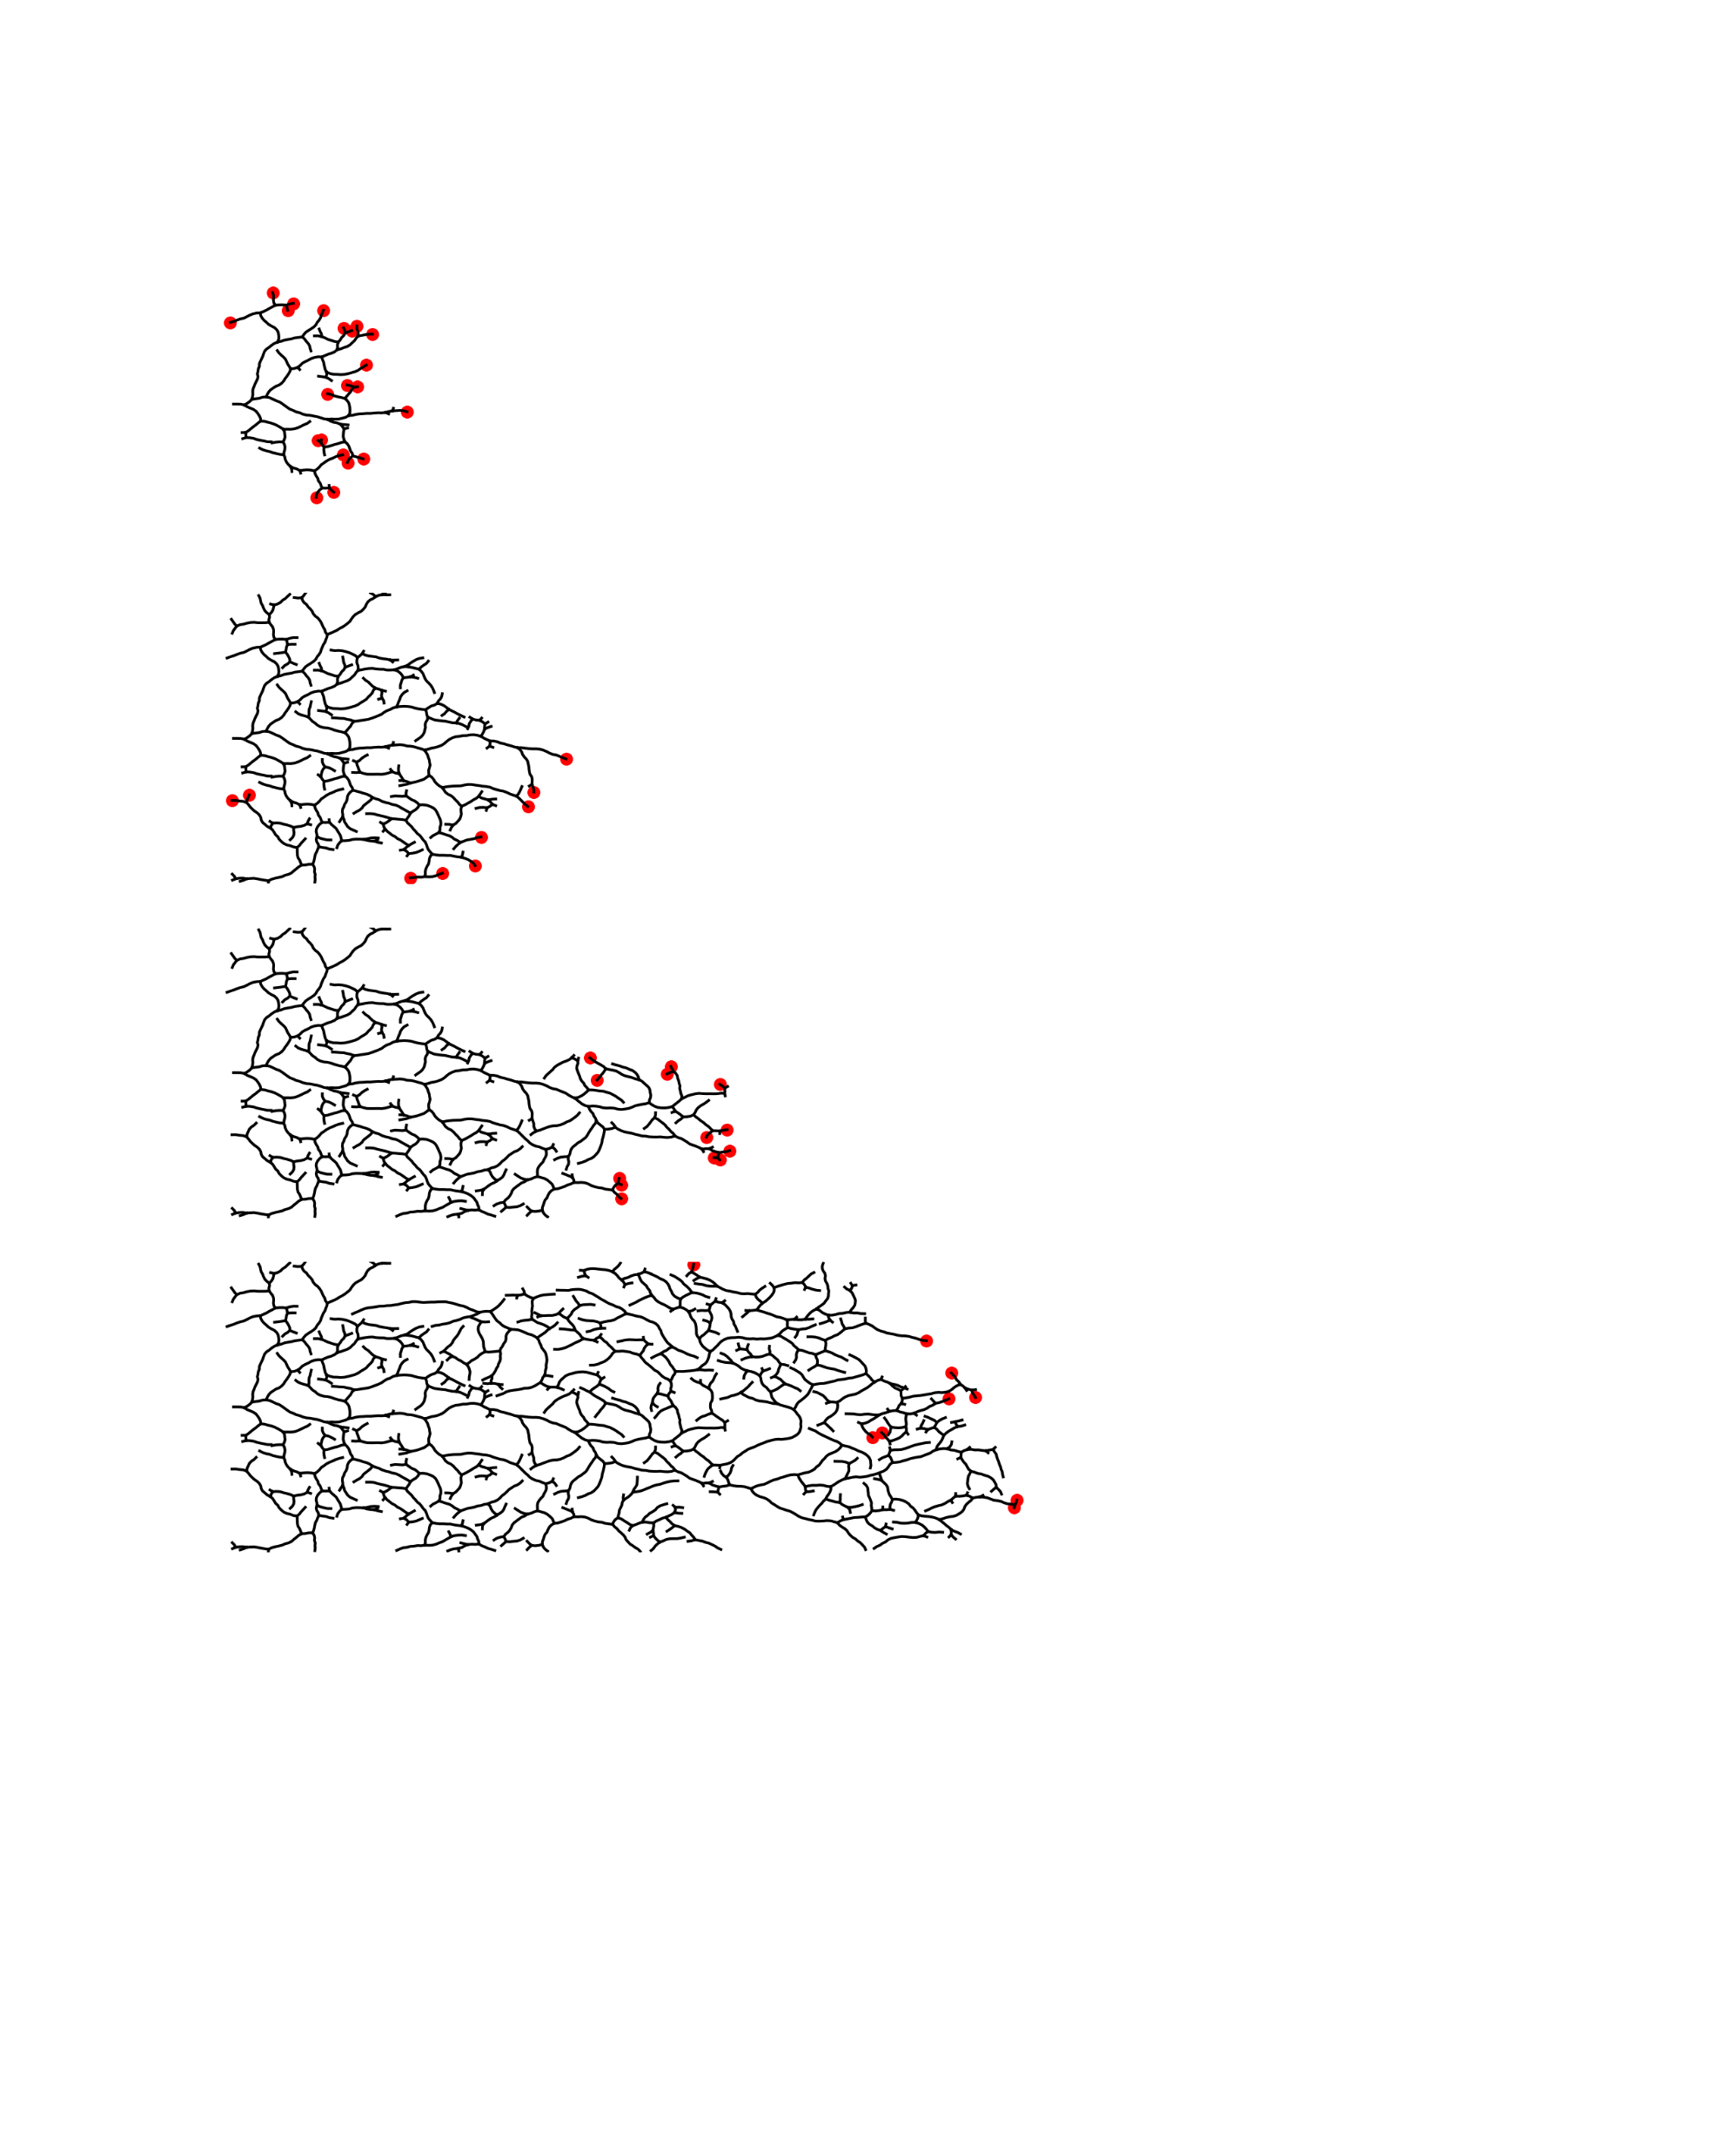

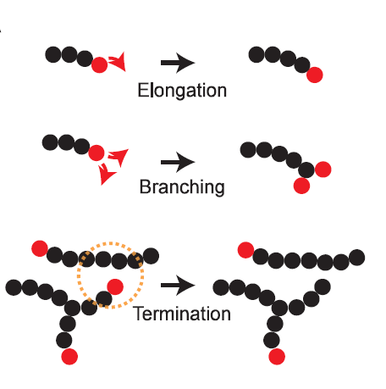
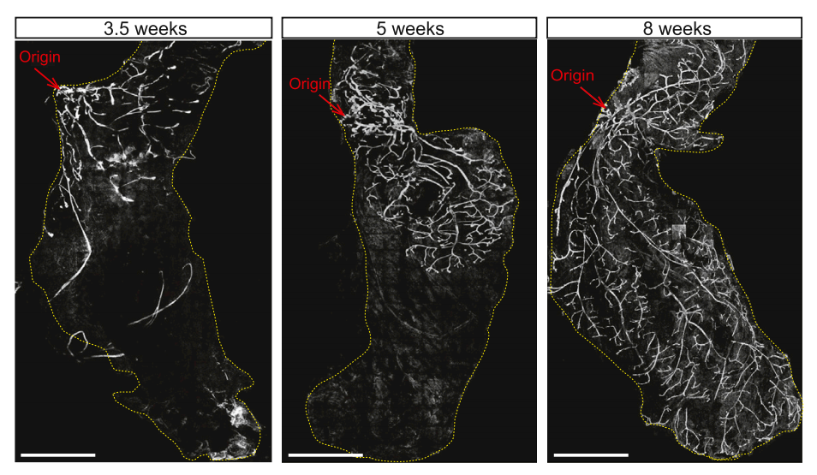

Branching and Annihilating Random Walks
Framework capable of describing branching morphogenesis in mammalian organs
Time
Topology
Meaning of optimality
How optimal are these networks?
Mammary gland
Hannezo E, et al. Cell (2017)

Slide 3
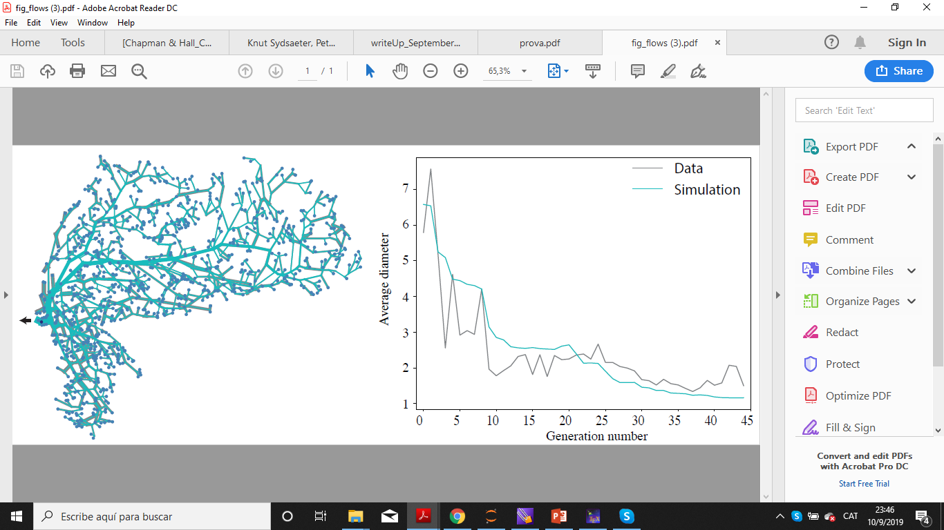
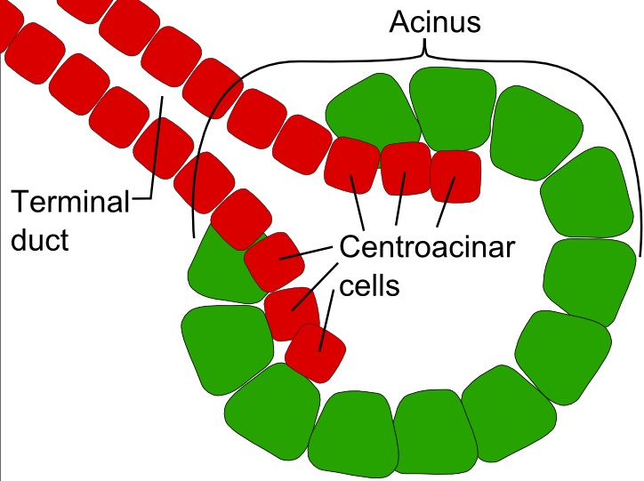
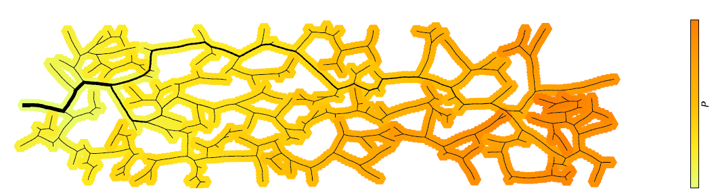
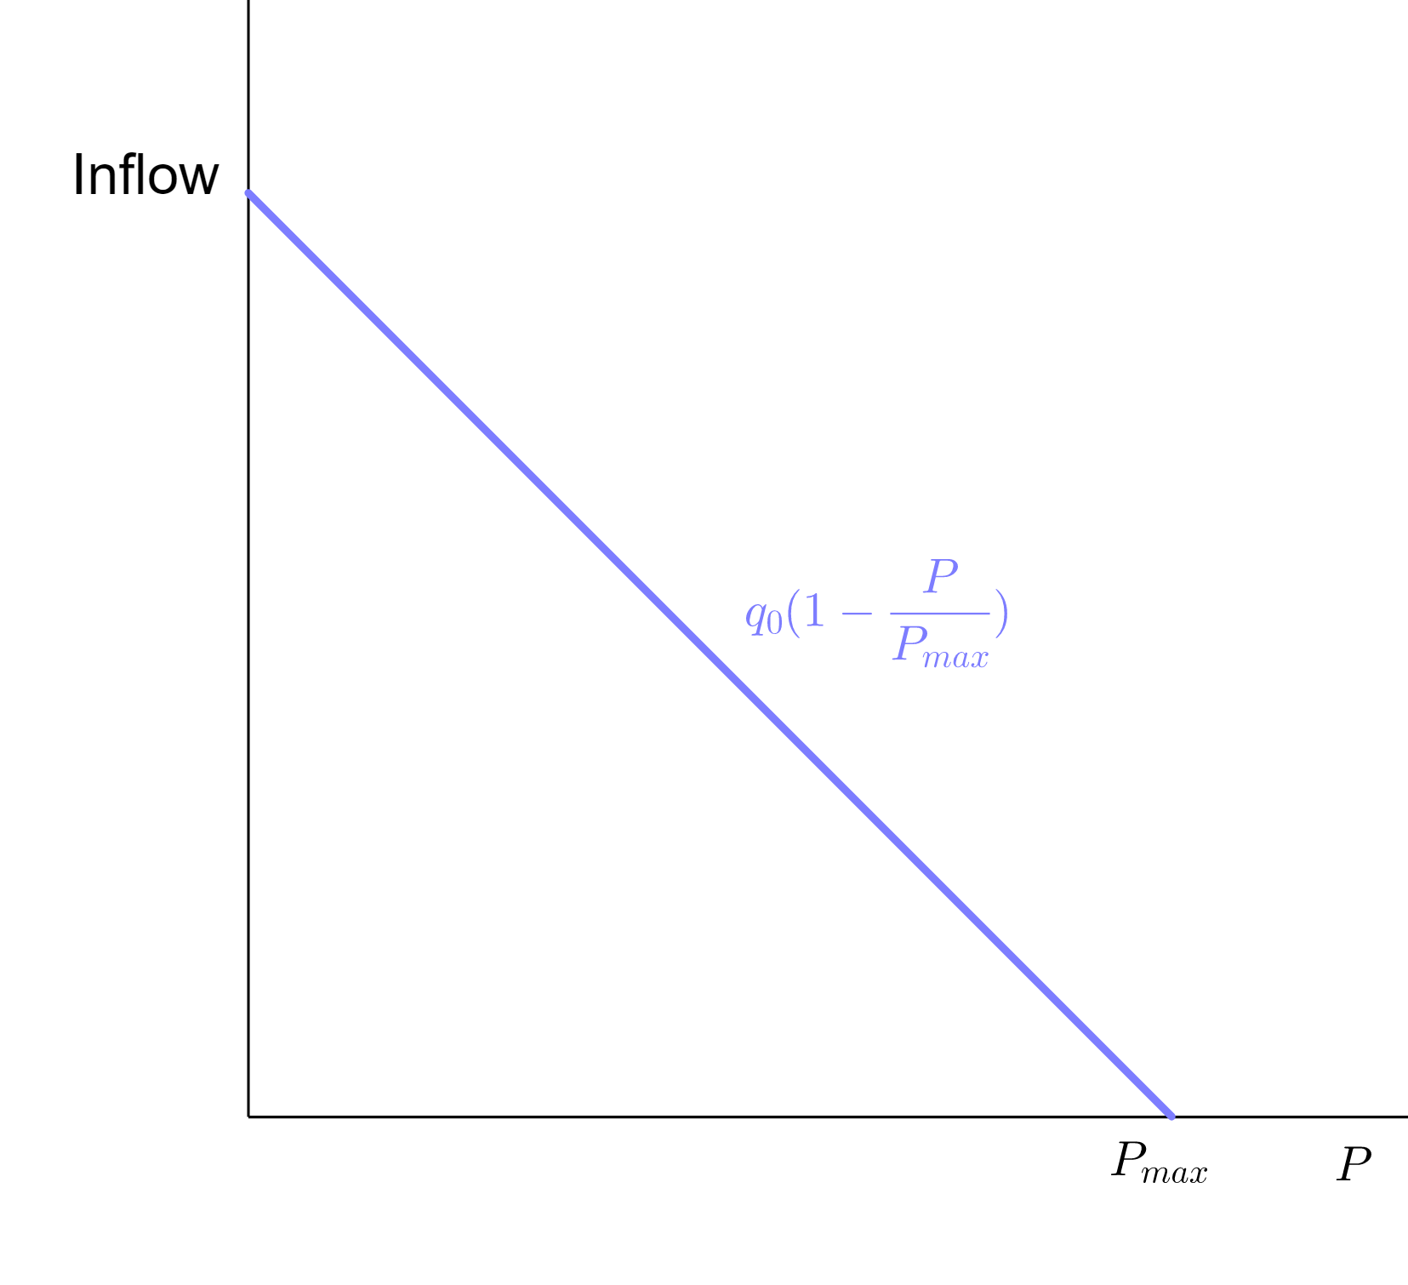
Optimization in two types of networks
Optimizing Power dissipation via adaptation rules
Maximizing Outflow in the mammary gland
Tree generated by BARWs and consider flow.
Find duct diameter minimizing power dissipation.
Example of exocrine gland. Produces and secrets a substance that flows through the network.
Substance is produced in small alveoli (spherical shape).
From first principles, a pressure-dependent inflow profile can be derived.
Figure by Michael Riedl
Ronellenfitsch H, Katifori E, Phys. Rev. Lett. (2016)

Slide 4
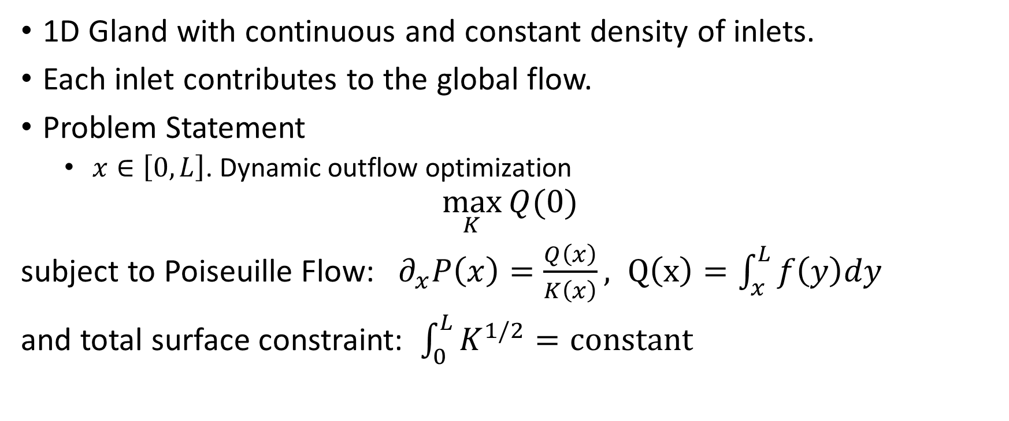
1D Mean Field Calculations
1D Gland with continuous and constant density of inlets.
Each inlet contributes to the global flow.
Problem Statement
$x∈\left[0,L\right]$. Dynamic outflow optimization
$$\max_{K}{Q(0)}$$
subject to Poiseuille Flow: ${ ∂}_{x}P\left(x\right)=\frac{Q\left(x\right)}{K\left(x\right)}, Q\left(x\right)=\int_{x}^{L}{f\left(y\right)dy}$
and total surface constraint: $\int_{0}^{L}{K^{1/2}}=constant$

Slide 5
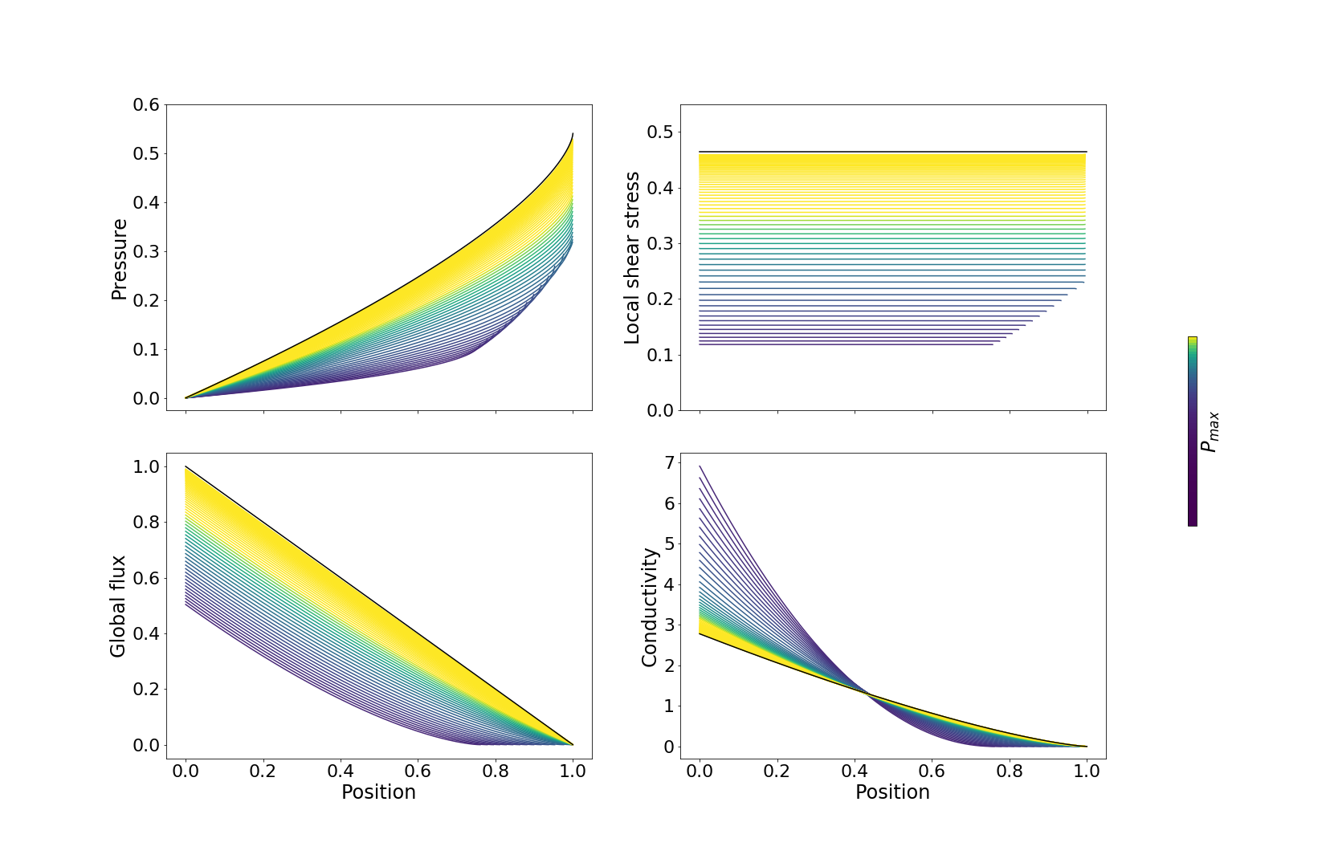
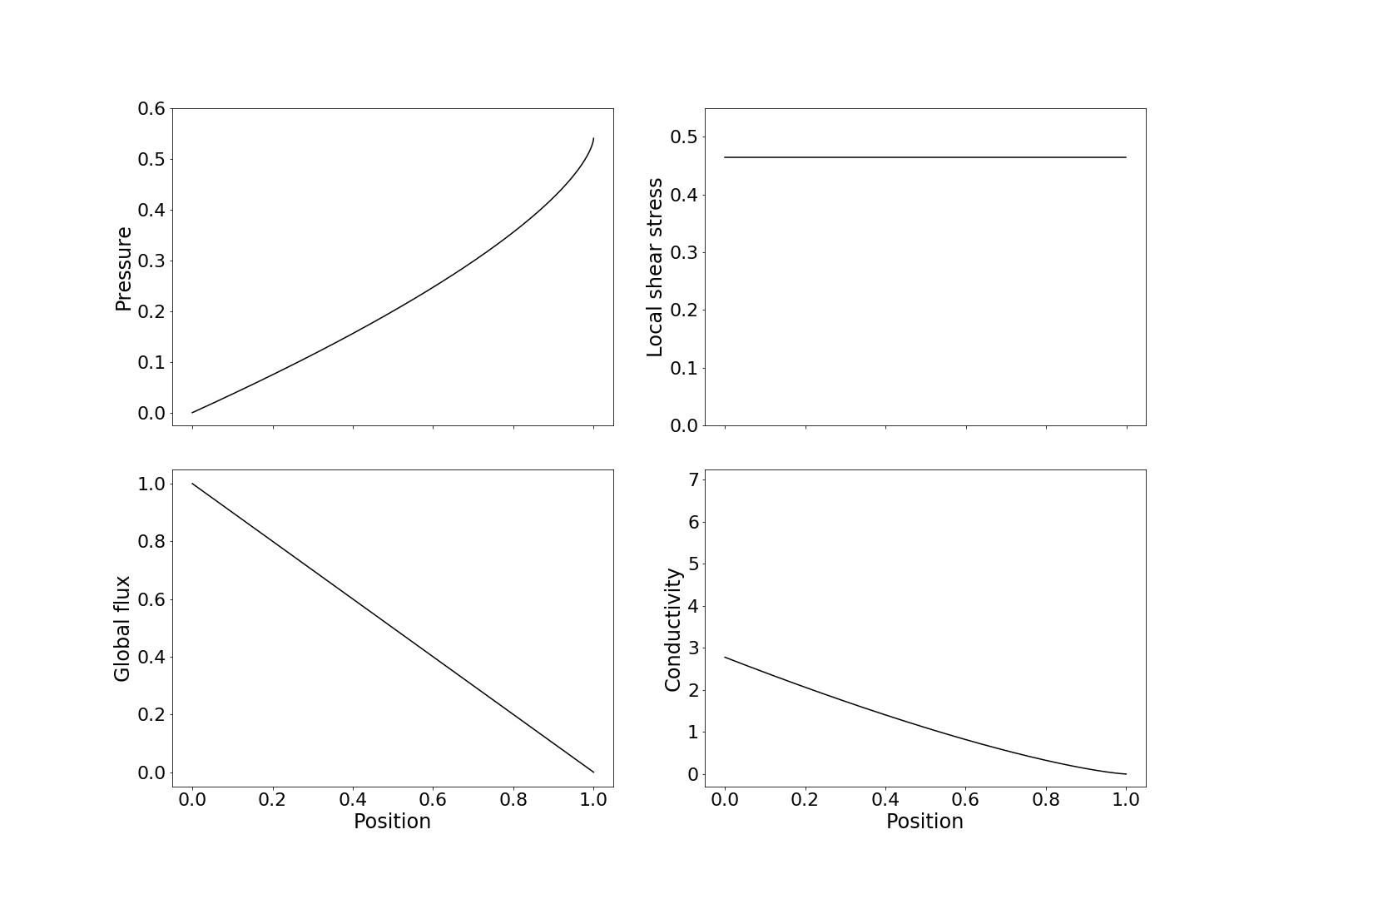
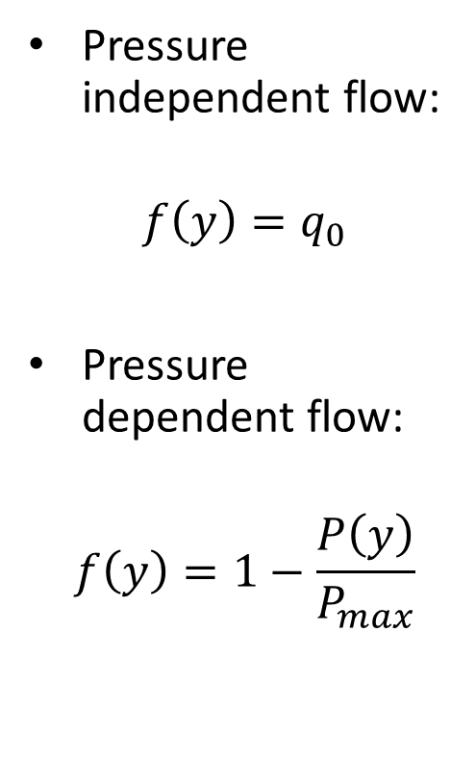
Pressure independent flow:
$$f\left(y\right)=q_{0}$$
Pressure dependent flow:
$$f\left(y\right)=1−\frac{P\left(y\right)}{P_{max}}$$

Slide 6
Thank you!

