Slide 1
iVR-GS
Inverse Volume Rendering for Explorable
Visualization via Editable 3D Gaussian Splatting
Kaiyuan Tang,
Siyuan Yao,
Chaoli Wang
Notes:
I will be presenting the approach to Inverse volume rendering using gaussian splatting

Slide 2
Volume Visualization
Two main concepts
  Inverse Volume Rendering
  Gaussian Splatting
Notes:
We will need to understand two concepts before proceeding

Slide 3
Inverse Volume Rendering
Traditional Volume Rendering
  You have a volume → you compute images.
Inverse Volume Rendering
  You have images → you reconstruct a representation → you compute new images
Notes:
Starting from rendered images of a volume (produced with some transfer function and lighting), we reconstruct an editable 3D representation that can then be re-rendered with new transfer functions and lighting.

Slide 4

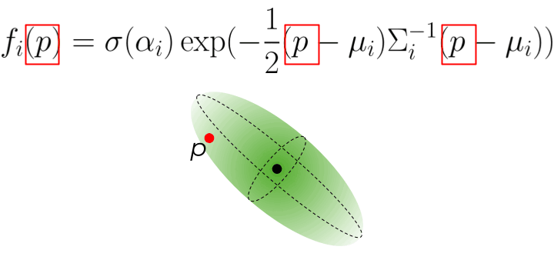
Gaussian Splatting
Notes:
Gausian splatting is a mathematical model that generates an oval. It uses a gausian model to define how transparency behaves on it.
primitive

Slide 5
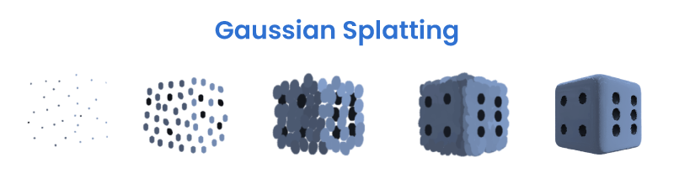
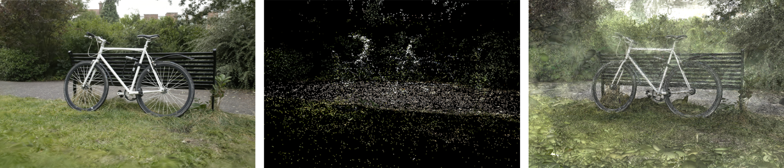
Gaussian Splatting

Slide 6
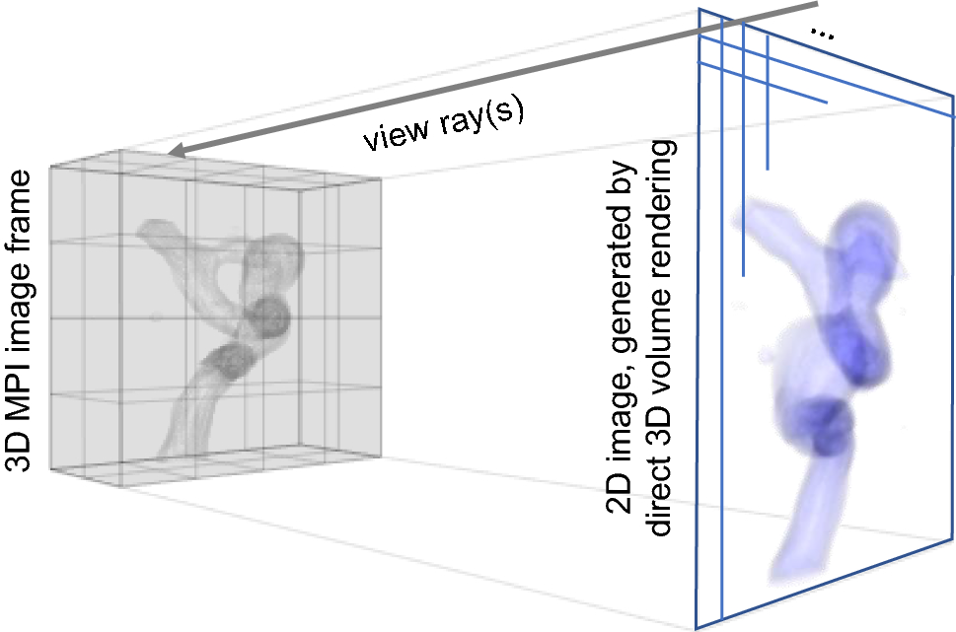
Direct Volume Rendering
Process of transforming a voxel object into a 2D image:
Notes:
This is what we are doing in the lab. It is computationally expensive but doable. Since we have the raw data we can modify it and also relight the scene. This implies recalculating lots of things each frame which ends up really expensive.

Slide 7
Direct Volume Rendering
COMPUTATONALLY EXPENSIVE

Slide 8
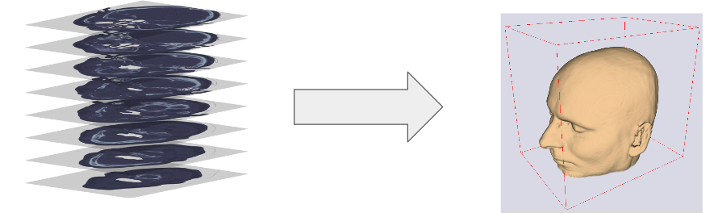
Volume rendering alternatives
Main Objective: Create a model that contains the information ready to render.
Notes:
This techniques learn the volumetric object and generate new images. This has obvius limitations, it will render exactly what it is being fed therfore we can not dynamically modify the transfer function or the light. Everithing is backed as we will see:

Slide 9
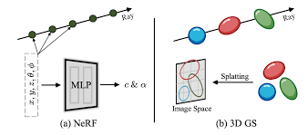
Volume rendering alternatives
NeRF
Plenoxels
TensoRF
Gaussian Splatting
CCNeRF
...
Notes:
This techniques learn the volumetric object and generate new images. This has obvius limitations, it will render exactly what it is being fed therfore we can not dynamically modify the transfer function or the light. Everithing is backed as we will see:

Slide 10
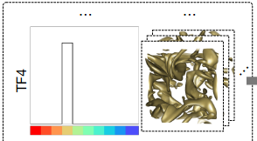
Volume rendering alternatives
They are locked to one transfer function (TF) used during training.
  Any parts of the volume with zero opacity in the TF are never learned.
Notes:
Most of them are limited to show what they were trained with and can not be edited.

Slide 11
Volume rendering alternatives
Their lighting and TF are baked into the model.
  You cannot change light direction, shininess, opacity, or color afterwards.
(there are papers in the literature on how to augment gausian splatting with normal information)
Notes:
Technically, it is posible to calculate light on the fly but it becames really expensive for big volumes.

Slide 12
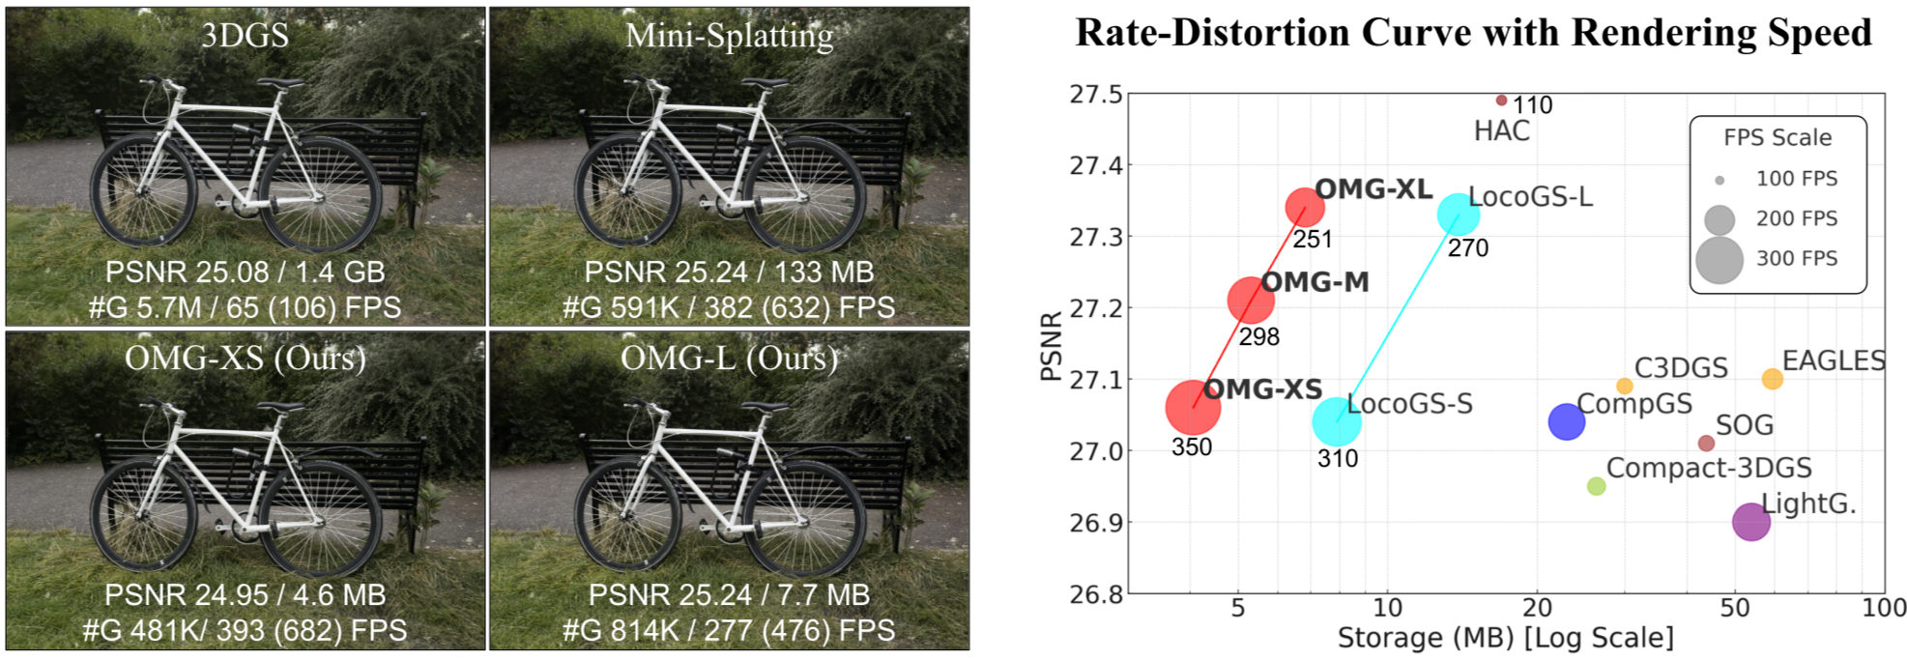
Volume rendering alternatives
They are either fast but big, or compact but slow, which is not ideal for interactive visualization.

Slide 13
Volume rendering alternatives
In summary
They are locked to one transfer function (TF) used during training.
Their lighting and TF are baked into the model.
They are either fast but big, or compact but slow, which is not ideal for interactive visualization.

Slide 14
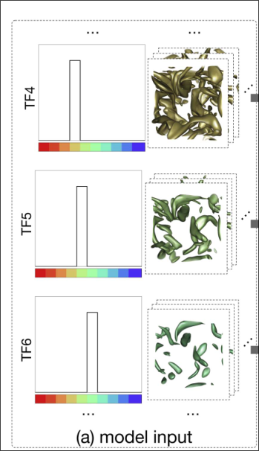
IVR-GS
IVR-GS SOLUTION:
It trains multiple basic 3DGS models, one per basic transfer function

Slide 15
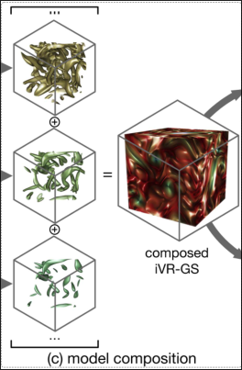
IVR-GS
IVR-GS SOLUTION:
It trains multiple basic 3DGS models, one per basic transfer function
These basic models are made composable

Slide 16
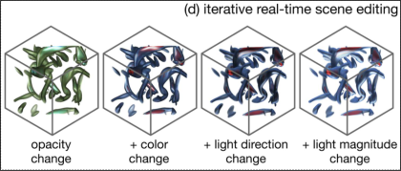
IVR-GS
IVR-GS SOLUTION:
It trains multiple basic 3DGS models, one per basic transfer function
These basic models are made composable
It introduces editable Gaussian primitives

Slide 17
IVR-GS
IVR-GS SOLUTION:
It trains multiple basic 3DGS models, one per basic transfer function
These basic models are made composable
It introduces editable Gaussian primitives
It compresses everything using vector quantization (VQ)
It enables inverse volume exploration

Slide 18
IVR-GS Contribution
The novelty is not in the individual components.
  All components existed
  Gaussian Splatting
  Differentiable rasterizer
  Blinn–Phong shading
  Inverse rendering optimization
  Volume DVR
But the combination into a coherent, working system for:
  turning DVR images → editable 3D model
  decomposing shading into normals + albedo
  enabling interactive re-lighting + transfer-function-like edits
  doing it with Gaussian splats
  doing it efficiently, reliably, and robustly

Slide 19
IVR-GS Contribution
They divide the problem into different steps:
Viewpoint Sampling
Base 3DGS Optimization
Editable Gaussian Optimization
Compression via Vector Quantization
Scene Composition and Editing

Slide 20
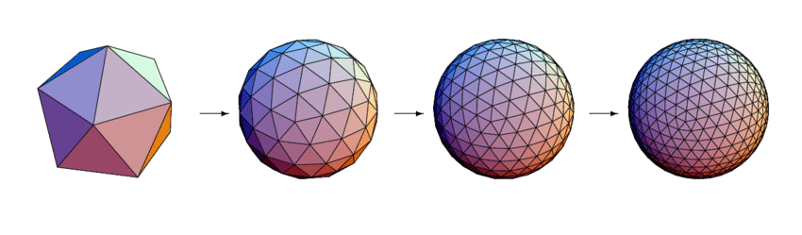

Viewpoint Sampling
Choosing the number of images for training.
1. Choose 12 multi-view images
for each basic TF.
2. Calculate complexity:
3. Choose the correct quantity for each Tfs (maybe one layer is really complex but the rest are simple)

Slide 21
Viewpoint Sampling
Complex scenes:
- have lots of varied colors
- have varied opacity (alpha)
- contain many structures
Simple scenes:
- low variation (e.g., a single tissue type with a small spatial footprint)
Notes:
Now that we have the images that we will feed the model, is time to define the model itself

Slide 22
Base 3DGS Optimization
A 3DGS primitive is parameterized as:
{
µi → position
qi, → quaternion
si, → scale
oi, → opacity
ni, → normal
Ci → color
}
Notes:
TODO: note of what each thing is
Each primitive of the model will be defined as

Slide 23


Base 3DGS Optimization
{ ni } initialization and training:
1. calculate depth and normal
2. calculate normal loss
Notes:
While training, normal direction starts as the volume calculated normals. In the process, the results are compared to the orignal images and aligned to behave like in the image instead of like in the volume

Slide 24
Base 3DGS Optimization
{ ci } initialization and training:
1. RGB components
2. Ra Ga and Ba alpha components
3. Encoded data in Spherical Harmonic
We use:
- L1 loss ensures pixel correctness
- SSIM loss ensures sharpness and structure preservation
Notes:
They have six components, colors and alpha per channel

Slide 25
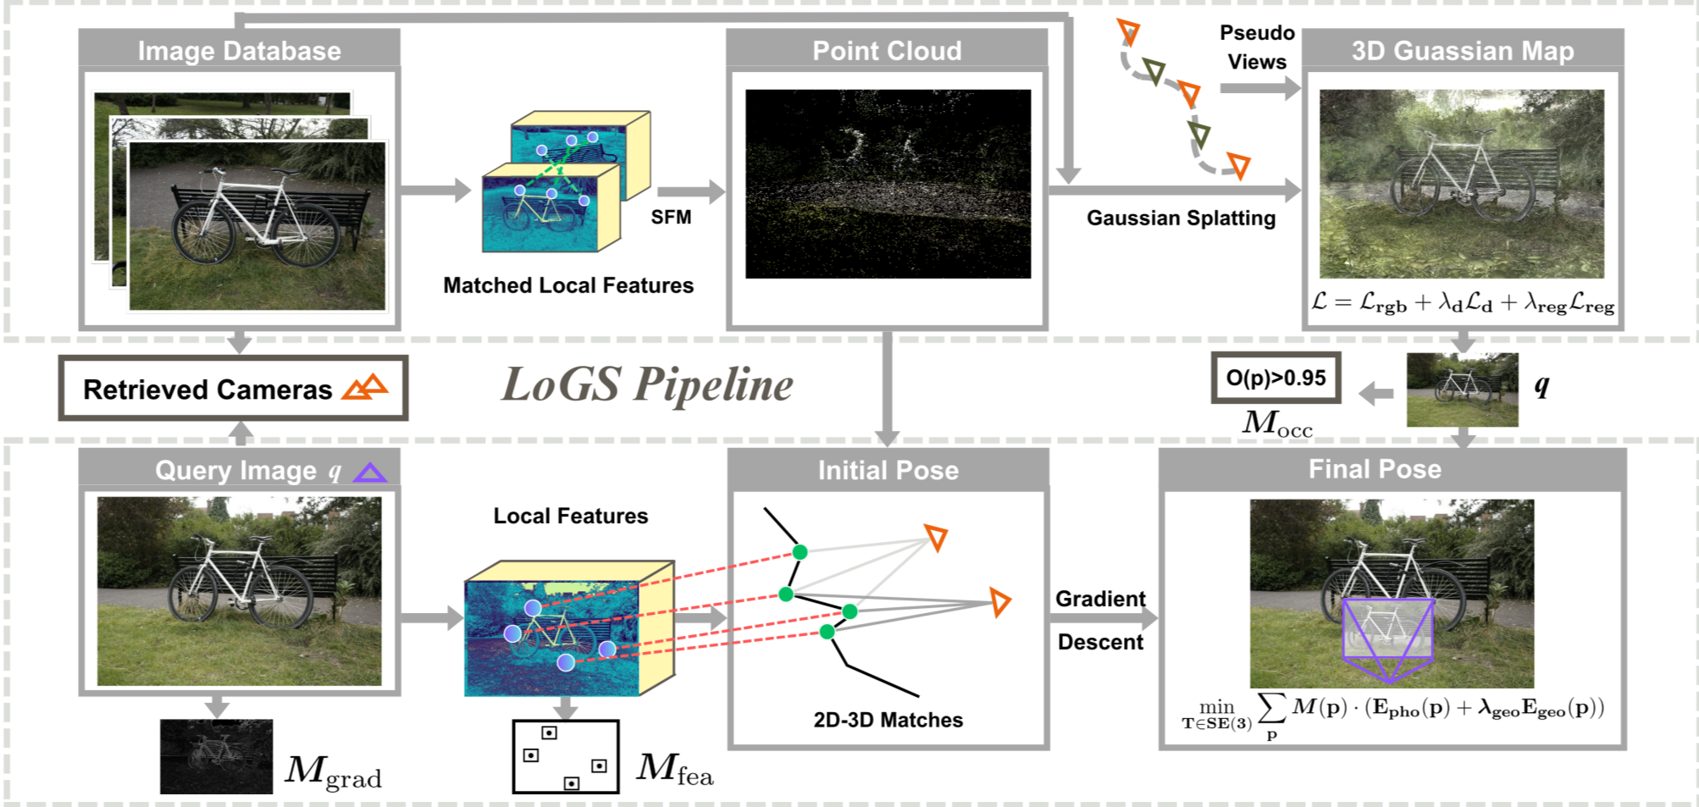
Base 3DGS Optimization

Slide 26
Editable Gaussian Optimization
Decompose light from the scene:
{µi, qi, si, oi, ni, Ci}
{µi, qi, si, oi, ni} + {Δci, kai , kdi , ksi , βi}
Notes:
Now that we have trained multiple gaussian splatting models it is time to remove the undesired backed components such as light

Slide 27
Editable Gaussian Optimization
Each Gaussian has shading attributes {Δci, kai , kdi , ksi , βi}
- Δc = offset color
- ka, kd, ks = ambient, diffuse, specular coefficients
- β = shininess for specular reflection

Slide 28
Editable Gaussian Optimization
1. Opacity regularization: encourages low-opacity. This allows for removing unnecessary splats.
2. Offset color sparsity: L1 loss on ΔC to avoid over-shifting the color palette.
3. Bilateral smoothness on shading coefficients to prevent abrupt changes in smooth regions.
Notes:
When training them we use certain regualrization terms to avoid weird behavior suc has bilateral smoothnes that allows us to only smooth parts that are percieved as smooth and leave the others intact

Slide 29
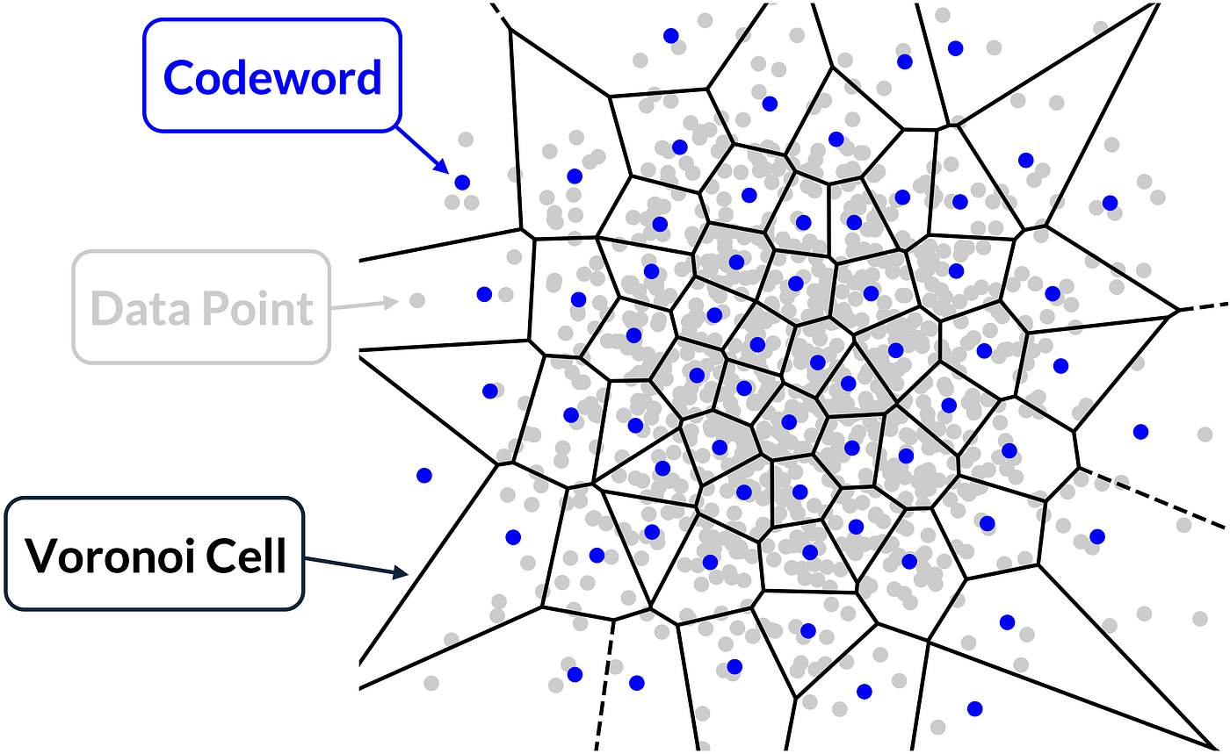
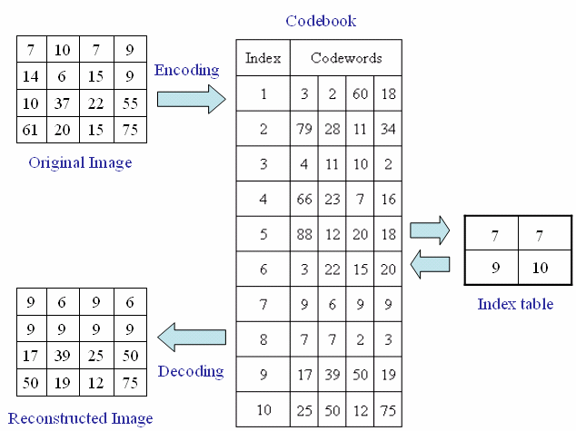
Compression via Vector Quantization
- {qi, si, oi} + {Δci, kai , kdi , ksi , βi}
- Compression up to 4x
Notes:
If any of you is familiar with telecomunications techniques, we usually apply this when receiving signals in an antenna. It just cassifies the value into the closest cell id. We loose precission but compression is about that.

Slide 30
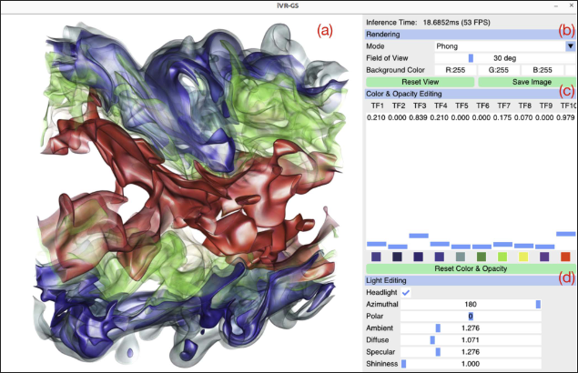
Scene Composition and Editing
Notes:
We now having mutiple Tfs trained, we can select colors and opacityes, what to show on screen and even light position.

Slide 31
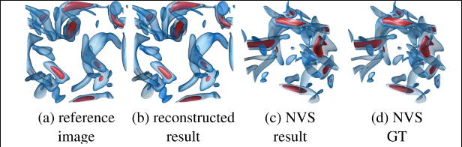
Inverse Volume Exploration
Approximate the intended rendering setting automatically, given a reference image as the desired effect and
its corresponding camera pose
1. Freeze gaussian splatting properties (position, variation…)
2. Gradient descend on global variables (c_i, light_pos...)
Notes:
They also included this method that given a picture they guess the parametters we need in the scene to recreate it. This means moving lights, setting intensity and emission colors and Tfs opacityes and colors.

Slide 32
Interactive Interface
😞 I was unable to execute the code, not nativelly, not using docker containers, nothing. I belive is some kind of incompativility with nvidia drivers and open source nvidia drivers of linux.

Slide 33
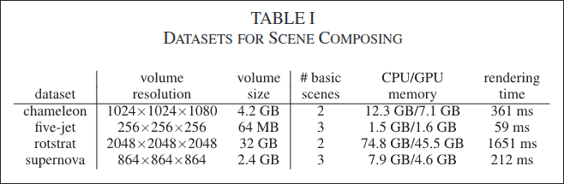
Results

Slide 34
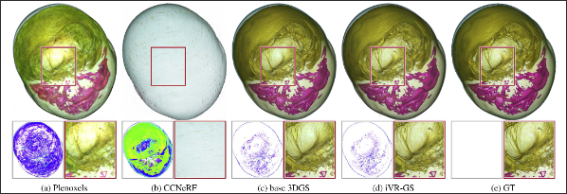
Results: Qualitative comparison

Slide 35
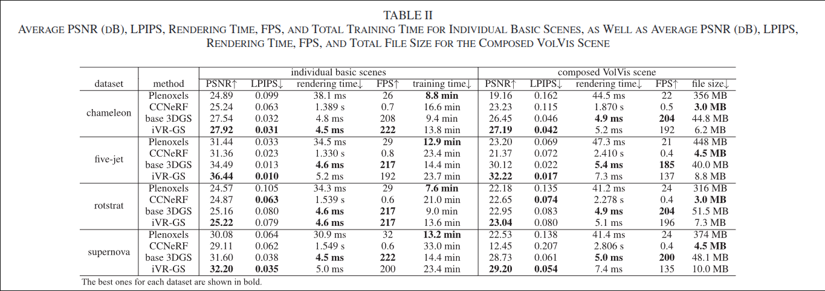
Results: Quantitative comparison

Slide 36
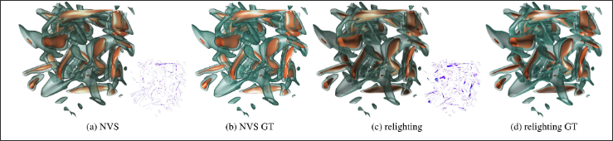
Results: Quantitative comparison
Notes:
We do see how for new views, relightning performs worse than the original model with the original lightning but the synthesis of shapes is still good.

Slide 37
Conclusions
Achievements:
iVR-GS creates a fast editable surrogate of a volume using composable Gaussian splats.
It outperforms previous NVS methods and supports real-time editing, recoloring, relighting, and inverse matching.
Notes:
We do see how for new views, relightning performs worse than the original model with the original lightning but the synthesis of shapes is still good.

Slide 38
Conclusions
Limitations:
- Model size grows significantly with the number of TF scenes.
- Uniform view sampling is inefficient; smarter sampling is costly.
- Using Blinn-Phong restricts relighting to simple lighting models.
Notes:
We do see how for new views, relightning performs worse than the original model with the original lightning but the synthesis of shapes is still good.

Slide 39
THANK YOU

