Slide 1
DSCI6001 – Final project
LINEAR ALGEBRA APPLIED TO CHEMISTRY

Slide 2
BALANCING CHEMICAL EQUATIONS
The case of saturated hydrocarbons.
The most elemental case:
x₁ CH₄ + x₂ O₂ → x₃ CO₂ + x₄ H₂O
It needs to be represented as:
x₁ CH₄ + x₂ O₂ = x₃ CO₂ + x₄ H₂O

Slide 3
BALANCING CHEMICAL EQUATIONS
Let’s represent our equation as a matrix:
 | CH₄ | O₂ | CO₂ | H₂O
C | 1 | 0 | 1 | 0
H | 4 | 0 | 0 | 2
O | 0 | 2 | 2 | 1

Slide 4
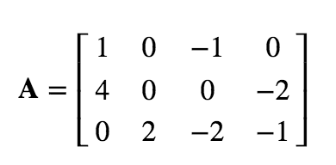
BALANCING CHEMICAL EQUATIONS

Slide 5
BALANCING CHEMICAL EQUATIONS
We will be solving for:
Ax = 0
Representing the linear equations:
x₁ - x₃ = 0
4x₁ - 2x₄ = 0
2x₂ - 2x₃ - x₄ = 0
Parametrizing x₃ = t

Slide 6
BALANCING CHEMICAL EQUATIONS
x₁ = t
x₂ = 2t
x₃ = t
x₄ = 2t
If t = 1
Then, the balanced chemical reaction is:
x₁ CH₄ + x₂ O₂ → x₃ CO₂ + x₄ H₂O | CH₄ + 2 O₂ → CO₂ + 2 H₂O

Slide 7
BALANCING CHEMICAL EQUATIONS
Generalizing for saturated hydrocarbons:
x₁ C_{a}H_{b} + x₂ O₂ → x₃ CO₂ + x₄ H₂O
x₁C_{a}H_{2a+2} + x₂ O₂→ x₃ CO₂ + x₄ H₂O
 | C_{a}H_{2a+2} | O₂ | CO₂ | H₂O
C | a | 0 | 1 | 0
O | 0 | 2 | 2 | 1
H | 2a+2 | 0 | 0 | 2

Slide 8
BALANCING CHEMICAL EQUATIONS

Slide 9
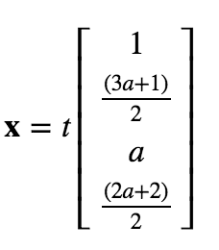
BALANCING CHEMICAL EQUATIONS
The general solution is:
C_{a}H_{2a+2} + (3a+1)/2 O₂→ a CO₂ + (2a+2)/2 H₂O

Slide 10
Mixing Chemical Components to Create a Chemical Solution
Another application consists in creating a chemical solution by mixing different proportions of chemical compounds.
For example, we know that if we mix chemicals X, Y and Z, we will produce a chemical solution due to its interaction.
There's some initial assumptions:
X, Y and Z have been previously dissolved separately.
Once mixed together, then they react to produce the new compound.

Slide 11
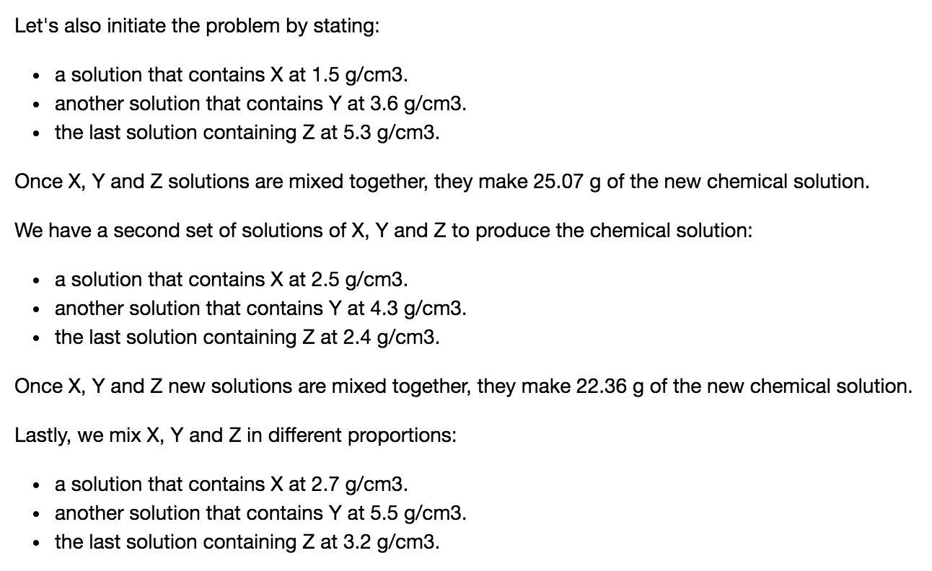
Mixing Chemical Components to Create a Chemical Solution

Slide 12
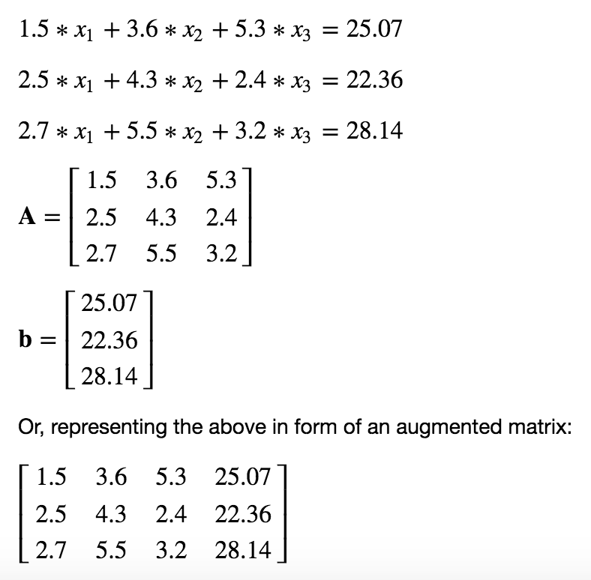
Mixing Chemical Components to Create a Chemical Solution

Slide 13
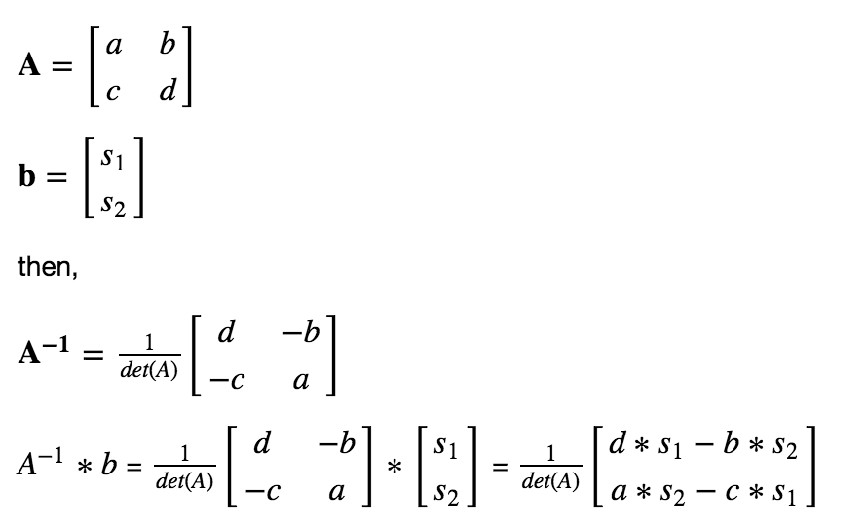
Mixing Chemical Components to Create a Chemical Solution
Generalizing for mixing two chemicals:

Slide 14
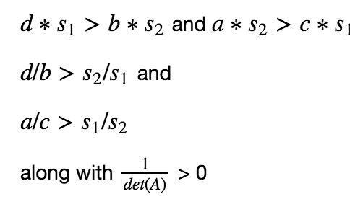
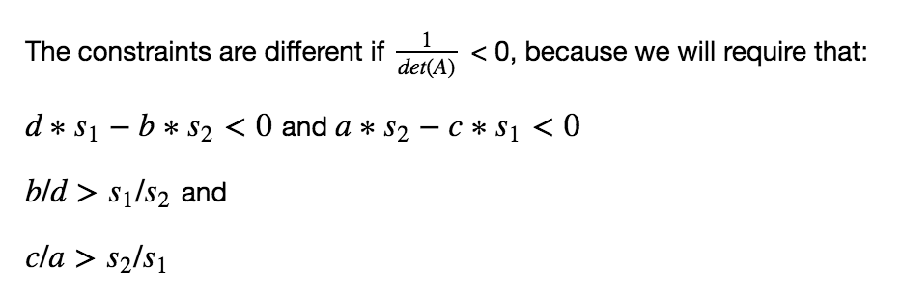
Mixing Chemical Components to Create a Chemical Solution
Constraints:

