Slide 1
DSCI6002 – Final project
Airplane crashes since 1908
https://www.kaggle.com/saurograndi/airplane-crashes-since-1908

Slide 2
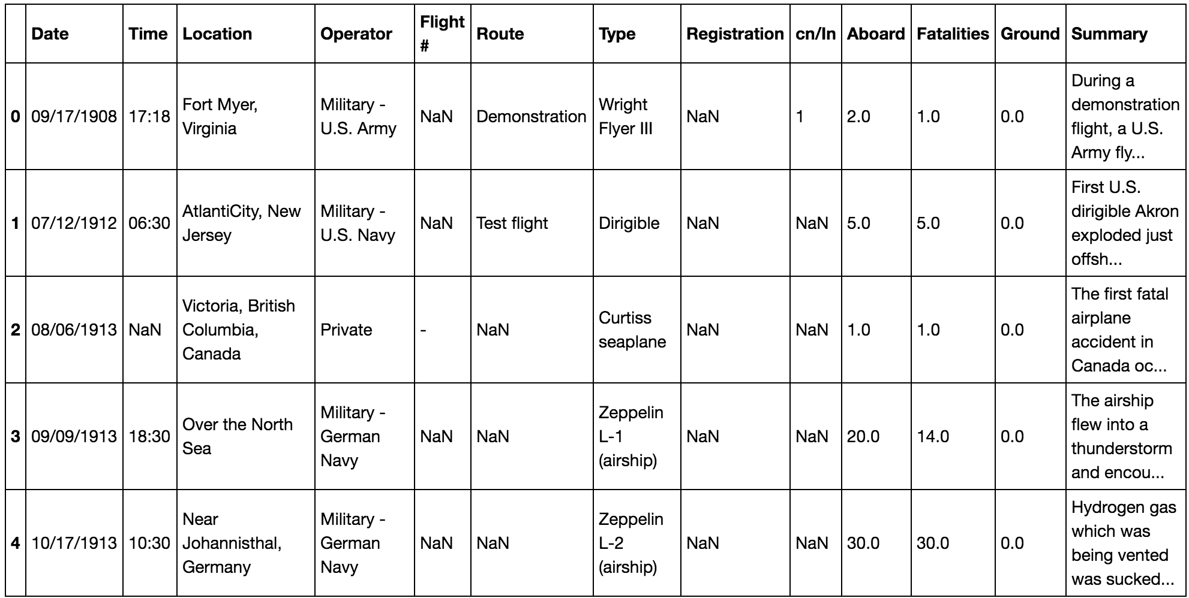
Airplane crashes since 1908
A quick look at the data:

Slide 3
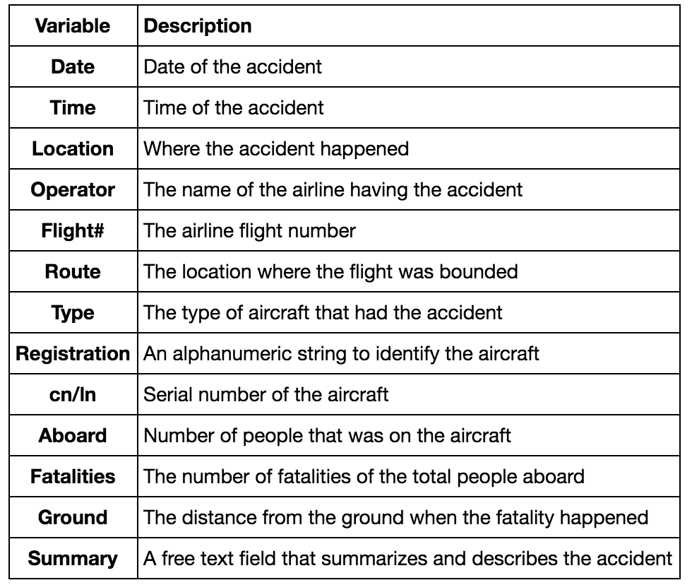
Airplane crashes since 1908
Variables description:

Slide 4
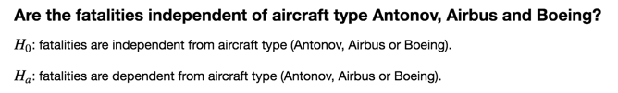
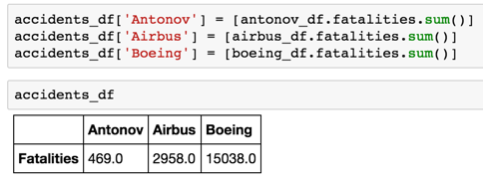
Airplane crashes since 1908

Slide 5
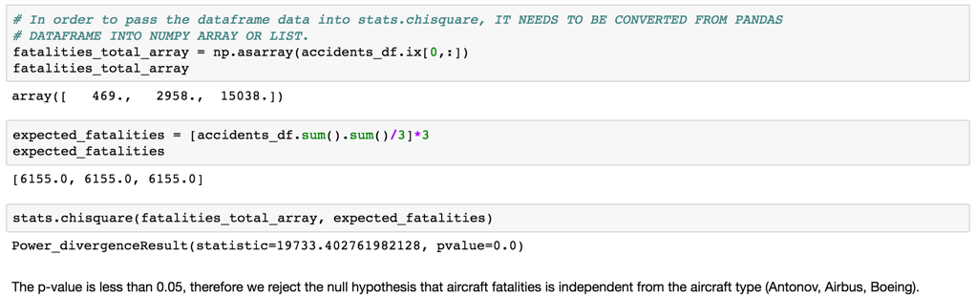
Airplane crashes since 1908

Slide 6
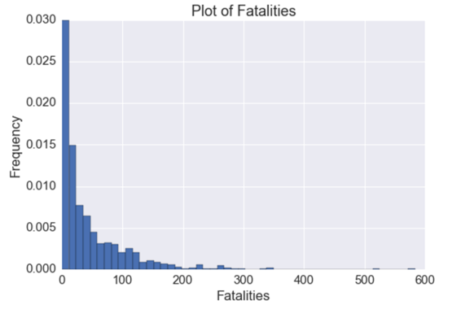
Airplane crashes since 1908
How “fatalities” distribution looks like?

Slide 7
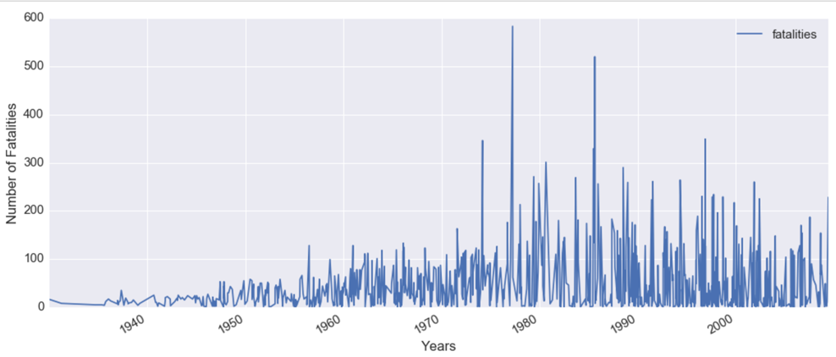
Airplane crashes since 1908
Time Series

Slide 8
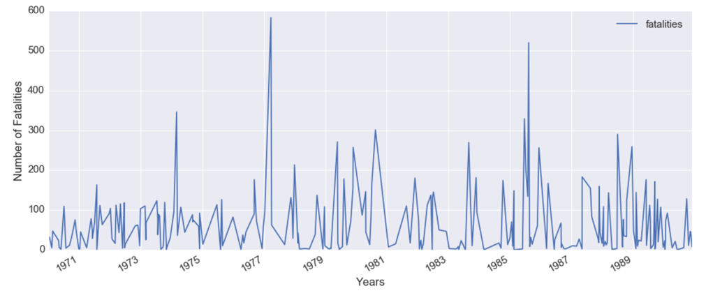
Airplane crashes since 1908
Time Series: “zooming in” 1970s-1980s

Slide 9
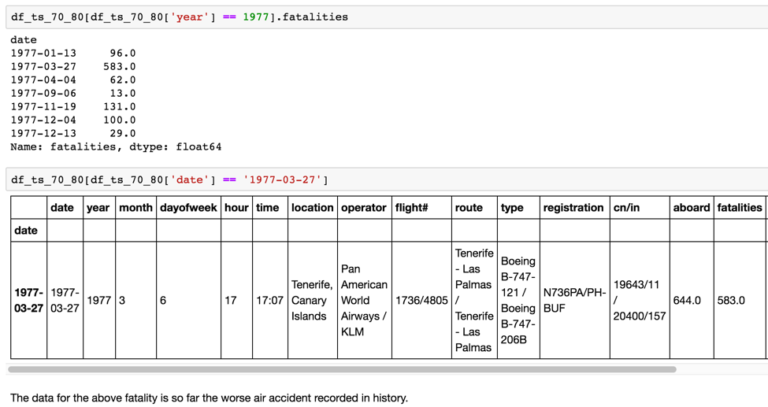
Airplane crashes since 1908
Time Series

Slide 10
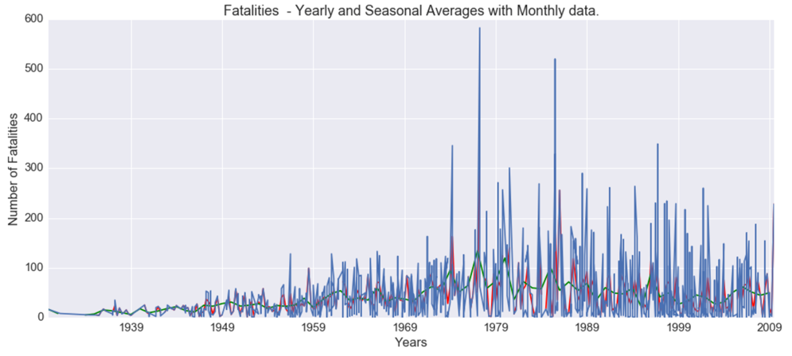
Airplane crashes since 1908
Time Series

Slide 11
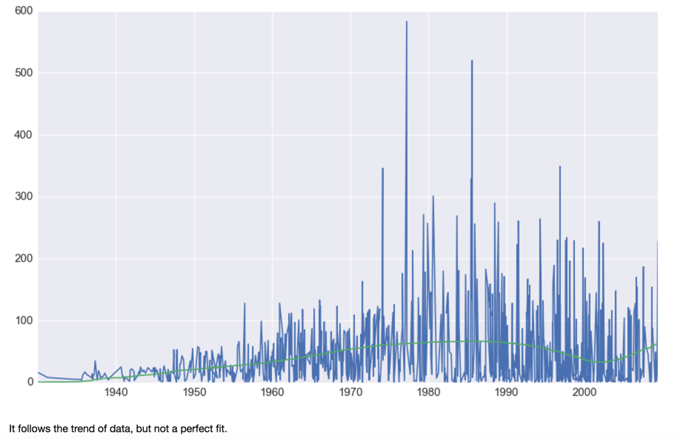
Airplane crashes since 1908
Time Series – ETS with 5th degree polynomial.

Slide 12
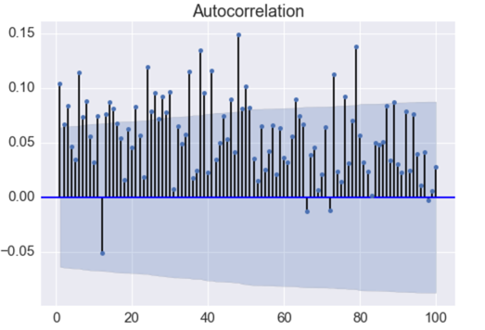
Airplane crashes since 1908
Non-Stationary.

Slide 13
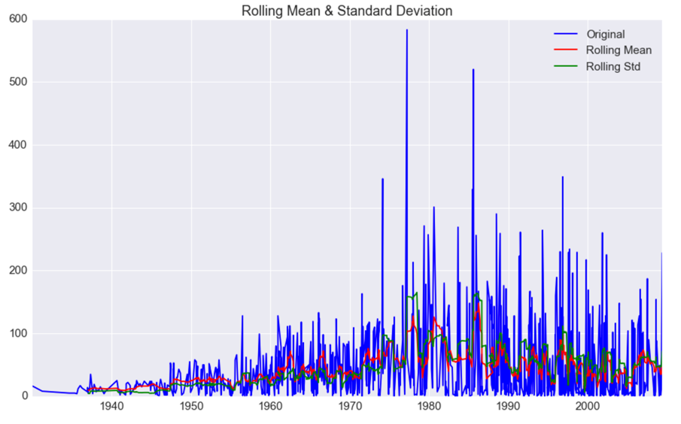
Airplane crashes since 1908
Non-Stationary.

Slide 14
Airplane crashes since 1908
GLM – You can have regular expressions:

Slide 15
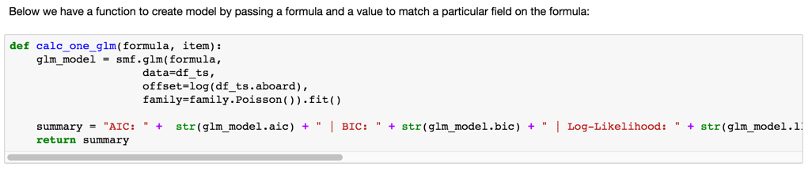
Airplane crashes since 1908
GLM – Poisson:

Slide 16
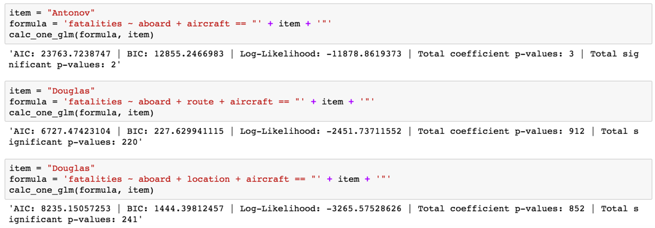
Airplane crashes since 1908
GLM – Poisson:

Slide 17
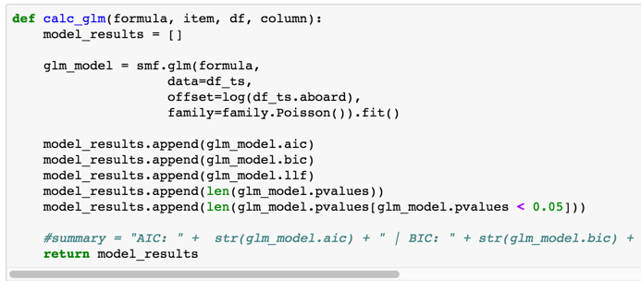
Airplane crashes since 1908
GLM – Poisson:

Slide 18
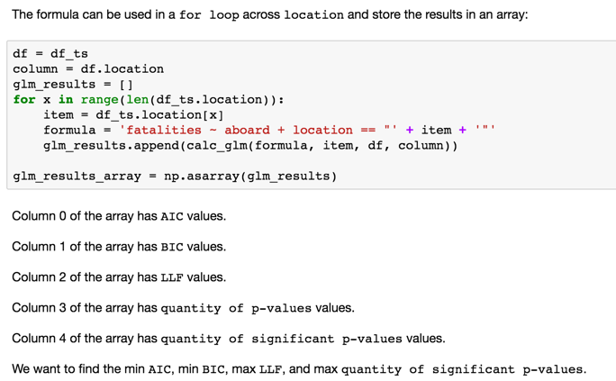
Airplane crashes since 1908
GLM – Poisson:

Slide 19
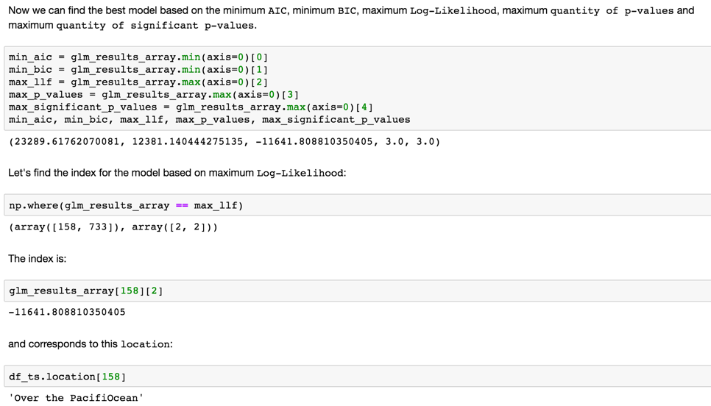
Airplane crashes since 1908
GLM – Poisson:

Slide 20
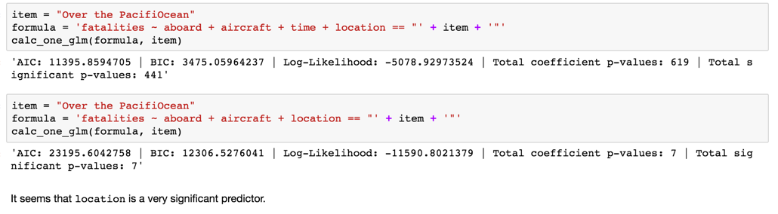
Airplane crashes since 1908
GLM – Poisson:

Slide 21
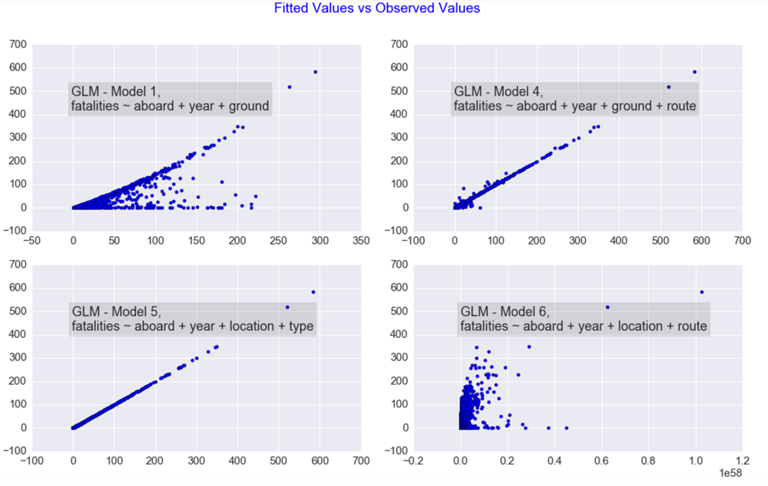
Airplane crashes since 1908
GLM – Poisson:

Slide 22
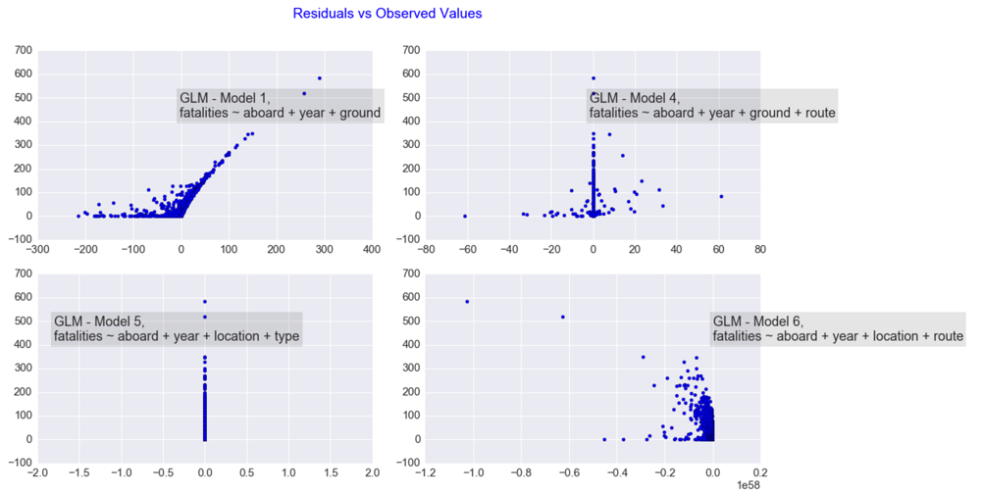
Airplane crashes since 1908
GLM – Poisson:

Slide 23
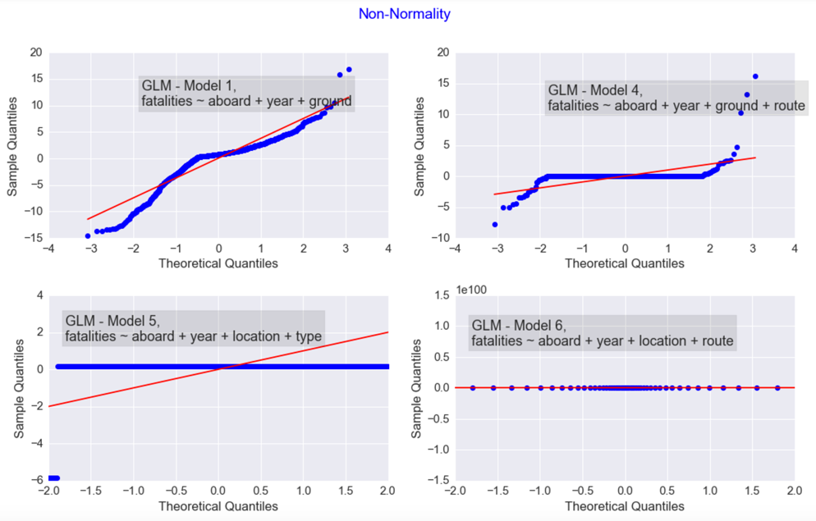
Airplane crashes since 1908
GLM – Poisson:

Slide 24
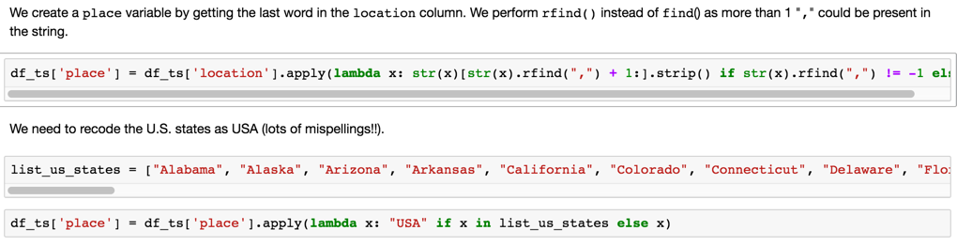
Airplane crashes since 1908
GLM – Poisson:

Slide 25
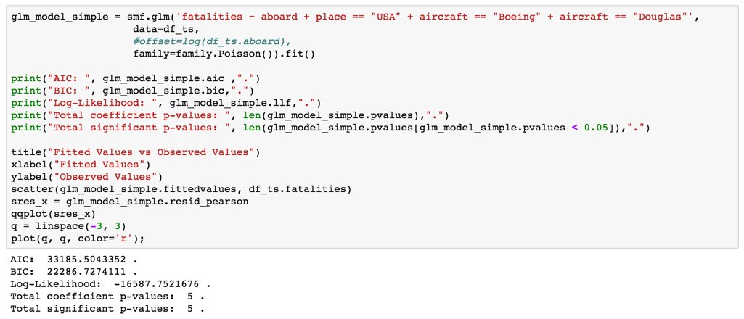
Airplane crashes since 1908
GLM – Poisson:

Slide 26
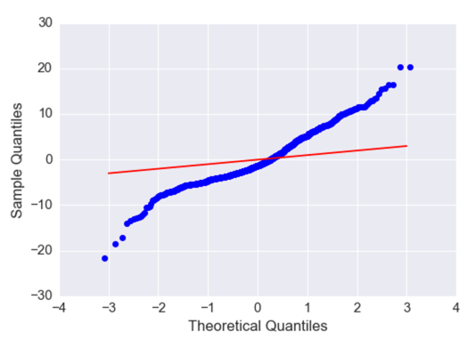
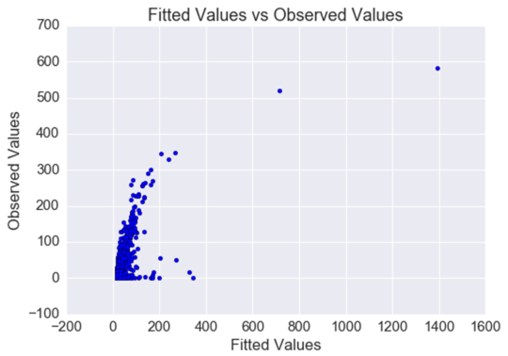
Airplane crashes since 1908
GLM – Poisson:

Slide 27
Airplane crashes since 1908
Next Steps:
Extract data from “Summary” field and classify it. It contains information on the cause of the accident and other details.
Apply SVD.
Do clustering with routes, airplanes and airlines.

