Slide 1
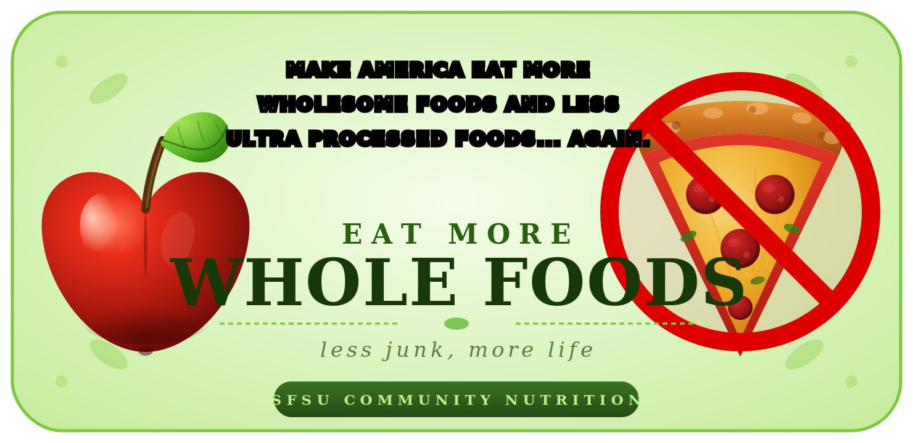
SCLP COMMUNITY NUTRITION PROJECT · PART 2
Real Food,
Real Health.
A 30-minute look at what's on your plate — and what to do about it.
Notes:
SLIDE 1 · TITLE [0:00] Welcome everyone. My name is [your name] and this is the SCLP Community Nutrition Project, Part 2. Today we have 30 minutes together. We will move quickly so stay with me. Before anything else — we need everyone to take a quick pre-survey. Go to the next slide.

Slide 2
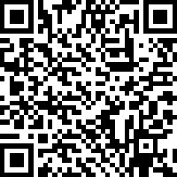
BEFORE WE START
Take the pre-survey.
It takes 3 minutes and sets our baseline. Scan the code below.
2 / 14
Notes:
SLIDE 2 · PRE-SURVEY [0:30] Please scan this QR code RIGHT NOW before we go further. It takes about 3 minutes. This is your baseline — your answers here versus your answers at the end show us whether this session actually worked. Take your time. I will wait.

Slide 3




TODAY'S 30 MINUTES
Here's what we'll cover.
01
What's actually in our food
How processing changes everything
02
Why your body cares
Heart, brain, gut, weight
03
Reading labels like a pro
Hands-on activity
04
Three recipes you'll actually make
Plus a 7-day swap challenge
SCLP Part 2 · Real Food, Real Health
3 / 14
Notes:
SLIDE 3 · AGENDA [4:00] Here is our plan for the next 30 minutes. We will cover what ultra-processed food actually is, look at what the science says about why it matters, do a quick hands-on label activity, and I will walk you through three easy recipes and a 7-day challenge you can take home today.

Slide 4
DEFINING THE PROBLEM
Not all "food" is created equal.
Researchers group foods into 4 categories — the NOVA classification.
GROUP 1
GROUP 2
GROUP 3
GROUP 4
Whole
Culinary
Processed
Ultra-Processed
Minimally processed
Used to cook with
2–3 ingredients added
Industrial formulations
Vegetables, fruit, eggs, meat, beans, grains.
Oils, butter, salt, sugar, vinegar.
Cheese, canned beans, fresh bread, smoked fish.
Soda, chips, packaged snacks, frozen dinners, breakfast cereals.
← Today's focus
SCLP Part 2 · Real Food, Real Health
4 / 14
Notes:
SLIDE 4 · NOVA [5:30] Researchers at the University of São Paulo created a system called NOVA that puts every food into one of four groups based on how much it has been industrially processed. Groups 1 and 2 are what people ate for most of human history. Group 4 — ultra-processed — is a 20th-century invention. Key point: Group 4 is not just junk food. That is the surprise. Go to the next slide.

Slide 5

HIDING IN PLAIN SIGHT
UPF isn't just junk food.
It's anything with ingredients you wouldn't keep in your kitchen — emulsifiers, stabilizers, modified starches, hydrogenated oils, artificial flavors.
LOOKS HEALTHY. ACTUALLY UPF.
Flavored yogurt with "natural flavors" + stabilizers
Plant milks with gums, oils, and added vitamins
Even "healthy-looking" products often qualify.
Whole-grain bread with dough conditioners
Granola bars with syrups + isolated proteins
Veggie chips and "made with real fruit" snacks
Pre-made smoothies with concentrates + flavors
Most breakfast cereals — even the bran ones
SCLP Part 2 · Real Food, Real Health
5 / 14
Notes:
SLIDE 5 · UPF HIDING [7:00] Raise your hand if you bought any of these in the last week. [Pause.] Flavored yogurt, plant milk, granola bars — these feel healthy. The marketing says healthy. But look at the ingredient list and you will find industrial additives that do not exist in home kitchens. The rule of thumb: if you would not find the ingredient in your pantry, it is a red flag.

Slide 6
57%
AND IT'S CLIMBING
Children & Teens
67%
of daily calories from UPF — the highest of any age group.
In 2000, the share was closer to 53%. The trend hasn't reversed.
of calories the average U.S. adult eats come from ultra-processed foods.
Source: NHANES analysis, BMJ (2022).
SCLP Part 2 · Real Food, Real Health
6 / 14
Notes:
SLIDE 6 · THE STAT [9:00] Let that number land. 57 percent. More than half of everything the average American eats is ultra-processed. For teenagers it is 67 percent — the highest of any age group. Pause here. Ask the room: does this surprise you? [Take 1-2 responses.] This is not about individual failure. The food system is designed this way.

Slide 7


WHAT THE RESEARCH SHOWS
Higher UPF intake is linked to…
+24%
+22%
+55%
+12%
increased risk of
increased risk of
increased risk of
increased risk of
Heart disease
Anxiety & depression
Obesity & weight gain
Type 2 diabetes
Cardiovascular events
Common mental disorders
Across long-term studies
Per 10% UPF intake
Risk increases vs. low UPF consumers. Pooled estimates from meta-analyses (BMJ 2024, Lancet 2024).
SCLP Part 2 · Real Food, Real Health
7 / 14
Notes:
SLIDE 7 · HEALTH IMPACT [11:30] These are pooled estimates from large meta-analyses published in the BMJ and Lancet. Walk through each: heart disease, anxiety and depression, obesity, type 2 diabetes. Emphasize: these are risks above and beyond what low-UPF consumers face — not absolute risk. We are talking about real, meaningful population-level shifts.

Slide 8

THE OTHER SIDE
Whole foods do the opposite.
Diets built around minimally processed foods consistently link to:
Better heart health
Stable energy
Lower blood pressure, healthier cholesterol.
Fiber + protein = no afternoon crash.
Improved gut health
Healthier weight
Fiber feeds the microbiome.
Greater satiety per calorie.
Sharper mood
Lower disease risk
Whole-food nutrients support mental health.
Across cancer, diabetes, dementia.
SCLP Part 2 · Real Food, Real Health
8 / 14
Notes:
SLIDE 8 · WHOLE FOODS [13:30] This is the flip side. We are not here to scare anyone — we are here to show what happens when you eat differently. Stable energy, better mood, lower disease risk. These benefits show up in the research too. Key message: this is not about perfection. It is about shifting the balance.

Slide 9


PRACTICAL SHIFTS
The big swaps.
SKIP
CHOOSE
• Sweetened breakfast cereal
• Oats with fruit & nuts
• Flavored yogurt
• Plain yogurt + honey + berries
• Soda or sweetened juice
• Water, tea, or fruit-infused water
• Packaged granola bars
• Apple + nut butter, or trail mix
• Frozen dinners
• Sheet-pan meal: protein + 2 veg
• Sandwich bread (long ingredients)
• Sourdough or whole-grain (4 ingredients)
SCLP Part 2 · Real Food, Real Health
9 / 14
Notes:
SLIDE 9 · BIG SWAPS [15:00] Walk through the SKIP vs CHOOSE columns together. Ask the room: which of these swaps feels most doable for you right now? [Take 1-2 responses.] Remind them: the goal is not to never eat UPF again. The goal is to close the gap — from 57% down toward something more balanced.

Slide 10
ACTIVITY
Read like a scientist.
Grab the worksheet. You have 5 minutes.
01
02
03
Count the ingredients
Spot the chemistry
Watch added sugars
Whole foods usually have 1–5. UPF often has 15+.
Mono- and diglycerides, modified starch, soy lecithin = UPF flag.
Sugar, syrup, dextrose, maltodextrin — all in the top 5? Skip it.
SCLP Part 2 · Real Food, Real Health
10 / 14
Notes:
SLIDE 10 · ACTIVITY [17:00 — 5 MINUTES] Hand out the worksheets NOW if you have not already. Give them exactly 5 minutes. Walk the room. If people finish early, ask them to check their neighbor's answers. After 5 min: go through the answers together. Yogurt B, Sourdough, Apple+Almond Butter are the whole-food options. Ask: which one surprised you most?

Slide 11



EATING WELL, ACTUALLY
Three recipes you'll cook this week.
BREAKFAST
LUNCH
DINNER
Overnight Oats
Lemon-Tahini Power Bowl
Sheet-Pan Chicken & Veggies
5 min · no cook
10 min
25 min · 1 pan
Rolled oats, milk, yogurt, berries, honey.
Chickpeas, greens, cucumber, grain, tahini-lemon.
Chicken thighs, broccoli, sweet potato, olive oil.
Full recipe cards in your handout pack.
SCLP Part 2 · Real Food, Real Health
11 / 14
Notes:
SLIDE 11 · RECIPES [23:00] Hand out the recipe cards here if not already distributed. Briefly walk through each recipe — do NOT read the card word for word. Overnight Oats: make tonight, eat tomorrow, zero cooking. Power Bowl: 10 minutes if you have pre-cooked grain. Sheet-Pan Chicken: one pan, one cleanup, scales up easily. If doing a live demo, now is the time. Keep it to 2 minutes max.

Slide 12
TAKE IT HOME
The 7-Day Swap Challenge.
One small change a day. By Sunday, your kitchen looks different — and so do you.
MON
Day 1
Swap soda for sparkling water + lemon
TUE
Day 2
Swap flavored yogurt for plain + fruit
WED
Day 3
Swap packaged snack for nuts + apple
THU
Day 4
Cook one whole-food dinner from scratch
FRI
Day 5
Read one label before you buy
SAT
Day 6
Stock the pantry with 3 staple swaps
SUN
Day 7
Meal-prep breakfast for the week
SCLP Part 2 · Real Food, Real Health
12 / 14
Notes:
SLIDE 12 · 7-DAY CHALLENGE [25:30] Hand out the action plan now. Walk through the 7 days briefly — do not read each one. Just say: one small change per day, check it off, by Sunday your kitchen looks different. Point out the checkboxes. Tell them these are for their own accountability, not to be turned in.

Slide 13
MAKE IT YOURS
Pick three. Start tomorrow.
On your take-home action plan, write down three swaps you'll commit to this week.
01
02
03
Easy swap
Habit shift
New skill
Something you can change today without thinking.
A weekly routine — meal prep, label-reading at the store.
Try one new whole-food recipe from your handout pack.
SCLP Part 2 · Real Food, Real Health
13 / 14
Notes:
SLIDE 13 · COMMITMENTS [27:00] Give them 90 seconds to write their 3 commitments on the action plan. Do not rush this — silence is fine. This is the most important minute of the session. While they write: remind them the post-survey is next and takes 3 minutes.

Slide 14
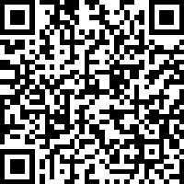
Thank you.
One last thing before you go.
Take the post-survey
It takes 3 minutes and shapes future workshops.
SCAN ME

