Slide 1
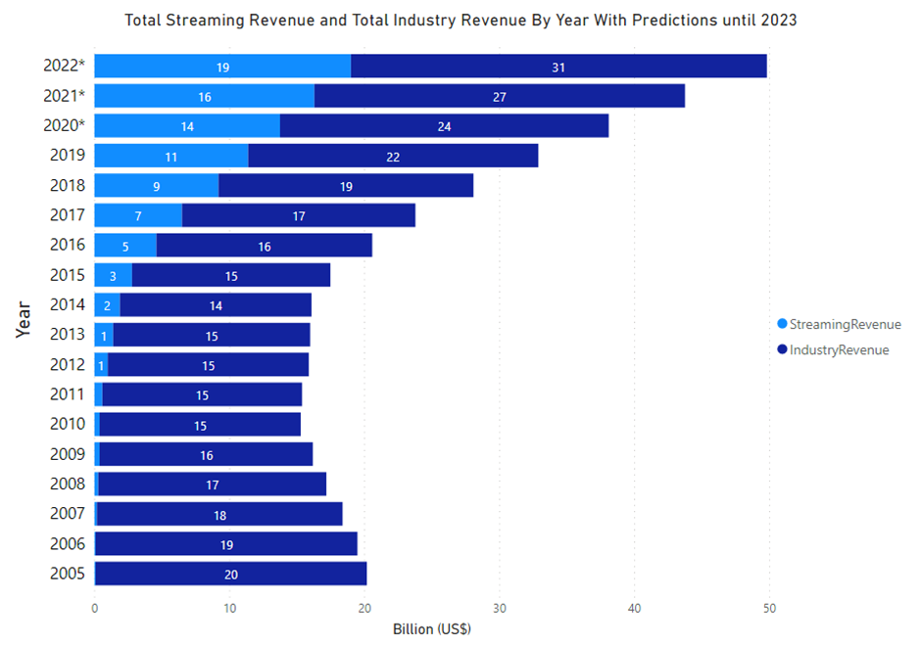
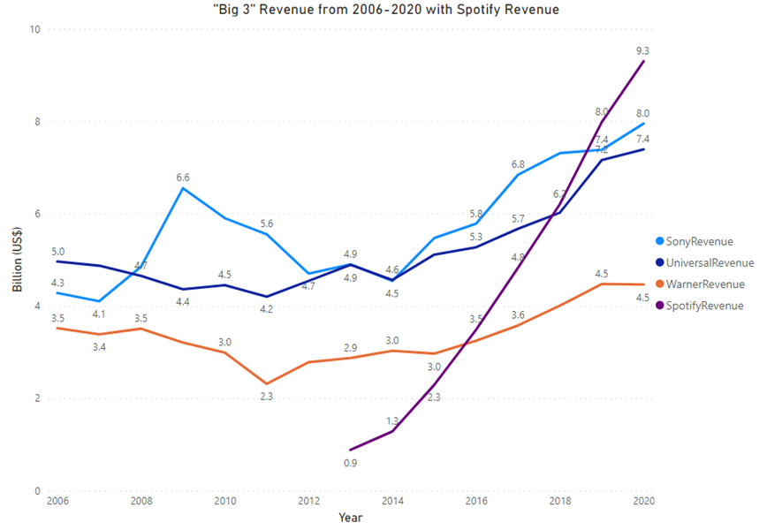







Carl Flynn BSc(Hons) in Computing(Data Analytics)
An Analysis of the Shift in Music Industry Revenue Streams in the Last 15 Years
Abstract:
The overall aim of this project is to gather and analyse appropriate data on the music industry from recent years and draw conclusions from this data using various analysis techniques as well as forecast into the future to see what kind of position the music industry may be in the next three years. Various datasets were gathered online from websites such as Kaggle.com and statista.com. This data covered a range of subjects like revenue, format market shares and sales and also covering several nations/regions as well as individual companies within the music industry. Some key findings from the analysis found that over the selected time scale there has been a universal shift towards digital music consumption formats and that music industry revenue across regions and companies and industry as a whole has been on the rise in recent years. Using forecasting techniques we have also made predicted to continue rising over the next three years based on previous years.
Project Explanation
Screenshots?
The motivation behind the project was to analyse music industry revenue over the last 15 years and to examine consumer listenership trends as well as revenue streams within the music industry. The project has three sets of results all focussing on different areas of the music industry and how they have changed in the set out time frame.
The project followed the KDD data analysis methodology and uses a combination of techniques learned in-class and other methods learned independently. The project used a combination of technologies, details of which can be found below
Technologies used

