Slide 1

An Analysis of the Shift in Music Industry Revenue Streams in the Last 15 Years
Carl Flynn BSHcDA4

Slide 2
Agenda
Project Overview
Approaches Taken
Results
Demonstration
Testing
Conclusions

Slide 3
Project Overview
What is it?
Objective?
Target Audience?
How is it different?

Slide 4
Approach
Approaches Taken
KDD Methodology
Visual analysis
Forecasting

Slide 5






Technologies Used

Slide 6
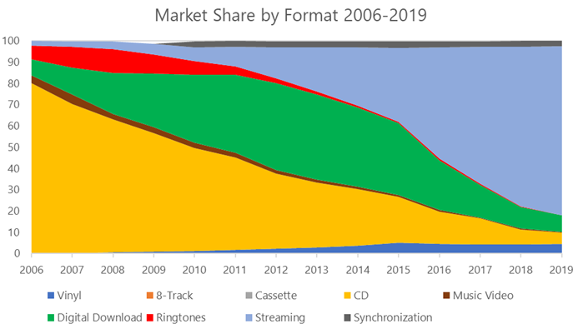
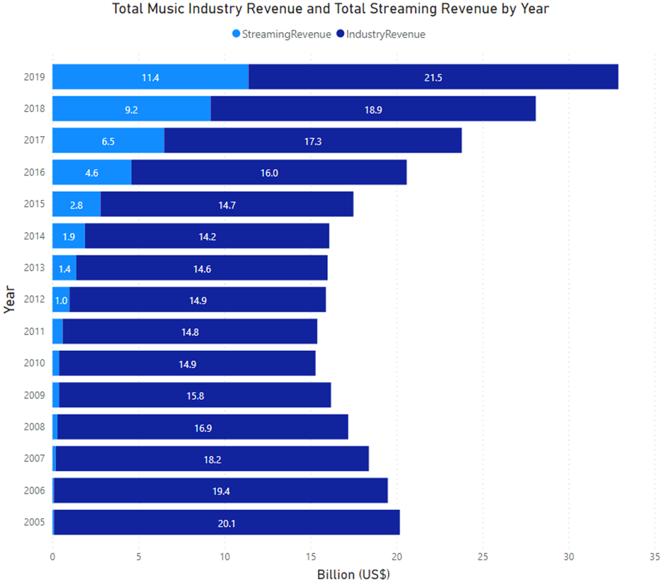
Results

Slide 7
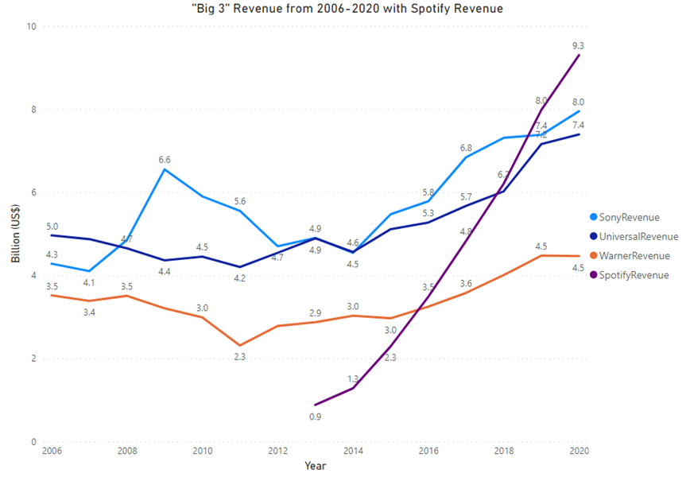
Results

Slide 8
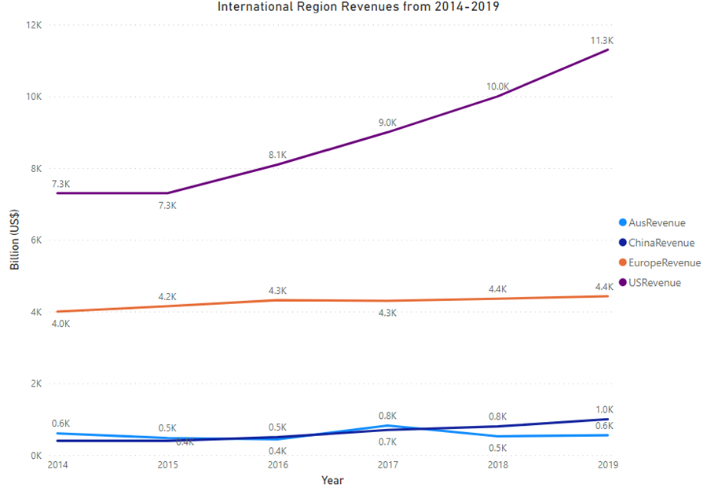
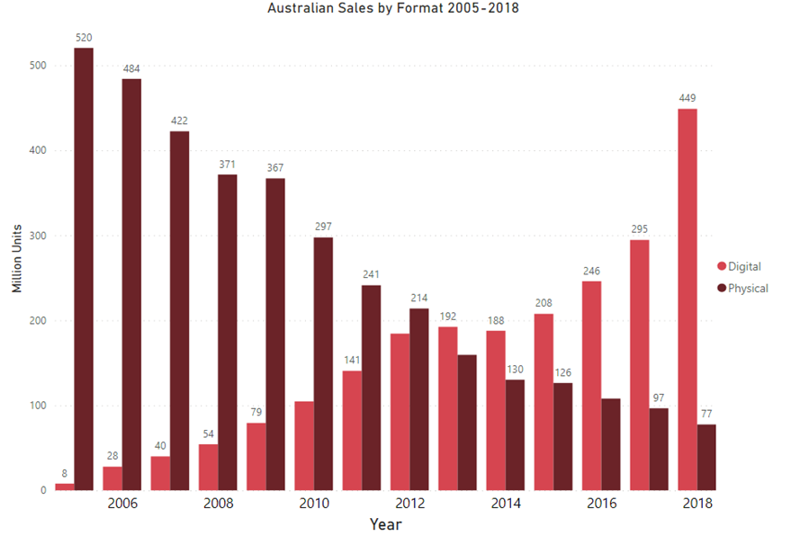
Results

Slide 10
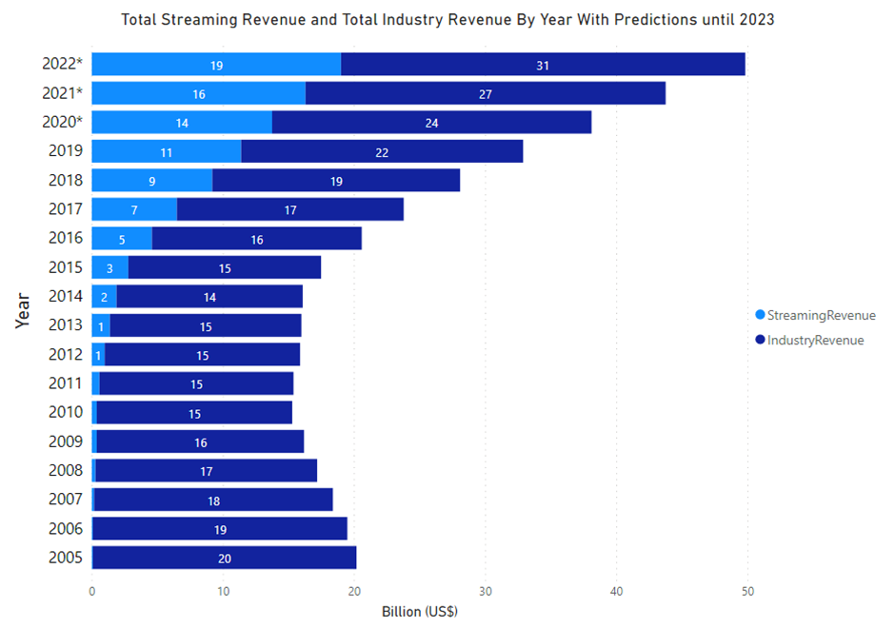
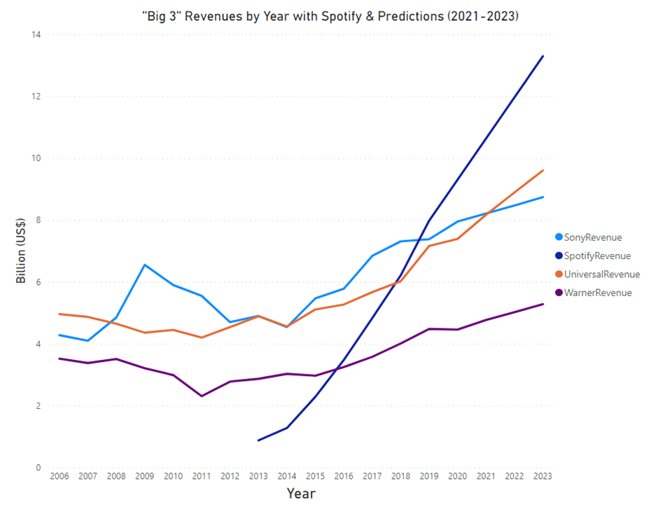
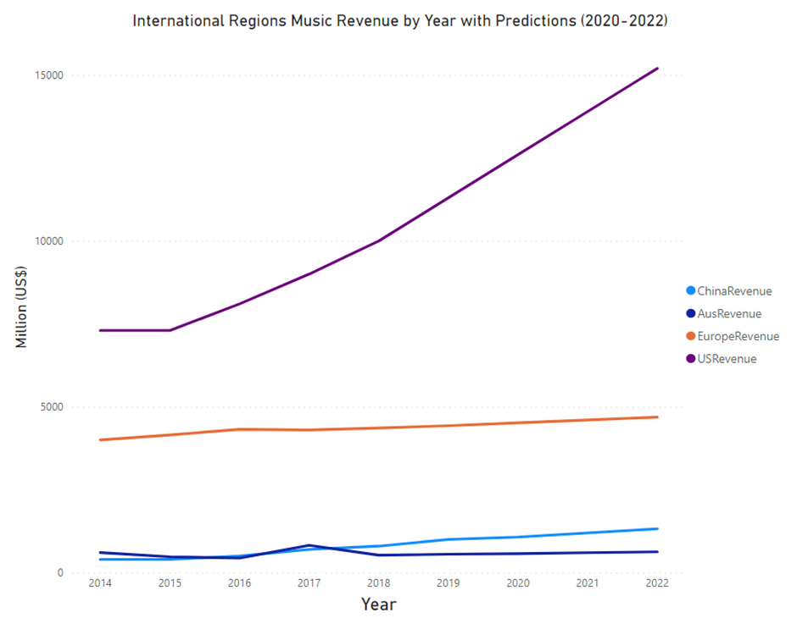
Results

Slide 11
Demonstration

Slide 12
Testing
Model Fit
Adjusted for Inflation
Plot Comparisons

Slide 13
Conclusions
Most difficult aspect?
Have the objectives been fulfilled and have they changed from the beginning?
Would I make changes?/Future Work?

Slide 14
Thank You!

