Slide 1
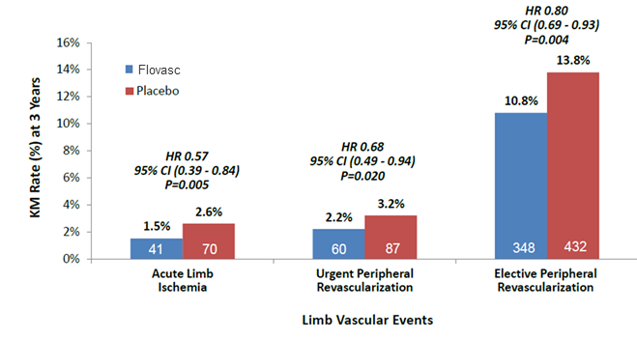
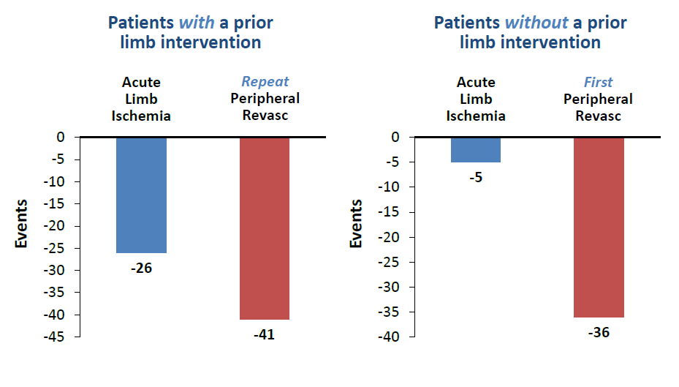
Clinical data
Limb vascular events in patients with known PAD or ABI (Ankle-brachial index) ≤0.90 (Blockage)
Limb Events Prevented for 1,000 Patients Treated for 3 Years (No Recent MI, No Stroke/TIA)
The figures below are specific to Flovasc

