Slide 1
MRI - Concept
By: Carl-Georg Meyer

Slide 2
Contents
Concept
Components
Models
User Interface
Conclusion

Slide 3
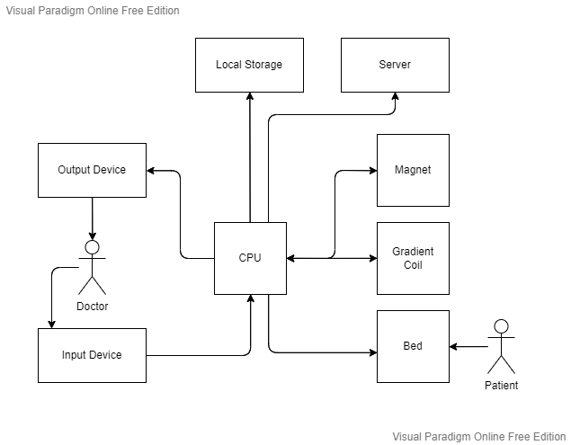
Concept

Slide 4
Components
Magnet
Gradient Coil
Control and Processing
Image Processing
Integrated Circuits
Storage Device
Server

Slide 5
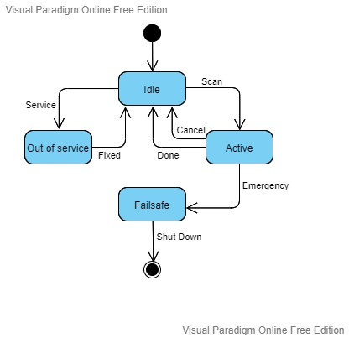
Models

Slide 6
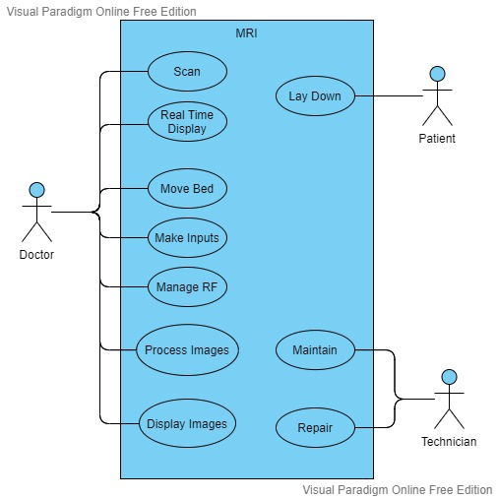
Models

Slide 7
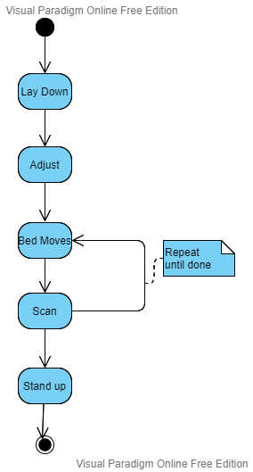
Models

Slide 8
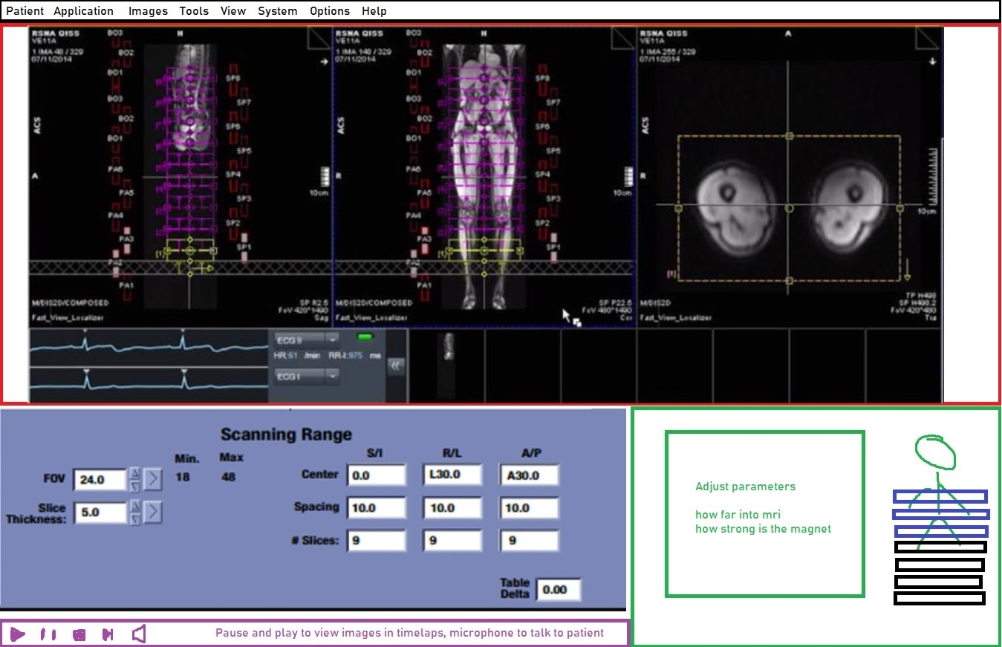
User Interface

Slide 9
Conclusion
Concept finished
Solution found
Can be expanded

