Slide 1
Project Presentation
Ning Wang - May 2nd 2017

Slide 2
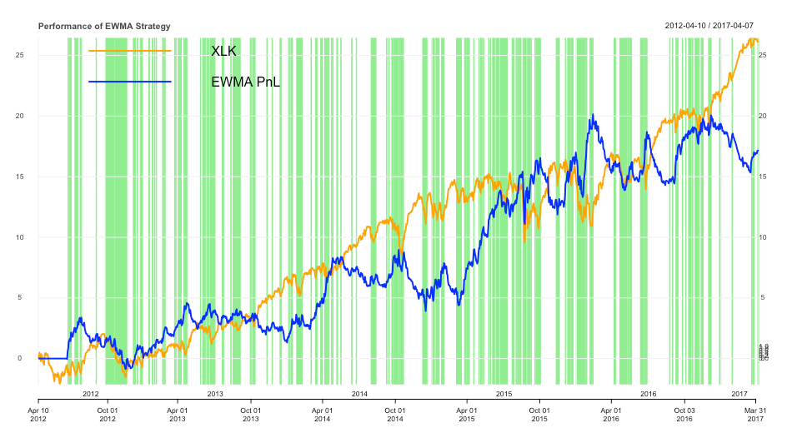
Instrument & Strategy
Notes:
The instrument I have chosen is XLK, an ETF for technology sector. The time period I used is 5 years, from 2014-04-10 to 2017-04-07. It includes the 2018 financial crises, which is a very unique opportunity to the test how robust the strategy is.
The trading strategy is based on the idea of mean reverting. I have calculated the exponential weighted moving average (EWMA) as the trading signal, and compare the close price with the EWMA signal. If the adjusted close price is higher than the signal, I short one unit of ETF; if the price goes lower than the signal, I long one unit of ETF. However, I have done some improvements to this strategy.
There are two arguments when calculating the EWMA, look back window length and lambda which represents how fast the weight of previous price decays. I improve the EWMA signal by choosing lambda dynamically according to the result of back testing. More specifically, when I look back at time t, I calculate the Sharpe Ratio and choose the lambda which gives me the highest Sharpe Ratio and use this lambda do calculate EWMA after time t.

Slide 3
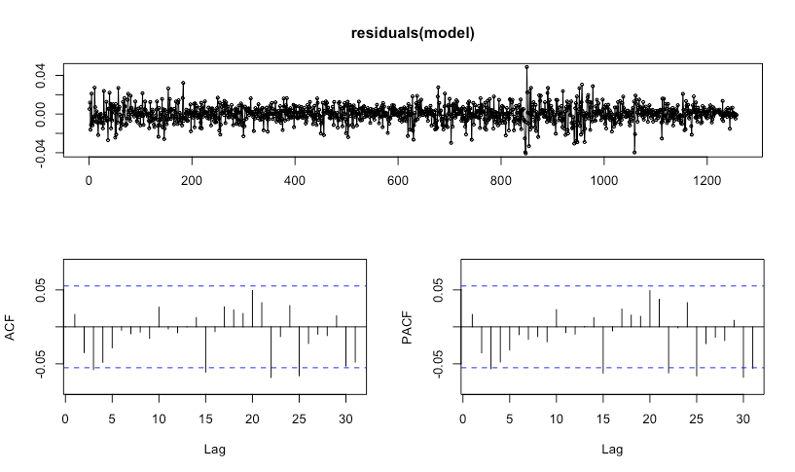
Time series model
auto.arima()

Slide 4
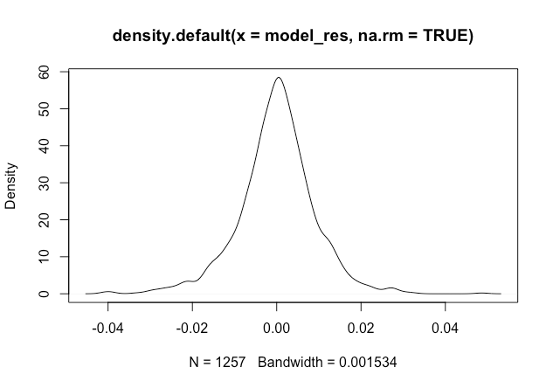
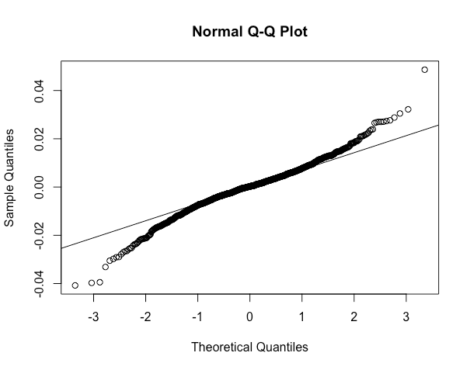
Time series model
Residuals

Slide 5
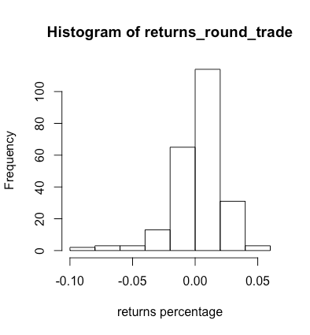
Bootstrap
Package: boot (multi processing)
 | tradeNum | total_return | winning_rate | max_drawdown | sharpe_ratio
Empirical | 234 | 0.6352441991573199 | 0.6324786324786325 | -0.16233981751398746 | 0.6641036907209302
Average | 241.511 | 0.1348806540552425 | 0.6017969591181141 | -0.4558688033834125 | 0.156091720975707
Notes:
on average, the return rate is lower and risk is much higher.

Slide 6
Possible improvement
1. EWMA -> ?
2. mean revert -> combination of strategies. E.g. bagging (weak classifiers to stronger ones)
3. Find a better model for time series
Notes:
We can always choose another signal
machine learning techniques
make the residuals normally distributed.

