Slide 1
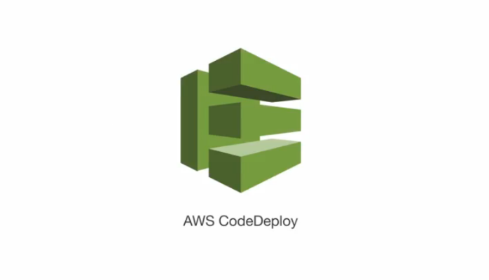

CDC
Deploying to AWS

Slide 2
CDC – Deploying to AWS
Jenkins
AWS cli
GIT
AWS
Notes:
- Trainees should have a dedicated branch (hopefully they have the same trainers)

Slide 3
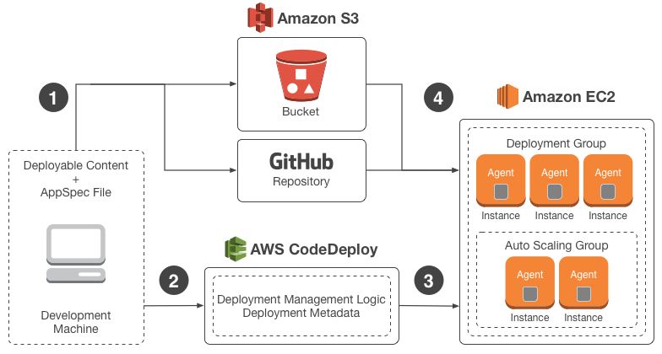
CDC – Deploying to AWS/ Introduction
We want to deploy our application to AWS instances
Using codedeploy
Notes:
http://docs.aws.amazon.com/codedeploy/latest/userguide/welcome.html

Slide 4
File structure
The AppSpec file is used to manage each deployment as a series of lifecycle events
Files that will be deployed

Slide 5
AWS management
Create IAM Role
Create instance with this IAM role attached
Create S3 bucket
Create Codedeploy Application https://ap-southeast-1.console.aws.amazon.com/codedeploy/home?region=ap-southeast-1#/applications
Create Deployment group

Slide 6
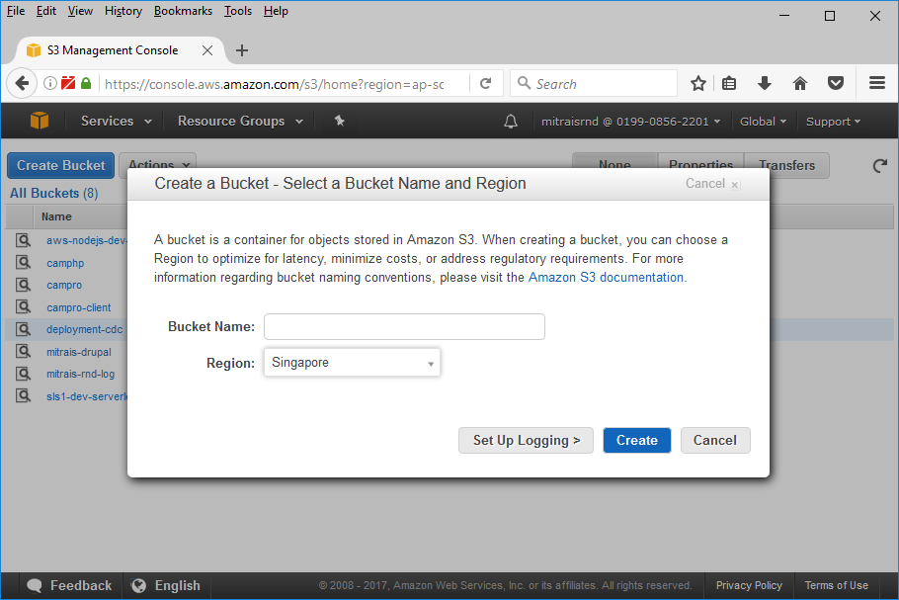
Create S3 bucket
Notes:
https://ap-southeast-1.console.aws.amazon.com/codedeploy/home?region=ap-southeast-1#/applications/CDC-deploy/deployment-groups/new

Slide 7
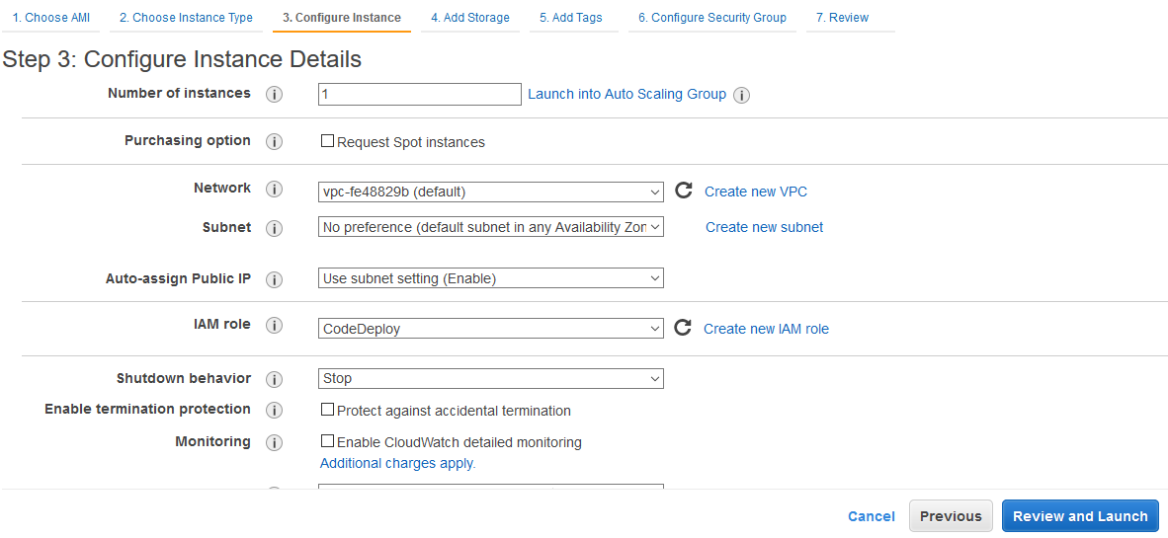
Preparing Instance
After the instance is cretead, the you need to install AWS Codedeploy agent
Notes:
https://ap-southeast-1.console.aws.amazon.com/codedeploy/home?region=ap-southeast-1#/applications/CDC-deploy/deployment-groups/new
http://docs.aws.amazon.com/codedeploy/latest/userguide/how-to-run-agent-install.html

Slide 8
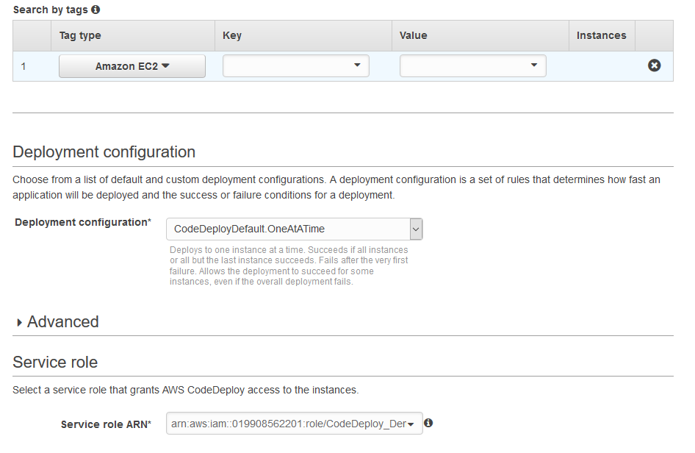
Create Deployment Group
Instance that will be deployed into
IAM Role that created before
Notes:
https://ap-southeast-1.console.aws.amazon.com/codedeploy/home?region=ap-southeast-1#/applications/CDC-deploy/deployment-groups/new

Slide 9
Jenkinsfile
Push to S3 aws deploy push --application-name ${applicationName} --description '${description}' --ignore-hidden-files --s3-location s3://${yourS3location} --source ${yourdeployable content} > .deployment_command
You will get the deployment command in file ‘.deployment_command’

Slide 10
Jenkinsfile
Or you can create your own deployment command aws deploy create-deployment --application-name CDC-deploy --s3-location bucket=deployment-cdc,key=langit.zip,bundleType=zip,eTag=db1f16bd84c48ab3952703cf4e86b291-16 --deployment-group-name <deployment-group-name> --deployment-config-name <deployment-config-name> --description <description>

