Slide 1


CDC
git interactive rebase

Slide 2

CDC – git interactive rebase / Prerequisites
https://github.com/mitrais-cdc-training
Git installed with any console/command line tool
Existing Github account
Go through: git-try → https://try.github.io/
Attendee of CDC Workshop I – Git merging
Notes:
- Trainees should have a dedicated branch (hopefully they have the same trainers)

Slide 3
CDC – git interactive rebase / Introduction
We want to alter individual commits!
Interactive Rebasing allows us to:
Squashing (squash) commits (see example above)
Splitting commits
Alter (reword) commit messages
Reorder commits
Notes:
Example for interactive rebase: squashing commits
pick 32618c4 Start developing a feature
pick 62eed47 Fix something from the previous commit →
pick 32618c4 Start developing a feature
squash 62eed47 Fix something from the previous commit → will end up in one commit, with new commit message

Slide 4
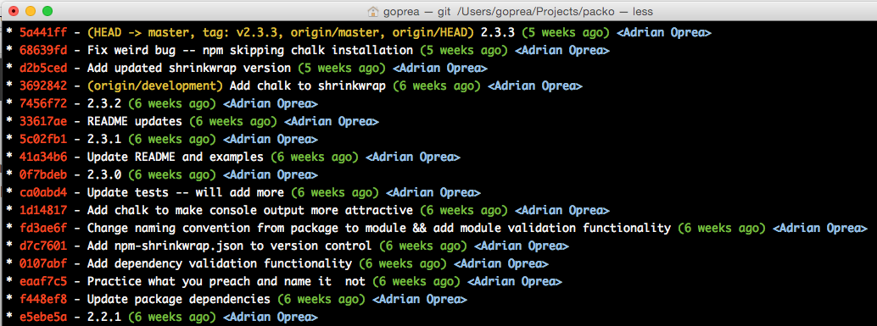
CDC – git interactive rebase / Introduction
Why is that so important?
Why we want to alter individual commits?
Commits and their messages are like history books
It’s a timeline what happened when!
Notes:
Instead of blindly moving all of the commits to the new base, interactive rebasing gives you the opportunity to alter individual commits in the process. This lets you clean up history by removing, splitting, and altering an existing series of commits. It’s like git commit --amend on steroids.

Slide 5
CDC – git interactive rebase / Environment
YOU are SQ or SE in a project
You finished your feature implementation (SE)
You finished your reviews/tests (SQ)
As SE, the reviewer don’t like your commit messages, not detailed enough!
As SE/SQ, you think some commits could be logically squashed/splitted!
As SQ/SE, you want to change commit messages to be more specific!

Slide 6
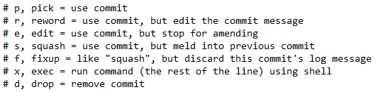
CDC – git interactive rebase / Overview
Our base command (shortcut)
Command (written form)
$git rebase –i <base>
or
$git rebase –interactive <base>
With great power comes great responsibility
Our current focus
Notes:
Be aware of rewriting history in public commits (squashing, splitting, reorder)
Difference to git commit --amend .. Changes to recent commit (not all)
Running the command pops up a editor with rebase script (see bottom of slide, start from pick)

Slide 7
CDC – git interactive rebase / Overview
“HEAD is a reference to the last commit in the currently checked-out branch.”
$git rebase –i HEAD~3
pick 9629e9b Add capybaras to index.
pick 21e37b1 Add capybaras page.
pick eb7d5a0 Actually, the plural is 'capybara'.
# Rebase 4202447..eb7d5a0 onto 4202447
#
# Commands:
# p, pick = use commit
# r, reword = use commit, but edit the commit message
# e, edit = use commit, but stop for amending
# s, squash = use commit, but meld into previous commit
# f, fixup = like "squash", but discard this commit's log message
# x, exec = run command (the rest of the line) using shell
these commands will
execute when you close
the editor
you can replace them
with any of these
$git log --oneline
Notes:
We replay the commands with the <base> we picked

Slide 8
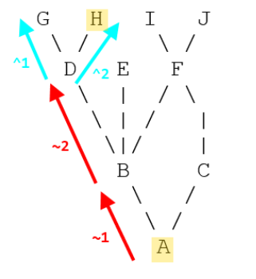

CDC – git interactive rebase / Overview
$git rebase –i HEAD~3
Hold on!!!
What does HEAD~3 doing??
HEAD^2
HEAD~2
HEAD@{2}
HEAD~~
HEAD^^
Other examples to pick the base
Notes:
~2 means up two levels in the hierarchy, via the first parent if a commit has more than one parent
^2 means the second parent where a commit has more than one parent (i.e. because it's a merge)

Slide 9
CDC – git interactive rebase / Practice
Exercise 1
Clone your branch from Workshop I (remember the command to clone a specific command)
Edit something and create multiple commit points
Squash some commit points together
Publish your branch again
Exercise 2
Clone your branch from Workshop I
Edit something and create multiple commits
Change the commit messages, be more specific
Publish your branch again

