Slide 1


CDC
fork & pull request

Slide 2

CDC – git fork & pull request/ Prerequisites
https://github.com/mitrais-cdc-training/ws3
Git installed with any console/command line tool
Existing Github account
Go through: git-try → https://try.github.io/
Attendee of CDC Workshop I & II
Notes:
- Trainees should have a dedicated branch (hopefully they have the same trainers)

Slide 3
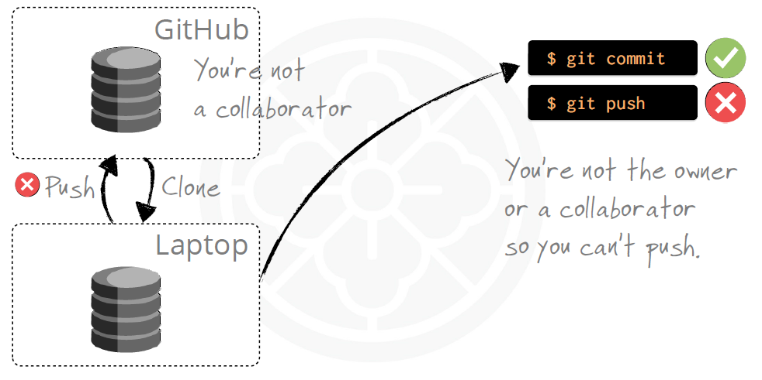
CDC – git fork & pull request / Introduction
When you are not a collaborator!

Slide 4

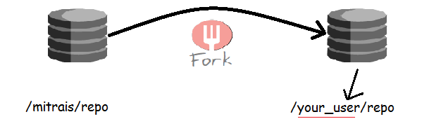
CDC – git fork & pull request / Introduction
How we can contribute to the project?
Github You can fork to your user account or an organization
Fork includes all: branches, tags and history.
Notes:
Forks are often used in open source development on GitHub.
You can contribute to the project by fork and pull request

Slide 5
CDC – git fork & pull request / Overview
A fork is a copy of a repository. Forking a repository allows you to freely experiment with changes without affecting the original project.
Propose changes to someone else's project
Fork the repository.
Make the changes.
Submit a pull request to the project owner.
Project owner likes your work? If so, they might pull your changes into the original repository!

Slide 6

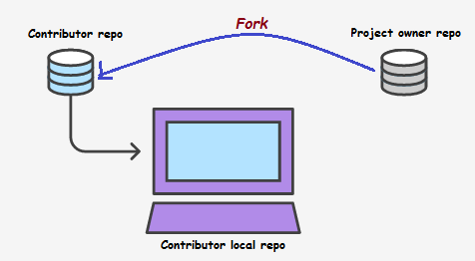
CDC – git fork & pull request /Fork Repository
Navigate to project owner repository and fork it.
https://github.com/mitrais-cdc-training/ws3
Contributor need to clone repository that she/he just forked
$ git clone https://github.com/<user>/ws3.git

Slide 7
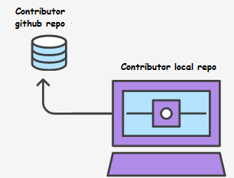
CDC – git fork & pull request / Make Changes
Keep forked repository synced to the original
$ git remote add upstream https://github.com/mitrais-cdc-training/ws3.git
# Check configured remote repository
$ git remote -v
Make some changes to local repo
$ git checkout -b feature_branch
# Edit some code
$ git commit -m “Add some feature"
Push the changes to github
$ git push origin feature_branch

Slide 8

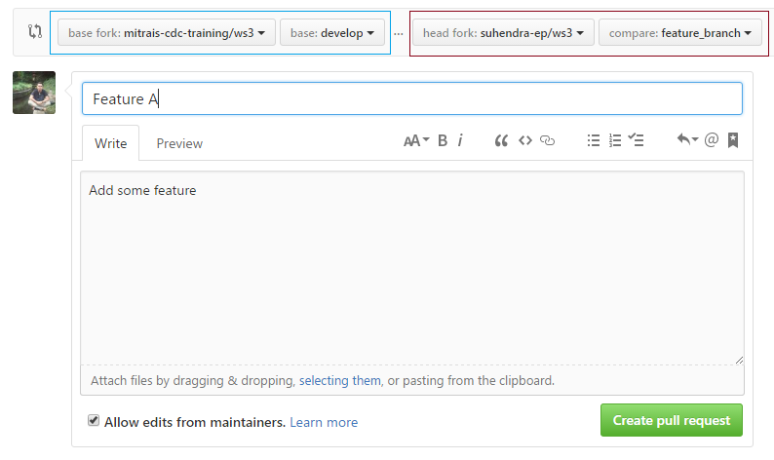
CDC – git fork & pull request/Create Pull Request
Create the pull request
Original repo
Forked repo
Pull request title
Summary of the proposed changes
Notes:
Pull requests let you tell others about changes you've pushed to a repository on GitHub. Once a pull request is opened, you can discuss and review the potential changes with contributor and add follow-up commits before the changes are merged into the repository.

Slide 9
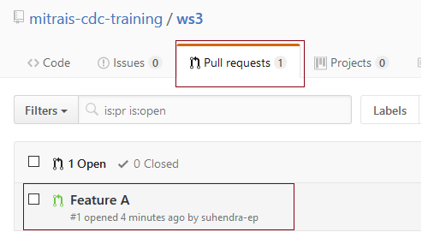
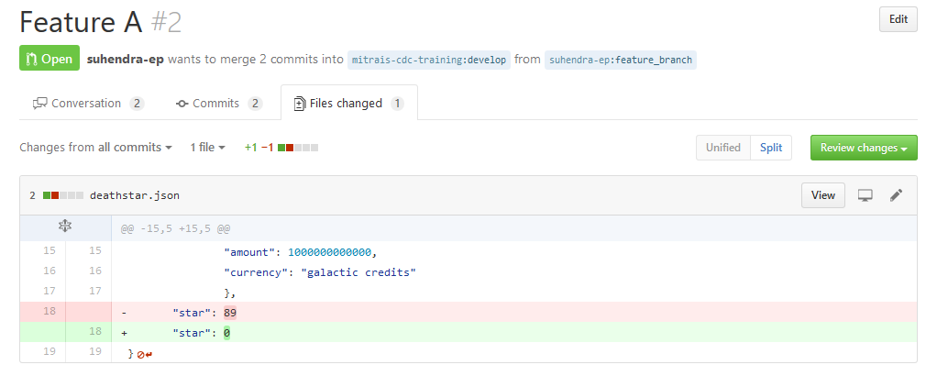
CDC – git fork & pull request/Review the changes
Project owner have a look on the pull request
Project owner review the changes. - Comment - Approve - Request changes
Notes:
Review Process: Comment Submit general feedback without explicit approval.
Approve Submit feedback and approve merging these changes.
Request changes Submit feedback that must be addressed before merging.

Slide 10
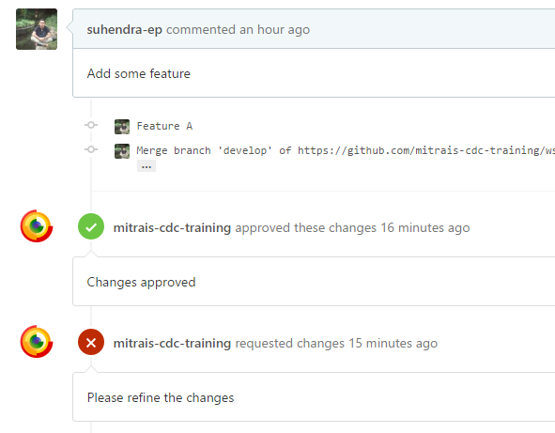
CDC – git fork & pull request/Review the changes
Project owner and contributor may have discussion here.
Wait!! Project owner found merge conflict.
I don’t wanna do it, go back revise it! Here what you have to do:
Step 1: From your forked repository, sync it to the original.
$ git pull upstream develop
Step 2: Merge your feature branch to the base branch and update on GitHub.
$ git checkout feature_branch
$ git merge --no-ff develop
# Fix merge conflict
$ git push origin feature_branch
Notes:
Conflict may happened here. Github will notify branch has conflicts that must be resolved.
There are 2 options:
The project owner solve it manually
Step 1: From your project repository, check out a new branch and test the changes.
$ git checkout -b suhendra-ep-feature_branch develop
$ git pull https://github.com/suhendra-ep/ws3.git feature_branch
Step 2: Merge the changes and update on GitHub.
$ git checkout develop
$ git merge --no-ff suhendra-ep-feature_branch
$ git push origin develop

Slide 11
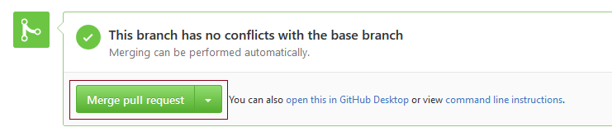
CDC – git fork & pull request/Review and Close!
Wait!! Project owner found merge conflict.
OK. I will do it by myself. Here what I wanna do:
Step 1: From my project repository, check out a new branch and test the changes.
$ git checkout -b suhendra-ep-feature_branch develop
$ git pull https://github.com/suhendra-ep/ws3.git feature_branch
Step 2: Merge the changes and update on GitHub.
$ git checkout develop
$ git merge --no-ff suhendra-ep-feature_branch
# solve merge conflict
$ git push origin develop
That’s it! I’m happy with your work, I’ll merge your pull request!
Notes:
Conflict may happened here. Github will notify branch has conflicts that must be resolved.
There are 2 options:
The project owner solve it manually
Step 1: From your project repository, check out a new branch and test the changes.
$ git checkout -b suhendra-ep-feature_branch develop
$ git pull https://github.com/suhendra-ep/ws3.git feature_branch
Step 2: Merge the changes and update on GitHub.
$ git checkout develop
$ git merge --no-ff suhendra-ep-feature_branch
$ git push origin develop

Slide 12
CDC – git fork & pull request / Practice
Exercise
Fork the repository from Workshop I
Clone the forked repository
Create feature branch then make some changes
Publish your feature branch
Create pull request
Discuss the changes with project owner
Project owner happy? If so, they might pull your changes into the original repository
Sync the forked repository

