Slide 1
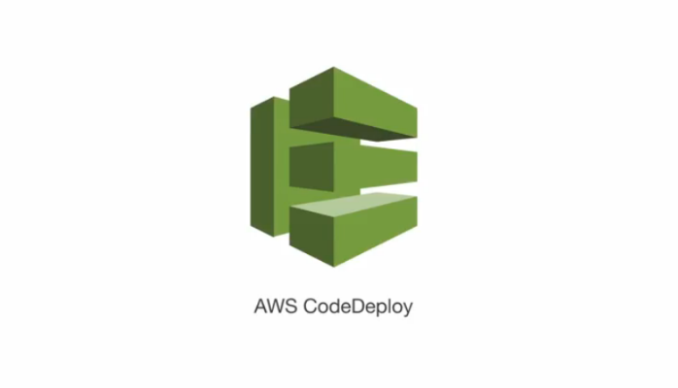

CDC
Deploying to AWS

Slide 2
AWS CodeDeploy
An application can contain deployable content like code, web, and configuration files, executables, packages, scripts, and so on. AWS CodeDeploy deploys applications from Amazon S3 buckets and GitHub repositories.
You do not need to make changes to your existing code to use AWS CodeDeploy. You can use AWS CodeDeploy to control the pace of deployment across Amazon EC2 instances and to define the actions to be taken at each stage.

Slide 3
AWS Services
EC2 Instance (Linux/Windows)
S3 Bucket (storage)
Codedeploy (Developer Tools)
Application
Deployment Group 1
Deployment Group 2
Deployment Group n
Done by trainer
Done by participant
https://github.com/rfajarachmad/cdc-aws/blob/master/cf-application-server.yml
template

Slide 4
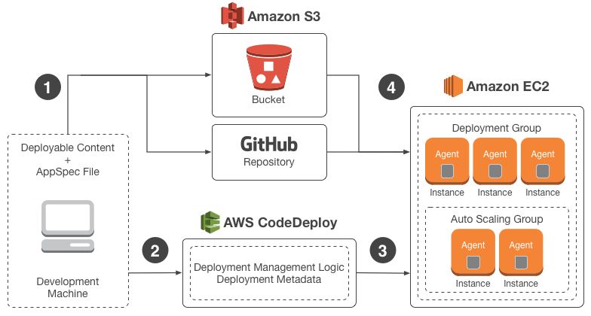
CDC – Deploying to AWS/ Introduction
We want to deploy our application to AWS instances
Using codedeploy
Notes:
http://docs.aws.amazon.com/codedeploy/latest/userguide/welcome.html

Slide 5
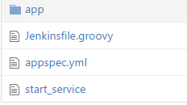
File Structure
Application artifact
Jenkins pipeline script
CodeDeploy script
myapp.zip
Notes:
- Trainees should have a dedicated branch (hopefully they have the same trainers)

Slide 6
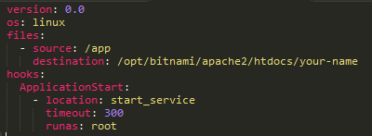

The appspec.yml
Notes:
- Trainees should have a dedicated branch (hopefully they have the same trainers)

Slide 7
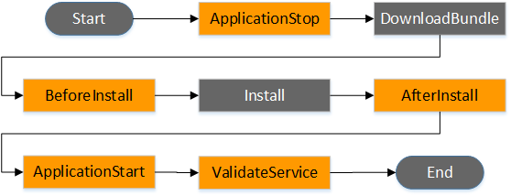
Deployment hooks
The Start, DownloadBundle, Install, BlockTraffic, AllowTraffic, and End events in the deployment cannot be scripted, which is why they appear in gray in this diagram. However, you can edit the files section of the AppSpec file to specify what's installed during the Install event.

Slide 8
The Way to Deploy
AWS Console
AWS CLI
Notes:
- Trainees should have a dedicated branch (hopefully they have the same trainers)

Slide 9
Exercise: Deploy todo list web application
Simple html
PHP web server (LAMP)
AWS CLI & Jenkins

Slide 10
Steps
Clone repository into your repository
Todo List Web Application
https://github.com/rfajarachmad/sample-html.git
Download deployment group template
https://github.com/rfajarachmad/cdc-aws/blob/master/cf-deployment-group.yml
Notes:
- Trainees should have a dedicated branch (hopefully they have the same trainers)

Slide 11
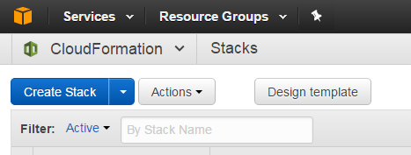
Steps
Create Deployment Group via CloudFormation
Open cloudFormation and create a stack
Notes:
- Trainees should have a dedicated branch (hopefully they have the same trainers)

Slide 12
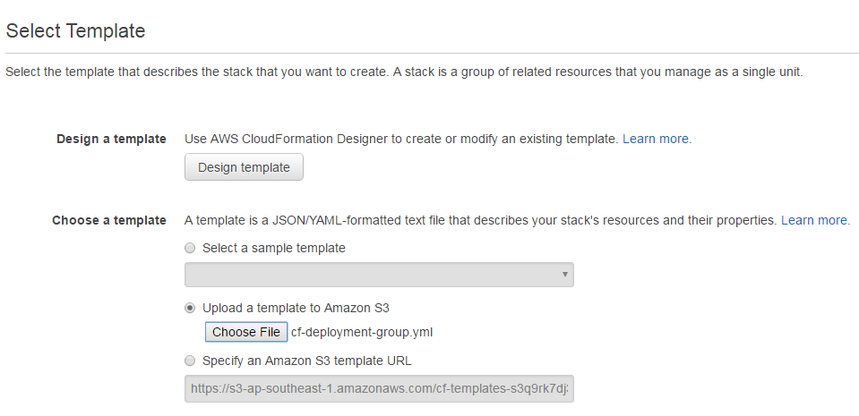
Steps
Create Deployment Group via CloudFormation
Upload the cloudformation template (cf-deployment-group.yml)
Notes:
- Trainees should have a dedicated branch (hopefully they have the same trainers)

Slide 13
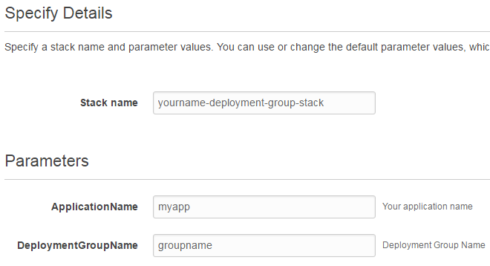
Steps
Create Deployment Group via CloudFormation
Specify stack name, Application name and Deployment group name.
Notes:
- Trainees should have a dedicated branch (hopefully they have the same trainers)

Slide 14


Steps
Modify appspec.yml file
e.g: /opt/bitnami/apache2/htdocs/fajar
Modify Jenkins.groovy file, application name & deployment group name
Commit and Push your changes
Notes:
- Trainees should have a dedicated branch (hopefully they have the same trainers)

Slide 15
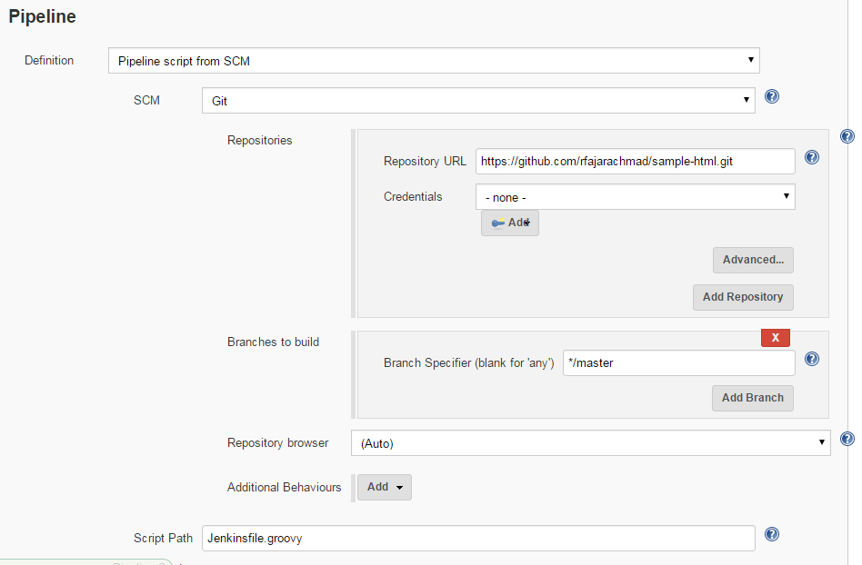
Steps
Create a new Jenkins Pipeline
Notes:
- Trainees should have a dedicated branch (hopefully they have the same trainers)

Slide 16
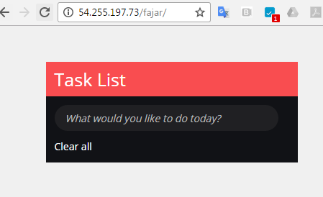
Steps
Verify your application
http://your-ip-address/your-name
Notes:
- Trainees should have a dedicated branch (hopefully they have the same trainers)

Slide 17
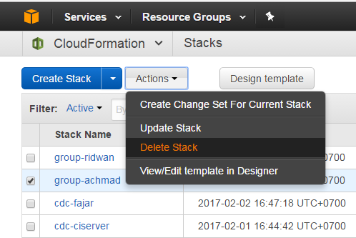
Steps
Delete cloud formation stack
Notes:
- Trainees should have a dedicated branch (hopefully they have the same trainers)

