Slide 1


CDC
fork & pull request

Slide 2

CDC – git fork & pull request/ Prerequisites
https://github.com/mitrais-cdc-training/ws3
Git installed with any console/command line tool
Existing Github account
Go through: git-try → https://try.github.io/
Attendee of CDC Workshop I & II
Notes:
- Trainees should have a dedicated branch (hopefully they have the same trainers)

Slide 3
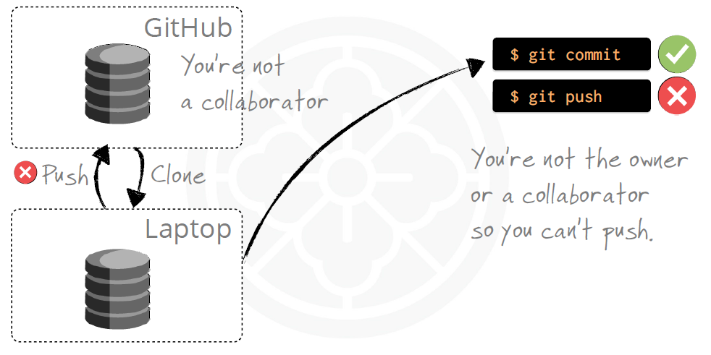
CDC – git fork & pull request / Introduction
When you are not a collaborator!

Slide 4

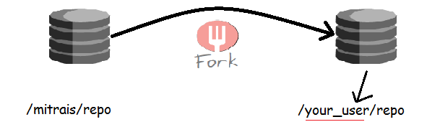
CDC – git fork & pull request / Introduction
How we can contribute to the project?
Github You can fork to your user account or an organization
Fork includes all: branches, tags and history.

Slide 5
CDC – git fork & pull request / Overview
A fork is a copy of a repository. Forking a repository allows you to freely experiment with changes without affecting the original project.
Propose changes to someone else's project
Fork the repository.
Make the changes.
Submit a pull request to the project owner.
Project owner likes your work? If so, they might pull your changes into the original repository!

Slide 6

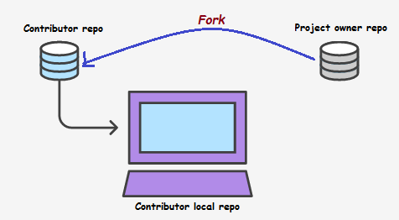
CDC – git fork & pull request /Fork Repository
Navigate to project owner repository and fork it.
https://github.com/mitrais-cdc-training/ws3
Contributor need to clone repository that she/he just forked
$ git clone https://github.com/<user>/ws3.git

Slide 7
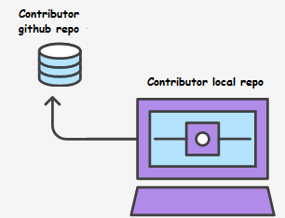
CDC – git fork & pull request / Make Changes
Keep forked repository synced to the original
$ git remote add upstream https://github.com/mitrais-cdc-training/ws3.git
# Check configured remote repository
$ git remote -v
Make some changes to local repo
$ git checkout - feature_branch
# Edit some code
$ git commit -m “Add some feature"
Push the changes to github
$ git push origin feature_branch

Slide 8

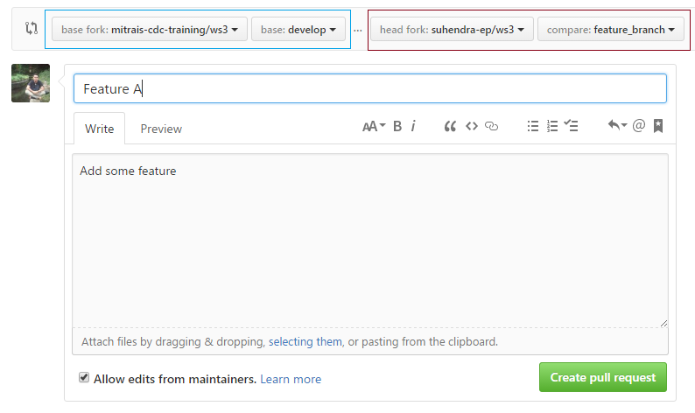
CDC – git fork & pull request/Create Pull Request
Create the pull request
Original repo
Forked repo
Pull request title
Summary of the proposed changes
Notes:
Pull requests let you tell others about changes you've pushed to a repository on GitHub. Once a pull request is opened, you can discuss and review the potential changes with contributor and add follow-up commits before the changes are merged into the repository.

Slide 9
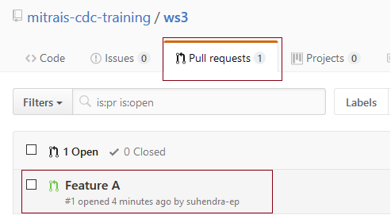
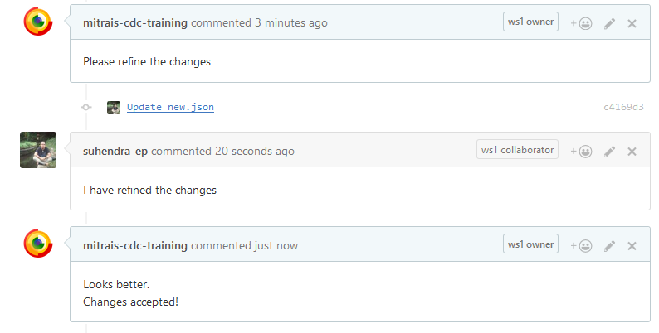
CDC – git fork & pull request/Review the changes
Project owner review the pull request
Project owner and contributor may have discussion
Notes:
We replay the commands with the <base> we picked

Slide 10
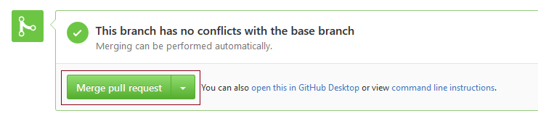
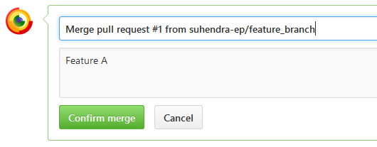
CDC – git fork & pull request / Close pull request
Project owner happy, merge pull request and close!
Contributor may sync the forked repository
$ git pull upstream develop

Slide 11
CDC – git fork & pull request / Practice
Exercise
Fork the repository from Workshop I
Clone the forked repository
Create feature branch then make some changes
Publish your feature branch
Create pull request
Discuss the changes with project owner
Project owner happy? If so, they might pull your changes into the original repository
Sync the forked repository

