Slide 1


CDC
git interactive rebase

Slide 2

CDC – git interactive rebase / Prerequisites
https://github.com/mitrais-cdc-training
Git installed with any console/command line tool
Existing Github account
Go through: git-try → https://try.github.io/
Attendee of CDC Workshop I – Git merging

Slide 3
CDC – git interactive rebase / Introduction
We want to alter individual commits!
Interactive Rebasing allows us to:
Squashing (squash) commits (see example above)
Splitting commits
Alter (reword) commit messages
Reorder commits
Notes:
Example for interactive rebase: squashing commits

Slide 4
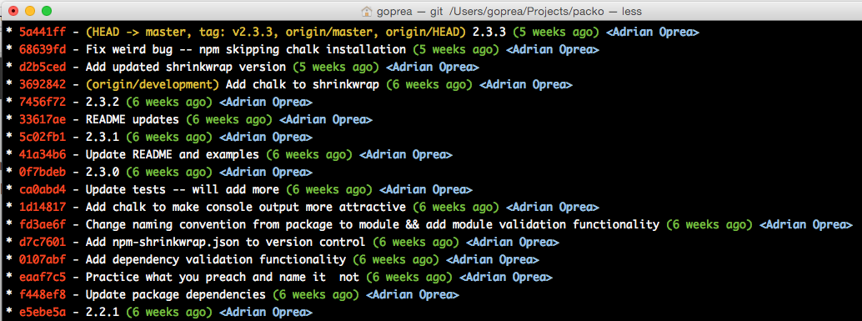
CDC – git interactive rebase / Introduction
Why is that so important?
Why we want to alter individual commits?
Commits and their messages are like history books
It’s a timeline what happened when!

Slide 5
CDC – git interactive rebase / Environment
YOU are SQ or SE in a project
You finished your feature implementation (SE)
You finished your reviews/tests (SQ)
As SE, the reviewer don’t like your commit messages, not detailed enough!
As SE/SQ, you think some commits could be logically squashed/splitted!
As SQ/SE, you want to change commit messages to be more specific!

Slide 6
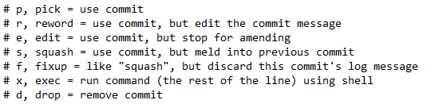
CDC – git interactive rebase / Overview
Our base command (shortcut)
Command (written form)
$git rebase -i
or
$git rebase --interactive
With great power comes great responsibility

Slide 7
CDC – git interactive rebase / Practice
Exercise 1
Clone you branch from Workshop I
Edit something and create multiple commits
Squash some commit together
Publish your branch again
Exercise 2
Clone you branch from Workshop I
Edit something and create multiple commits
Change the commit messages, be more specific
Publish your branch again

