Slide 1


CDC
git merging

Slide 2
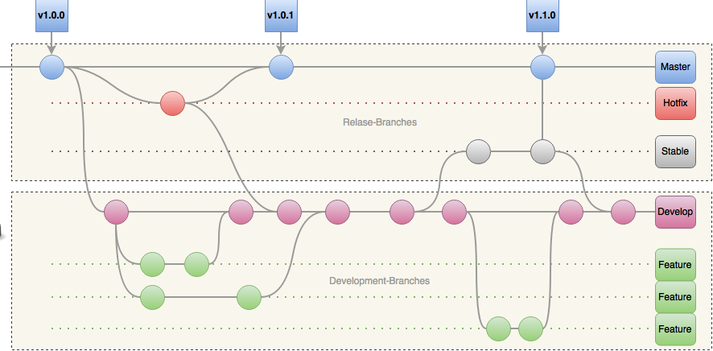
CDC – git merging / Theory
Workflow!
Notes:
We will cover development for now
Pull request comes later

Slide 3
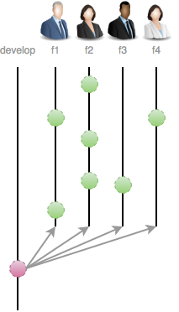
CDC – git merging / Theory
Workflow!
Notes:
We will cover development for now
Pull request comes later

Slide 4
CDC – git merging / Theory
Conventions!
Branching
Master branch tracks release
Develop branch tracks features/issue development
Hot-Fix branches -> branched off Master
Feature branches -> branched off Develop
Release branches -> branched off Develop
Merging
Feature branches -> merged to Develop
Hot-Fix & Stable branches -> Master & Develop
Only Hot-Fix & Stable are allows to merge into Master

Slide 5

CDC – git merging / Part I - Setup
Environment!
YOU fresh joined a project
Your first Scrum Planning in the Project
You agreed to a task/feature and have no idea
All information you got:
Github URL to a repository
You will be collaborator
Working with “Gitflow”, branch from develop, create a local feature branch, implement your task, push it

Slide 6

CDC – git merging / Part I - Setup
Requirements!
Git installed with any console/command line tool
Existing Github account
Go through: git-try → https://try.github.io/
https://github.com/mitrais-cdc-training

Slide 7
CDC – git merging / Part I - Setup
Configuration!
Set email, name and beautiful UI
$git config --global user.name “Thomas Rothe”
$git config --global user.email "thomas.rothe@mitrais.com"
$git config --global color.ui true
Set standard editor
$git config --global core.editor "'C:/Portable/Notepad++/notepad++.exe' -multiInst -notabbar -nosession -noPlugin"
$git config --global core.editor notepad
Check!
$git config --global --list
$git config --local --list
“The shell is my friend!”

Slide 8

CDC – git merging / Part II – “The Daily Work”
Lets check all existing branches on our given URL
$git ls-remote https://github.com/mitrais-cdc-training/ws1
Since we working with Gitflow, lets grab development-branch
$git clone -b develop https://github.com/mitrais-cdc-training/ws1
Lets create a local branch for our given task/feature
$git checkout -b <unique-name>
Edit some files … go ahead!
“The shell is my friend!”

Slide 9

CDC – git merging / Part II – “Work Done!”
Commit done work
$git commit –m “commit-message”
Our main workflow to merge as SE
$git checkout develop
$git fetch
$git checkout <unique-name>
$git rebase develop
$git checkout develop
$git merge --no-ff <unique-name
“The shell is my friend!”

Slide 10
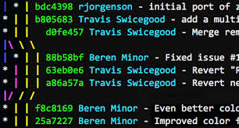
CDC – git merging / Part II – “Final Check!”
Log & Aliases
$git log --online --decorate –graph --all
$git config –global alias.lg “log --online --decorate --all --graph”
Hold on!!!
I got a merge error while rebase, Ahh HELP!!
1. Solve conflicts
2. Continue rebase
Holy, what is --no-ff ??
Rebase first and then merge, why .. I don’t get it ??
“The shell is my friend!”

Slide 11
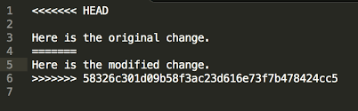
CDC – git merging / Part III – “Merge conflicts”
Solve conflict(s) manually with IDE/Editor
Continue rebase process
$git rebase --continue
“The shell is my friend!”

Slide 12

CDC – git merging / Part III – “Merge Theory”
Recursive merge
$git merge --no-ff <branch-name>
Why recursive?
Clear what was done on a branch
Single commit to revert
Log
“The shell is my friend!”

Slide 13
CDC – git merging / Part III – “Merge Theory”
Fast-Forward merge
$git merge <branch-name>
Less commits
Log
“The shell is my friend!”

Slide 14
CDC – git merging / Part III – “Rebase – Why?”
“The shell is my friend!”

