Slide 1
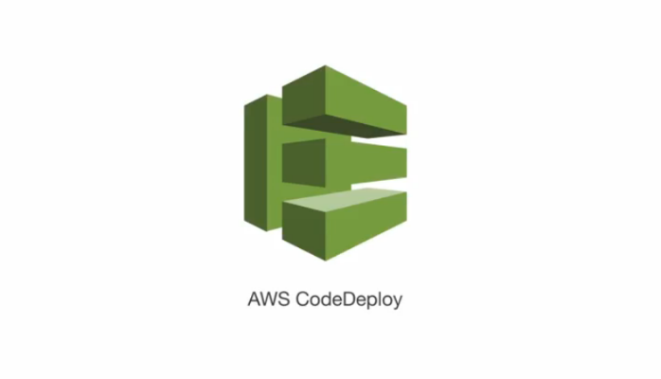

CDC
Deploying to AWS

Slide 2
AWS CodeDeploy
An application can contain deployable content like code, web, and configuration files, executables, packages, scripts, and so on. AWS CodeDeploy deploys applications from Amazon S3 buckets and GitHub repositories.
You do not need to make changes to your existing code to use AWS CodeDeploy. You can use AWS CodeDeploy to control the pace of deployment across Amazon EC2 instances and to define the actions to be taken at each stage.

Slide 3
CDC – Deploying to AWS
Prerequisite :
Jenkins
AWS cli (http://docs.aws.amazon.com/cli/latest/userguide/installing.html)
GIT
AWS
Notes:
- Trainees should have a dedicated branch (hopefully they have the same trainers)

Slide 4
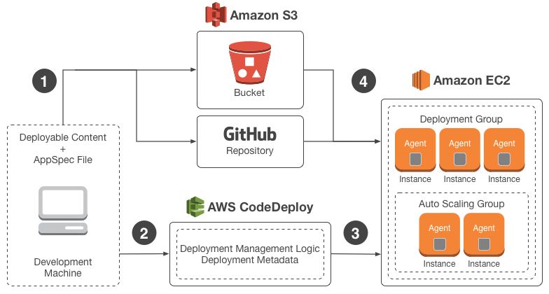
CDC – Deploying to AWS/ Introduction
We want to deploy our application to AWS instances
Using codedeploy
Notes:
http://docs.aws.amazon.com/codedeploy/latest/userguide/welcome.html

Slide 5
File structure
The AppSpec file is used to manage each deployment as a series of lifecycle events
Files that will be deployed

Slide 6
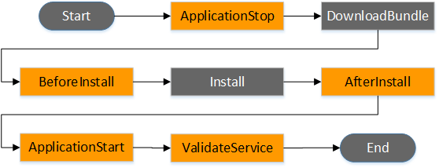
Deployment hooks
The Start, DownloadBundle, Install, BlockTraffic, AllowTraffic, and End events in the deployment cannot be scripted, which is why they appear in gray in this diagram. However, you can edit the files section of the AppSpec file to specify what's installed during the Install event.

Slide 7
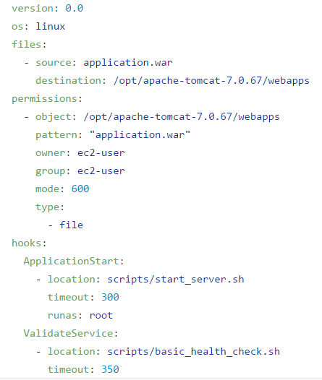
Appspec.yml
What files you install
AppSpec 'hooks' Section

Slide 8
AWS management
Create IAM Role
Create instance with this IAM role attached
Create S3 bucket
Create Codedeploy Application https://ap-southeast-1.console.aws.amazon.com/codedeploy/home?region=ap-southeast-1#/applications
Create Deployment group

Slide 9
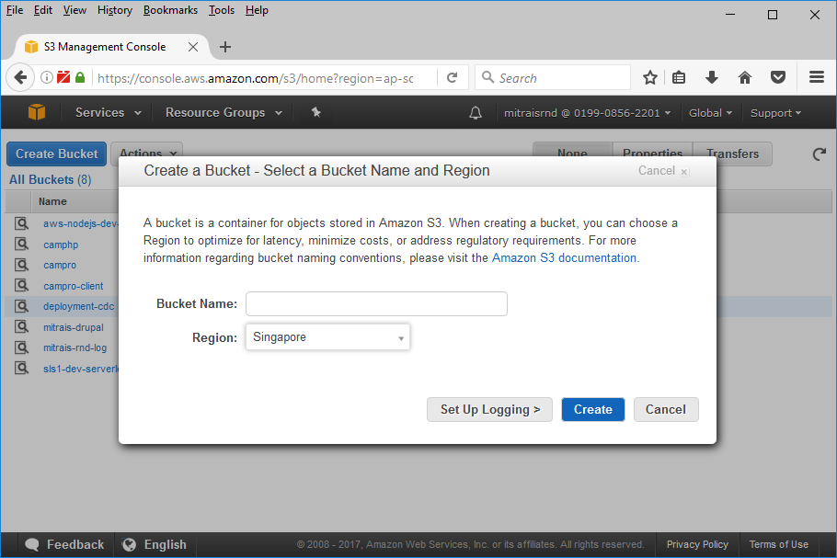
Create S3 bucket
Notes:
https://ap-southeast-1.console.aws.amazon.com/codedeploy/home?region=ap-southeast-1#/applications/CDC-deploy/deployment-groups/new

Slide 10
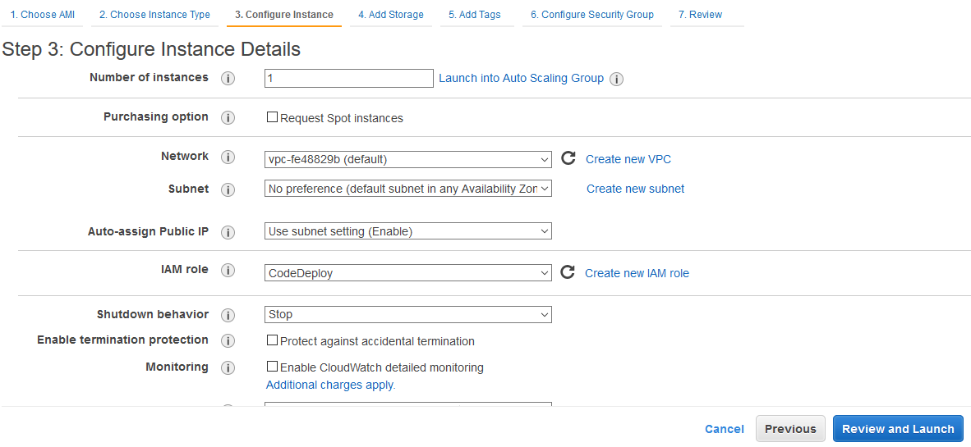
Preparing Instance
After the instance is cretead, the you need to install AWS Codedeploy agent
Notes:
https://ap-southeast-1.console.aws.amazon.com/codedeploy/home?region=ap-southeast-1#/applications/CDC-deploy/deployment-groups/new
http://docs.aws.amazon.com/codedeploy/latest/userguide/how-to-run-agent-install.html

Slide 11
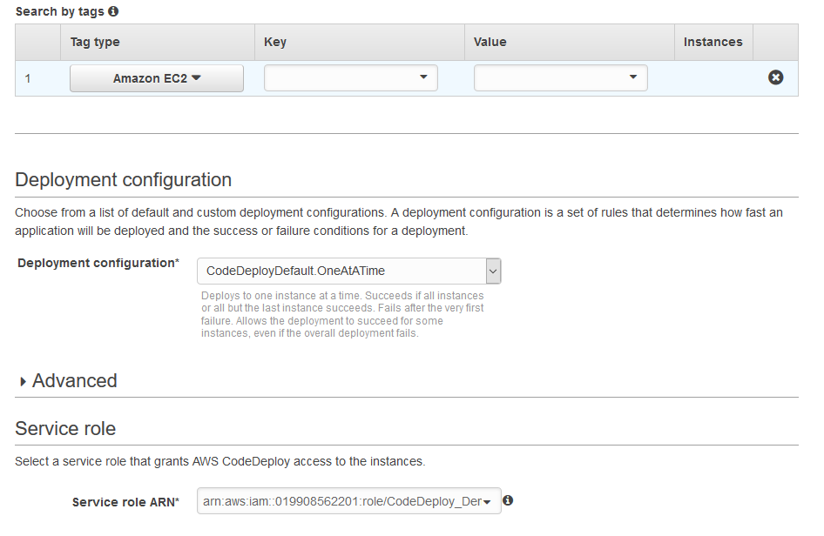
Create Deployment Group
Instance that will be deployed into
IAM Role that created before
Notes:
https://ap-southeast-1.console.aws.amazon.com/codedeploy/home?region=ap-southeast-1#/applications/CDC-deploy/deployment-groups/new

Slide 12
Jenkinsfile
Push to S3 “aws deploy push --application-name ${applicationName} --description '${description}' --ignore-hidden-files --s3-location s3://${yourS3location} --source ${yourdeployable content} > .deployment_command”
You will get the deployment command in file ‘.deployment_command’

Slide 13
Jenkinsfile
Or you can create your own deployment command “aws deploy create-deployment --application-name CDC-deploy --s3-location bucket=deployment-cdc,key=langit.zip,bundleType=zip,eTag=db1f16bd84c48ab3952703cf4e86b291-16 --deployment-group-name <deployment-group-name> --deployment-config-name <deployment-config-name> --description <description>”

Slide 14
Jenkinsfile
def deployRevisionToS3(String key, String applicationName) {
def description = "web application deployment"
sh("aws deploy push --application-name ${applicationName} --description '${description}' --ignore-hidden-files --s3-location s3://${codedeploy_s3_bucket}/${key} --source ${codedeploy_source} > .deployment_command ")
sh("cat .deployment_command")
}
def deployToCodeDeploy(String key) {
def description = "'web application deployment v${key}'"
def cmd = getCodedeployCommand()
cmd = cmd.replace('<deployment-group-name>',deployment_group).replace('<deployment-config-name>','CodeDeployDefault.OneAtATime').replace('<description>', description)
sh("aws ${cmd} > .deployment_id")
sh("cat .deployment_id")
}

