Slide 1
Jenkins Continues Integration
Basic

Slide 2
Agenda
Overview of CI
Jenkins Installation & Configuration
Simple Pipeline
Integration with Git
Integration with Maven
Exercise: Create a simple pipeline

Slide 3
Assumptions
Familiar with Github
Familiar with Java Syntax
Familiar with Maven
How to build a project
How to run unit testing

Slide 4
CI at a Glance

Slide 5
Software Development Workflow

Slide 6
Continuous Integration (CI)
“Continuous Integration is a software development practice where members of a team integrate their work frequently, usually each person integrates at least daily - leading to multiple integrations per day. Each integration is verified by an automated build (including test) to detect integration errors as quickly as possible” – Martin Fowler

Slide 7
CI – Benefits
Immediate bug detection
Enables automated testing
Enables Continuous Deployments
Increases confidence in the software

Slide 8
CI - The Tools
Code Repositories
SVN, Mercurial, Git
Continuous Build Systems
Jenkins, Bamboo, Cruise Control
Test Frameworks
JUnit, Cucumber, CppUnit
Artifact Repositories
Nexus, Artifactory, Archiva

Slide 9
The Goal
Automated
Using Jenkins

Slide 10
Jenkins Installation & Configuration

Slide 11
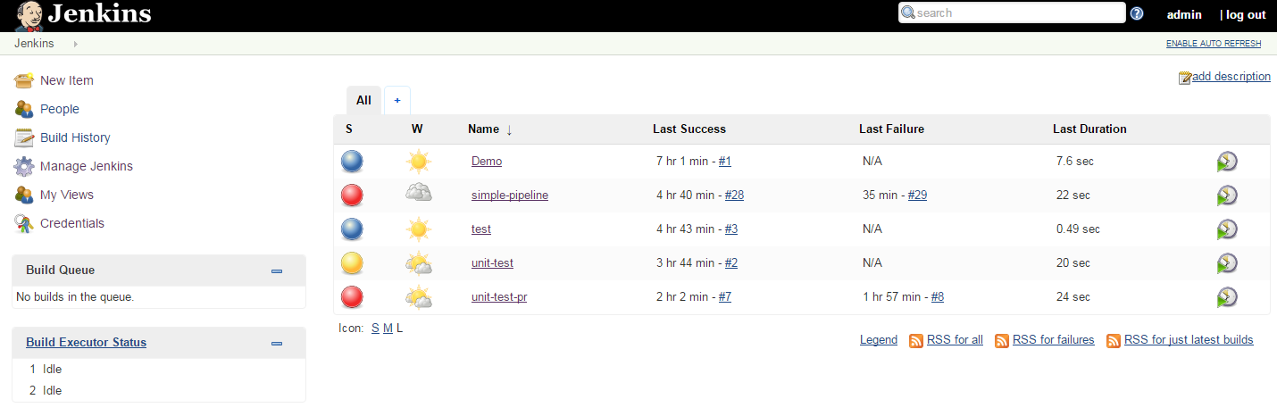
Overview
1
2
4
3
Jenkins is a Continuous Integration server.

Slide 12
Jenkins Installation
Download the war file form official web site here and run it
Once the processing is complete without major errors, the following line will come in the output of the command prompt.
access Jenkins from the link − http://localhost:8080
D:\>Java –jar Jenkins.war
INFO: Jenkins is fully up and running

Slide 13
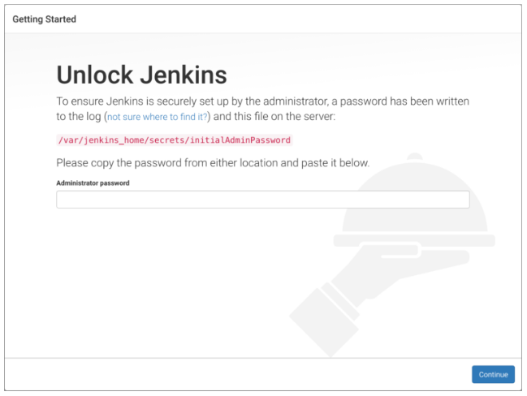

Slide 14
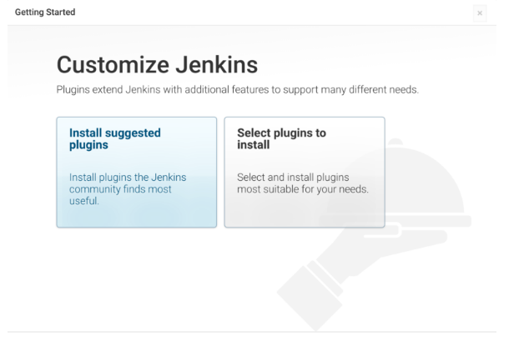

Slide 15
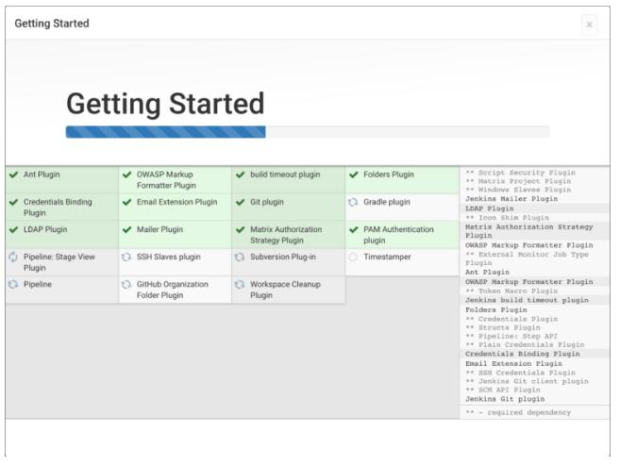

Slide 16
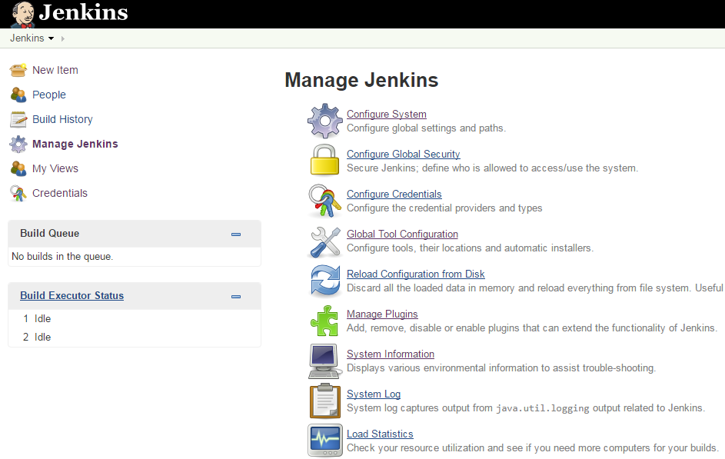
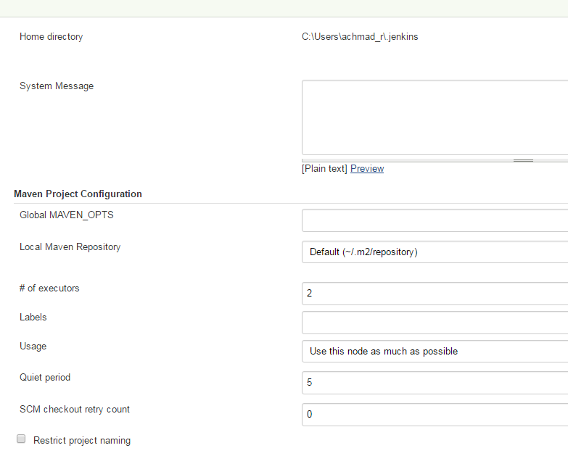
Jenkins Configuration
2
1
3

Slide 17
Jenkins Configuration
Jenkins Home Directory
Default: ~/.Jenkins
Set "JENKINS_HOME" environment variable to the new home directory before launching the servlet container.
# of executors
the recommendation is to keep this number the same as the number of CPU on the machines for better performance.
Environment Variables
to add custom environment variables which will apply to all the jobs
Jenkins URL
Default: localhost
If you have a domain name setup for your machine, set this to the domain name else overwrite localhost with IP of machine. This will help in setting up slaves and while sending out links using the email as you can directly access the Jenkins URL using the environment variable JENKINS_URL which can be accessed as ${JENKINS_URL}.
Email Notification
In the email Notification area, you can configure the SMTP settings for sending out emails. This is required for Jenkins to connect to the SMTP mail server and send out emails to the recipient list.

Slide 18
Simple Pipeline
Create Project
Define Stage
Build

Slide 19
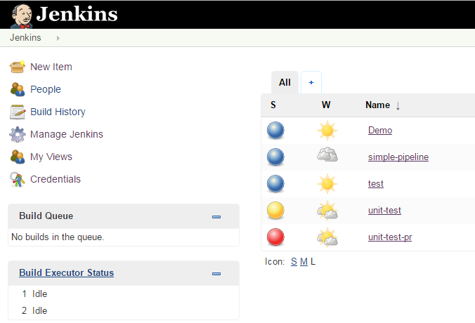
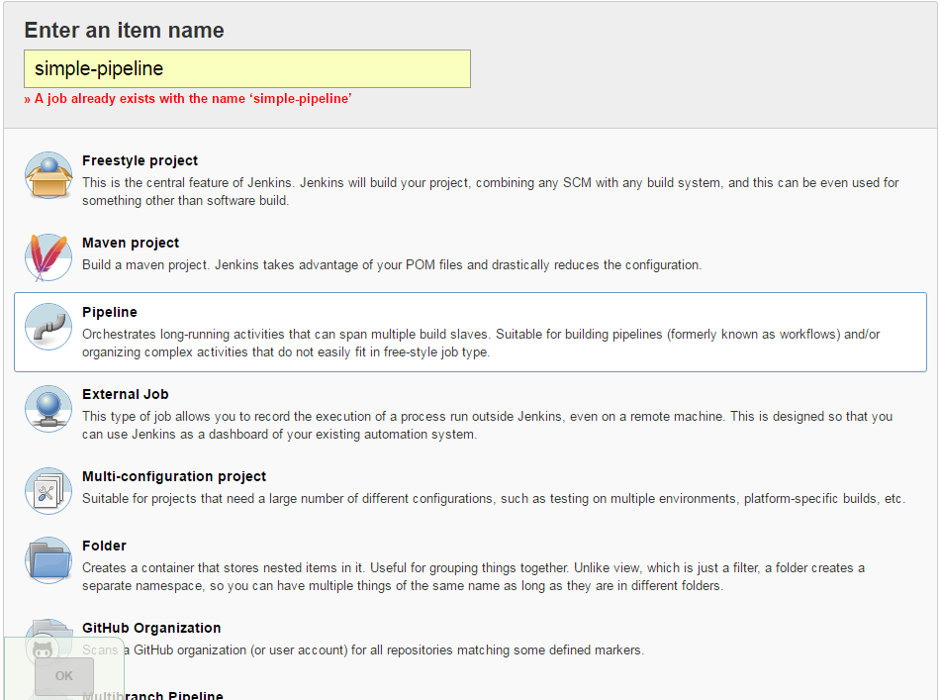
Simple Pipeline: Create a new project
1
2
3
4

Slide 20
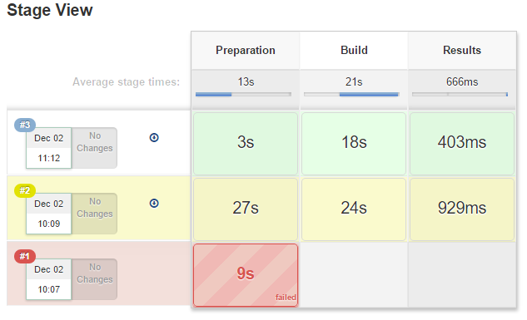
Simple Pipeline: Define build stage
Stage View
Pipeline Script
node {
stage("Checkout") {
echo "Checkout code from Git"
}
stage("Build") {
echo "Build code using Maven“
}
stage(“Result") {
echo “Unit test result" }
}
}

Slide 21
Integration with Git
Install Git Plugin
Checkout from Git
Setup Git Credential

Slide 22
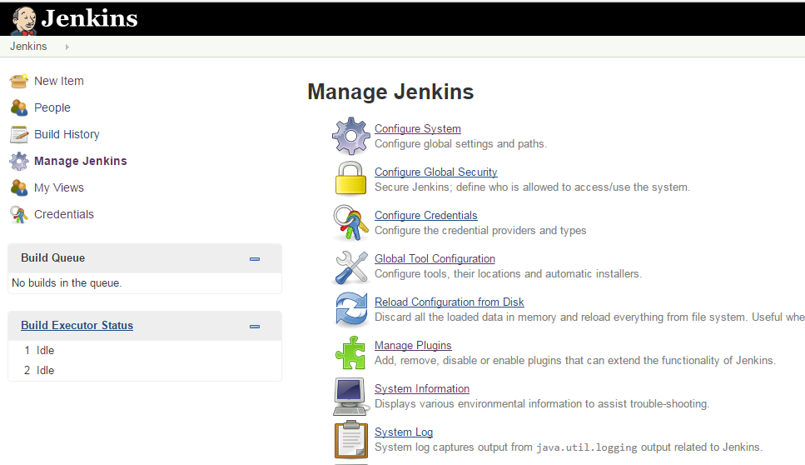
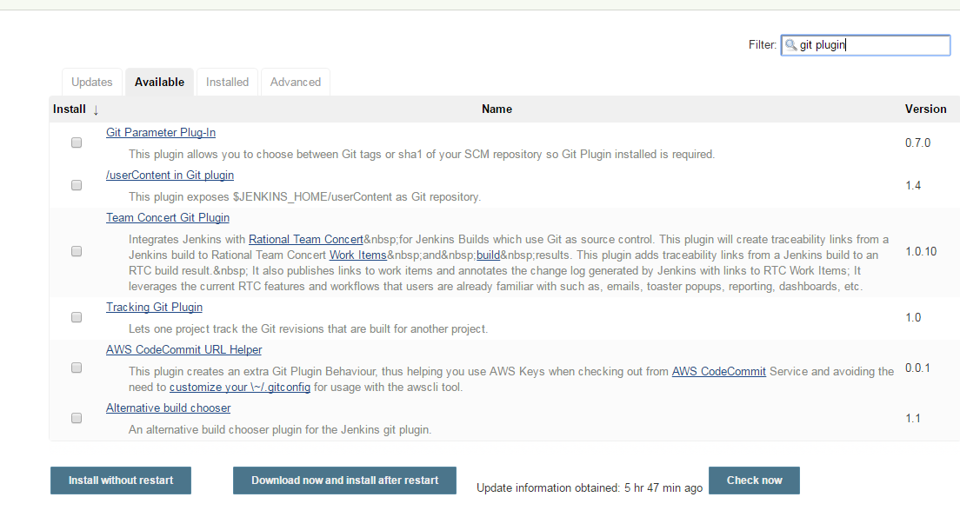
Install Git Plugin
1
3
2
4
5

Slide 23
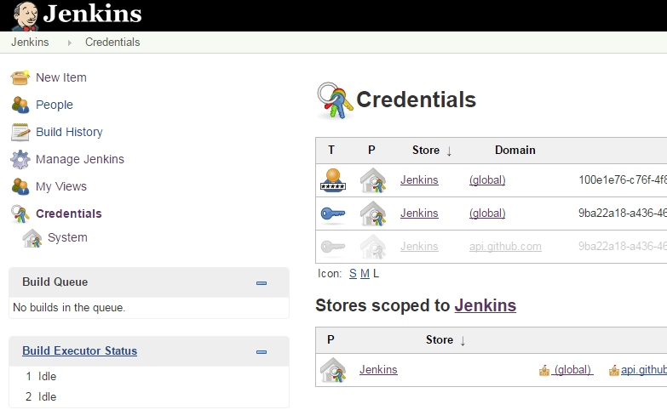
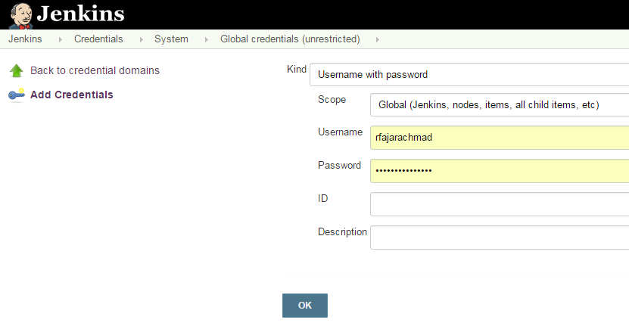
Setup Git Credential
2
1
3
4

Slide 24
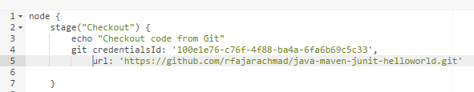
Checkout from Git
Modify the checkout stage by adding following code

Slide 25
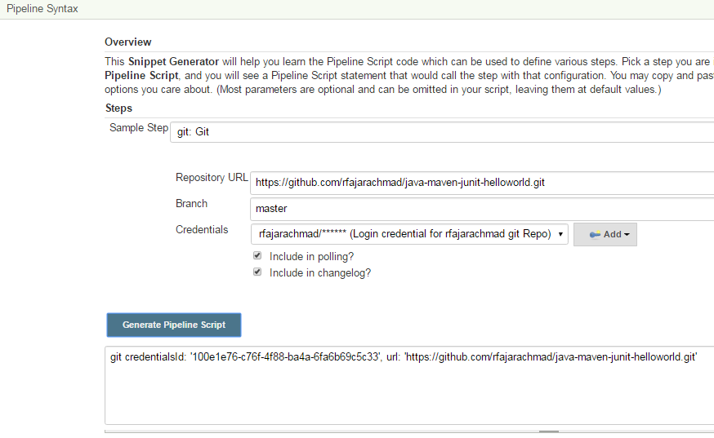
Checkout from Git
Generate pipeline script using Snippet Generator

Slide 26
Integration with Maven
Setup Maven Tool
Build a Project

Slide 27
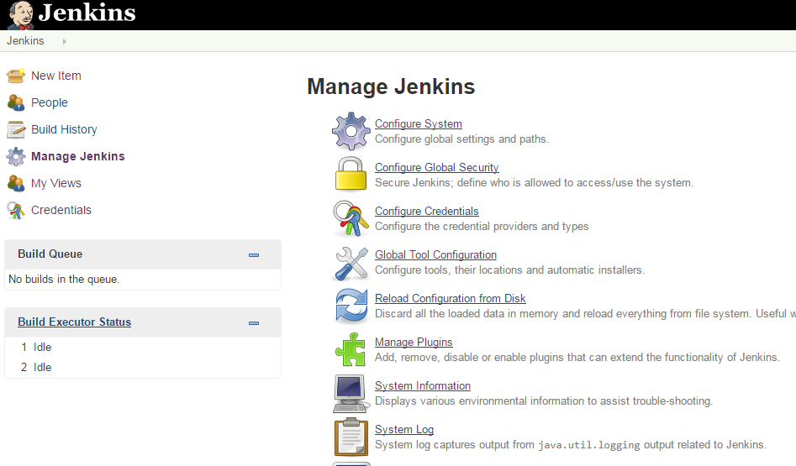
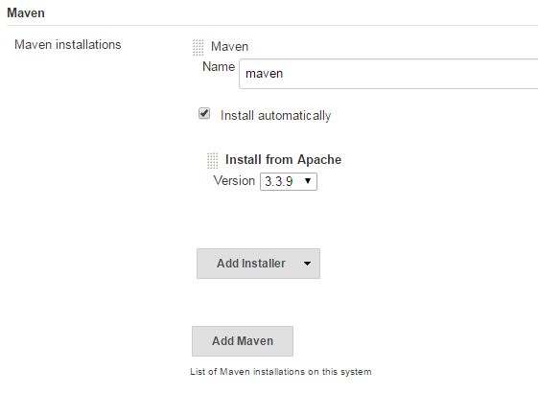
Setup Maven Tool
1
2
3

Slide 28
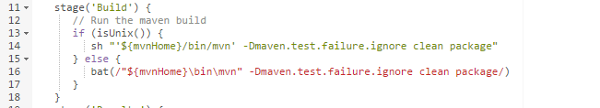
Build Maven Project
Sample Java project: https://github.com/rfajarachmad/java-maven-junit-helloworld

Slide 29
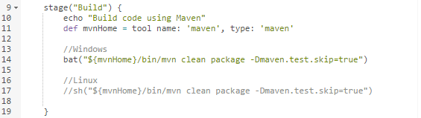
Summarize..
Checkout
Build

Slide 30
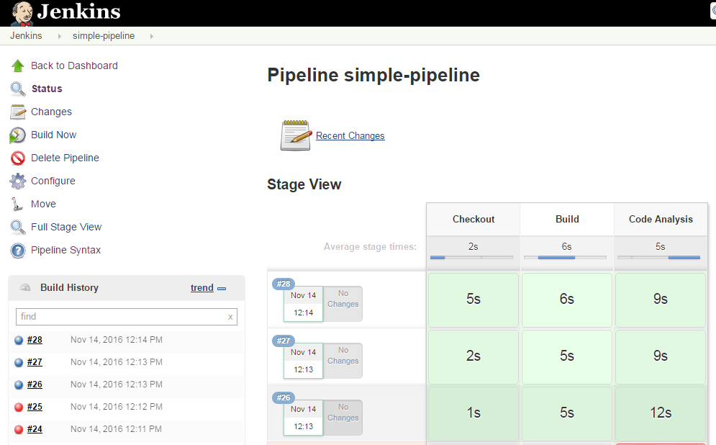
Simple Pipeline: Build

Slide 31
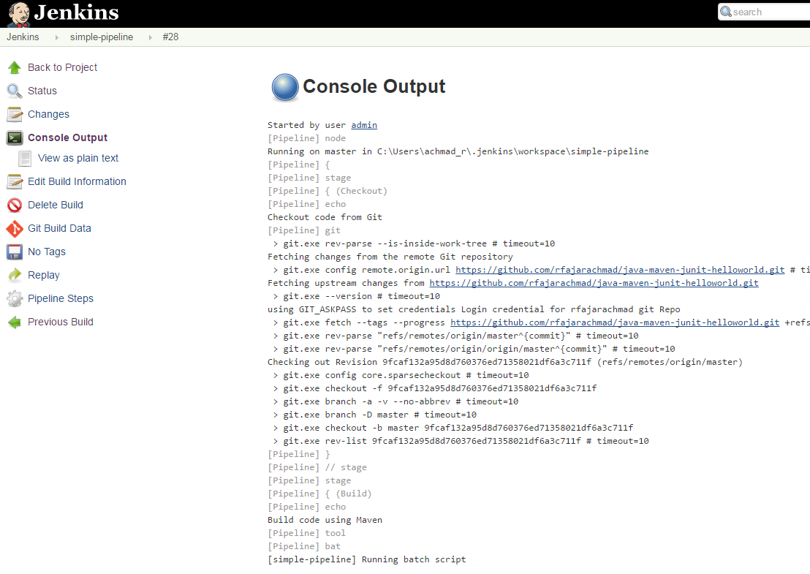
Simple Pipeline: Console Output
2
1

Slide 32
Thank You

