Slide 1


CDC
git merging

Slide 2
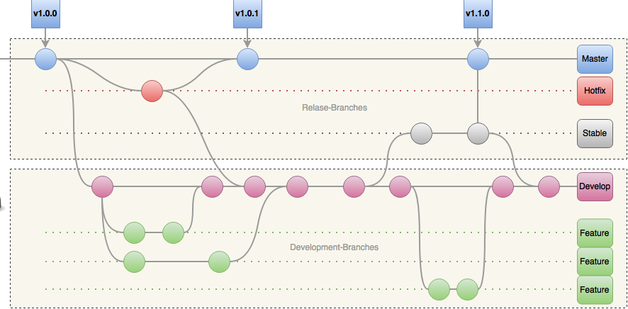
CDC – git merging / Introduction – “Workflow”
Notes:
We will cover development for now
Pull request comes later

Slide 3
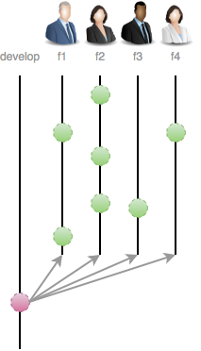
CDC – git merging / Introduction – “Workflow”
Notes:
We will cover development for now
Pull request comes later

Slide 4
CDC – git merging / Introduction – “Conventions”
Branching
Master branch tracks release
Develop branch tracks features/issue development
Hot-Fix branches -> branched off Master
Feature branches -> branched off Develop
Release branches -> branched off Develop
Merging
Feature branches -> merged to Develop
Hot-Fix & Stable branches -> Master & Develop
Only Hot-Fix & Stable are allows to merge into Master

Slide 5

CDC – git merging / Part I – “Setup”
Environment!
YOU fresh joined a project
Your first Scrum Planning in the Project
You agreed to a task/feature and have no idea
All information you got:
Project URL to a repository
You will be collaborator
Working with “Gitflow”
Branch from develop, create a local feature branch, implement your task, merge it back and push it to develop! ASAP

Slide 6

CDC – git merging / Part I – “Setup”
Requirements!
Git installed with any console/command line tool
Existing Github account
Go through: git-try → https://try.github.io/
https://github.com/mitrais-cdc-training

Slide 7
CDC – git merging / Part I – “Setup”
Configuration!
Set email, name and beautiful UI
$git config --global user.name “Thomas Rothe”
$git config --global user.email "thomas.rothe@mitrais.com"
$git config --global color.ui true
Set standard editor
$git config --global core.editor "'C:/Portable/Notepad++/notepad++.exe' -multiInst -notabbar -nosession -noPlugin"
$git config --global core.editor notepad
Check!
$git config --global --list
$git config --local --list
“The shell is my friend!”

Slide 8


CDC – git merging / Part II – “The Daily Work”
Lets check all existing branches on our given URL
$git ls-remote https://github.com/mitrais-cdc-training/ws1
Since we working with Gitflow, lets grab development-branch
$git clone -b develop https://github.com/mitrais-cdc-training/ws1
Lets create a local branch for our given task/feature
$git checkout -b <unique-name>
Edit some files…
“The shell is my friend!”

Slide 9

CDC – git merging / Part II – “Work Done!”
Commit your done work
$git commit –m “commit-message”
Commit some changes…
“A commit is carefully created by a human being. It's a meaningful unit that wraps only related changes, and annotates them with a comment.”
Main workflow to merge
$git checkout develop
$git pull
$git merge --no-ff <unique-name>
$git delete –d <unique-name>
Merge conflict could occur!
Merge your local branch back…
“The shell is my friend!”
Notes:
Feature branch is local!
Focus on –no-ff
Don’t forget to push back …

Slide 10
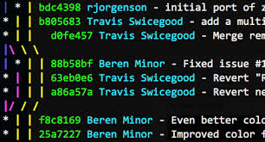

CDC – git merging / Part II – “Final Check!”
Log & Aliases
$git log --oneline --decorate –graph --all
$git config –global alias.lg “log --online --decorate --all --graph”
Hold on!!!
I got a merge error, Ahh HELP!!
Holy, what is --no-ff ??
So what’s rebase and when to use?
Lets jump for a second in theory…

Slide 11
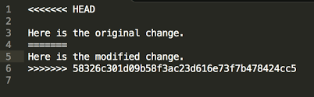
CDC – git merging / Part III – “Merge conflicts”
Solve conflict(s) manually with IDE/Editor
Declare as solved
$git commit -a
“The shell is my friend!”

Slide 12
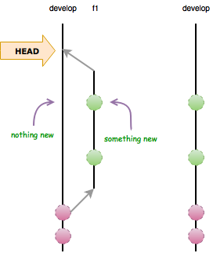
CDC – git merging / Part III – “Merge Theory”
Fast-Forward merge
$git merge <branch-name>
Conditions for ff-merge:
Nothing new on parent!
Less commits
“The shell is my friend!”

Slide 13
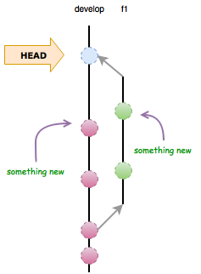
CDC – git merging / Part III – “Merge Theory”
Recursive merge
$git merge --no-ff <branch-name>
Why recursive?
Clear what was done on a branch
Single commit to revert
“A merge commit: instead of being created by a developer, it gets created automatically by Git. And instead of wrapping a set of related changes, its purpose is to connect two branches, just like a knot.”

Slide 14
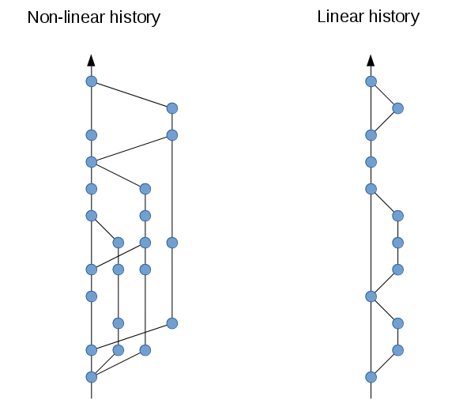
CDC – git merging / Part IV – “Rebase”
“Keeping a clean history in git comes down to knowing when to use merge vs. rebase.”
!Rebase is a team-decision because it change the team workflow
$git checkout develop
$git fetch origin
$git checkout <unique-name>
$git rebase –p origin/develop
$git checkout develop
$git merge <unique-name>
“The primary reason for rebasing is to maintain a linear project history.”
Merge conflicts
Solve conflict(s)
Continue rebase process
$git rebase --continue
Notes:
Rebasing Deletes Merge Commits!

Slide 15
CDC – git merging / Part V – “Practice”
Exercise 1 – Merge strategy - recursive.
Clone repository with branch develop
Create local feature-branch
Change/Edit/Add and commit
Merge back to develop with recursive- strategy (check history)
Publish to remote
Delete feature-branch
Exercise 2 – Merge Strategy - FF.
Clone repository with branch develop
Create local feature-branch
Change/Edit/Add and commit
Merge back to develop with fast-forward (check history)
Delete feature-branch

Slide 16
CDC – git merging / Part V – “Practice”
Exercise 3 – Working with remote feature branch:
Clone repository with branch develop
Create local feature-branch
Change/Edit/Add and commit
Publish feature-branch to remote (check on github)
Merge back to develop with recursive- strategy
Publish to remote
Delete remote- feature-branch
Notes:
$git push -u origin feature-branch
$git push origin feature-branch
To check if branch is deleted on remote and sync on local:
$git fetch –f
$git branch –a/-r

