Slide 1


CDC
git merging
Notes:
☺
Try to add attendees besides as collaborator
They have to accept invitation link (comes with registered github account email)

Slide 2
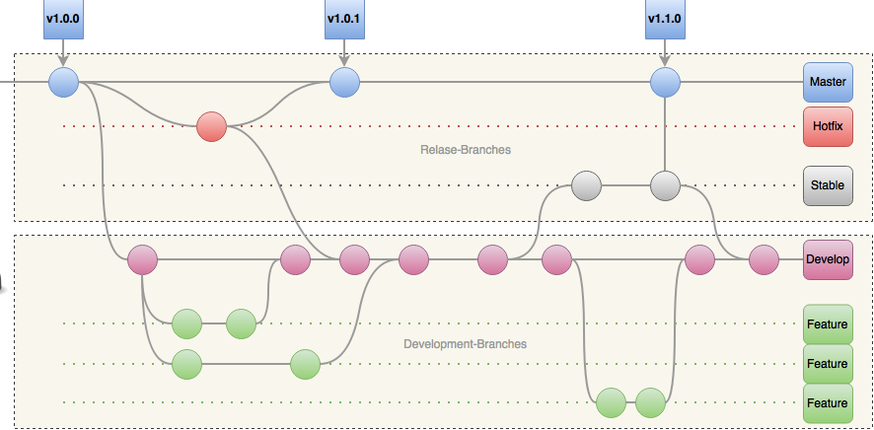
CDC – git merging / Introduction – “Workflow”
Notes:
Explain briefly gitflow workflow
Concentrate on deployment branches
Release branches with pull requests come later

Slide 3
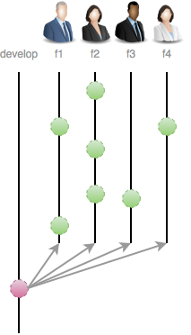
CDC – git merging / Introduction – “Workflow”
Notes:
That will be todays situation, we branch at time x from develop, create features branches

Slide 4
CDC – git merging / Introduction – “Conventions”
Branching
Master branch tracks release
Develop branch tracks features/issue development
Hot-Fix branches -> branched off Master
Feature branches -> branched off Develop
Release branches -> branched off Develop
Merging
Feature branches -> merged to Develop
Hot-Fix & Stable branches -> Master & Develop
Only Hot-Fix & Stable are allows to merge into Master
Notes:
Related to gitflow workflow, explain common branch and merge conventions

Slide 5

CDC – git merging / Part I – “Setup”
Environment!
YOU fresh joined a project
Your first Scrum Planning in the Project
You agreed to a task/feature and have no idea
All information you got:
Project URL to a repository
You will be collaborator
Working with “Gitflow”
Branch from develop, create a local feature branch, implement your task, merge it back and push it to develop! ASAP
Notes:
A normal situation a SE have to face

Slide 6

CDC – git merging / Part I – “Setup”
Requirements!
Git installed with any console/command line tool
Existing Github account
Go through: git-try → https://try.github.io/
https://github.com/mitrais-cdc-training

Slide 7
CDC – git merging / Part I – “Setup”
Configuration!
Set email, name and beautiful UI
$git config --global user.name “Thomas Rothe”
$git config --global user.email "thomas.rothe@mitrais.com"
$git config --global color.ui true
Set standard editor
$git config --global core.editor "'C:/Portable/Notepad++/notepad++.exe' -multiInst -notabbar -nosession -noPlugin"
$git config --global core.editor notepad
Check!
$git config --global --list
$git config --local --list
“The shell is my friend!”
Notes:
Base config parts, focus on name, email… mention about aliase

Slide 8


CDC – git merging / Part II – “The Daily Work”
Lets check all existing branches on our given URL
$git ls-remote https://github.com/mitrais-cdc-training/ws1
Since we working with Gitflow, lets grab development-branch
$git clone -b develop https://github.com/mitrais-cdc-training/ws1
Lets create a local branch for our given task/feature
$git checkout -b <unique-name>
Edit some files…
“The shell is my friend!”

Slide 9

CDC – git merging / Part II – “Work Done!”
Commit your done work
$git commit –am “commit-message”
Commit some changes…
“A commit is carefully created by a human being. It's a meaningful unit that wraps only related changes, and annotates them with a comment.”
Main workflow to merge
$git checkout develop
$git pull
$git merge --no-ff <unique-name>
$git branch –d <unique-name>
Merge conflict could occur!
Merge your local branch back…
“The shell is my friend!”
Notes:
Feature branch is local!
Focus on –no-ff
Don’t forget to push back …
Try to produce a merge error
Explain a commit .. See comment in slide
If time, explain –D (force deleting branch when not merged back)

Slide 10
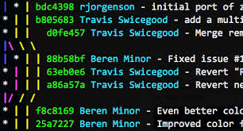

CDC – git merging / Part II – “Final Check!”
Log & Aliases
$git log --oneline --decorate --graph --all
$git config –global alias.lg “log --online --decorate --all --graph”
Hold on!!!
I got a merge error, Ahh HELP!!
Holy, what is --no-ff ??
So what’s rebase and when to use?
Lets jump for a second in theory…

Slide 11
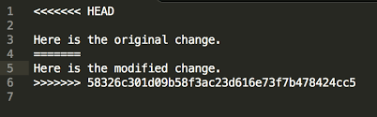
CDC – git merging / Part III – “Merge conflicts”
Solve conflict(s) manually with IDE/Editor
Declare as solved
$git commit -a
“The shell is my friend!”
Notes:
Explain concepts of merge and what to
Try to show anyhow a merge conflict (change the current develop, pull, merge), present it
Don’t exercise merge conflicts with all attendees ☺ just show them maybe 1-2 times

Slide 12
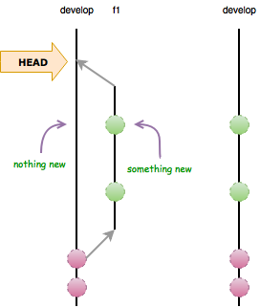
CDC – git merging / Part III – “Merge Theory”
Fast-Forward merge
$git merge <branch-name>
Conditions for ff-merge:
Nothing new on parent!
Less commits
“The shell is my friend!”

Slide 13
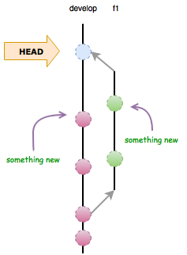
CDC – git merging / Part III – “Merge Theory”
Recursive merge
$git merge --no-ff <branch-name>
Why recursive?
Clear what was done on a branch
Single commit to revert
“A merge commit: instead of being created by a developer, it gets created automatically by Git. And instead of wrapping a set of related changes, its purpose is to connect two branches, just like a knot.”
Notes:
Explain recursive merge and merge commit

Slide 14
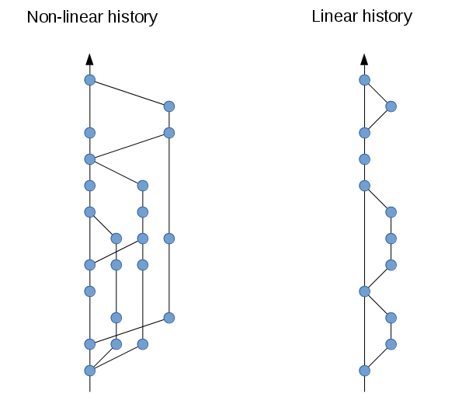
CDC – git merging / Part IV – “Rebase”
“Keeping a clean history in git comes down to knowing when to use merge vs. rebase.”
!Rebase is a team-decision because it change the team workflow
$git checkout develop
$git fetch origin
$git checkout <unique-name>
$git rebase –p origin/develop
$git checkout develop
$git merge <unique-name>
“The primary reason for rebasing is to maintain a linear project history.”
Merge conflicts
Solve conflict(s)
Continue rebase process
$git rebase --continue
Notes:
Explain the differences between merging and rebasing, don’t jump to deep!
Rebasing Deletes Merge Commits!
Golden Rule: Rebase only for local branches or single developer remote branches, never rebase published branches which others use (because commit IDs will change with their related source code)
Rebasing is like masturbation - it is better if you do it in private - if you do it n public, you will be scorned.

Slide 15
CDC – git merging / Part V – “Practice”
Exercise 1 – Merge strategy - recursive.
Clone repository with branch develop
Create local feature-branch
Change/Edit/Add and commit
Merge back to develop with recursive- strategy (check history)
Publish develop-branch to remote
Delete feature-branch
Exercise 2 – Merge Strategy - FF.
Clone repository with branch develop
Create local feature-branch
Change/Edit/Add and commit
Merge back to develop with fast-forward (check history)
Delete feature-branch
Notes:
- If time is short, skip E2

Slide 16
CDC – git merging / Part V – “Practice”
Exercise 3 – Working with remote feature branch:
Clone repository with branch develop
Create local feature-branch
Change/Edit/Add and commit
Publish feature-branch to remote (check on github)
Merge back to develop with recursive- strategy
Publish to remote
Delete remote- feature-branch
Notes:
$git push -u origin feature-branch
$git push origin feature-branch
To check if branch is deleted on remote and sync on local:
$git fetch –f
$git branch –a/-r

