Slide 1
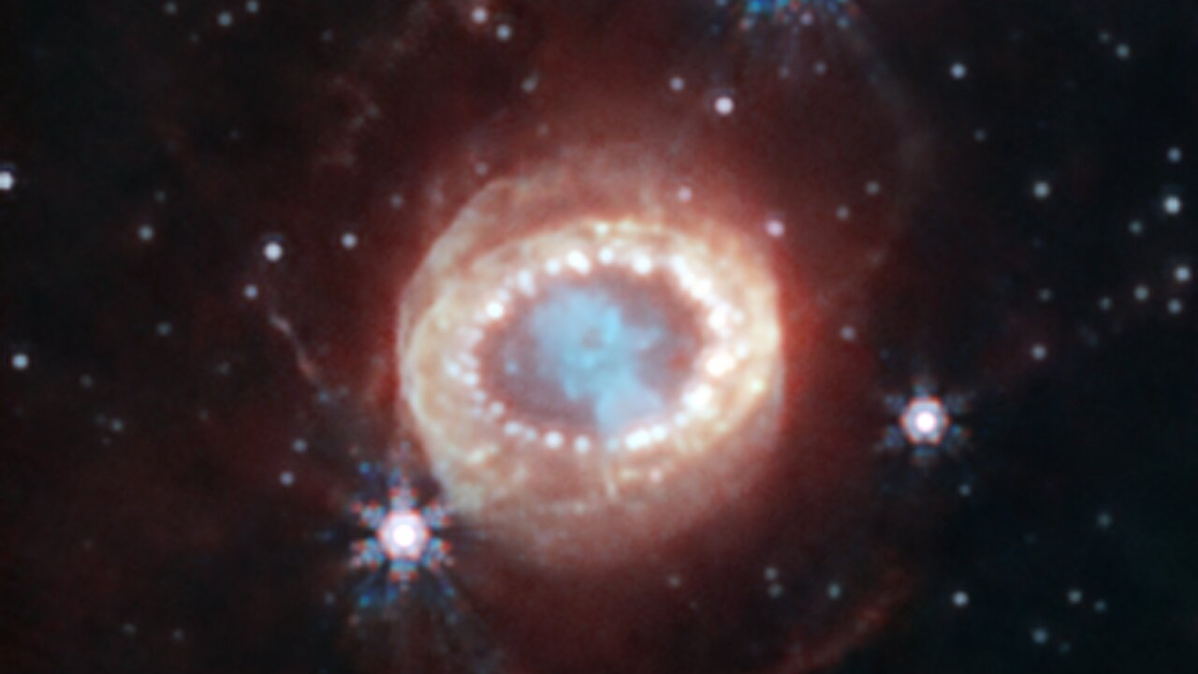
The Landscape of Supernovae
ASTR 400A – Theoretical Astrophysics
Fall 2026
Prof. Carl Fields
TA & GRA Brain Hsu (Guest Lecture)
10/27/2026
Background: SN 1987A – NASA/ESA/CSA JWST/NIRCam

Slide 2
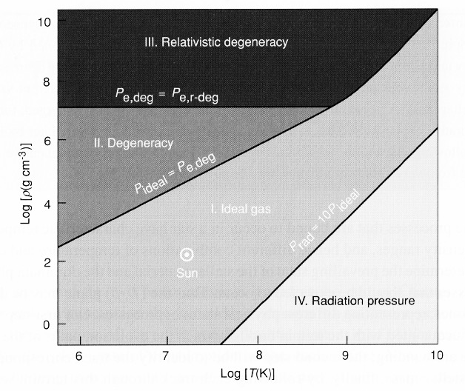
Core Conditions Dictate Final Fate
schematic core evolution. Temp vs. Density diagram
Si
?
O
C
3α
p-p
CNO
BD
0.1 M
pair
1 M
8-9 M
6 M
10 M
200 M
60 M

Slide 3
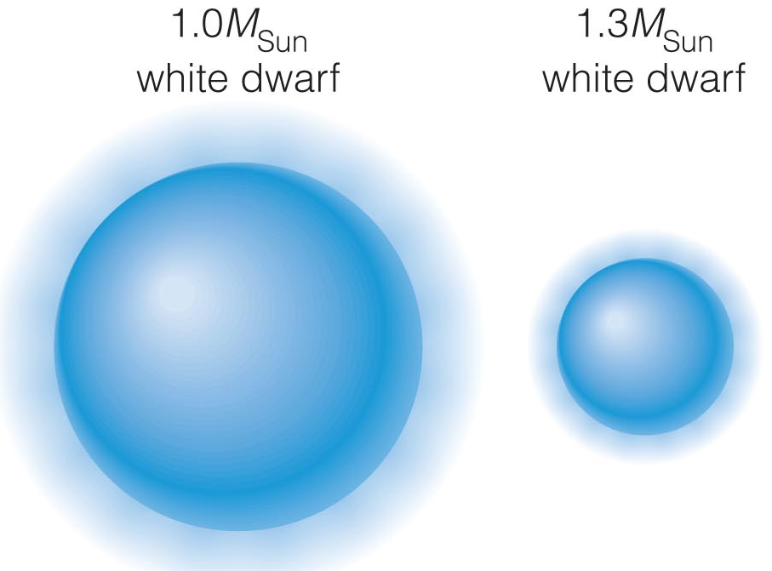
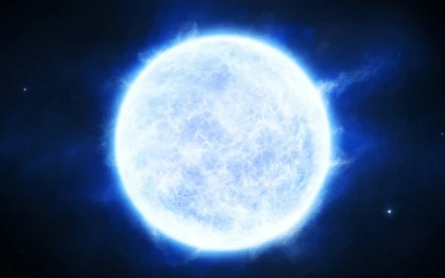
White Dwarfs
Accreting WD continues to gain mass (and shrink in size), but not forever!
Binary white dwarfs can also get close enough to tidally disrupt (making an accretion disk onto more massive WD) or merge into one.
When it reaches a mass of 1.4 M, the entire white dwarf (mostly carbon) burns in a violent thermonuclear explosion.

Slide 4
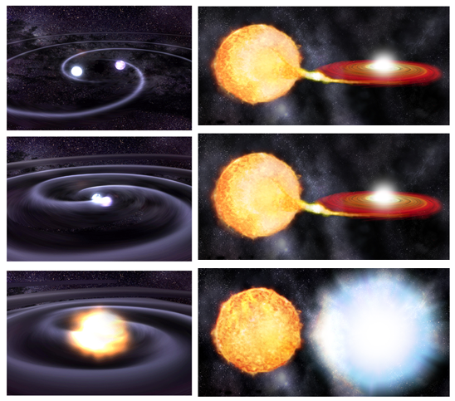
White Dwarf Supernova
WD Supernova completely burns and explodes the WD
Nothing left behind (no neutron star or black hole)
They are bright! About 10⁴³ erg/s at peak
Because all are explosions of WD with same mass (1.4 M), all WD supernovae have roughly the same luminosity
Two scenarios:
  Single degenerate with a MS/RG/He star
  Double degenerate with another WD
Thermonuclear Supernova
or
Type Ia Supernova

Slide 5
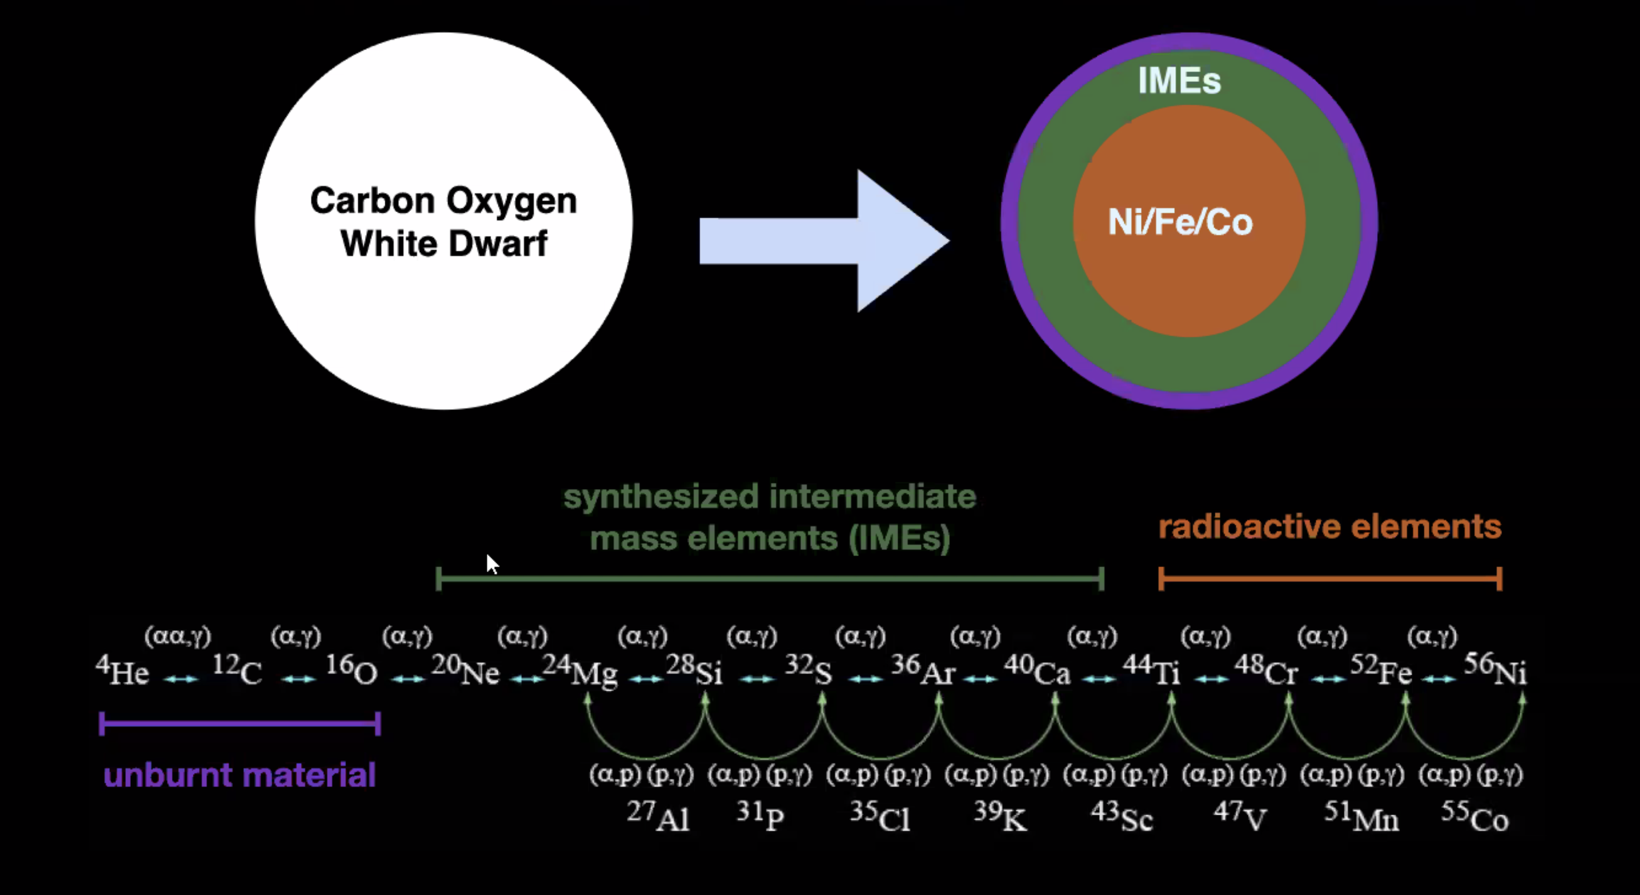
C/O WD and Thermonuclear Reactions

Slide 6
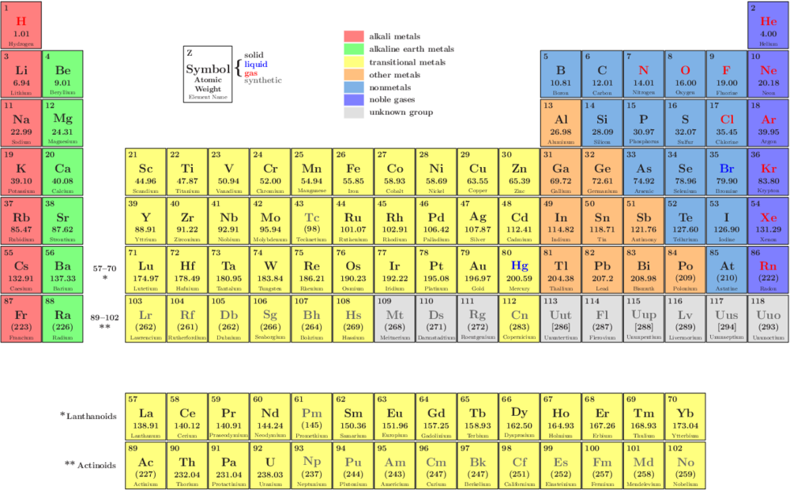
Type Ia SNe lose all shock-deposited heat due to adiabatic expansion (PdV work). They would be invisible if it were not for reheating of the ejecta by radioactive decay.
Radioactive decay:
⁵⁶Ni ⁵⁶Co ⁵⁶Fe

Slide 7
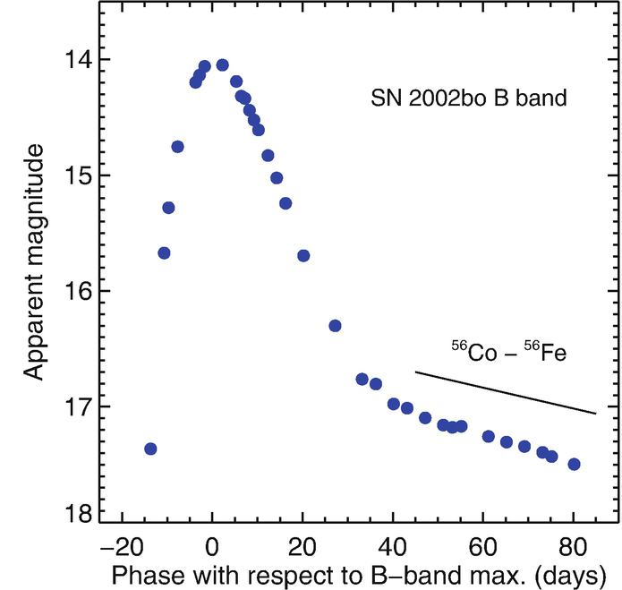
Type Ia SNe lose all shock-deposited heat due to adiabatic expansion (PdV work). They would be invisible if it were not for reheating of the ejecta by radioactive decay.
Radioactive decay:
⁵⁶Ni ⁵⁶Co ⁵⁶Fe
⁵⁶Ni half-life = 6.1 d
decay time = t_{1/2}/ln(2) = 8.8 days
so L = L₀ e^{-8.8} --- declines at 1/8.8 mag/day
⁵⁶Co half-life = 77.1
decay time = t_{1/2}/ln(2) = 111 days
so L = L₀ e⁻¹¹¹ --- declines at 1/111 mag/day

Slide 8
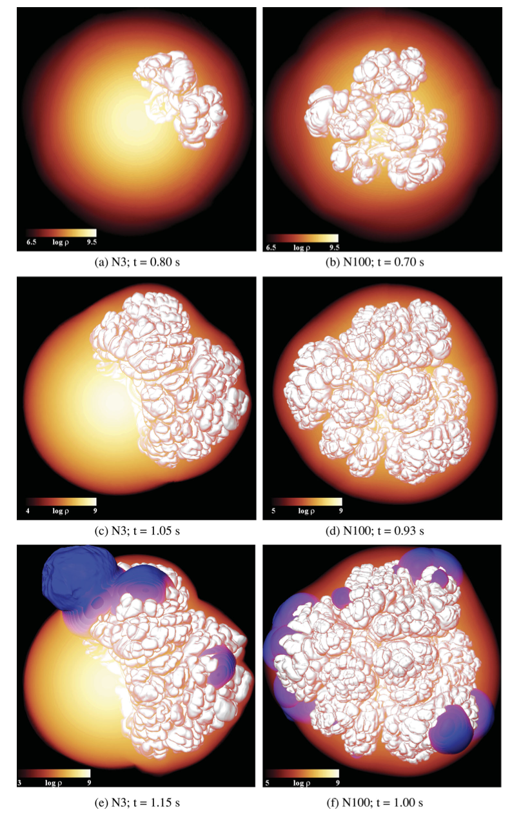
Mechanism 1: Deflagration-to-Detonation Transition
Seitenzahl et al. (2013)
Central deflagration
Transition to detonation
Full detonation
Deflagration: subsonic burning; Detonation: supersonic burning
This mechanism is also often referred to as the Delayed-Detonation Model

Slide 9
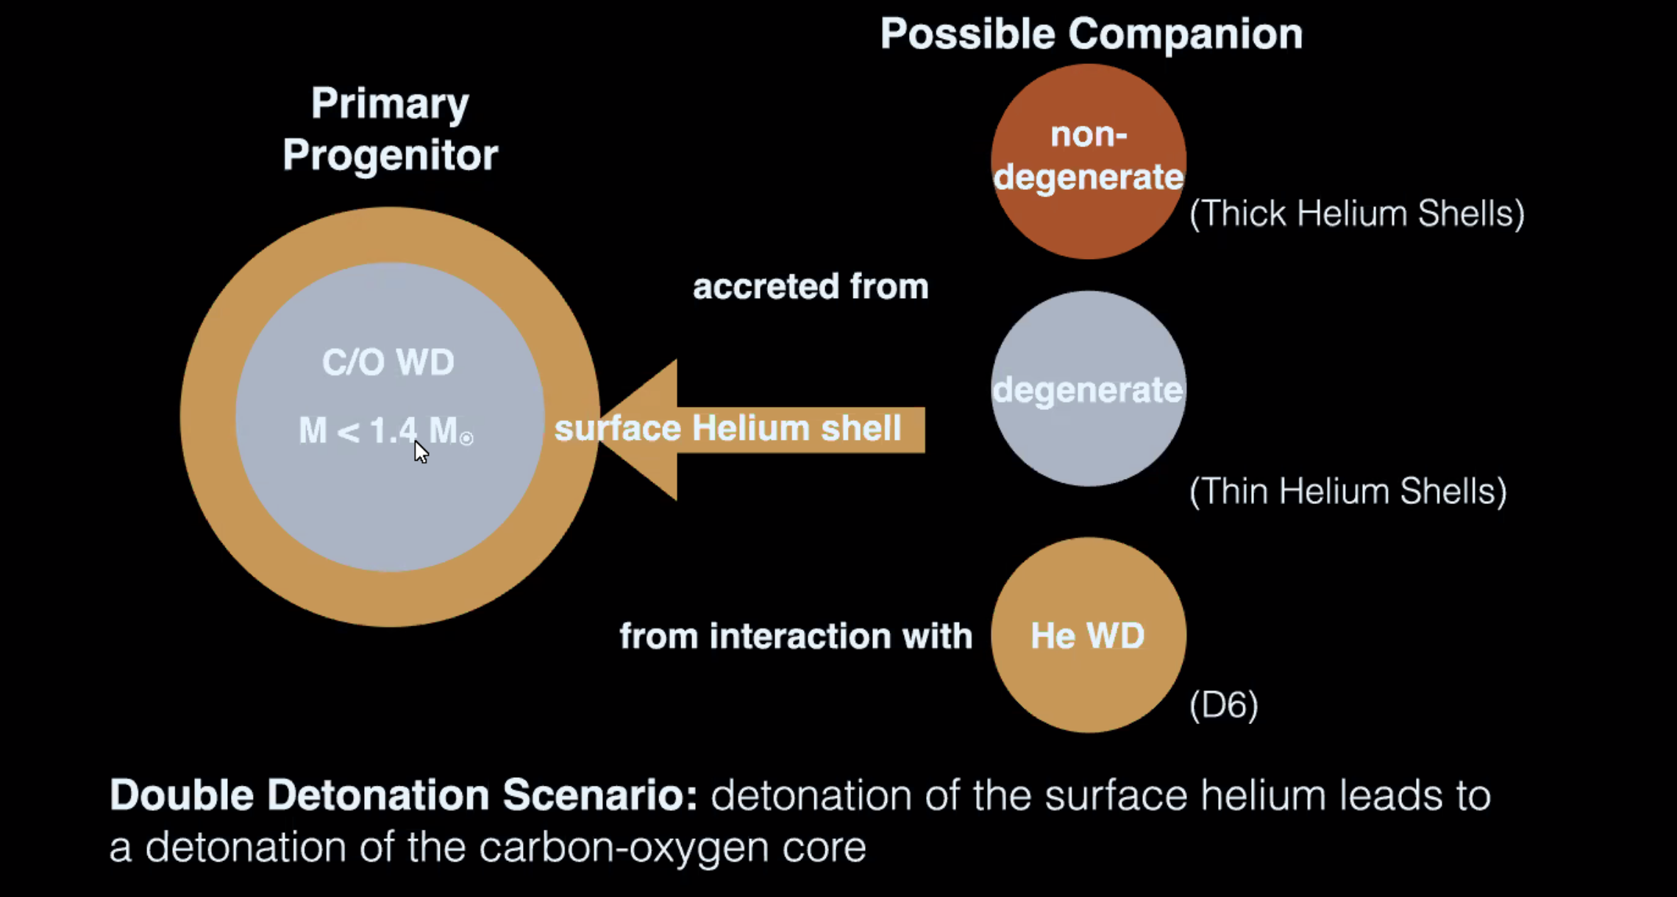
Mechanism 2: Double Detonation

Slide 10
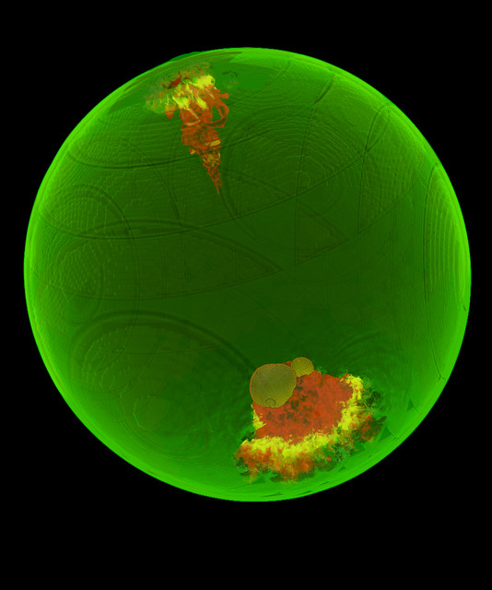
Mechanism 3: Gravitationally Confined Detonation
Deflagration occurs off-center
A hot bubble consists of burning ash expands and rises toward the surface
Burning front expands laterally around the surface
The fronts collide at the other side of the surface and compress unburned material
This detonates the WD

Slide 11
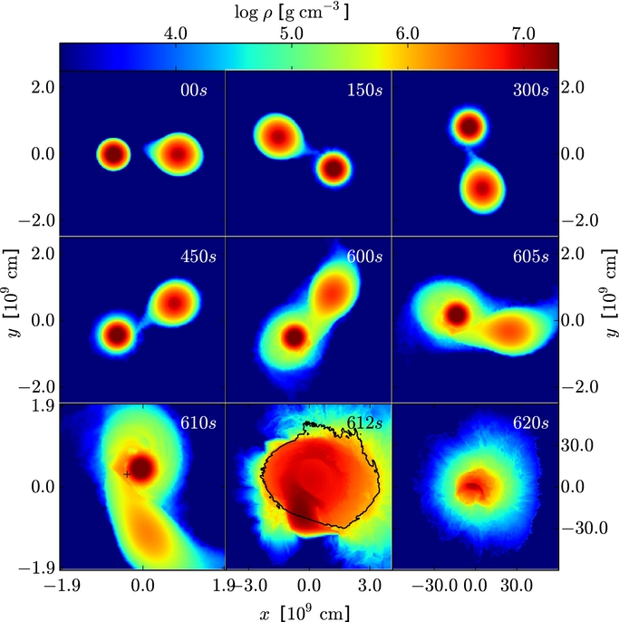
Scenario 4: Violent Mergers
Binary WDs in-spiral and merge
Secondary WD is disrupted and accreted onto the primary
Detonation occurs upon impact of the disrupted secondary
Pakmor et al. (2012)

Slide 12
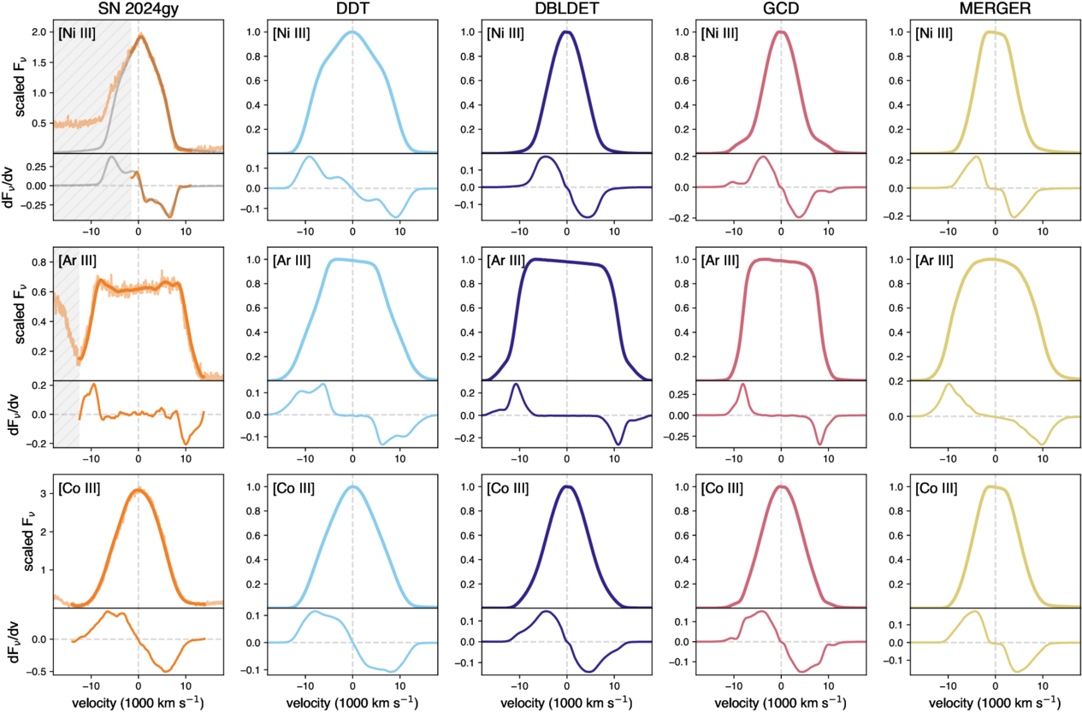
How do we distinguish between mechanisms?
Nebular spectra with JWST!
Different atomic/ionic lines show different profile shapes depending on the explosion mechanism.
Kwok et al. (2026)

Slide 13
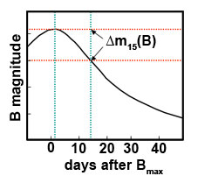
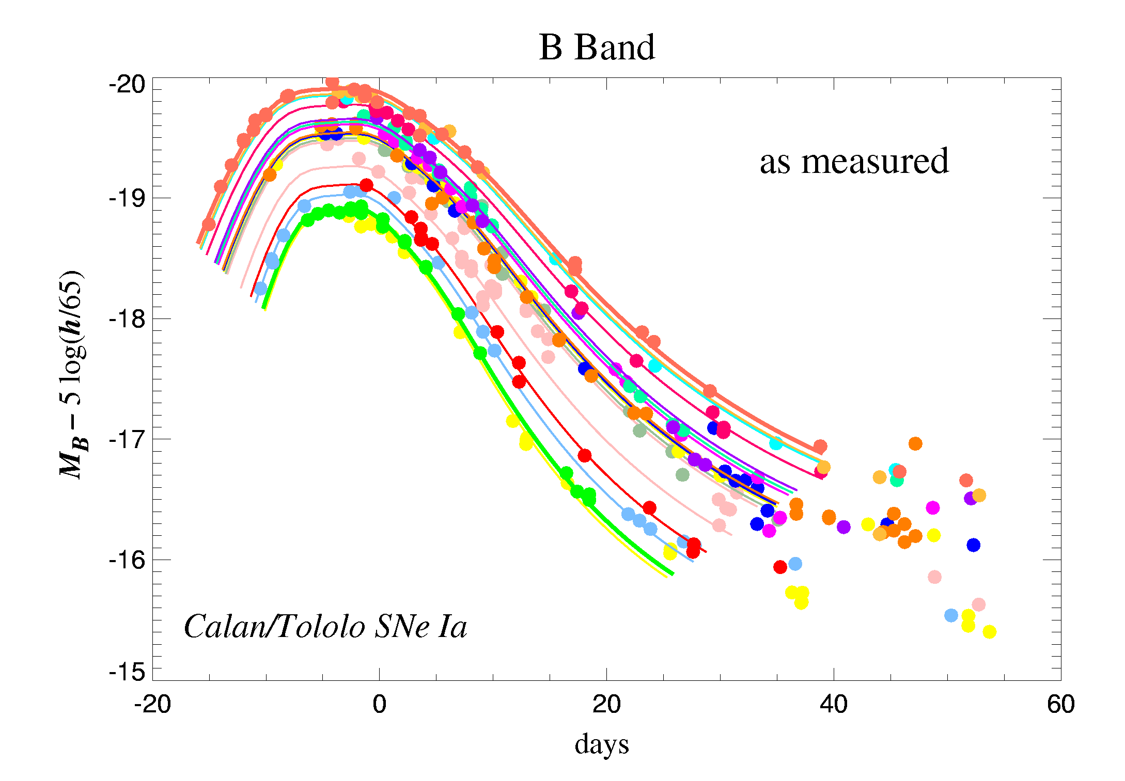
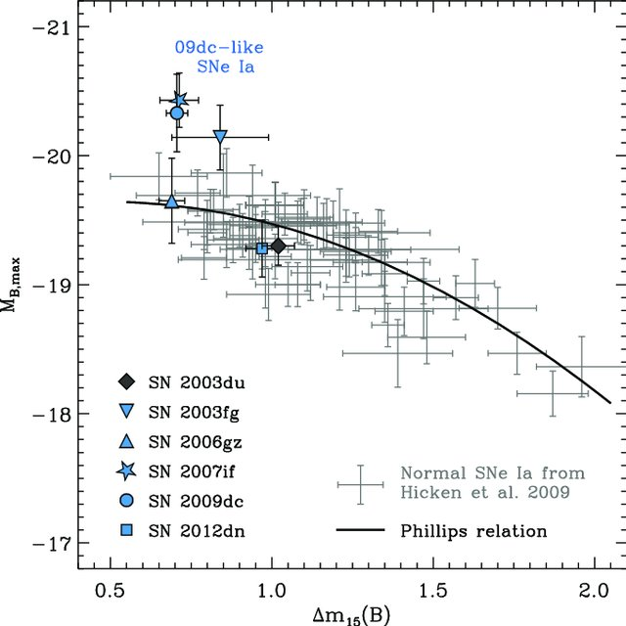
Type Ia SN Cosmology
Type Ia SNe are not standard candles, but they are “standardizable” candles.
More luminous = slower decay
Less luminous = faster decay
Luminosity–decline rate relation, a.k.a. the “Phillips relation”

Slide 14
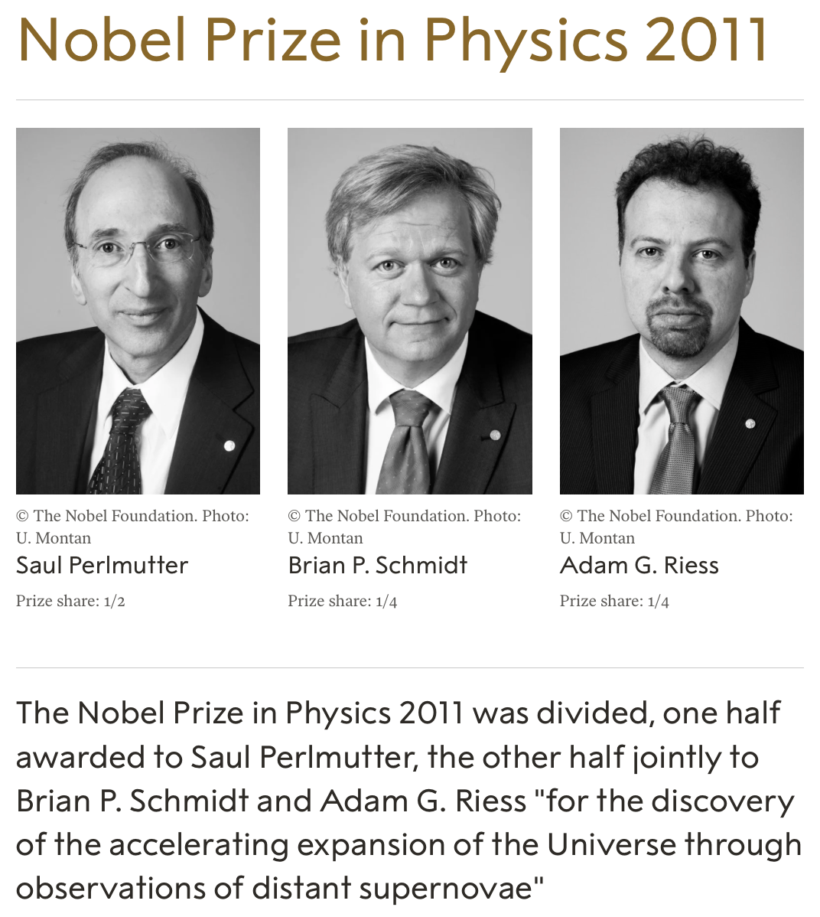
Type Ia SN Cosmology
Type Ia SNe are not standard candles, but they are “standardizable” candles.
More luminous = slower decay
Less luminous = faster decay
Luminosity–decline rate relation, a.k.a. the “Phillips relation”

Slide 15
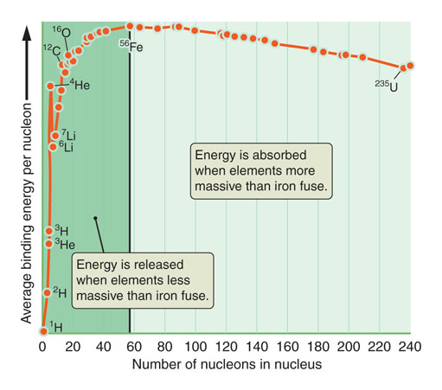
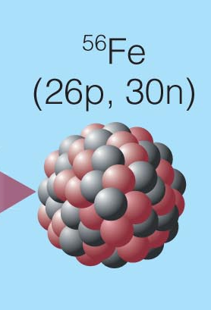
Nuclear Burning in Massive Stars
Cores of high-mass stars are hot enough to have fusion reactions beyond carbon.
Can produce all elements up to iron (Fe)
Even a high-mass star can’t burn iron, because it doesn’t produce energy.
Fe core builds up in mass, as gravity gets stronger and stronger…

Slide 16
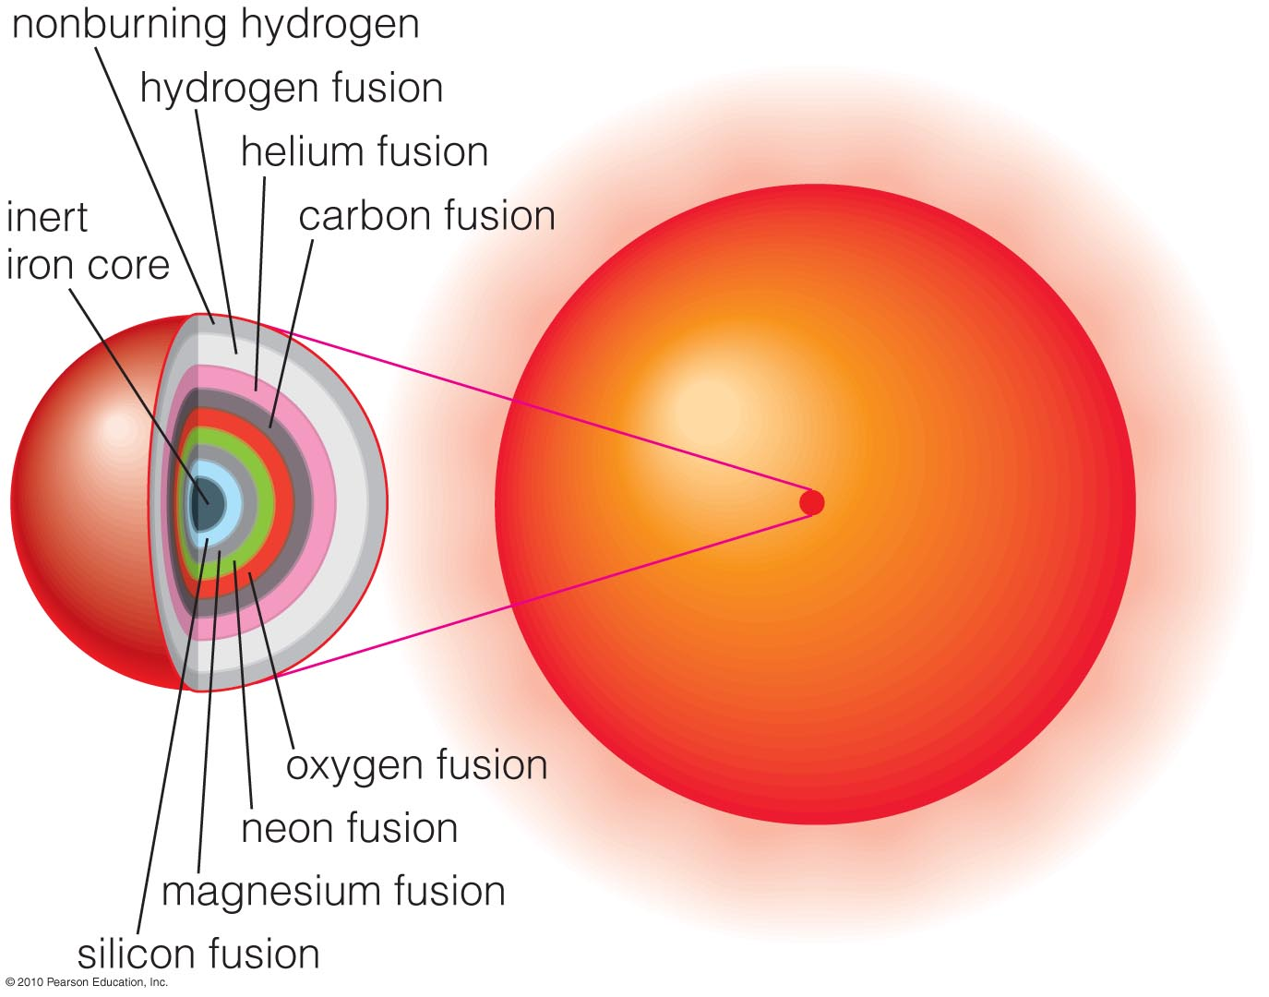
Advance Burning Stages in Massive Stars
Advanced core burning stages are fast – envelopes can’t adjust (t_{diff}).
Burning times and T (20 M):
H ~ 1e7 yr; 1e7 K
He ~ 0.5-1e6 yr; 1e8 K
C ~ 1000 yr; 6e8 K
Ne ~ 1 yr; 1.5e9 K
O ~ ≤1 yr; 2e9 K
Si ~ 1 day; 3.5e9 K
Core convergence… next burning sequences starts when shell has added enough fuel (roughly at M_{Ch}).
}
Heavy neutron
excess, neutrino
cooling

Slide 17
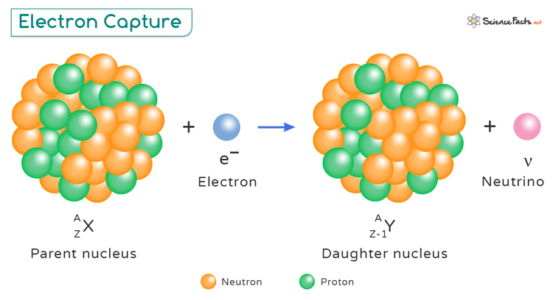
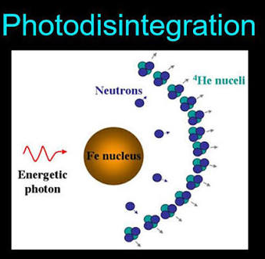

Iron Core Collapse
As with C/O WDs, inert Fe cores also have a corresponding M_{Ch}≈1.26 M.
Two processes accelerate the core collapse:
Electron captures:
  At high density, free electrons can be captured via inverse beta decay - core becomes more neutron rich - neutronization.
  This reduces the free electron number and therefore M_{Ch}.
Photo-disintegration:
  At ~10¹⁰ K, gamma rays can break up heavy nuclei into lighter ones
  ⁵⁶Fe + $γ$ $⟺$ 13(⁴He) + 4n and ⁴He + $γ$ $⟺$ 2p + 2n
  This removes pressure support from the Fe core, potentially triggering the Fe core collapse.

Slide 18

Iron Core Collapse
The collapse is extremely rapid, ~10 ms (recall our dynamical timescale and typical core density $ρ$~10¹⁰ g cm⁻³).
Photo-disintegration and electron captures continue due to increases in photon energies/density and lead to further neutronization.
The temperature and pressures rise, but not enough to halt collapse until nuclear densities are reached $ρ$~10¹⁴ g cm⁻³).
The composition becomes predominantly neutrons, modifying the equation of state, the gas becomes nearly incompressible and the proto-neutron star halts collapse at a radius of about 20 km.

Slide 19
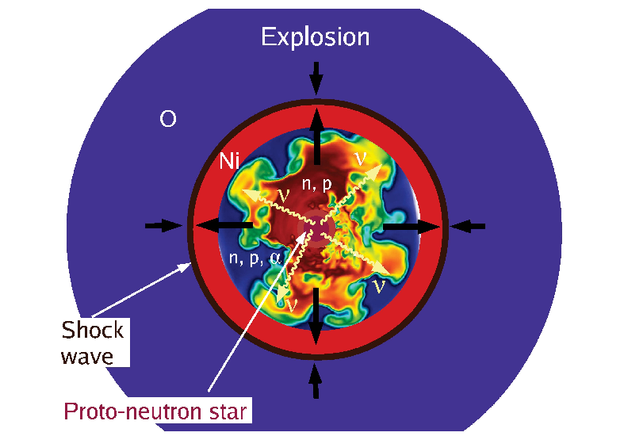
The Delayed Neutrino-heating Mechanism
At a few ~3×10¹⁴ g cm⁻³, neutrons become degenerate and the inner core like a spring causing the core bounce.
The velocity of the inner core is reversed due to the bounce and travels towards still infalling material of the outer core.
These material impact each other, the supersonic material creates a shock wave that steepens as it moves outward into lower density.
Photo-disintegration and electron captures take away most of the energy from the shock, and the shock front stalls.
If the shock is not revived, the star doesn’t explode and becomes a failed supernova.

Slide 20
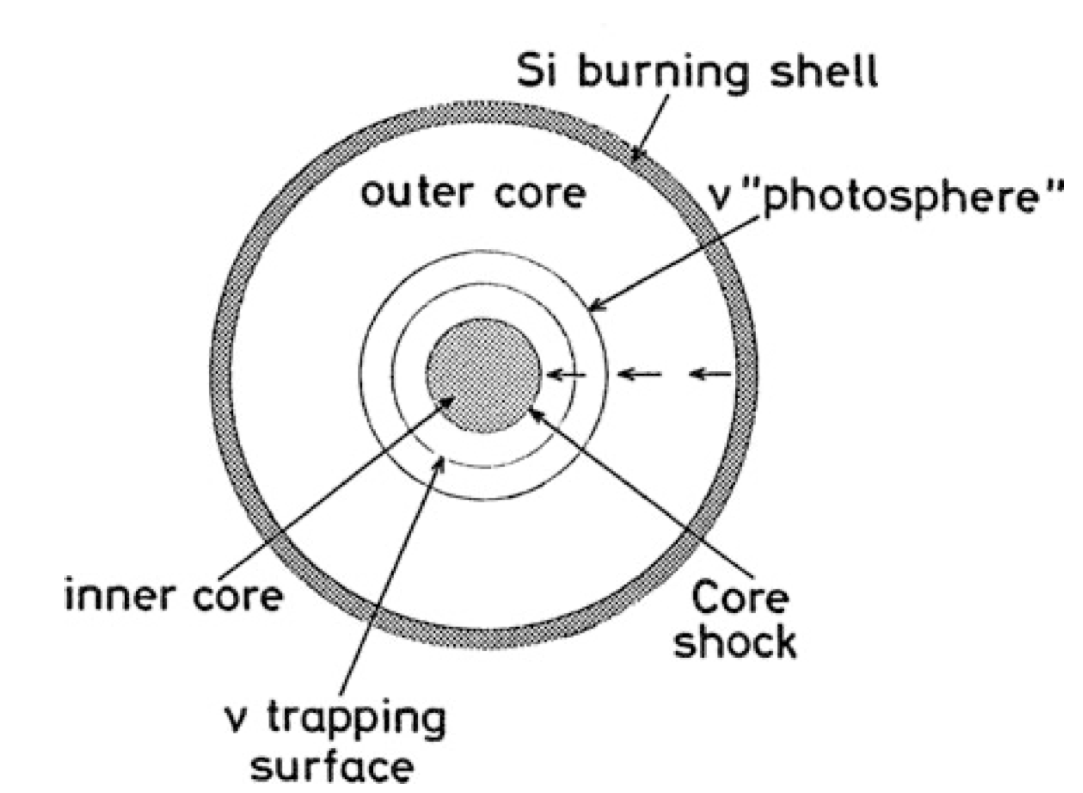
The Explosion Mechanism
The core becomes opaque to neutrinos and forms a neutrinosphere - outer layers of the core where the density is low enough for neutrinos to escape. Within this radius neutrinos have to scatter many times before escaping.
Neutrino heating - neutrinos able to diffuse out of the core heat the region where the shock has already passed (the post shock region) - from about 30 km to 100-300 km.
This neutrino-heated region becomes convective and provides a way to convert thermal energy deposited by neutrinos into kinetic energy potentially leading to revival of stalled shock overcoming ram pressure to lead to explosion.

Slide 21
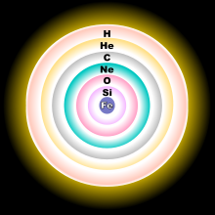
Explosive Nucleosynthesis
Most of the Fe goes into the proto-NS.
Infalling Si, Mg, Ne, O may also disintegrate into He nuclei.
NSE fuses these He nuclei to heavier elements.
Expansion cools the ejecta, and heavier elements “freeze out” before they are destroyed.
Note that the Fe produced in the star’s core will never escape (goes into the NS or BH). Massive stars are not primary source of Fe.

Slide 22
As in Type Ia SNe, NSE burning in CCSNe makes a lot of Fe-peak elements, especially ⁵⁶Ni. However, much smaller 56Ni mass results (more like 0.1 M instead of ~1 M). So normal CCSNe are less luminous.
Radioactive decay:
⁵⁶Ni ⁵⁶Co ⁵⁶Fe

Slide 23
As in Type Ia SNe, NSE burning in CCSNe makes a lot of Fe-peak elements, especially ⁵⁶Ni. However, much smaller 56Ni mass results (more like 0.1 M instead of ~1 M). So normal CCSNe are less luminous.
Radioactive decay:
⁵⁶Ni ⁵⁶Co ⁵⁶Fe
NSE burning only lasts a short time as the shock passes through layers outside Fe core. Only a mall fraction of star is burned, so primary nucleosynthesis yield is intermediate-mass elements like O, Mg, S, etc. plus small mass of r-process elements.

Slide 24
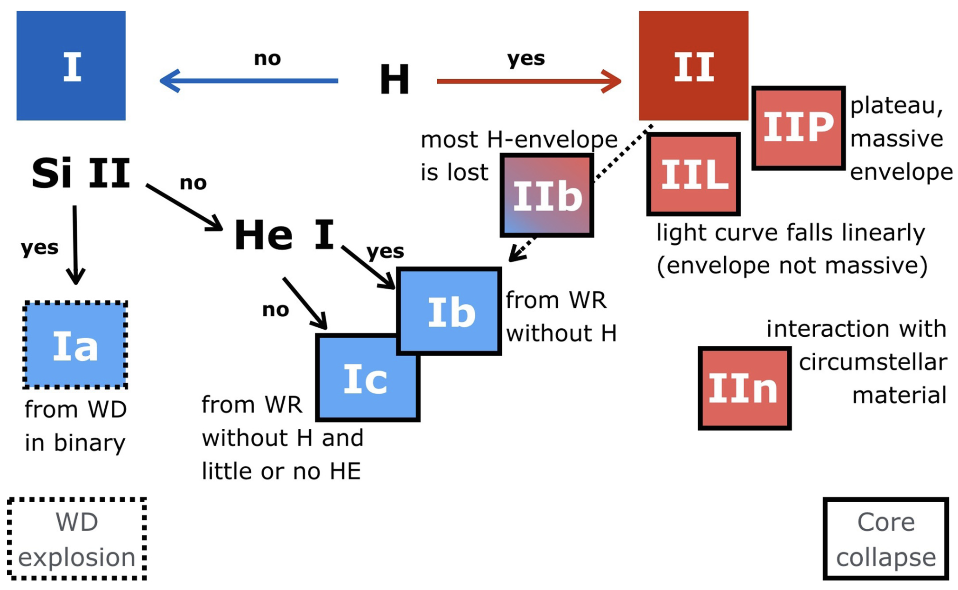
Supernova classification is purely observational

Slide 25

.
M
WNH
LBV
120 M
Type IIn
IIn
Wolf-Rayet
60 M
YHG
BSG/LBV
RSG
II-L
Ib/c
30-35 M
II-P
II-pec (87A)
IIb
(1993J, SN 2011dh)
Cas A
Ib/c
8-20 M
8-15 M ➔ Type II-P
But something like 50% or more of
Massive stars are in close binaries…
END FATES of MASSIVE STARS:
What type of supernova from which type of star?

Slide 26
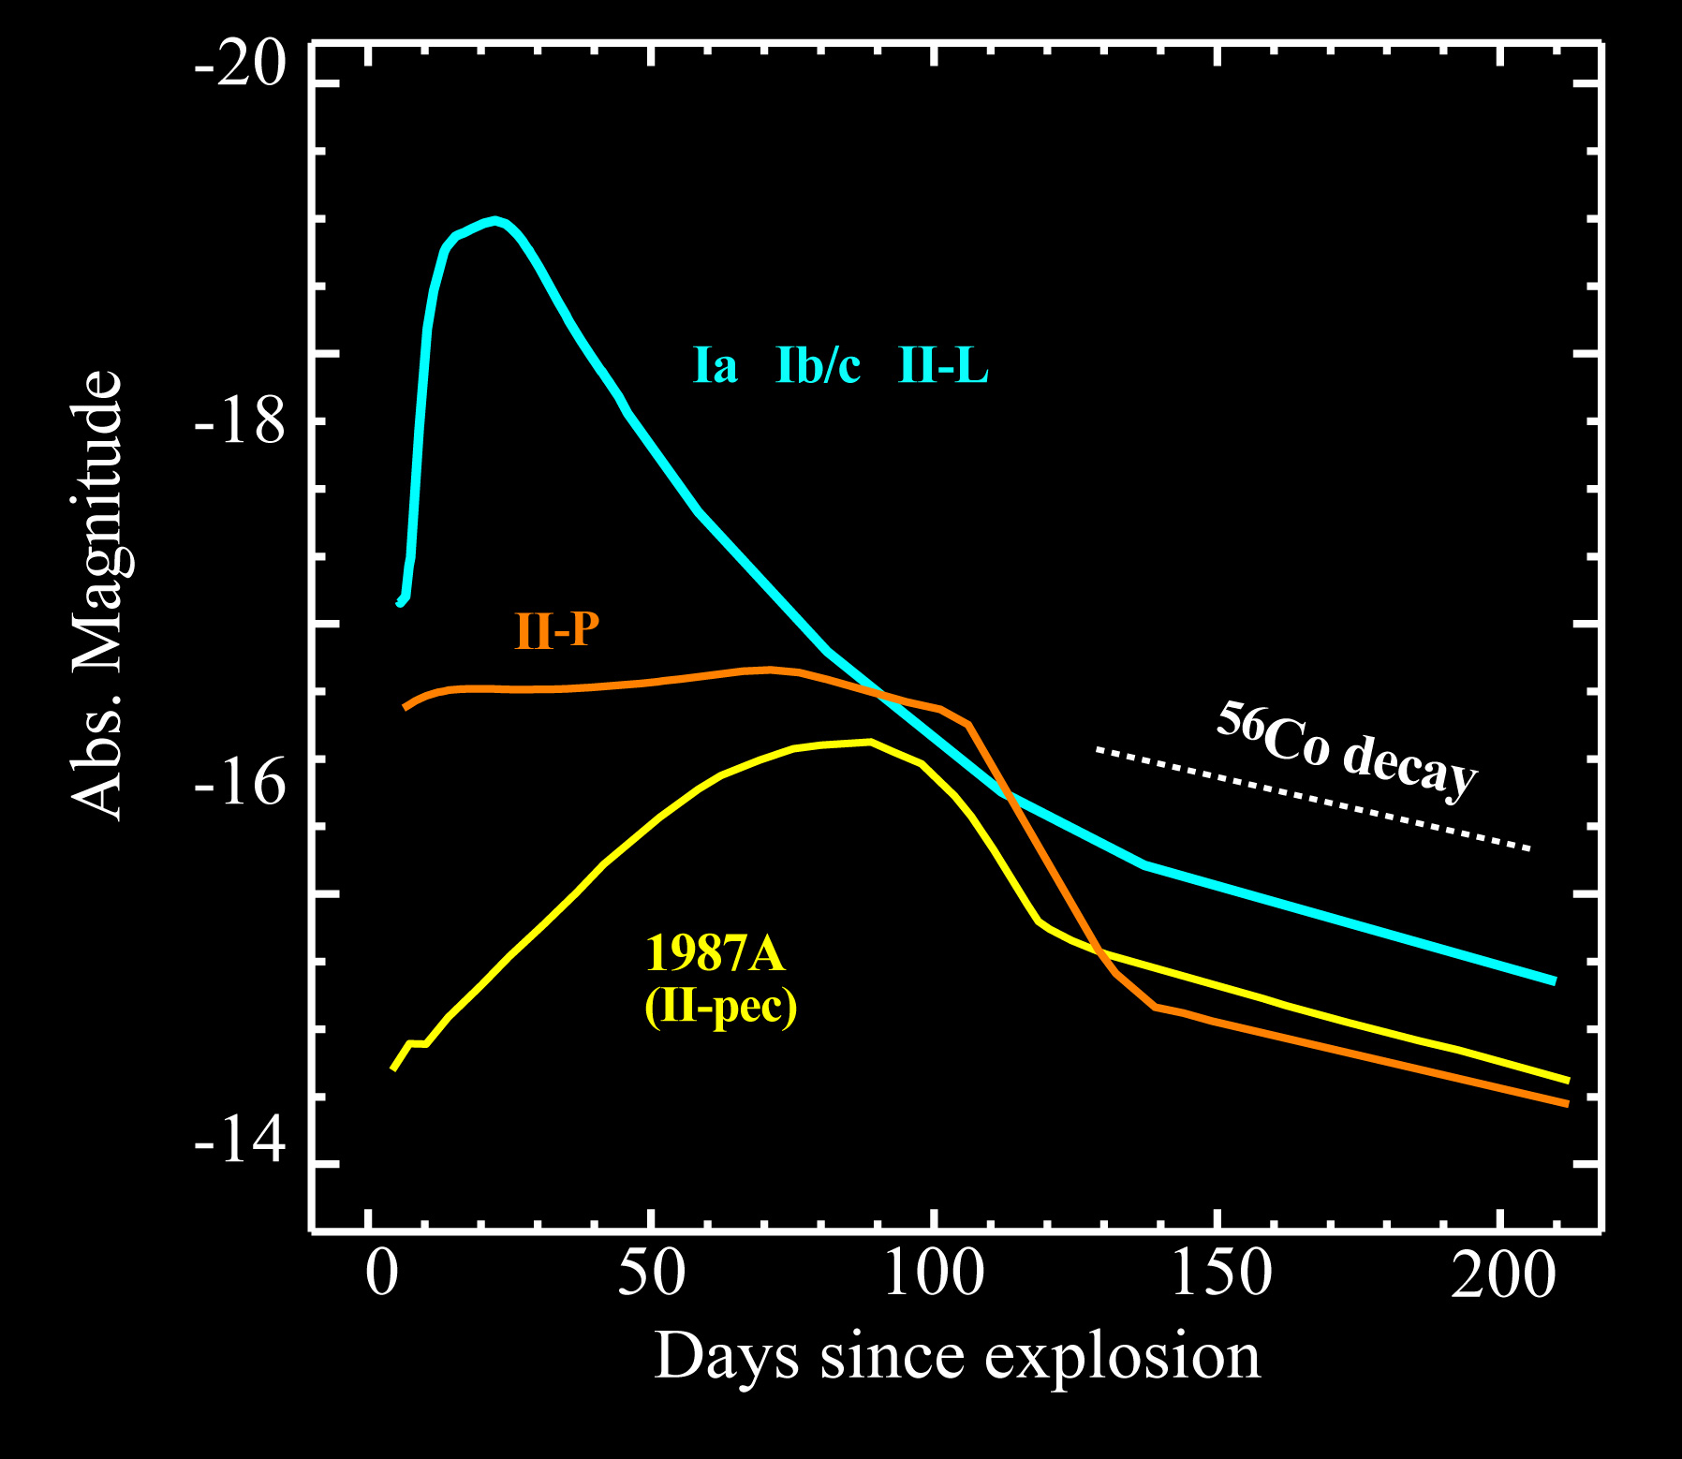
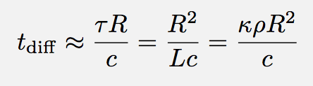
Light Curves
Type Ib/Ic: core-collapse SNe with no H. a.k.a.: “stripped-envelope SNe”
WR star progenitors (small R).
Light curves look like SNe Ia (but fainter)
Powered entirely by radioactive decay.
Type II-P: progenitors with H envelopes. RSGs produce light curve with a “plateau”. Plateau is powered by shock heated envelope at first, then radioactive decay toward end. Plateau ends when whole H envelope recombines and becomes optically thin. Plateau time is approximately the diffusion time.
Type II SNe with more compact BSG progenitors (like 1987A) are fainter at first.

Slide 27
Light Curves
Pair Instability SN
makes ~10 M⊙ of ⁵⁶Ni
This makes it a “Super-Luminous SN”
(about 10x brighter than brightest Type Ia SNe, which are brighter than core collapse SNe)
Since star that exploded is very massive (>100 M⊙), diffusion time is longer and PISNe take a longer time to brighten and fade.

Slide 28
In-class Assignment 16
Work on ICA 16 here with groups per usual.
Discuss conceptual questions together and prepare answers to share at the end of class.
Choose someone that will report out the group’s responses ahead of time!
After Class: Due: Submitted to D2L by EoD
Note: The goal of ICAs are to use plots produced in the notebook for discussion and interpretation of results presented in lecture in groups and as a class.

