Slide 1
Computational Statistic Project
Application of Extended and Ensemble Kalman Filters to two particular cases : Lorenz System and Thomas Attractor
Laurenti Argento Carlo - Svagna Marcello A.A 2022/23

Slide 2
Idea of the Project
Approach to the problems:
Show the analytical time evolution of the systems
Analyze the filter algorithm to find out the correct parameters to implement
Sample measurements with noise from the analytical solution
Apply the filter algorithm to our systems
Discuss errors and results according to the expected physical behaviour

Slide 3
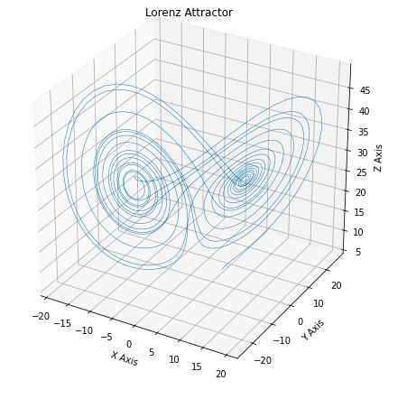

Lorenz System
From Theory we know that this is the time evolution of Lorenz System with a specific choice of the parameters (s, r, b) of the PDE.

Slide 4
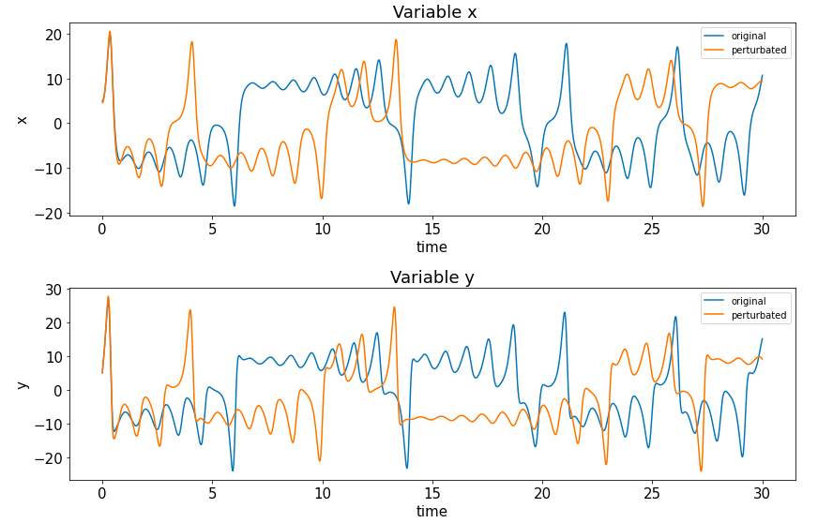
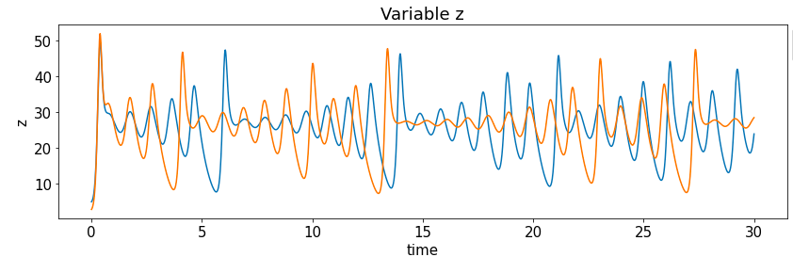

Dealing with perturbations
From theory we know that with a little noise over initial conditions, the systems change completely the evolution.
Our aim is to fix this inconvenience trough Kalman Filters
Here are reported the graph representing the evolution of the original system and of the perturbed one

Slide 5
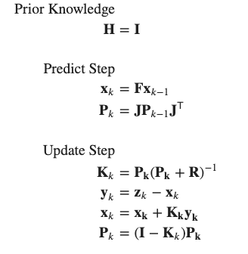
Kalman Filters Implementation
To implement the Kalman Filters algorithm we need to sample some measurements (z_k) form the analytical equations.
Thus we decided to sample 40 measurement in a range of 2000 time steps (30 seconds)

Slide 6
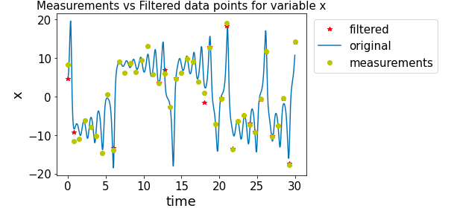
Extended Kalman Filter
Our first trial was to use the Extended Kalman Filter to handle the problem.
The result for the estimate of variable x is reported on the right
The main feature of this kind of filter is that trough the computation of the Jacobian Matrix (J in the previous scheme) , it can be applied also to nonlinear system like this one

Slide 7

Analysis of the results
Plotting the error of the filtered points against the error between the original system and the perturbate one, we can see that we have a clear improvement in terms of precision
However, it is evident both looking at the previous graph and analyzing the diagonal of the Kalman Gain Matrix (K i,i ~ 1) that the measurements have a lot of influence in the filtered point estimate, thus affecting the reliability and the effectiveness of our model

Slide 8
Ensemble Kalman Filter
The approach of the Ensemble Kalman Filters is pretty much the same as the one for the EKF : the only difference relies in the fact that instead of taking a single measurement as a guess, the idea is to sample N points following a Gaussian distribution and to apply the filtering to every point; the final filtered-estimate will be given by the mean of each filtered point
x0 is the EKF measurement while P0 is the sampling error covariance matrix

Slide 9

Comparison between EKF and EnKF
Although the result for the EnKF is similar to the one for EKF in terms of error, the EnKF filtering is more indipendent from the measurements and so more relevant and statistically reliable.

Slide 10
Possible improvements
How can we achieve better results for our system ?
More accurate numerical integration (from EE to RK methods)
More measurements (all variables changes very fast w.r.t. time)
Implementation of other types of KF
Decreasing noise in sampling measurements

Slide 11
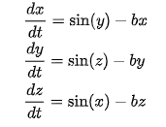
Thomas Attractor
We then decided to analyze the time evolution of the Thomas Attractor , with b=0.208

Slide 12
Different system, same problem, same approach

Slide 13
Extended Kalman Filter results :
As can be seen, the results for the EKF applied to the Thomas System are good :
even if for variable x there is still a strong displacement in favour of measurements against the dynamic of the system, for the other variables the filtering process achieves good results in terms of system approxiamtion and bring error estimate very low a.e.

Slide 14
Ensemble Kalman Filter results :
After a improvement trial to the bare EKF with the implementation of RK4 method for the system approximation, we decided again to rely on EnKF and the result, as can be easily seen both by the graph and by the error plot, is really good.

Slide 15
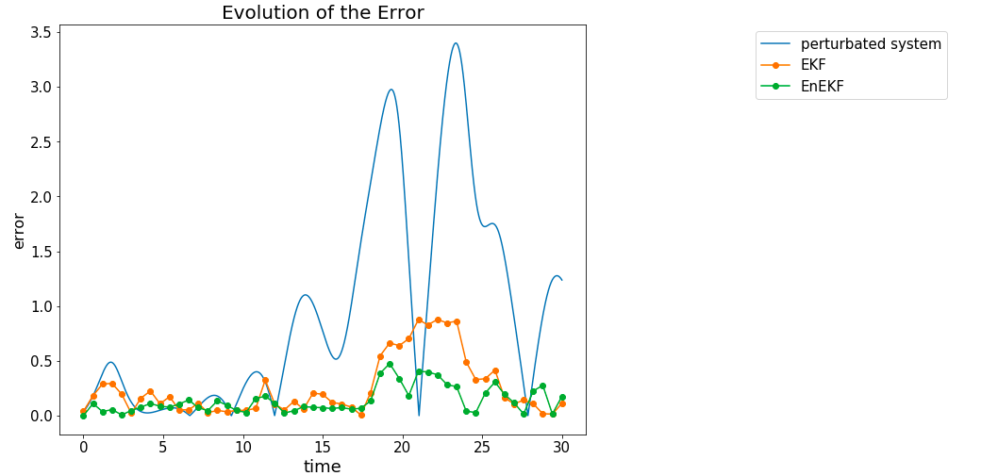
Final Considerations and comparison
As it can be seen on the graph reported above, the EnKF filtering for Thomas system improves significantly the estimate given by the bare EKF algorithm
In general, for EnkF, the filtered points approximate a. e. better the system equations than the measurements : for this reason we can state that our approach gives us satisfying results and works in an appropriate way
Morover, reducing the noise covariance matrix for the measurements sampling, the EnKF estimates get better and better still remaining not completely dependent upon the measurements themselves, still guaranteeing us the proper functioning of the algorithm

Slide 16
Sources and related paperwork
Information and guidelines for our project
Google Colab and Jupiter as working interface, where we wrote our two working Notebook
The article “PyDA: A Hands-On Introduction to Dynamical Data Assimilation with Python” , link : https://www.osti.gov/pages/servlets/purl/1737509
The GitHub repository “deeptime”
Chapter 10 from ClassNotes_CS_2022

