Slide 1
My Queries
Ileana Aguilar

Slide 2
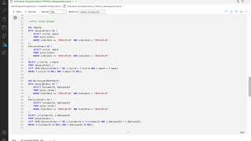
Use of Gantt, To-Do List, Top Queries

Slide 3
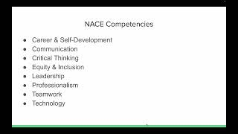
NACE

Slide 4
My Queries
Taruna Mangar

Slide 5
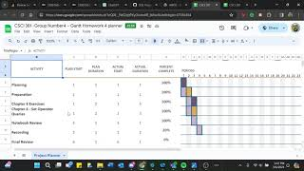
Use of Gantt, To-Do List and Chapter Six Queries

Slide 6
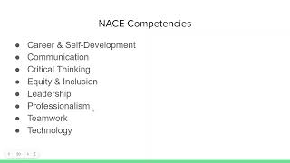
NACE APPLICATION

Slide 7
My Queries
Carlo Ace Sagad

Slide 8
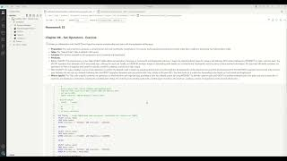
Presentation 1 covers To do list, Gannt Chart, Notebook

Slide 9
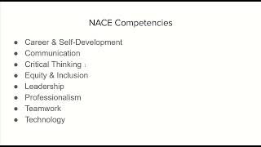
Presentation 2. Nace Compentencies

Slide 10
My Queries
Bin Xie

Slide 11
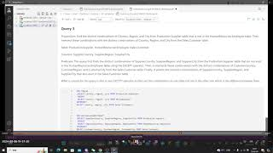
Use of To-Do List, Gantt, Top 3 Queries

Slide 12
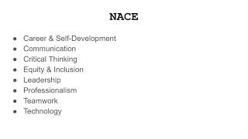
NACE AND CHATGPT

Slide 13
My Queries
Arrafi Talukder

Slide 14
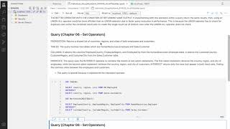
Use of Gantt, To-Do List and Top 3. Also, use of Chat GPT

Slide 15
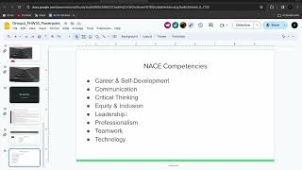
Nace Competencies

Slide 16
NACE Competencies
Career & Self-Development
Communication
Critical Thinking
Equity & Inclusion
Leadership
Professionalism
Teamwork
Technology

