Slide 1
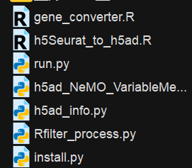
the execution script
the main script
script for ‘viewing h5ad file structure’
script for setting up
can handle h5ad files of any size, regardless of memory constraints.
(fully memory-adaptive and ensures successful processing even for extremely large datasets)
The optimal memory allocation is between 50G and 100G
Support filtering and downsampling

Slide 2
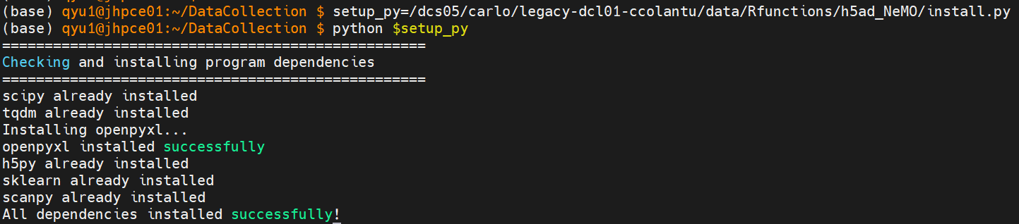
1. Use install.py to set up
This is a one-time installation script. It installs all required dependencies into the user's local directory. You only need to run it the first time before using the pipeline.
Linux Command:
setup_py=/dcs05/carlo/legacy-dcl01-ccolantu/data/Rfunctions/h5ad_NeMO/install.py
python $setup_py

Slide 3
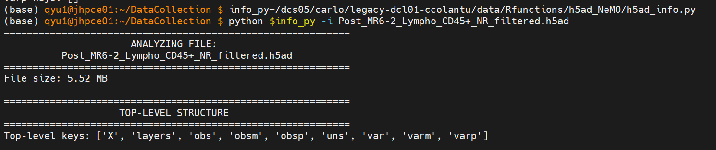
2. Use h5ad_info.py to inspect the h5ad.file
Linux Command:
info_py=/dcs05/carlo/legacy-dcl01-ccolantu/data/Rfunctions/h5ad_NeMO/h5ad_info.py
python $info_py –i {your_h5ad_file}
How to check the output:
In the "X MATRIX" section, check whether the data type is as expected
In the "OBSERVATIONS (obs)" section, locate the column that stores cell identifiers
In the "VARIABLES (var)" section, locate the column names that correspond to Ensembl IDs and gene symbols.

Slide 4
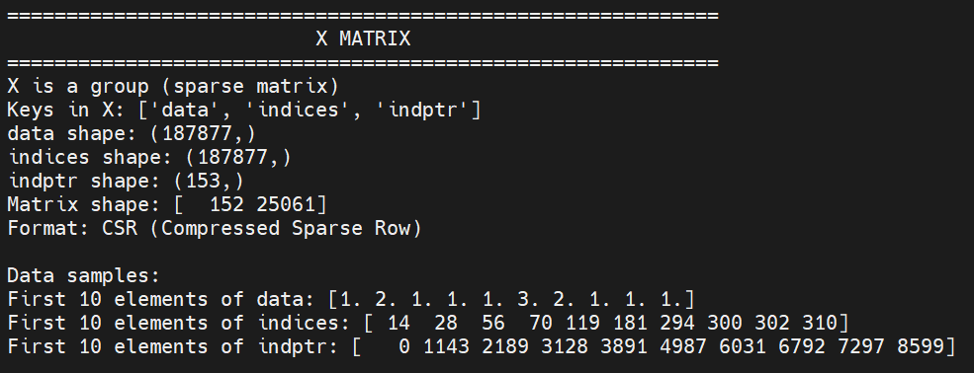
- In the "X MATRIX" section, check whether the data type is as expected.
In this sample, it contains raw counts. If log-normalized data is required, additional processing is needed.

Slide 5
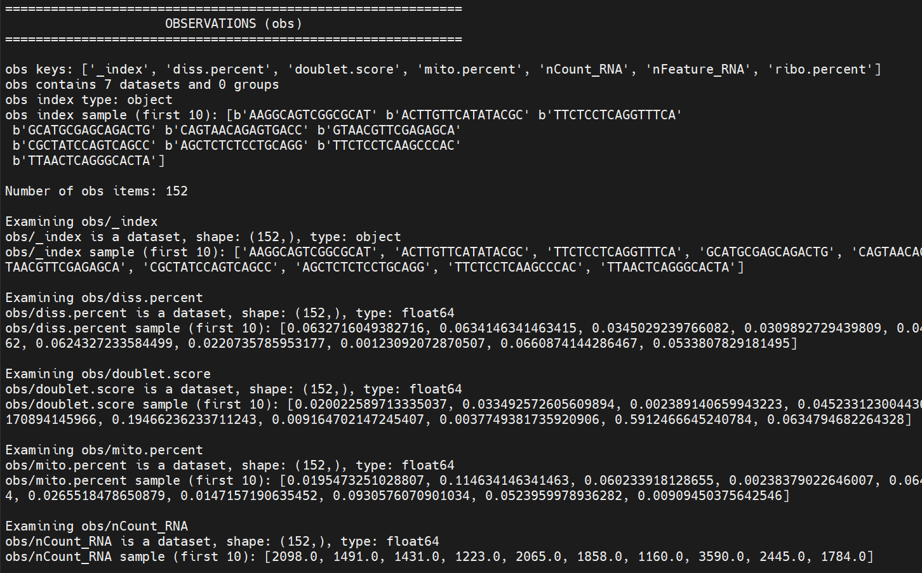
In the "OBSERVATIONS (obs)" section, locate the column that stores cell identifiers
In this sample, the column name is _index

Slide 6
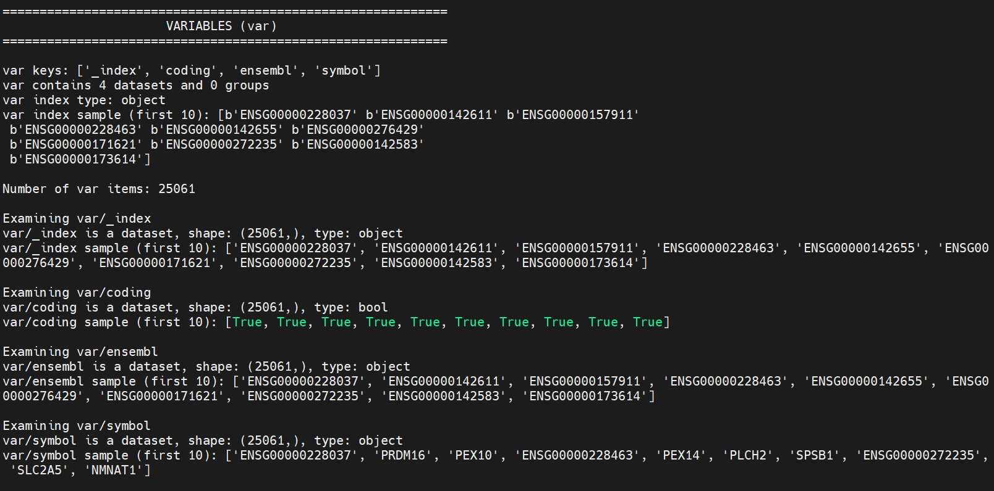
In the "VARIABLES (var)" section, locate the column names that correspond to Ensembl IDs and gene symbols.
In this sample, the column names are simply ensembl and symbol

Slide 7
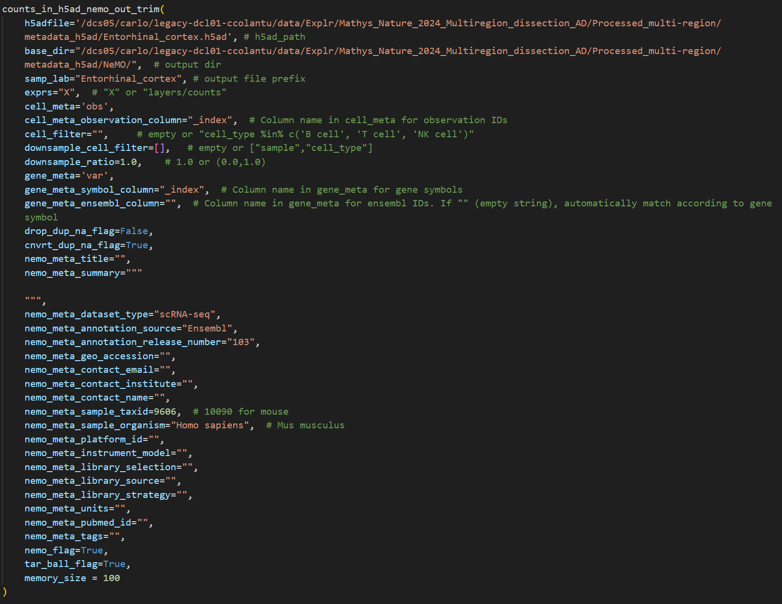
3. Modify arguments in run.py , then execute from the terminal
Consider that manually editing parameters inside function scripts was inconvenient, run.py is created to simplify usage.
You can copy it to any working directory, set parameters in one place, and call the core functions without modifying the original codebase.
Overall approach: provide the path to the h5ad file along with additional textual information.

Slide 8
Five new parameters have been added, while all other arguments remain consistent with the R function:
cell_meta_observation_column (required): Specifies the column in obs used as the identifier for cells. The default is "_index", which corresponds to how cell names are stored in obs/_index when converting from h5Seurat to h5ad. This parameter is necessary because the expression matrix in h5ad does not retain explicit row or column names, so external naming must be supplied.
memory_size (required): Defines the available memory for processing (in GB). The script uses this value to automatically choose between the full-loading (V1) and chunked (V2) strategy.
cell_filter (optional): Accepts an R-style logical expression as a string (e.g., "cell_type %in% c('B cell', 'T cell')"). Used to filter target cells.
downsample_cell_filter (optional): Specifies which metadata fields to stratify the downsampling by, maintaining proportional representation across groups. - accepts a list of column names (e.g., ["sample", "cell_type"]). - leave empty ([ ]) to perform random downsampling without stratification.
downsample_ratio (optional): A float between 0 and 1 indicating the proportion of cells to retain. - 1.0 means no downsampling - values like 0.3 mean retaining 30% of cells

Slide 9
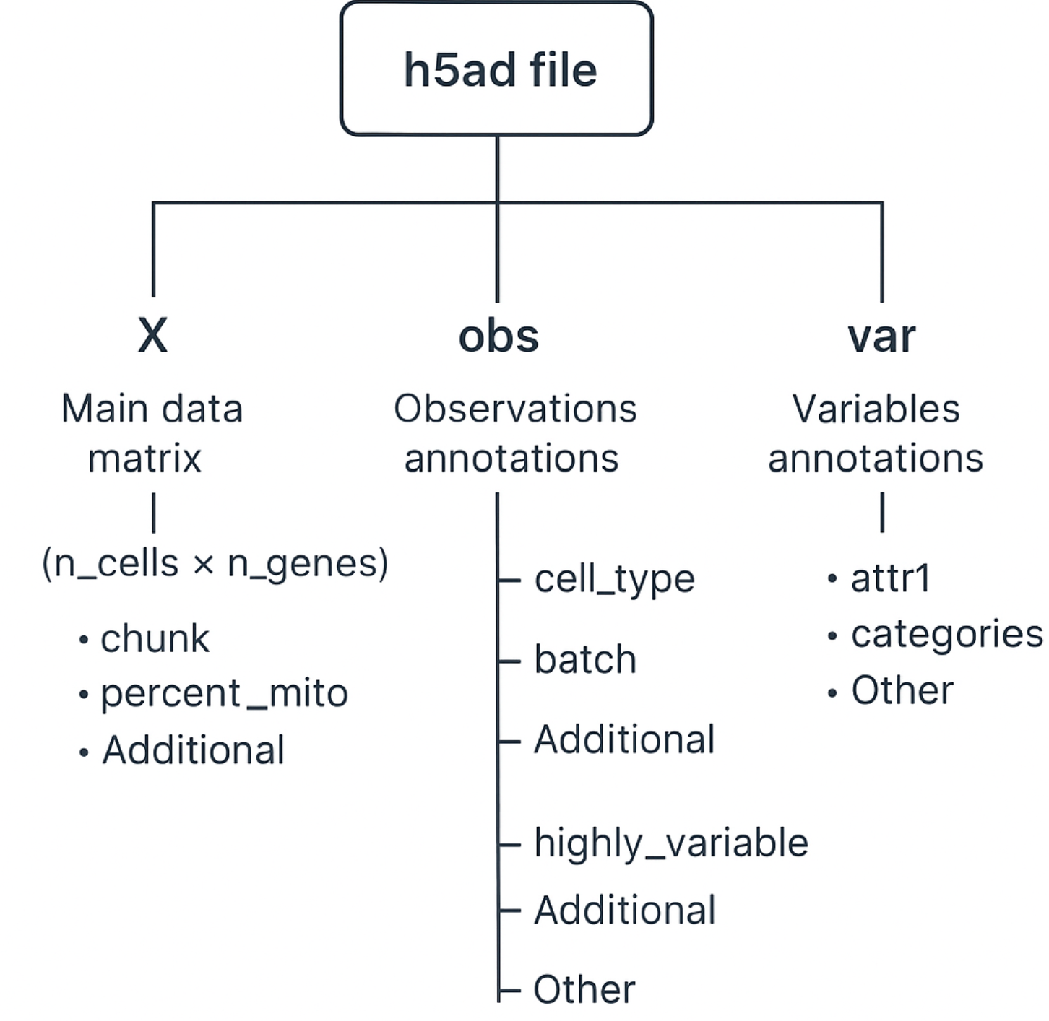


An h5ad file typically has a three-layer structure
default expression matrix

Slide 10
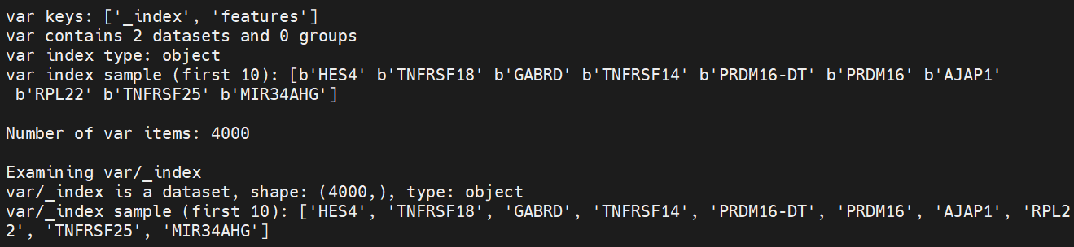

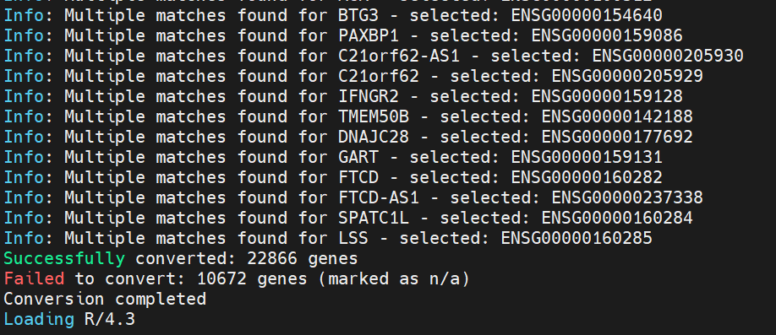
1) automatically generate Ensembl IDs from Gene Symbols
an additional function to generate Ensembl gene IDs from gene symbols (based on Version 130).
For gene symbols with multiple corresponding Ensembl IDs → automatically selects the one with the smallest numeric ID, assuming that smaller IDs indicate earlier release versions.
Some lncRNAs or pseudogenes can’t be converted into Ensembl IDs
→ marked as null values
→ either removed or replaced with “NOensemblIDmapped.XX”

Slide 11
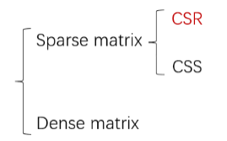
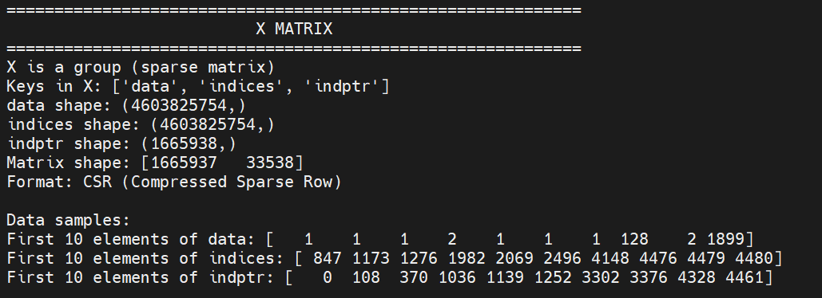
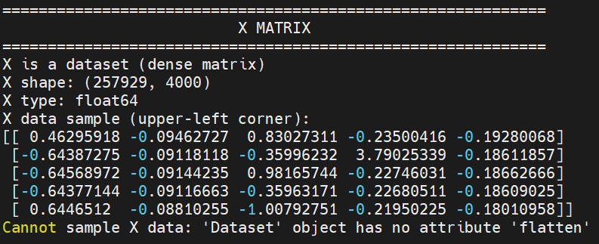
2) Accept different formats of expression matrix
There are three possible formats for the expression matrix stored in an h5ad file: CSR, CSC, and dense matrix.
Among them, CSR is the most challenging to process, mainly due to two reasons. First, while NeMO requires the output to be in a gene × cell format, h5ad stores it as cell × gene. Second, due to the structure of CSR, data can only be accessed row-wise (i.e., per cell), which means a transposition is needed.
(V1) If memory is sufficient: load the entire CSR matrix → convert it to CSS format → write by row
(V2) If memory is limited: load the CSR matrix in chunks → convert each chunk into a dense matrix and transpose it, then write the results into separate sub-files → merge all sub-files by columns → add the header

Slide 13
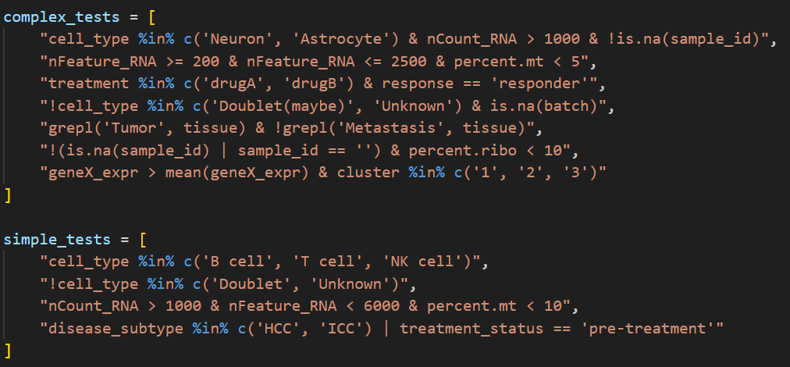
3) Support filtering based on cell information
Accepts an R-style logical expression as a string. The following expressions have been tested

Slide 14
4) Support different downsampling methods
random downsampling
stratified downsampling (based on ‘sample’)
stratified downsampling (based on ‘sample’ and ‘cell_type’)

Slide 15
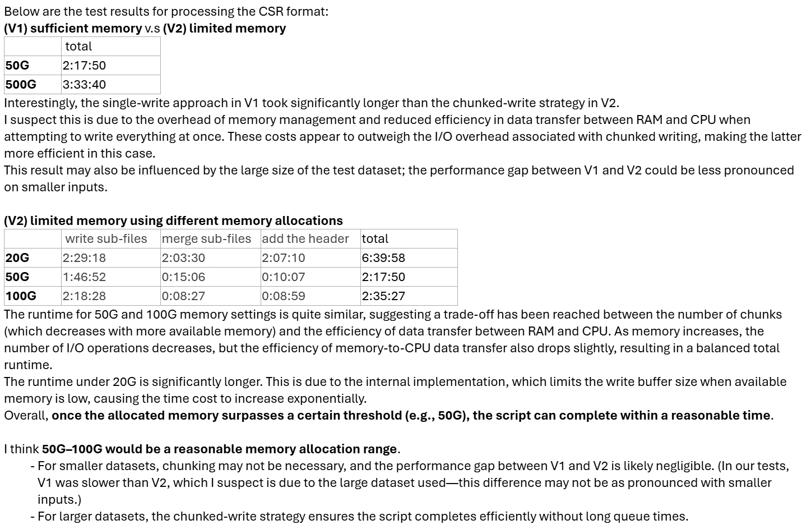
5) Suggested memory allocation: 50–100 GB

