Slide 1
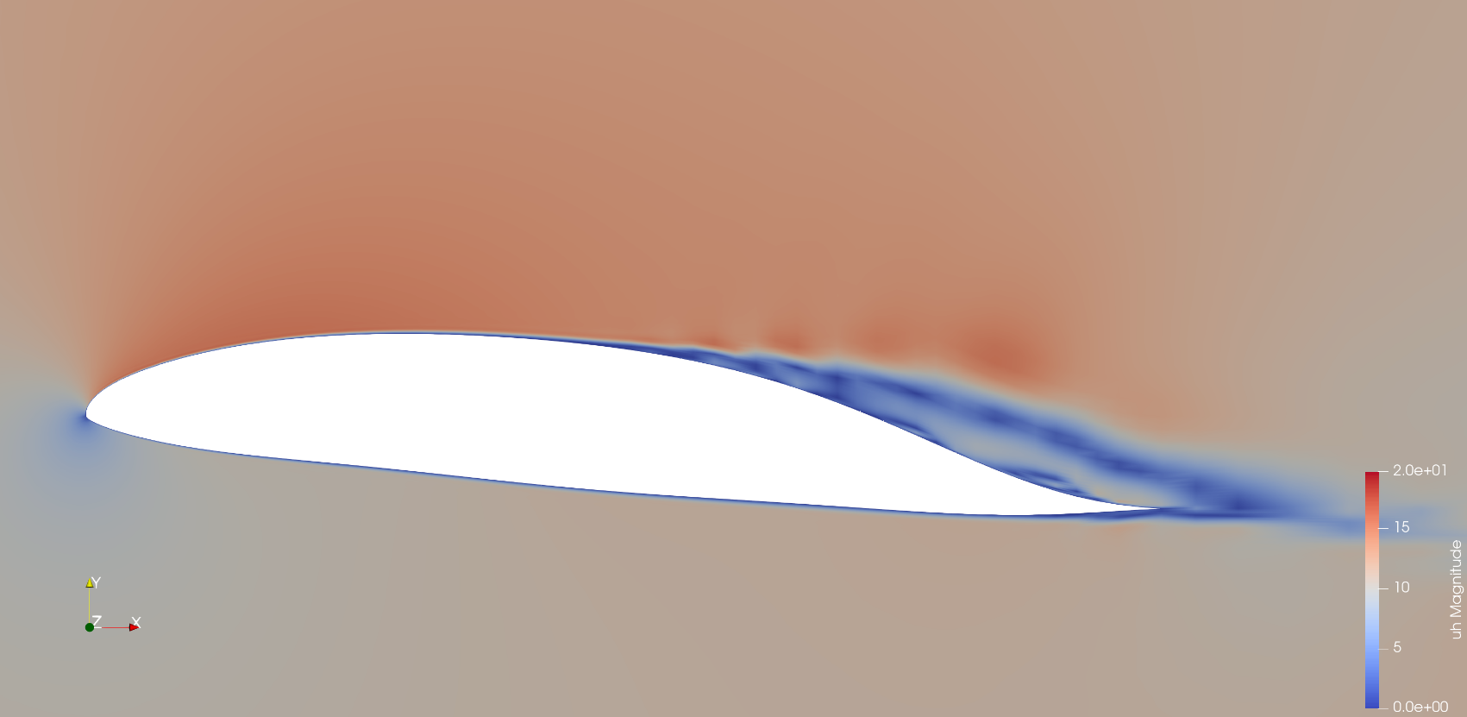
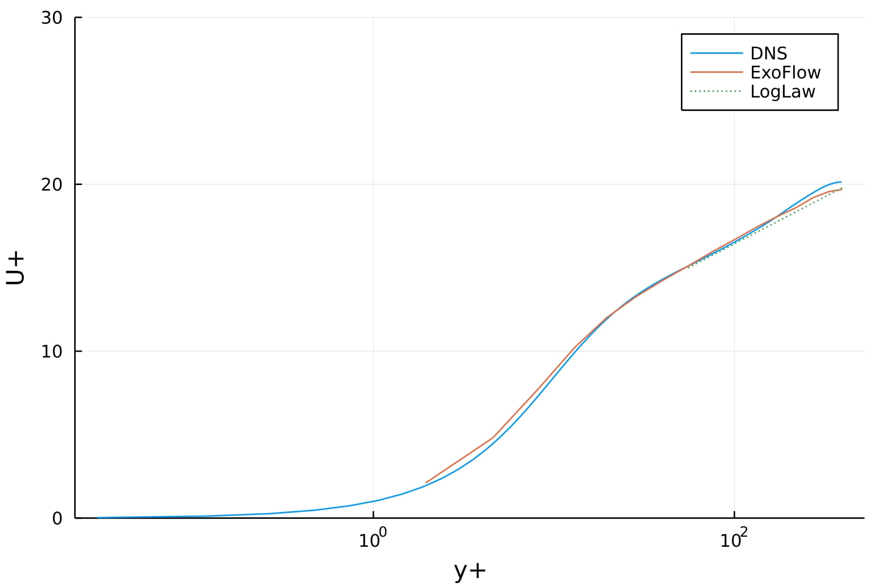
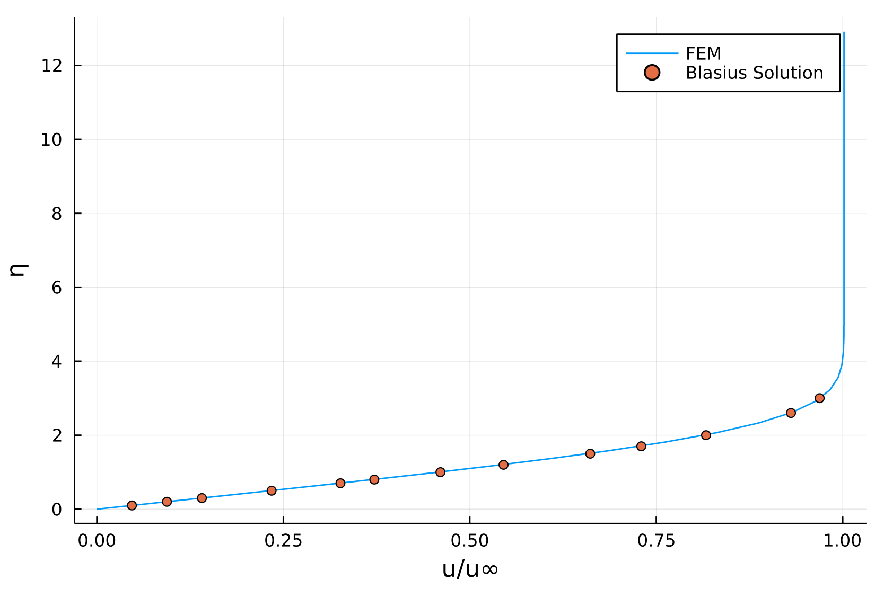
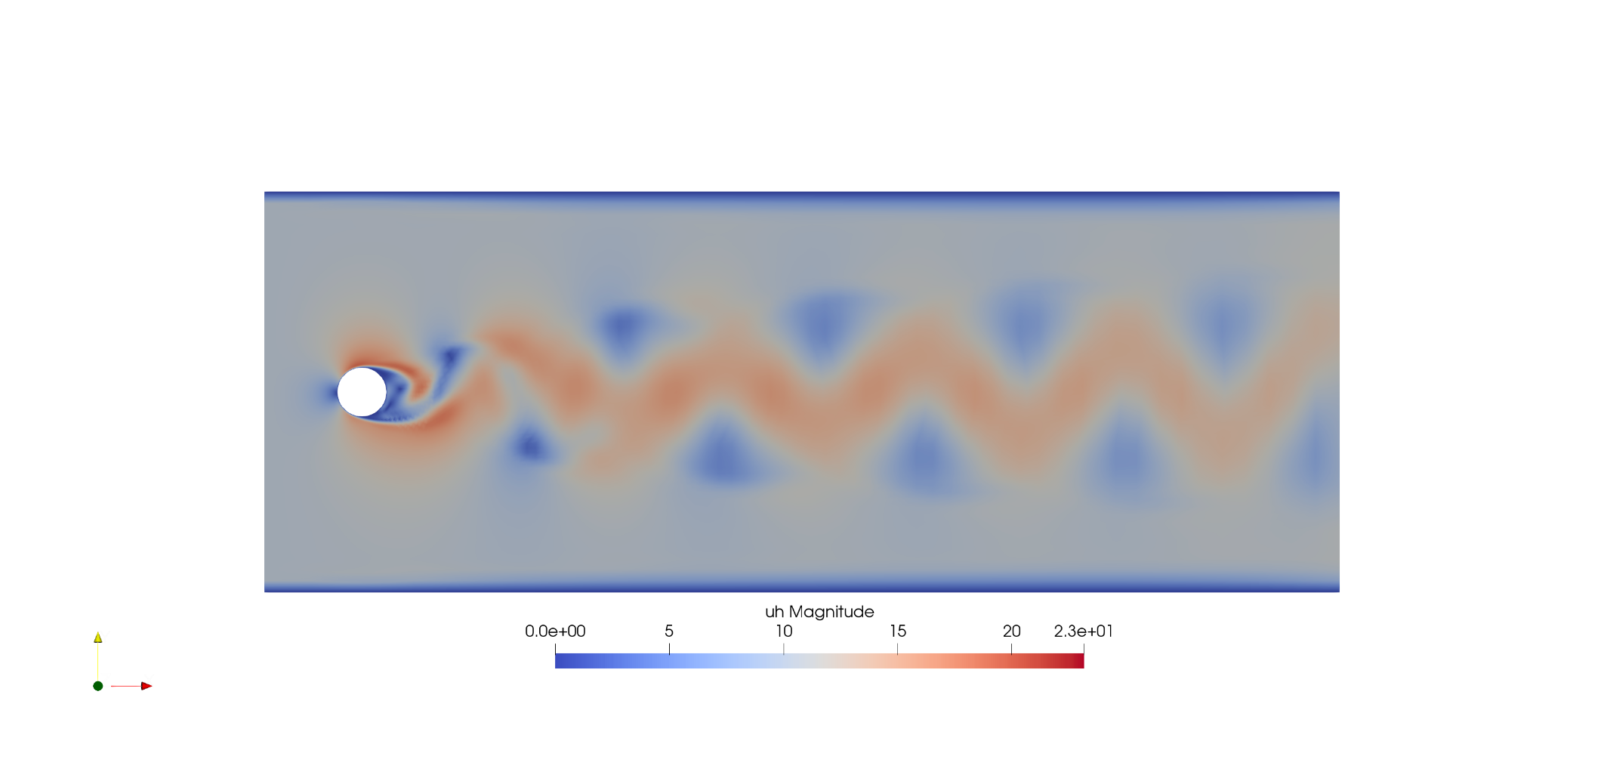
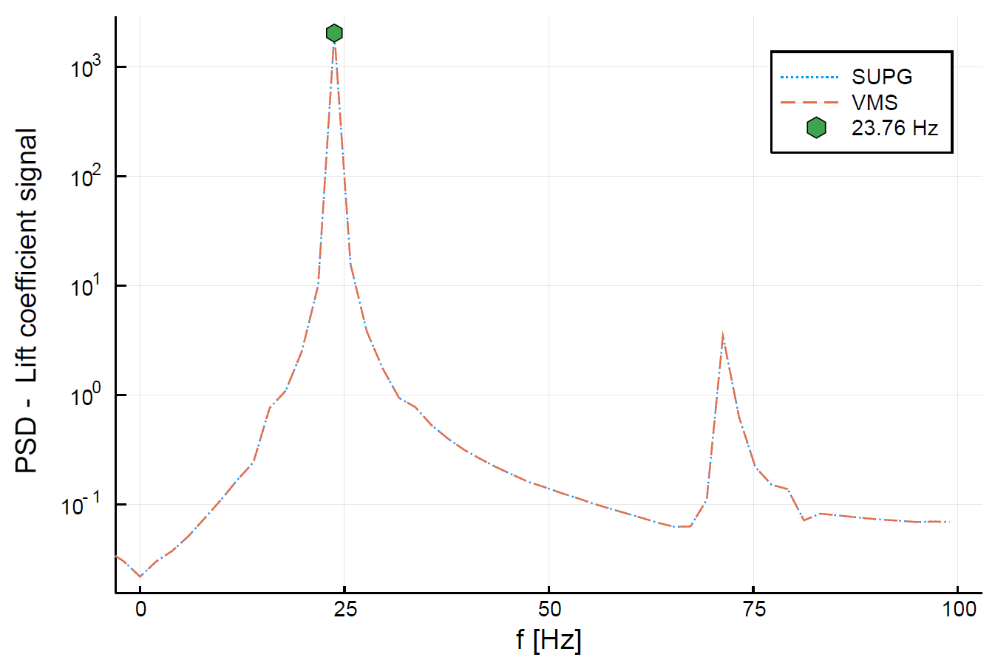
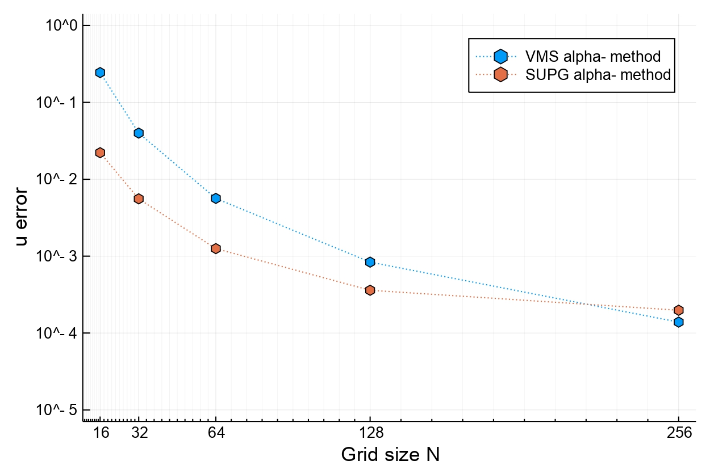
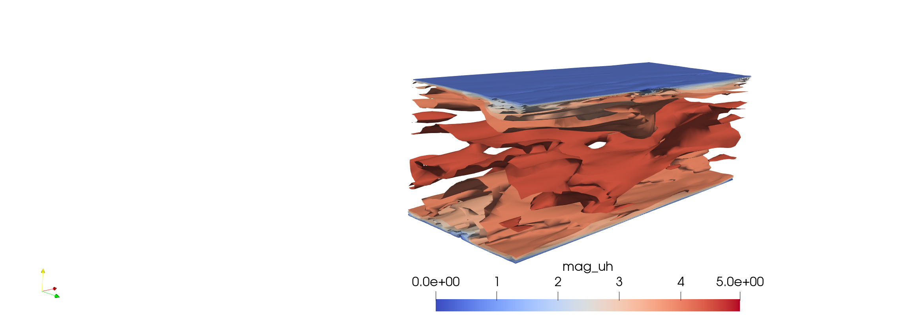
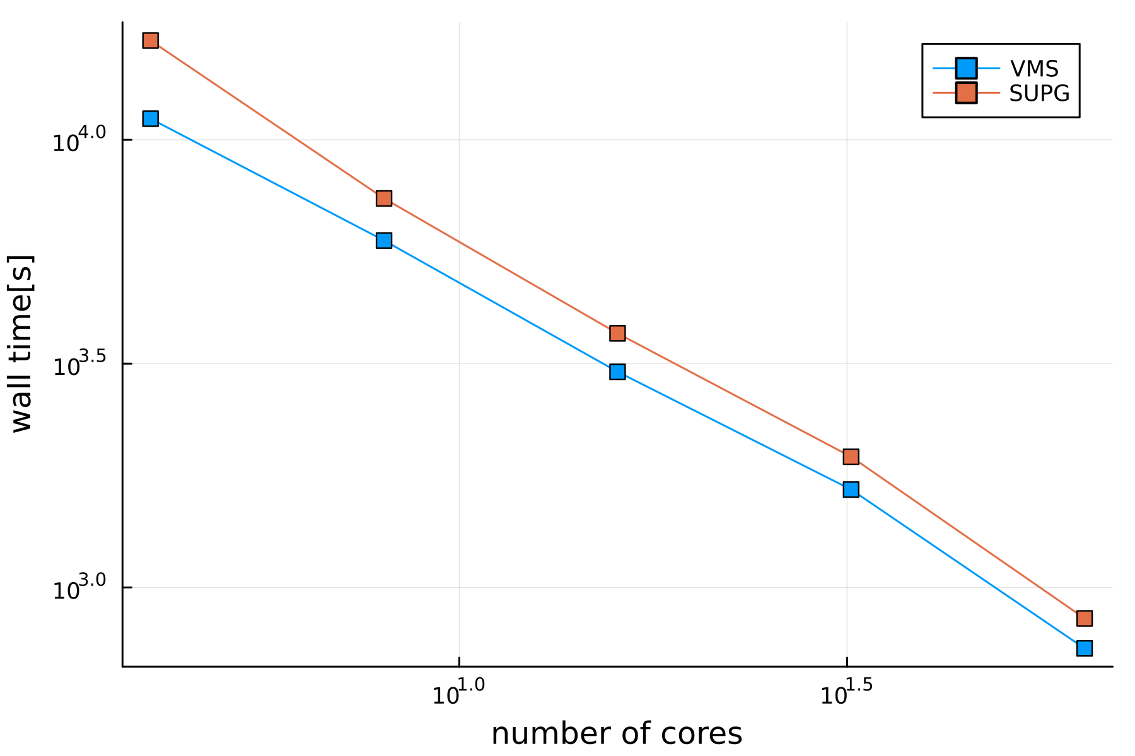
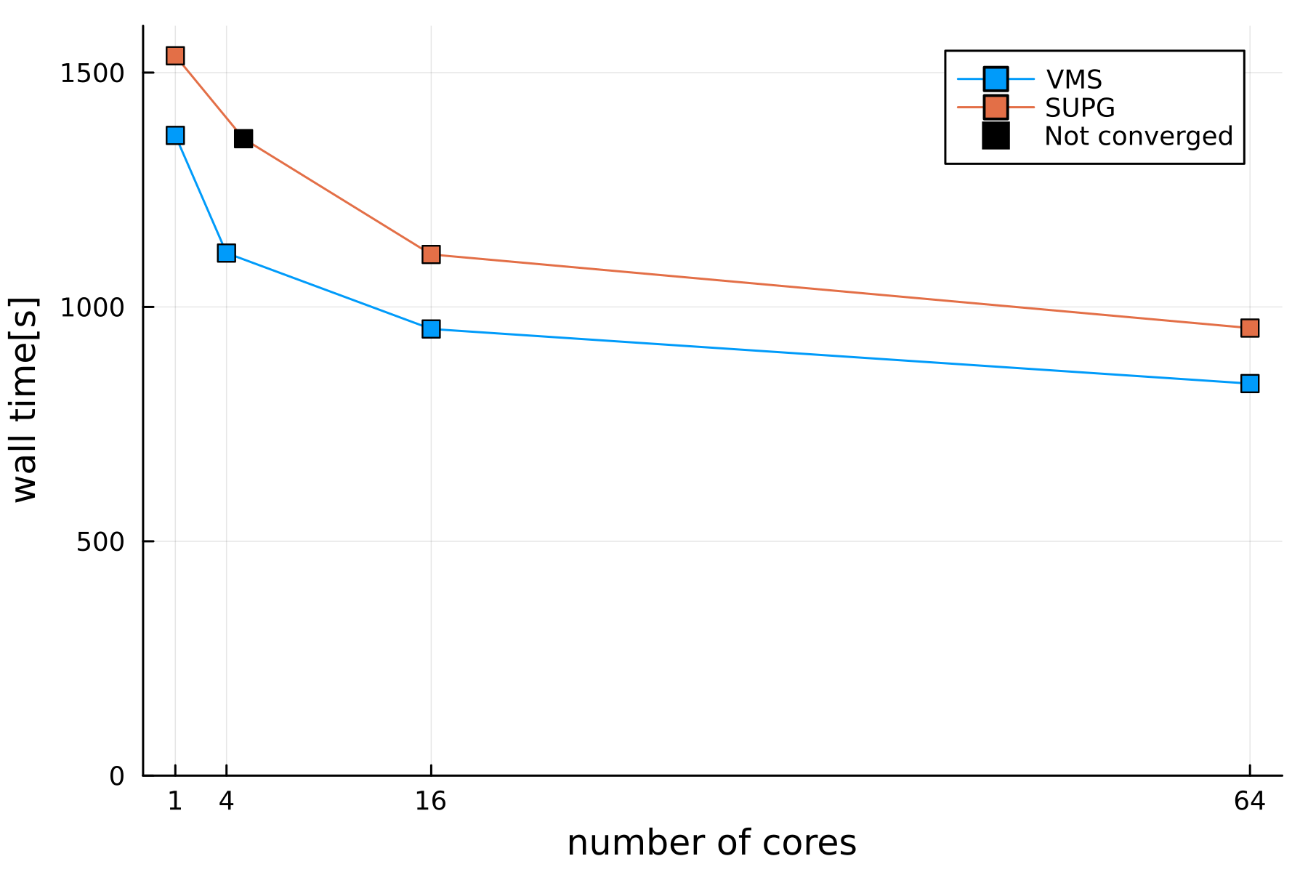
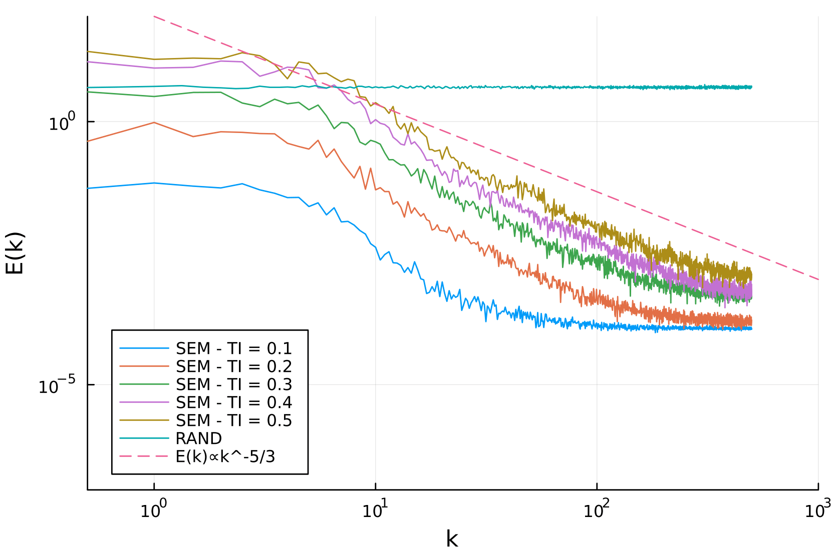


Variational Multiscale Method in Julia
Carlo Brunelli^{1,2,3}, Bart Janssens¹, Georg May², Mark Runacres³
¹Mechanical Engineering Department, Royal Military Academy, Belgium
²Aeronautics and Aerospace Department, von Karman Institute for Fluid Dynamics, Belgium
³Engineering Technology Thermodynamics and Fluid Mechanics Group, VUB, Belgium
FEM method for High Reynolds
Validation in 2D and 3D
The method provides accurate results while testing it for 2 and 3 dimensions problems.
DU89 Airfoil (suitable for Low Reynolds flight) velocity magnitude field at Re 250 000 and 3° angle of attack in 2D domain, using 1st order elements
In the context of High-Altitude Pseudo-Satellites this research project aims to develop, test and calibrate, suitable numerical methods to quantify airfoil aerodynamic performance. The VMS method, an evolution of SUPG, is intended to be adopted to efficiently solve the incompressible Navier-Stokes on HPC.
Non dimensional velocity profile, channel at Ret 395, mesh 32x32x32
Laminar boundary layer over a flat plate
Computing
Speed-up
VMS implementation
Numerical validation
Cylinder Vortex Shedding at Re 1000, velocity field
Parallelization
extension
Experimental validation
New geometry testing
Cylinder Vortex Shedding at Re 1000, Power Spectral Density of Lift coefficient signal
Outline of the study on a horizontal timeline
Increasing the grid resolution leads to a smaller error. Keeping the CFL constant does not appreciably change the results.
VMS implementation in Julia
A two–scale Variational MultiScale (VMS) method, following the formulation of Bazilevs et al. [1], has been successfully implemented in the Julia programming language using the expressive Finite Element Method FEM package Gridap [2]. The incompressible and time-dependent Navier-Stokes equations are solved using the Finite Element Method as an implicit Large Eddy Method (LES) for turbulence modelling.
The goal is to spot the point of laminar to turbulent transition or separation.
2D Taylor-Green Vortex velocity error and number of divisions per dimension, VMS and SUPG comparison
High scalability on multiprocessors
strong scalability: doubling the number of processors halves the solution time
weak scalability: the solution time almost does not change with constant problem size per processor
Contour of velocity magnitude, channel at Ret 395, mesh 32x32x32
The results have a perfect match with the literature. Performance in terms of time taken is still not satisfactory enough, particularly for 3D cases.
2D Taylor-Green Vortex case with 1.6 Mln dofs
2D Taylor-Green Vortex case with 30K dofs/proc
Synthetic Eddy Method
The method runs in MPI execution mode, using PETSc interface in Julia as a solver for the parallel sparse problem. The actual solution method use the additive schwarz method as the main preconditioner, an incomplete LU factorization over each processor and the final system is solved using the GMRES method. In this case the VMS outperforms the SUPG.
The SEM has been implemented to effectively produce realistic and coherent turbulent fluctuations, which deeply influence the transition and separation point. Random fluctuations do not produce a realistic flow and they are quickly dissipated.
References
Flowfields energy spectra produced using SEM at different turbulence intensity. Comparison with the random generated fluctuations
[1] Bazilevs, Y., Calo, V.M., Cottrell, J.A., Hughes, T.JR., Reali, A., Scovazzi (2007) “Variational multiscale residual-based turbulence modeling for large eddy simulation of incompressible flows”, Computer methods in applied mechanics and engineering, Vol. 197
[2] Badia, S., Verdugo., F., (2020 ), “Gridap: An extensible Finite Element toolbox in Julia “, Journal of Open Source Software, Vol. 5

