Slide 1
Predicting Severity Code of a Collision in Seattle
Carol Yang

Slide 2
Introduction
Predicting the severity of collisions using variables such as time, location, and number of people involved
Beneficial to police department and/or the development department
Avoid collisions that cause most harm and damages by:
Implementing alternative city planning
Patrolling schedule

Slide 3
Data
Records collision data from 2015 to May 2020
Target variable: SEVERITYCODE
Predictor variables:
Location factors: coordinates, street name, address type, junction type
Timestamp factors: time of incident
Environmental factors: weather, light condition, road condition
Subjects involved: number of people involved, number of pedestrians involved, number of vehicles involved

Slide 4
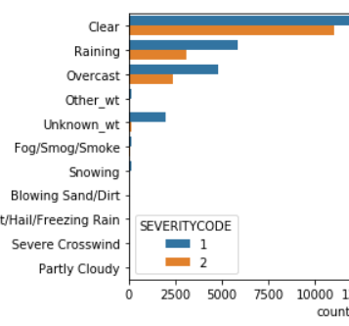
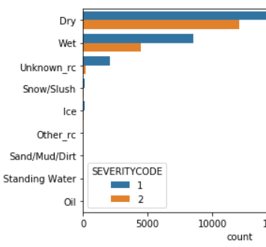
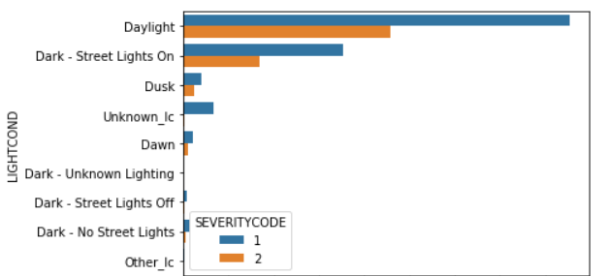
Severity VS Environmental Factors
Regardless of severity, most collisions occur on a clear day, on a dry road, during the day.
People may be way more careful when driving in imperfect environment

Slide 5
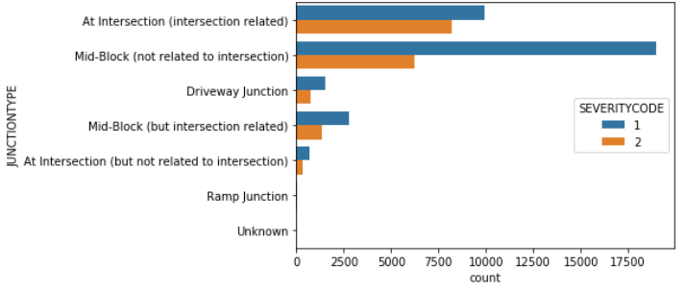
Severity VS Junction Type
Number of collision without fatalities is significantly higher at mid-block
Most collisions with fatalities happen at intersection

Slide 6
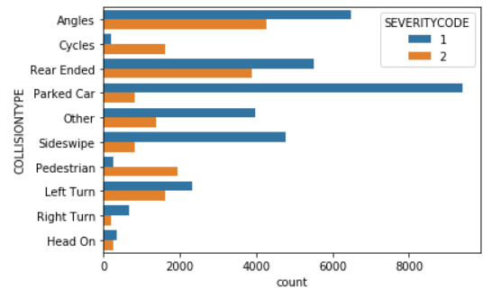
Severity VS Collision Type
Number of collisions involved a parked car are significantly higher than other collision types
Collisions involved cycles and pedestrians almost always result in fatalities

Slide 7
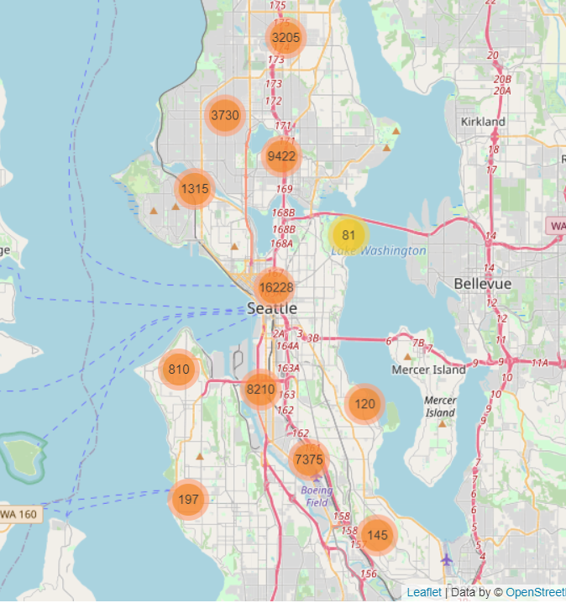
Collision Clusters
Most collision clusters center along I5 highway
The clusters get bigger as they approach the downtown area

Slide 8
Data Cleansing
Drop empty columns (i.e. EXCEPTRSNCODE, EXCEPTRSNDESC)
Convert categorical variables such as WEATHER, ROADCOND, and LIGHTCOND to numerical values
Standardize measures of UNDERINFL and HITPARKEDCAR to 1 and 0
Predictor Variables:
JUNCTIONTYPE
UID
WEATHER
ROADCOND
LIGHTCOND
HPC
PERSONCOUNT
PEDCOUNT
PEDCYLCOUNT
VEHCOUNT
COLLISIONTYPE

Slide 9
Methodology
Split the dataset to train and test sets
Use ML methods to do the classification using the predictors:
K-Nearest Neighbours
Random Forests
Support Vector Machines

Slide 10
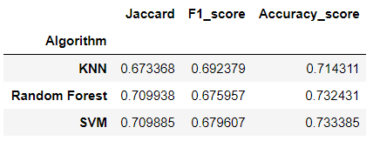
Model Evaluation
Jaccard score, F1 score, and accuracy score are computed against the test set on the three models mentioned above

Slide 11
Results & Discussion
All three models perform well, while SVM performs slightly better than the other two
Environmental factors (weather, road condition, light condition) play a big role to collisions:
Number of collisions is significantly higher in the ideal environment
Number of collisions is much higher at an intersection and at mid-block:
the highest number of collision with fatalities happens at an intersection
highest number of collision without fatalities happens at mid-block
Collisions involving pedestrians and cyclists almost always result in fatalities
Clusters of collisions center along the I5 highway:
Size of clusters increase as they approach the downtown area
Heavier traffic infers higher chance of collisions

Slide 12
Recommendations & Conclusion
To the drivers: Drive cautiously regardless of the environment
To the police department:
Schedule more patrols surrounding the highway (i.e. on the highway and the highway exits) and the downtown area
impose penalties on jaywalking or crossing a red light on major intersections or major streets to keep pedestrians and/or cyclists safe

