Slide 1
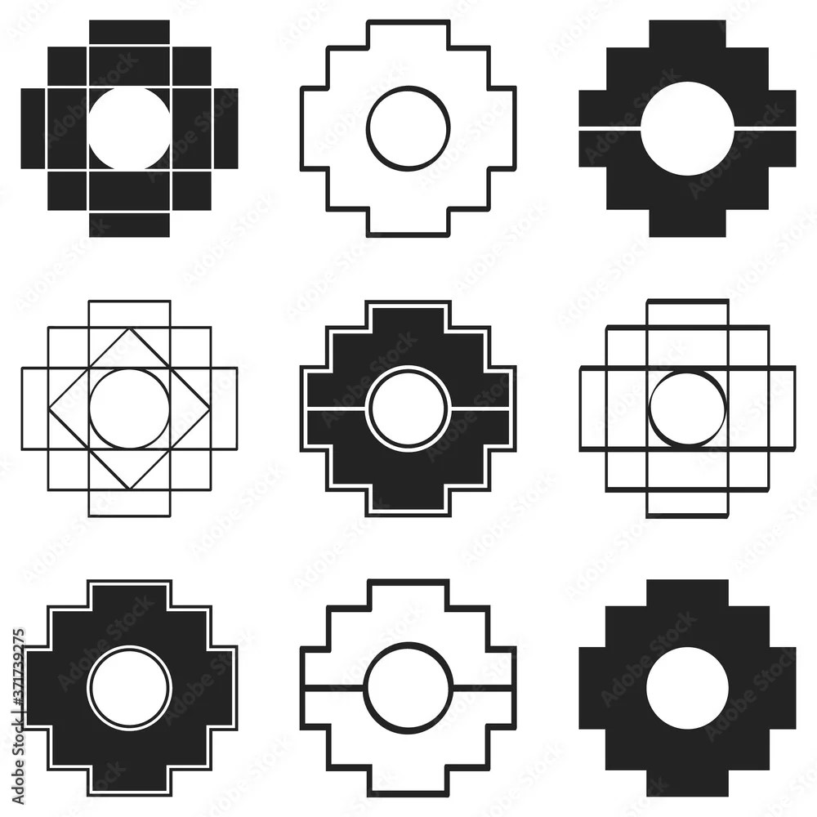

Slide 5




Slide 9
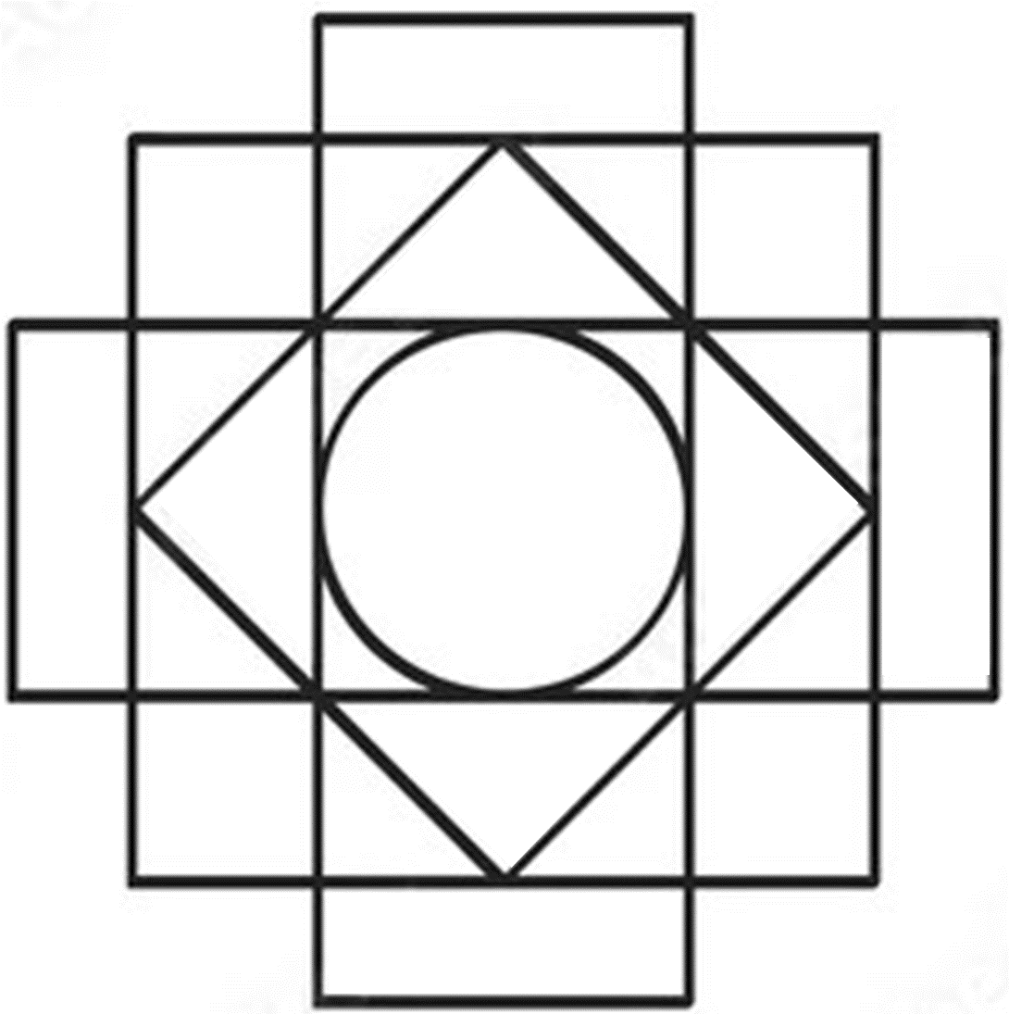

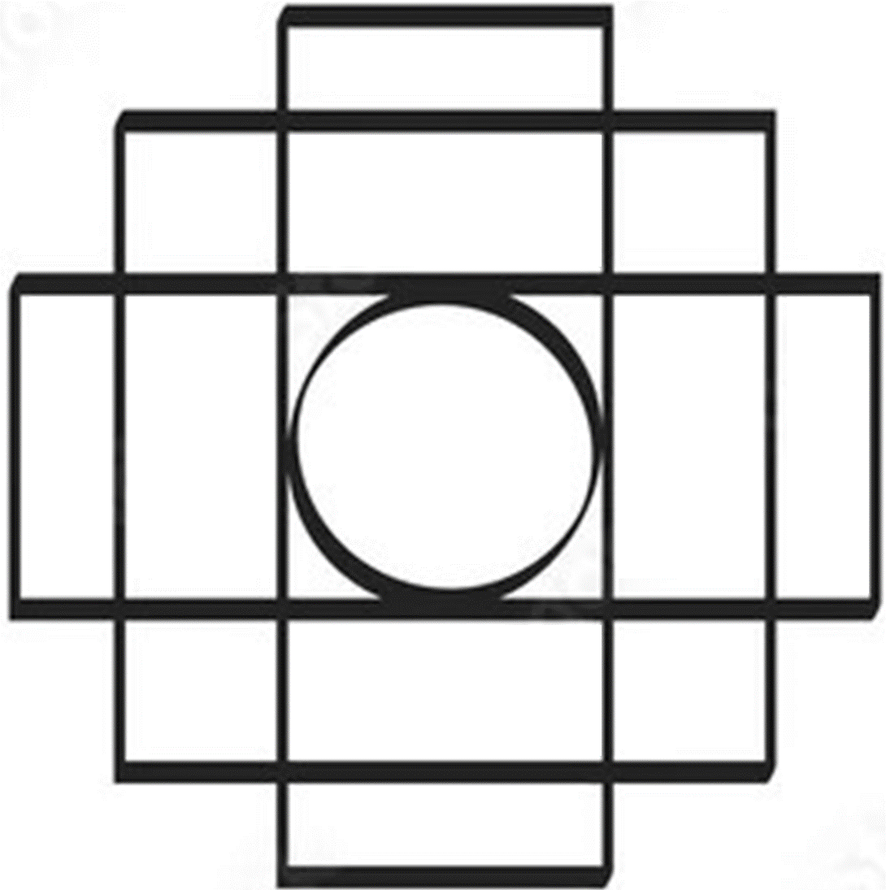

Slide 13




Slide 14
Now the vertical ones

Slide 17


