Slide 1
What’s Eating Apple’s Customers?
BY: Carlos Marin

Slide 2
Outline
Background
Business Problem
Data
Methods
Results
Conclusions

Slide 3
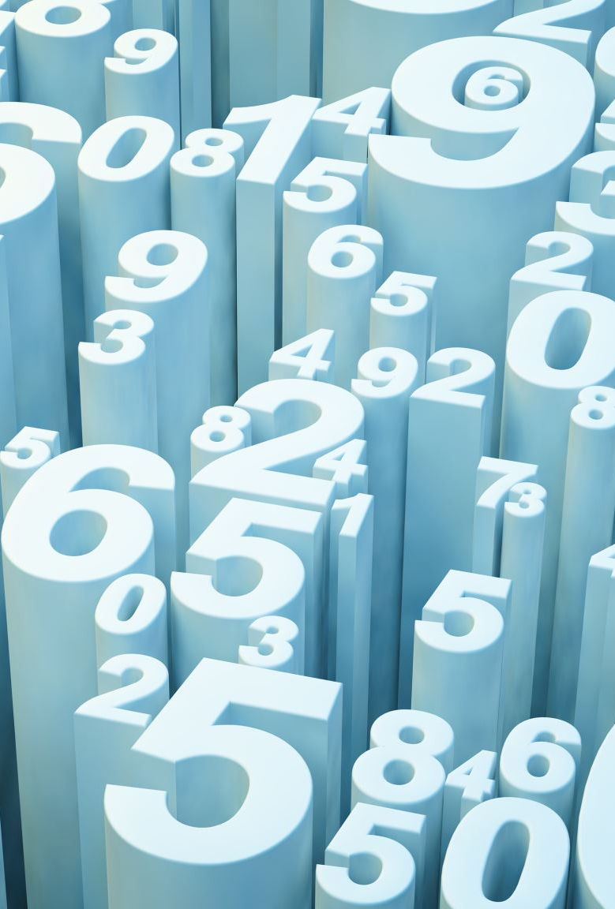
Background
Customers buy apple products everyday. They also hop on twitter to voice their opinions about products everyday on Twittter. Using Natural Language Processing (NLP), we can determine what are the most common words being sent and with what tone. And Identify the best model for future predictions.

Slide 4
Business Problem
What positive things are customers saying about Apple Products or Apple Company?
What negative things are customers saying about Apple Products or Apple Company?

Slide 5
Data
Using the tweet product dataset. Dataset has over 9000 tweets, and 3 columns.
Contains data including
Tweets
Focus of the tweet
Sentiment

Slide 6
Methods
Removal of special characters (@,#, etc.)
Applying NLP Techniques such as Stemming, Lemmatization, and Tokenization.
Removal of small words (less than 3 characters in length)
Removing stop words

Slide 7
Methods
Build machine learning models with Word Vectorizers to predict future sentiments (using CountVectorizer and Term Frequency - Inverse Document Frequency (TFIDF)
Developed several models to evaluate performance
Precision – correct predictions vs total predictions
Recall – Correct predictions vs actual positive predictions
F1 score – harmonic mean of Precision and Recall • Accuracy

Slide 8
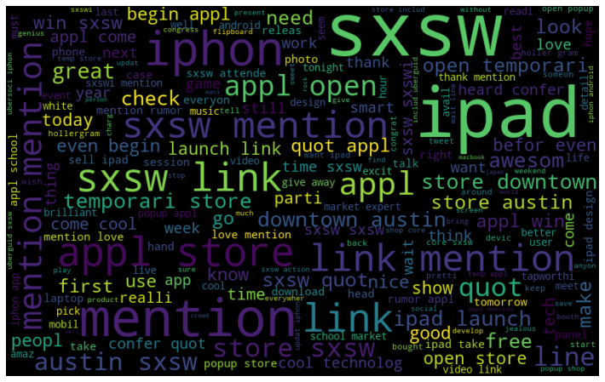
Results
WordCloud for positive Emotion Sentiment

Slide 9
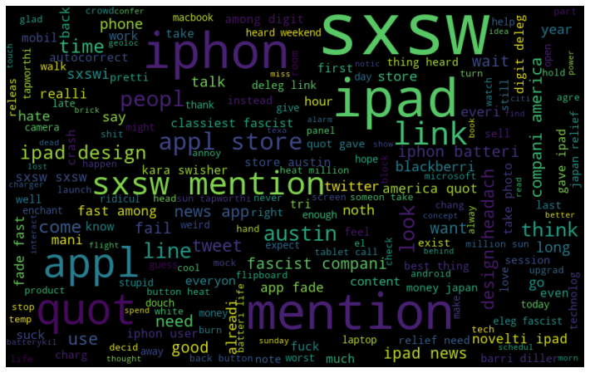
Results
WordCloud for Negative Emotion Sentiment

Slide 10
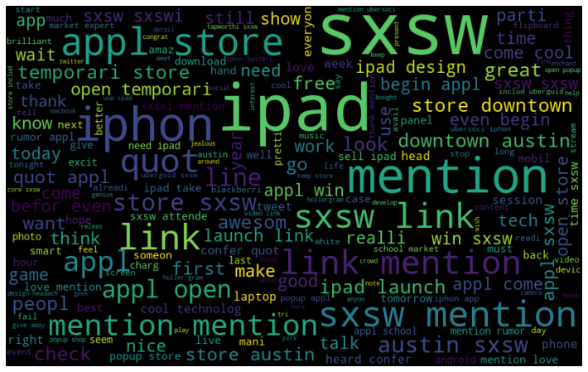
Results
WordCloud for all Apple Sentiments

Slide 11
Summary of Findings / Conclusion
Most positive words were associated with events.
Most negative words associated with the product or negative words (such as battery)
The TFIDF Vectorizer is the best for predicting future sentiments.
TFIDF Vectorizer outperformed Precision, Recall, F1 score against CountVectorizer

Slide 12

Thank you!

