Slide 1
What’s Eating Apple’s Customers?
BY: Carlos Marin

Slide 2
Outline
Background
Business Problem
Data
Methods
Results
Conclusions

Slide 3
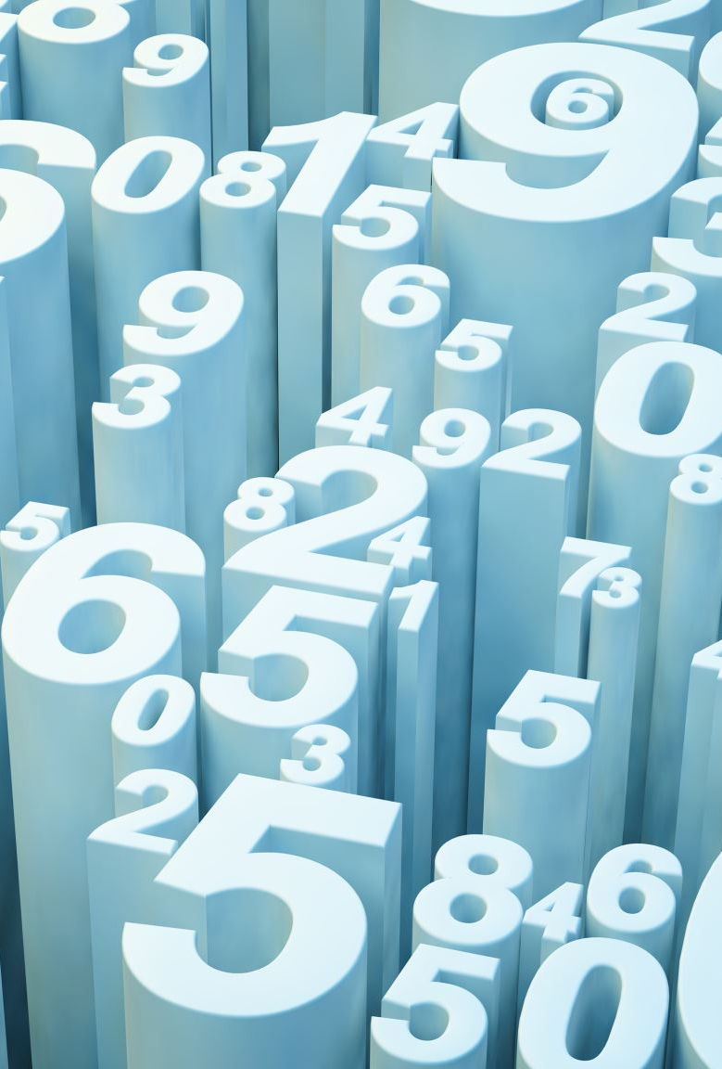
Background
A new iPhone and Android has just been released.
Attendees are voicing their opinions on twitter.
Using Natural Language Processing (NLP), we can determine what are the most common words being used and what tone.
Identify the best model for future predictions.

Slide 4
Business Problem
We are a marketing company , contracted to evaluate these customers tweets based on sentiment.
Identify what customers are saying about the new phones and company.

Slide 5
Data
Using the tweet product dataset. Dataset has over 9000 tweets, and 3 columns.
Contains data including
Tweets
Focus of the tweet
Sentiment

Slide 6
Methods
Removal of special characters (@,#, etc.)
Applying NLP Techniques such as Stemming, Lemmatization, and Tokenization.
Removal of small words (less than 3 characters in length)
Removing stop words
WordClouds – Visualizations of most important words

Slide 7
Methods
Build machine learning models with Word Vectorizers to predict future sentiments (using CountVectorizer and Term Frequency - Inverse Document Frequency (TFIDF)
Developed several models to evaluate performance
Precision – correct predictions vs total predictions
Recall – Correct predictions vs actual positive predictions
F1 score – harmonic mean of Precision and Recall
Accuracy

Slide 8
Methods
A Little bit about the Vectorizer models…
CountVectorizer counts number of times a word appears.
TFIDF (Term Frequency – Inverse Document Frequency) – counts the number of words but considers overall document weightage

Slide 9
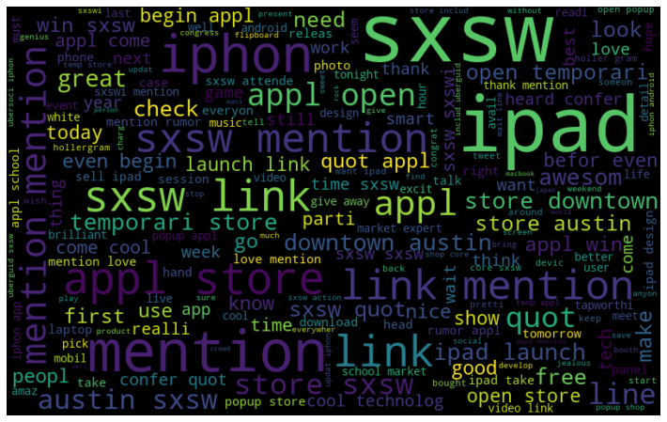
Results
WordCloud for positive Emotion Sentiment (Apple)

Slide 10
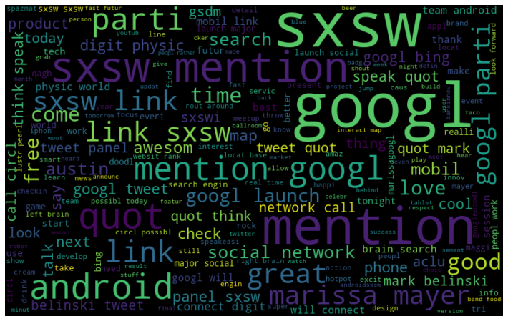
Results
WordCloud for positive Emotion Sentiment (Google / Android)

Slide 11
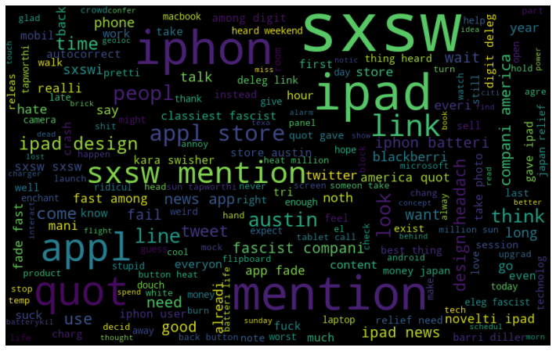
Results
WordCloud for Negative Emotion Sentiment (Apple)

Slide 12
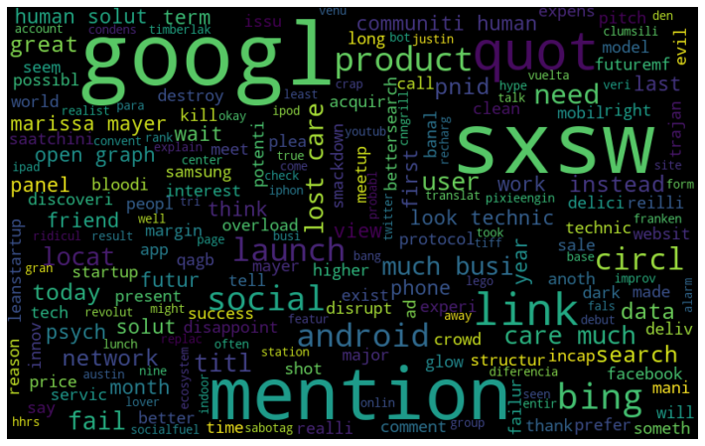
Results
WordCloud for Negative Emotion Sentiment (Google / Android)

Slide 13
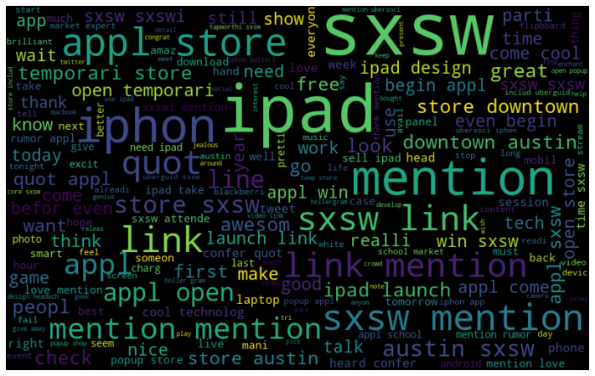
Results
WordCloud for all Apple Sentiments

Slide 14
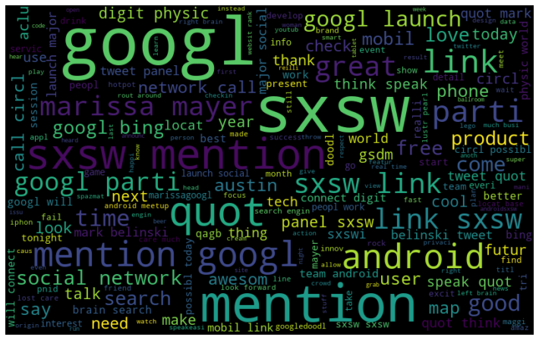
Results
WordCloud for all Google Sentiments

Slide 15
Results
Evaluation of the Count Vectorizer and TFIDF Model
 | Count Vectorizer | TFIDF
PRECISION (negative Emotion) | 42% | 71%
PRECISION (No Emotion) | 69% | 71%
PRECISION (Positive Emotion) | 58% | 72%
RECALL (Negative Emotion) | 22% | 24%
RECALL (No Emotion) | 82% | 92%
RECALL (Positive Emotion) | 47% | 46%
F1 SCORE (Negative Emotion) | 0.29 | 0.36
F1 SCORE (No Emotion) | 0.75 | 0.80
F1 SCORE (Positive Emotion) | 0.52 | 0.56
ACCURACY | 65% | 71%

Slide 16
Results
DRUM ROLL!!! AND THE WINNER IS….
TFIDF Vectorizer!
Outperformed in all sections

Slide 17
Summary of Findings / Conclusion
Most positive words were associated with events for Google and Apple
Most negative words associated with the product or negative words (such as battery) for Apple.
Most negative words were associated with the event for Google.
The TFIDF Vectorizer is the best for predicting future sentiments.
TFIDF Vectorizer outperformed Precision, Recall, F1 score against CountVectorizer

Slide 18
Next Steps…
Next steps...
1) Perform Sentiment analysis at 6 months then a year to see how much better or worse the product has improved.
2) Based on the reviews, make improvements to product to please customer.
3) Perform on other companies that make smart phones such as Nokia, Samsung, Huawei see how they are doing using sentiment analysis

Slide 19

Thank you!

