Slide 1
Image classification using CNN for Diabetic Retinopathy
BY: Carlos Marin

Slide 2
Outline
Background
Business Problem
Data
Methods
Results
Conclusions

Slide 3

Background What is Diabetic retinopathy?
Diabetic retinopathy is disease of the eyes
Caused by high blood sugar
Affects blood vessels
Loss of vision
Measured by disease proliferation
Affects people with diabetes
Found in 4.1 million people
roughly 1/29 diabetics
1/3 are African-American and Mexican-American

Slide 4
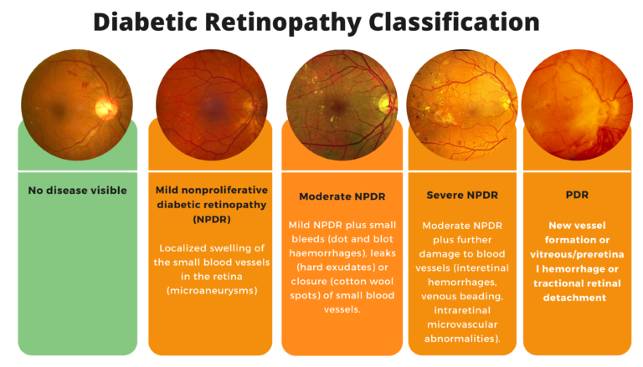
Background What is Diabetic retinopathy?

Slide 5
Business Problem
We are a building a deep learning model to detect the various levels of diabetic retinopathy

Slide 6
Business Problem
Why?
Medical misdiagnosis caused by varying levels of knowledge and experience.
Ensuring proper diagnosis for medical professional

Slide 7
Data
Data is created by TensorFlow
Contains images 35,000+ images of different levels of diabetic retinopathy.

Slide 8
Methods
Images imported from directory
Baseline model created for comparison
Model evaluation

Slide 9
Methods
Using transfer learning, instantiating pre-trained model as base
Adding the base model to final model
Model evaluation

Slide 10
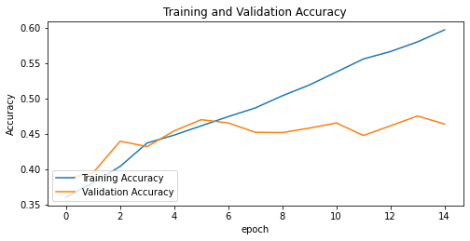
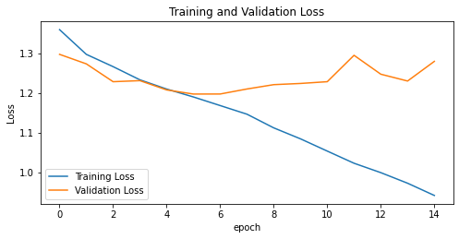
Results
Data Visualization of initial model performance

Slide 11
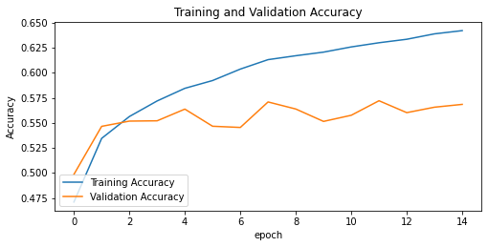
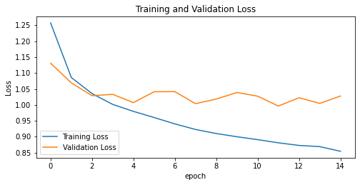
Results
Data Visualization of model with transfer learning performance

Slide 12
Summary of Findings / Conclusion
The end accuracy after running the model is 68%
Overfitting occurs in both models
Transfer learning greatly improves model performance

Slide 13
Next Steps…
Next steps...
1) Build Deep Learning models to other ocular diseases (e.g., Diabetic Macular Edema)
2) Pursue other areas of medicine, where we can track disease progression. (e.g., Cancer metastasis)
3) Use Deep learning to build models for disease detection (e.g., Pneumonia)

Slide 14

Thank you!

